Slide 1
RESEARCH PROJECT
INFLUENCE OF THE INPUT AND INTERACTION ON VOCABULARY ACQUISITION IN THE TENTH YEAR AT “CIUDAD DE CUENCA” HIGH SCHOOL DURING THE SECOND PERIOD OF THE SCHOOL YEAR
2014-2015
AUTHOR: LILIANA TERESA CORREA MONCAYO
THESIS DIRECTOR: DR.MARÍA TERESA LLUMIQUINGA P., MG
THESIS CO-DIRECTOR: MG. CARLOS ESPÍN
AUGUST, 2015

Slide 2
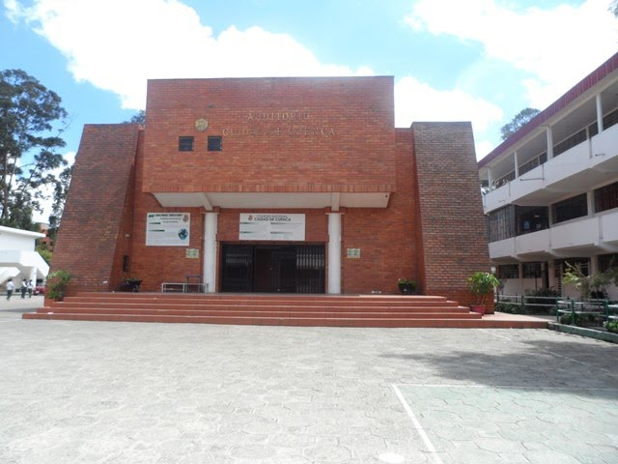

Slide 3
Effect 1.1
The students cannot communicate in English
Effect 2.1
The students manage a scarse vocabulary
Effect 3.1
The students don’t understand new words from oral speech
Effect 1
Inappropriate enhancement of linguistic skills
Effect 2
Memory-focused learning
Effect 3
Isolate vocabulary
Limited English vocabulary
Cause 1
Limited practice of input and interaction
Cause 2
Few opportunities for acquiring and increasing vocabulary
Cause 3
Book-centered approach
Cause 1.1
Predominant use of Spanish in class
Little knowledge of Linguistic Theories
Cause 2.1
Old-fashioned methodologies
Cause 3.1
Minimal use of extra material

Slide 4
Problem-formulation
What is the relationship between the practice of input and interaction and the students´ vocabulary acquisition and development?

Slide 5
The applying of language input and interaction in English classes in the tenth year of the “Ciudad de Cuenca” high school will enhance the students’ vocabulary acquisition.
HYPOTHESIS

Slide 6
RESEARCH QUESTIONS
Do students in the experimental group comprehend input more successfully than those on the control group?
Do students in the interactionally experimental group recognize more words than those on the control group?
Do students in the interactionally modified group retain more words than those on the control group?
Do students in the modified experimental group
comprehend the meaning of
target words in context more accurately
than those on the control group?

Slide 7
VARIABLES
INDEPENDENT
INTERACTION
INPUT
DEPENDENT
VOCABULARY ACQUISITION
LISTENING COMPREHENSION

Slide 8
METHODOLOGY
TYPE
POPULATION
SAMPLE
INSTRUMENTS
INPUT
INTERACTION
BEHAVIORISM
NATURIST
DPZ
Notes:
BE

Slide 9
PROCESS
PRE-TEST
TREATMENT
IMMEDIATE POST-TEST
DELAYED POST-TEST 1
DELAYED POST-TEST 2

Slide 10
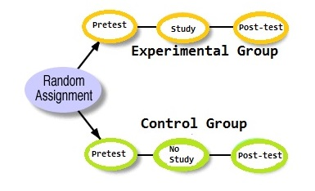
PROCEDURE

Slide 11
Objectives
General
To identify the incidence of implementing an input-interactional approach to the ESL curriculum in order to improve the English vocabulary in the students of tenth year Basic Education at “Ciudad de Cuenca” High School during the second quimester, 2014-2015.
To create an input- interactional classroom environment that allows both students and teachers at the “Ciudad de Cuenca” High School engage on communicative activities, negotiation for meaning as well as opportunities to acquire and improve their English vocabulary.
Specifics To determine the relationship between comprehensible input and vocabulary acquisition.
To ascertain at what extent the incidental vocabulary opportunities are provided by teacher talk.

Slide 12
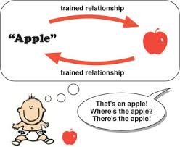
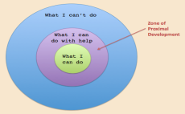
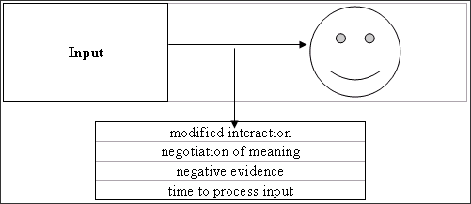
Theoretical Framework approaches to language acquisition
BEHAVIORISM
NATIVISM
CONSTRUCTIVISM
INTERACTION HYPOTHESIS
INPUT HYPOTHESIS
GASS’ MODEL
L.A.D

Slide 13
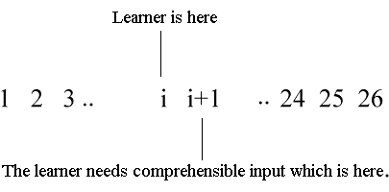
INPUT HYPOTHESIS

Slide 14
ANALYSIS OF RESULTS PRE-TEST

Slide 15
TREATMENT
SESSION | TASK
SESSION 1 | Listen-and-do task
SESSION 2 | pair listen-speak-write task
SESSION 3 | group listen-speak-recognize task

Slide 16
COMPARISON OF POST-TEST RESULTS BETWEEN THE TWO GROUPS

Slide 17
CONCLUSIONS
Do students in the interactionally experimental group recognize more words than those on the control group?
Experimental 403 words
Do students in the experimental group comprehend input more successfully than those on the control group?
Experimental: Pret-est:3. 03 Post-test: 12.03
Control: Pre-test 3.61 Post-test 5:71
Do students in the modified experimental group comprehend the meaning of target words in context more accurately than those on the control group?
Experimental: more words in context
Control: less words
Control: 188 words
What is the role of interaction on word knowledge? Experimental: negotiation for meaning . Some encounters with the new words
Does the teacher talk enhance vocabulary acquisition? Experimental: a challenge to comprehend the message. Use language in a real communicative situation

Slide 18
THE PROPOSAL

Slide 19
JUSTIFICATION
The main purpose of learning a language is communication.
EFL learners cannot communicate effectively by using the target language.
The limited vocabulary prevents students from comprehending a message and maintaining the normal flow of communication.
There is a need to review the teaching practice and see how teachers can support students to be competent speakers of English.

Slide 20
STAKEHOLDER ANALYSIS
PARTICIPANTS |  | INTERESTS EXPECTATIONS | PERCIEVED PROBLEMS | RESOURCES
DIRECT BENEFICIARIES | Ciudad de Cuenca High School Tenth year students | Acquire and develop basic vocabulary which enable them to communicate better | Limited target vocabulary corpora which prevent them to communicate effectively | HUMAN Researcher Students MATERIAL Stationery Projector
 | English teachers from Ciudad de Cuenca High School | Update in ESL approaches to teach vocabulary in an interactive manner | Teaching and learning process based mostly on the textbook and on Grammar and Translation | HUMAN Researcher Instructor English Teachers MATERIAL Stationery Projector Vocabulary in action (Book)
INDIRECT BENEFICIARIES | Ciudad de Cuenca High School professors | Supply of methods and strategies to enhance the students’ word knowledge | Procedures and curricular methodologies focused on repetition and memory | HUMAN Instructor Professors MATERIAL Stationery Projector
 | Ciudad de Cuenca High School Bachillerato students | Learn vocabulary in situations similar to those of real life | Used to be provided with large lists of words and glossaries | HUMAN Instructor Professors MATERIAL Stationery Projector
NEUTRAL/ EXCLUDED | Private schools | Take advantage of the new approaches to teaching English | Use of proved methodologies and techniques for a long time | HUMAN Instructor MATERIAL Proposal

Slide 21
RECOMMENDATIONS
Input
Teachers should create a positive environment
Give the students opportunity to listen to language a little beyond their current language competence
Interaction
Students should be given the opportunity to negotiate for meaning
Students can promote other language skills
Vocabulary acquisition
Teachers should use other strategies in addition to the repetition and memorization
The students should have many encounters with the new word
Teacher Talk
Teachers should use as much of the target language as possible
Teachers should use some complementary tools to help the students understand: gestures, mime, facial expressions, visual cues, context

Slide 22
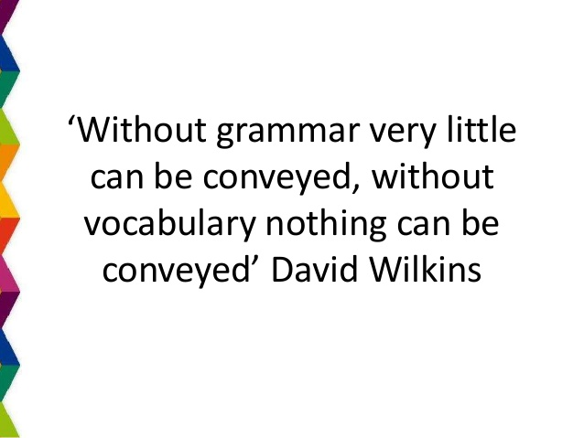
FINAL CONCLUSION

