Slide 1

DEPARTAMENTO DE CIENCIAS HUMANAS Y SOCIALES
APPLIED LINGUISTICS IN ENGLISH MAJOR
RESEARCH PROJECT PRIOR TO OBTAINING THE APPLIED LINGUISTICS IN ENGLISH DEGREE
THEME:
“INFLUENCE OF COLLABORATIVE LEARNING ON THE DEVELOPMENT OF WRITING SKILLS WITH SOLDIERS FROM THE FIRST YEAR CANDIDATES’ COURSE, CLASSROOM “I” AT ESFORSE DURING THE FIRST SEMESTER 2015”
AUTHOR: Miguel E. Cunalata Chango
TUTORS:
Director: Dr. María T. Llumiquinga, Mg.
Co-Director: Mg. Carlos M. Espín
Quito, diciembre 2015

Slide 2
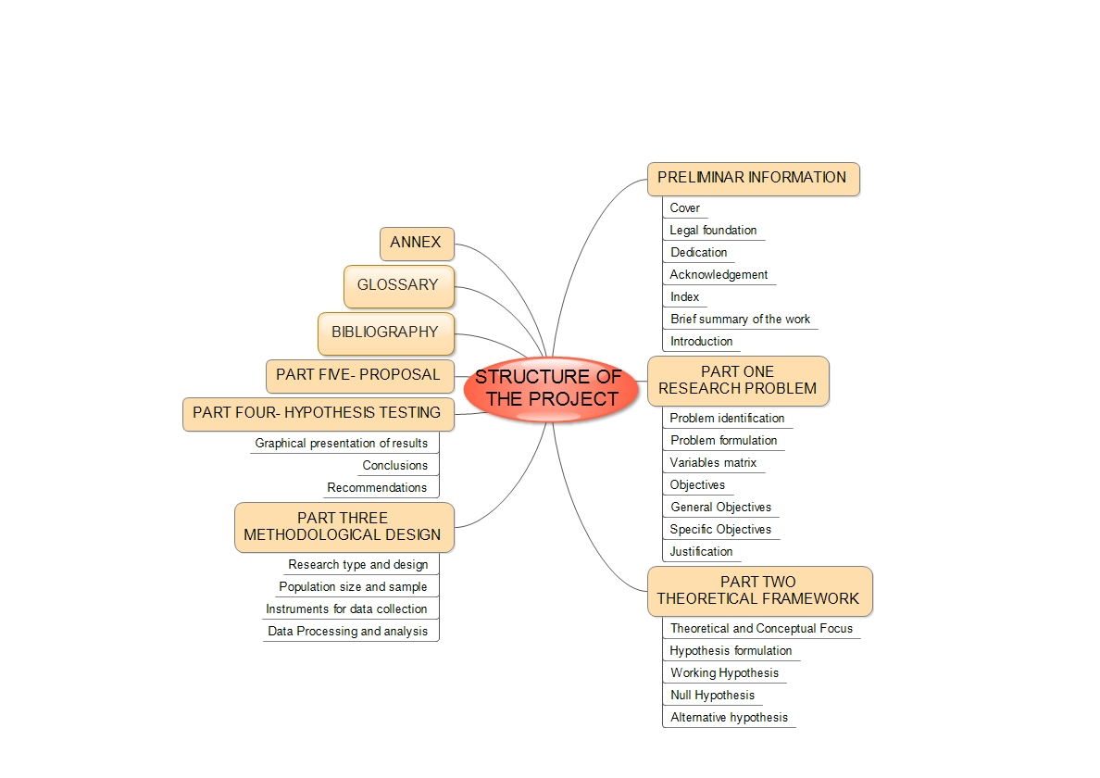
This project is based on the study carried out by Hussein Meihami (February 2015)

Slide 3

PART ONE
RESEARCH PROBLEM

Slide 4
PROBLEM IDENTIFICATION

Slide 5

PROBLEM FORMULATION
Will Collaborative Learning influence the development of the writing skill with first year soldier candidates, classroom “I”, at ESFORSE, during the first semester 2015?

Slide 6
VARIABLES MATRIX
INDEPENDENT VARIABLE
DEPENDENT VARIABLE
THE COLLABORATIVE
LEARNING
THE WRITING SKILL
From this chart, General and Specific objectives were set up, and
the Theoretical Framework was formulated.

Slide 7
GENERAL
OBECTIVES
To determine the influence of the Collaborative Learning Approach on the development of English writing skills.
To apply Collaborative Learning as an Approach to develop English Writing skills.

Slide 8
To prove that soldier candidates at ESFORSE can improve their English Writing skills through Collaborative Learning.
ESPECIFIC OBJECTIVES
To encourage soldiers at ESFORSE to use Collaborative Learning to improve their writing skills.
To propose a workshop to train the English teachers about the use of the Collaborative Learning approach to improve writing skills.

Slide 9
JUSTIFICATION
The importance of English Foreign Language
Low competence in English writing skill
Students work better when they work in pairs or groups
Collaborative Learning helps to foster respect, friendship and the other values among the diverse groups of students

Slide 10

PART TWO
THEORETICAL FRAMEWORK

Slide 11
History
ESFORSE
Location
Mission
It was founded in February, 1990
To train soldiers

Slide 12
DEFINITION
ORIGINS
COLLABORATIVE
LEARNING
TECHNIQUES
GROUP
FORMATION PROCESS
CL is a didactic method where two or more students work together.
According to Hulbert, each group member has to fulfill a role, it can help to foster inclusion, commitment, and efficiency.

Slide 13
WRITING SKILL
DEFINITION
WRITING COMPONENTS
Content
Organization
Grammar
Vocabulary
Mechanics
(Shehadeh,2011)
Writing is a form of communication that allows people to put their feelings and ideas on paper, and to transfer meaning into convincing text..

Slide 14
WRITING PROCESS
PARAGRAPH STRUCTURE
Planning
Drafting
Editing
Final version
Topic sentence
It tells the reader about what is a paragraph.
Controlling idea
Informs the reader on the specific aspect of the
topic
Supporting sentences
They give explanation, evidence, and reason
for the claim.
Concluding sentence
It is the last sentence in the paragraph.
^{(How to teach writing)}
^{(Harmer, 2004)}

Slide 15
COLLABORATIVE LEARNING ON THE DEVELOPMENT OF WRITING SKILLS
Languaging and Writing Skill: The Effect of Collaborative Writing on EFL Students’ Writing Performance (Meihami, 2015).
A Collaborative Writing Approach: Methodology and Student Assessment (Mulligan & Garofalo, 2011).
The Effectiveness of Using the Cooperative Language Learning Approach to Enhance EFL Writing Skill among Saudi University Students (Montasser, 2014)
Collaborative Writing in Summary Writing: Student Perceptions and Problems (Nooreiny Maarof, 2012).

Slide 16
HYPOTHESIS FORMULATION
ALTERNATIVE
HYPOTHESIS
NULL
HYPOTHESIS
WORKING
HYPOTHESIS
The use of Grammar Translation affects the development for improving writing skills with soldiers from the first year candidates’ course, classroom “I” at ESFORSE
The application of Collaborative Learning does not affect the development of writing skills with soldiers from the first year candidates’ course, classroom “I” at ESFORSE
The application of Collaborative Learning directly affects the development of writing skills with soldiers from the first year candidates’ course, classroom “I” at ESFORSE

Slide 17

PART THREE
METHODOLOGICAL DESIGN

Slide 18
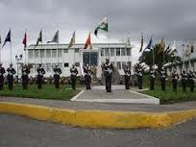
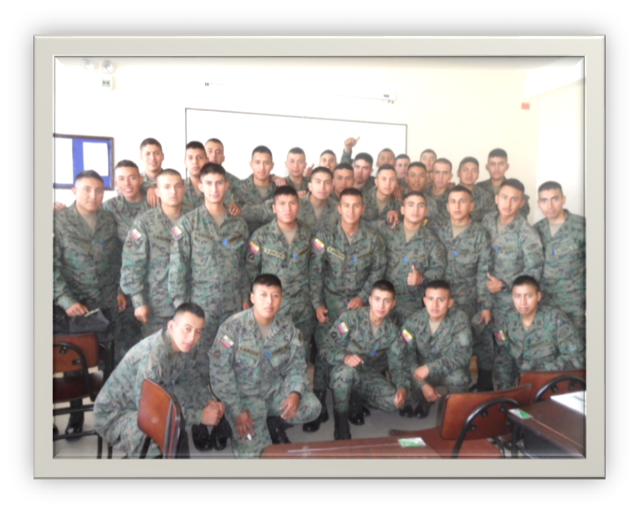
TYPE OF RESEARCH AND DESIGN
Descriptive
Of field
Quasi-experimental
2. POPULATION AND SAMPLE
Population 1200 soldier candidates
Sample 64 soldier candidates

Slide 19
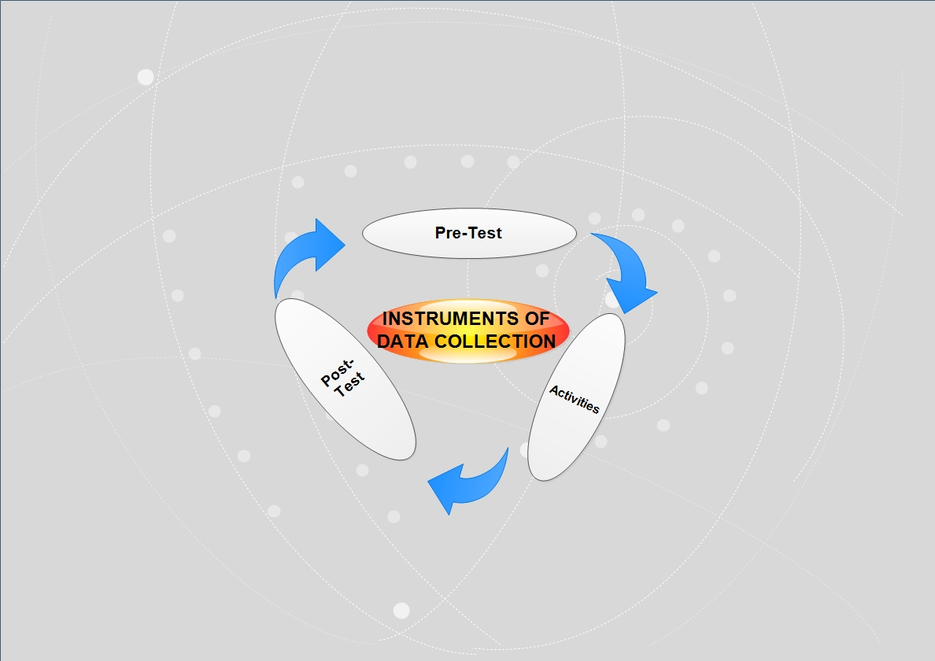
FIELD WORK
Arithmetic means of score
To set the objectives. And test de hypothesis (pre-post test)
Then, tests and 4 activities (Writing rubric (0-5))

Slide 20
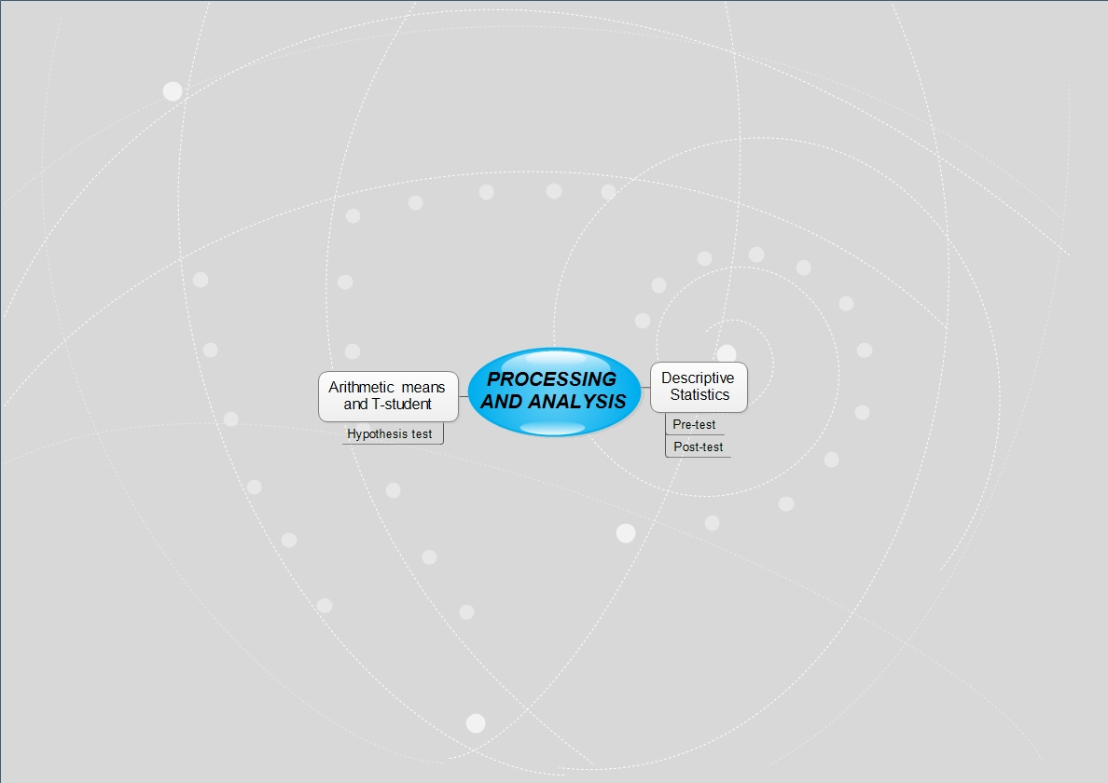
Descriptive statistics was used to process (P-P)
The arithmetic mean and T-student were implemented for the hypothesis test in order to establish if the pattern of frequency observed in students corresponded to expected pattern.

Slide 21

PART FOUR
TESTING THE HYPOTHESIS
GRAPHICAL EXPOSITION OF RESULTS

Slide 22
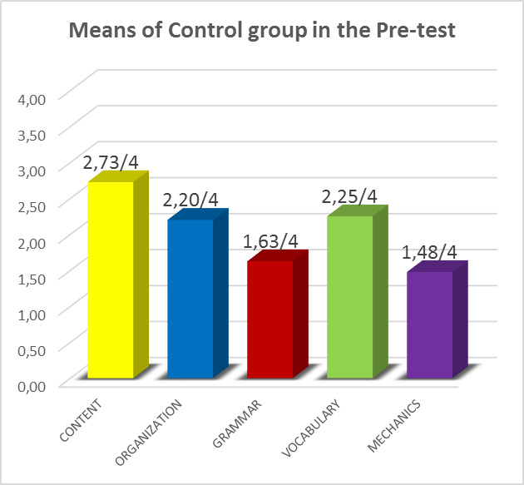
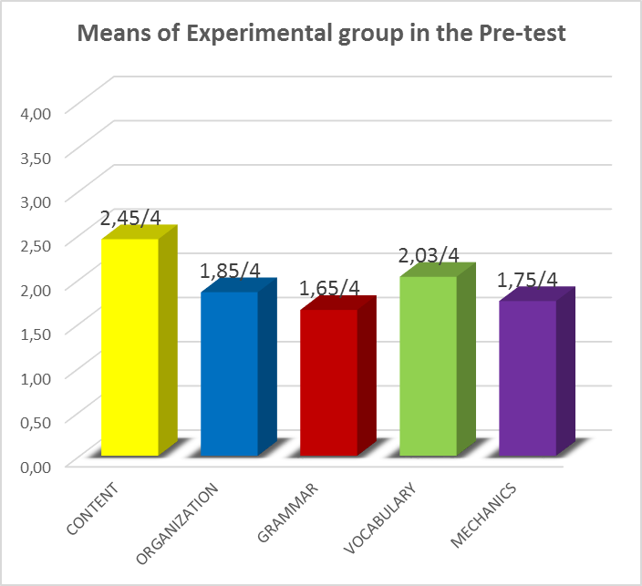
PRE – TEST RESULTS
Both groups reached a low competence in the pre-test

Slide 23
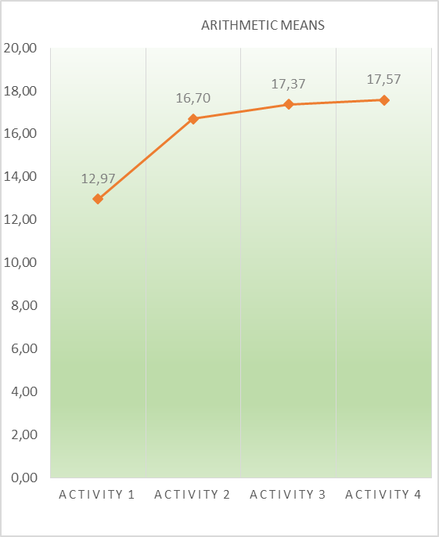
MEANS OBTAINED WITH THE EXPERIMENTAL GROUP
Learners improved their writing skill using collaborative learning techniques from one activity to another. They started with a low mean but reached a high performance.

Slide 24
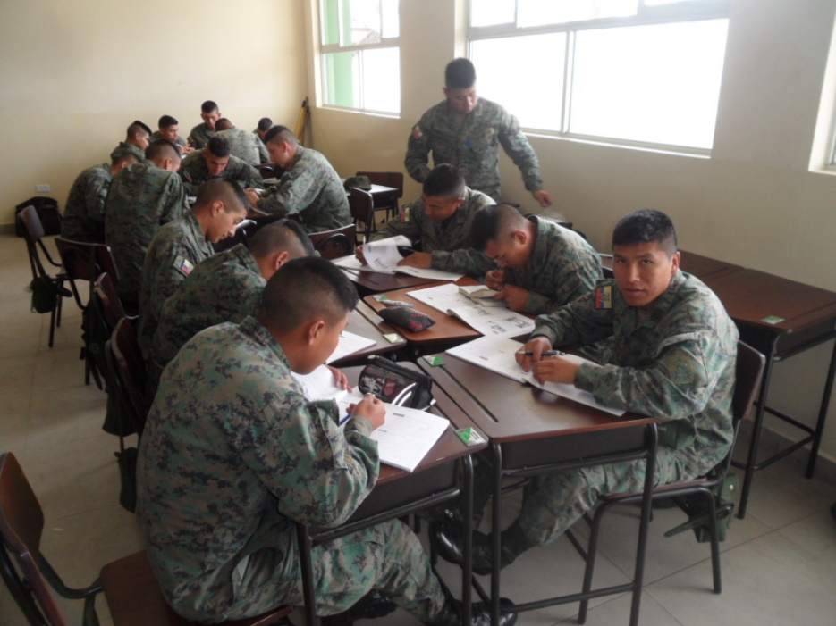
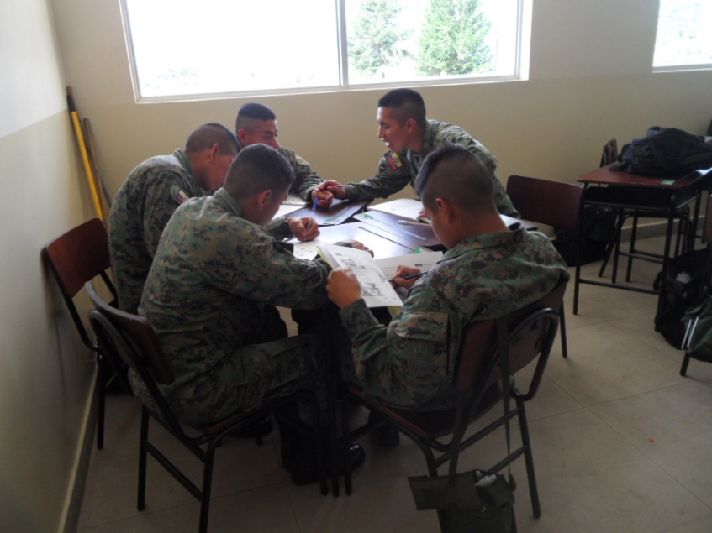
ACTIVITIES USING COLLABORATIVE LEARNING
TECHNIQUES WITH THE EXPERIMENTAL GROUP
Students work better in the problem solutions and share ideas and opinions about given topic.
Soldier candidates using collaborative strategies in writing activities in classroom.

Slide 25
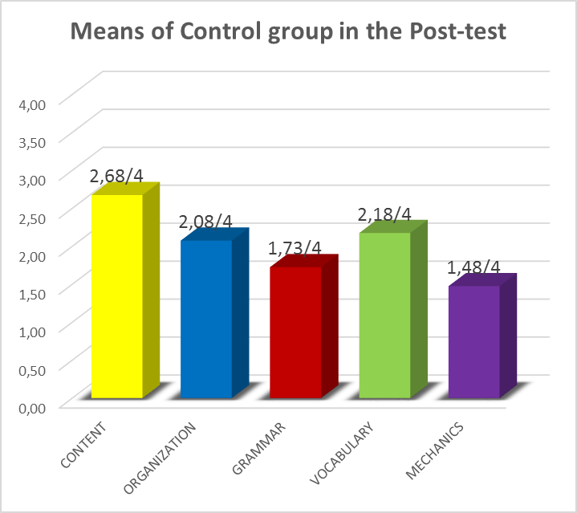
CONTROL GROUP
PRE-TEST VS. POST-TEST
The Control group did not improve their writing skills from the pre-test to the post-test

Slide 26
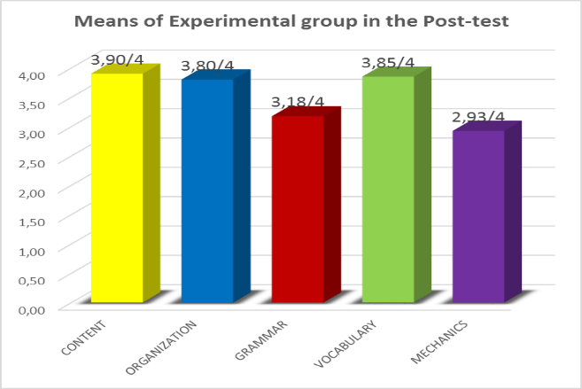
EXPERIMENTAL GROUP
PRE-TEST VS. POST-TEST
The experimental group improved significantly with the use of collaborative learning techniques on writing skills.

Slide 27

POST – TEST RESULTS
CONTROL VS. EXPERIMENTAL
The post test showed how the CL was an effective tool with respect to the development of writing skills in 5 issues in the experimental group.

Slide 28
HYPOTHESIS TESTING
STATISTICAL MODEL AND CALCULATION OF THE
T-STUDENT
T-student Formula=
Informative data:
S̄1= Square deviation of the pre-test
S̄2= Square deviation of the post-test
N1= Number of soldier candidates in the pre-test
N2= Number of soldier candidates in the post-test
gl (N1-N2-2)= Degrees of freedom

Slide 29
DATA TO CALCULATE T-STUDENT:
N1= 32
N2= 32
S1= 152
S2= 49.84
T-student= √((S1+S2)/(N1+N2-2))
T-student = √((152+49,84)/(32+32-2))
T-student = 1.80
Determination of the technical and statistical test
gl = N1+N2-2 = Degrees of freedom
gl= 32+32-2
gl= 62 Degrees of freedom

Slide 30
That rounded is 1.67
With a Confidence level of 95% (0.05)

Slide 31
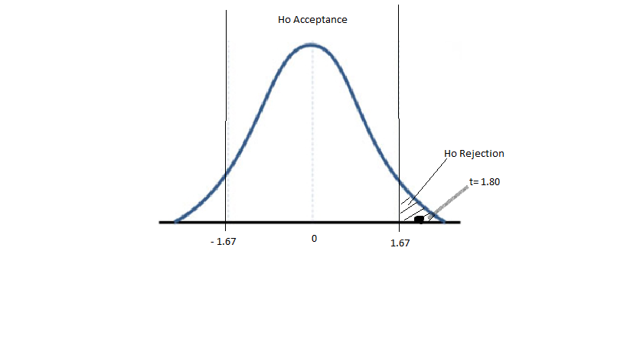
POST-TEST
T- STUDENT ANALYSIS
T-student calculated at 1.80 is greater than T-student tabulated of 1.67 which means it is outside the area of acceptance.
The results of the T-student of this application let us state that the null hypothesis is rejected.

Slide 32
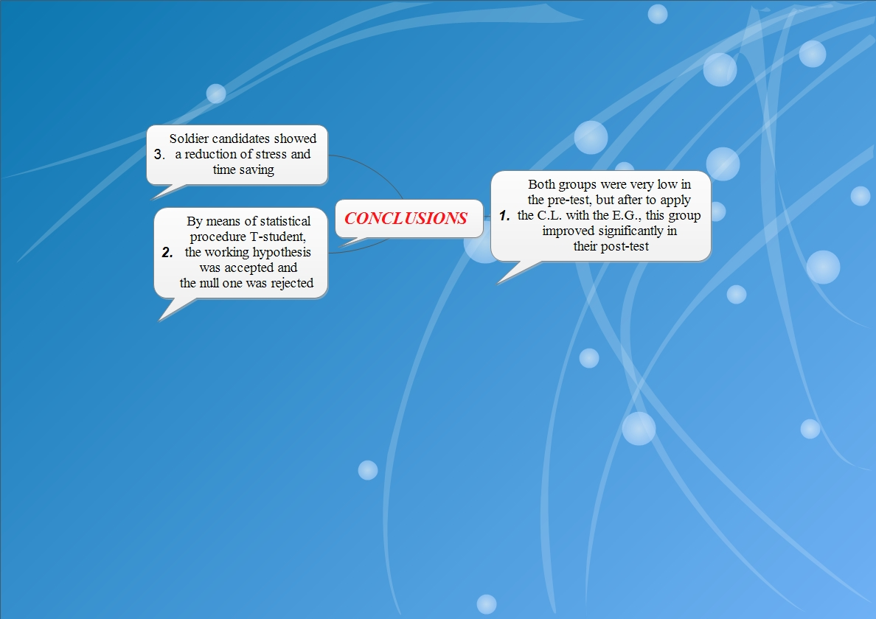

Slide 33
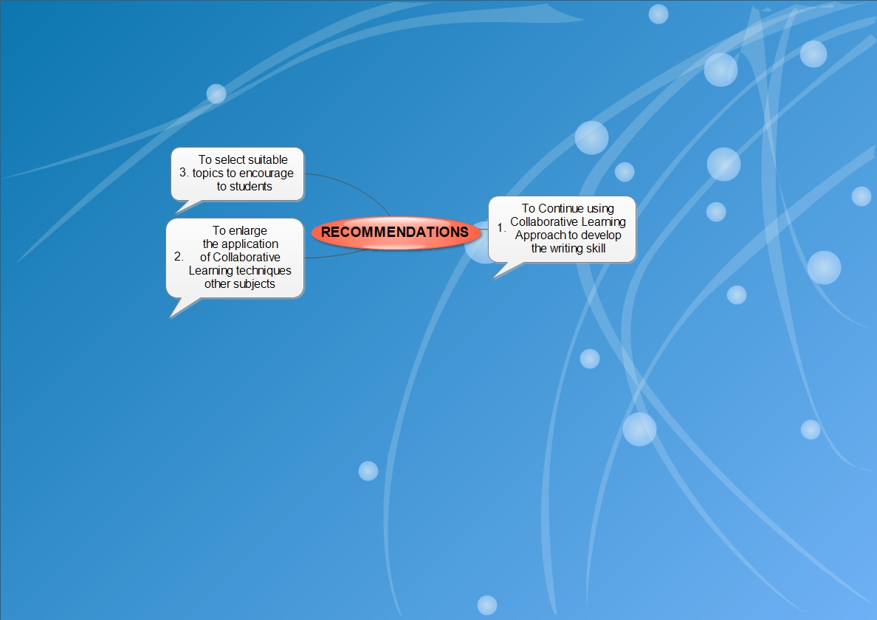

Slide 34
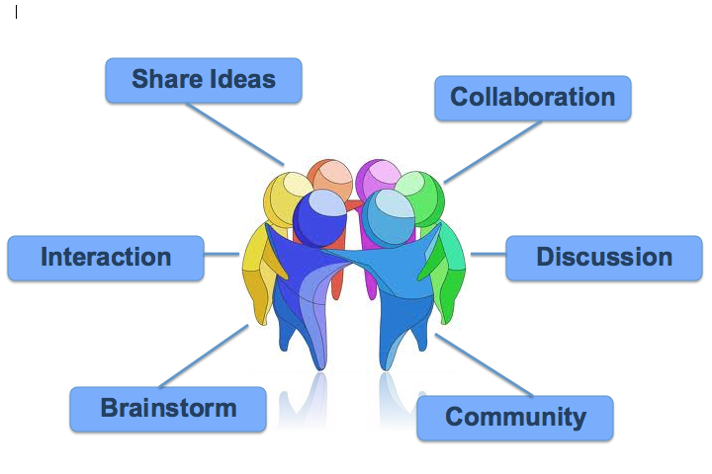
PART FIVE
PROPOSAL

Slide 35
The proposal consists in:
Organizing a workshop for training teachers to develop and implement collaborative learning approach in order to improve writing skills at ESFORSE.
The training will carry out in December of this year.

Slide 36
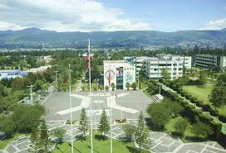
THANKS FOR YOUR
ATTENTION

