Slide 1
DEPARTMENT OF HUMAN AND SOCIAL CIENCES APPLIED LINGUISTICS IN ENGLISH CAREER “THE INFLUENCE OF TEACHER’S ATTITUDES AND BELIEFS INTO TECHNOLOGY-RELATED SKILLS, AT UNIDAD EDUCATIVA TUMBACO DURING 2010-2011 SCHOOL YEAR. AUTHOR: COLLAGUAZO, HECTOR DIRECTOR: M.S. PONCE, MIGUEL CODIRECTOR: LIC. MG. PINTO, MONICA

Slide 2
PART ONE
PROBLEM RESEARCH

Slide 3
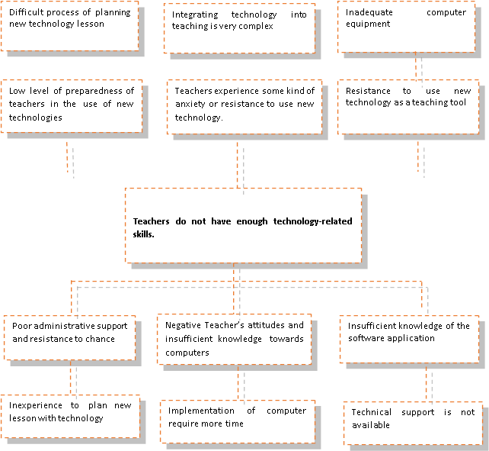
PROBLEM TREE
EFFECTS
CAUSES

Slide 4
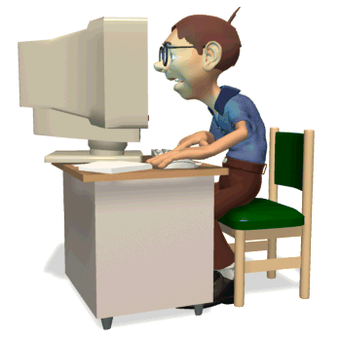
PROBLEM formulation
How influence teacher’s attitudes AND BELIEFS into technology-related skills?

Slide 5
VARIABLES MATRIX
INDEPENDENT VARIABLE
TEACHER’S ATTITUDES AND BELIEFS
DEPENDENT VARIABLE
TECHNOLOGY-RELATED SKILLS

Slide 6
OBJECTIVES
To suggest the planning courses and workshops to enhance the skills of teachers in the use of technology in teaching.
To find out the teachers’ experience and skills in use technology.
To identify the teachers´ barriers related the use of technology in education.
To analyze the teachers attitudes towards the new technology.
GENERAL
To determine the relationship between the teacher’s attitudes and beliefs into technology-related skills.
SPECIFIC

Slide 7
Justification
Through this study on teacher training highlights the importance of using these technologies in education, as a tool to support students in a personalized way according to their characteristics and learning styles as well as a tool that facilitates dialogue and the exchange of knowledge among teachers and those with student. One of the factors that affect the introduction of technology into teaching is the resistance to change on the part of teachers, keep in mind that teachers require time, training, incentives and support for the incorporation of technologies to teaching. Research in various countries show that the integration of technology into teaching depends on a variety of factors such as beliefs and experience of teachers. As for the educational use of technology, research is needed to evaluate the results and contributions of technology to improve the quality of education aimed at improving teaching practices and learning processes of students in contexts and specific situations.

Slide 8
PART TWO
THEORETICAL FRAMEWORK

Slide 9
Theoretical framework
TEACHER’S BELIEFS AND ATTITUDES
Refer to internal constructs that help teachers interpret experiences
M. Rokeach
Pajares, Nespor
Green
Thoughts, perceptions, behaviors, and attitudes
Beliefs affect the person’s perception
Beliefs are more central to beliefs system

Slide 10
The knowledge and abilities needed to accomplish computer-related duties
Acquires electronic information in variety of formats
Technical skills, knowledge, and abilities
TECHNOLOGY-RELATED SKILLS
Troubleshooting of software and hardware problems
Ability to perform basic operation
knowledge and appropriate use of operating systems, software applications, and communication and networking components
ability to use software and hardware.

Slide 11
OTHER CAUSES OF THE CORE PROBLEM
ADMINISTRATIVE SUPPORT
key elements needed for successful implementation of technology in education
TECHNICAL SUPPORT
Teachers need to be able to have basic troubleshooting skills to overcome technical problems
INFRAESTRUCTURE IN TECHNOLOGY IMPLEMENTATION AND INTEGRATION
physical equipment (hardware and software)
TEACHER ATTITUDES TOWARD TECHNOLOGY
knowledge and experience

Slide 12
HYPOTHESIS SYSTEM
WORKING HYPOTHESIS
THE TEACHER’S ATTITUDES AND BELIEFS INFLUENCE INTO TECHNOLOGY-RELATED SKILL.
NULL HYPOTHESIS
THE TEACHER’S ATTITUDES BELIEFS DO NOT INFLUENCE INTO TECHNOLOGY-RELATED SKILLS.

Slide 13
PART III
METHODOLOGICAL DESIGN

Slide 14
METHODOLOGICAL DESIGN
RESEARCH TYPE AND DESIGN
DESCRIPTIVE AND FIELD
POPULATION AND SAMPLE
15 TEACHERS AND 25 STUDENTS
UNIDAD EDUCATIVA TUMBACO
FIELD RESEARCH
INSTRUMENTS FOR DATA COLLECTION
SURVEY
QUESTIONARIES
DATA PROCESSING AND ANALYSIS
DESCRIPTIVE AND INFERENTIAL

Slide 15
PART FOUR
TESTING THE HYPOTHESIS

Slide 16
SURVEY: ADMINISTERED TO THE TEACHERS

Slide 17
SURVEY: ADMINISTERED TO STUDENTS

Slide 18
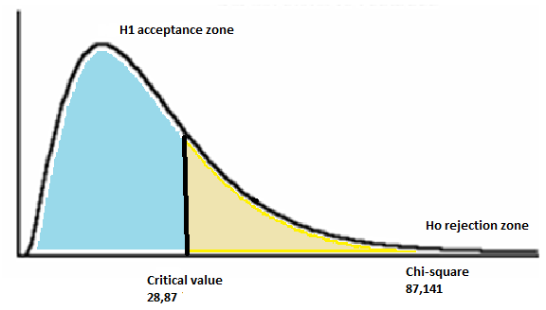
GRAPHICAL RESULTS
Degrees of freedom= 18
Critical value= 18,87
Chi-Square calculated= 87,141
Confidence level= 95%
Probability= 5%
STATISTICAL DECISION:
Once chi-square was calculated 87,141 and the critical value 28,87 it is notable that chi-square is higher than the critical value, therefore the null hypothesis is rejected.

Slide 19
conclusions
Null hypothesis is rejected
Insufficient technology-related skills in Teachers at Educational Unit “Tumbaco” is influenced by several factors as lack of resources, inadequate knowledge and skills, institutional barriers, negative attitudes and beliefs.
Teachers’ aren’t trained to give support and share knowledge online because they don’t have enough experience.
The successful use of technology in the classroom depends to a large extent on the teachers’ attitudes toward these tools.
Students affirm that enjoy learning when teachers’ use new technology in the classroom.
According to the students’ survey, teachers are not trained to give support and share knowledge online.
Students affirm that teachers don’t trust in its efficacy in use new technology.

Slide 20
recommendations
Teachers should attend course or workshop to get skills and experience in the use new technology.
Implement annual training plan to use basic applications such as word processors, spreadsheets, and presentation programs in the classroom.
Implement use the Internet, digital media tools to enhance students learning
Promote the use video clips into power point presentation in the classroom.
Prepare teachers’ to solve problems about hardware and software.
Training teachers’ to give support and share knowledge online.
Motivate teachers to use new technology in classroom, to make easier the students learning process.

Slide 21
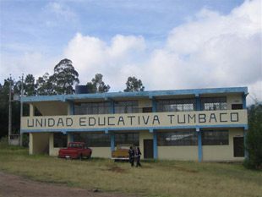
PART FIVE PROPOSAL

Slide 22
Narrative Summary of objectives | Indicators | Verification Media | Supposes
Goals 1. Teaching technology-related skills improvement 2. To obtain good experience in use computer like effective teaching tools in the classroom. | 60% of teachers have positive attitudes toward new technology. 80% of teachers show enough skills and knowledge in the effective use of instructional purpose. | Survey interview Test about computers skills | Teachers will feel motivated and interested in the learning process. Teachers are interested in develop their skills outside of regular schools day.
Purpose Interactive and interesting technological-related skills improvement | 85% of teachers show adequate knowledge and skills in use computer in the classroom. | Test | Using computers in the two processes of teaching and learning saves time and effort for both the teacher and the learner
Components Teachers get technological trainings every school periods. Application of technology in education. Teachers share their knowledge to their peers and students. | 90% of persons use new technology to use with their course, and participate in online discussion groups. Students improve their learning process. Quick communication between students, teachers. | Statistical of access to the forums and chats. tests results Workshops evaluations | Computer-based instruction can effectively enhance learning. Teachers use technology efficiently. Teachers and students can share knowledge easily.
Activities Training courses programing Attend course to acquire knowledge and skill in use new technology. Participate in workshops to practice and training in the use of hardware and software. | Resources Coordinator Teachers Computer Internet Computer book Internet Trainer | Costs $ - $1200 $ 500

Slide 23
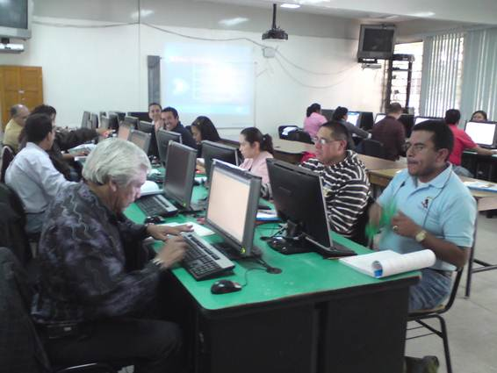
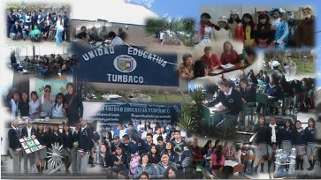
Beneficiaries
Teachers
Students
institution

Slide 24
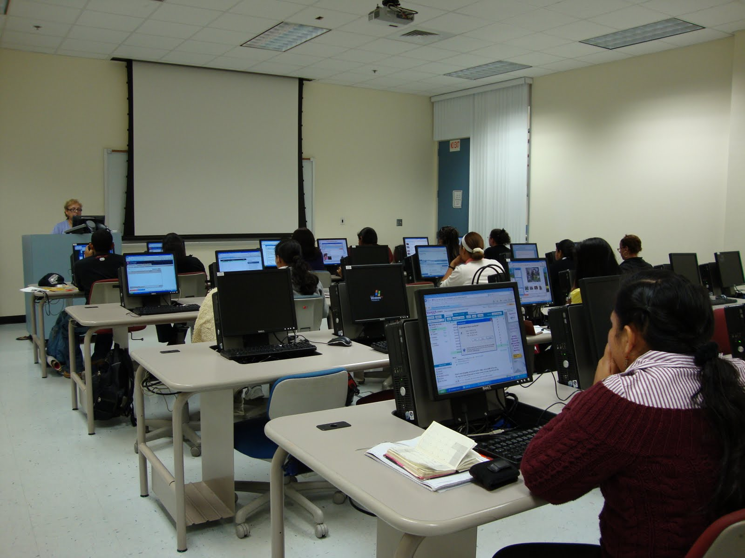
THANKS FOR YOUR ATTENTION

