Slide 1
Department of Engineering
TEST RIG CONTROL
Supervised by:
Prof. Dr.-Ing. Christian Oertel
Ing. Jan Hempel
TEST RIG CONTROL - Daniel Suárez Freile
2016

Slide 2
Contents:
Introduction
Tyre Property Lab -> Tyre Test Rig.
Graphic User Interfaces.
.net and C++.
Tyre cross section test rig
Basic definitions.
Implemented GUI.
GUI elements and measurement VI’s
Implementation of the GUI and measurement VI’s
TEST RIG CONTROL - Daniel Suárez Freile
2016

Slide 3
Tyre Property Lab:
Tyre Test Rig
Parametric Model of a Tyre
Modeling, studies and development
TEST RIG CONTROL - Daniel Suárez Freile
2016

Slide 4
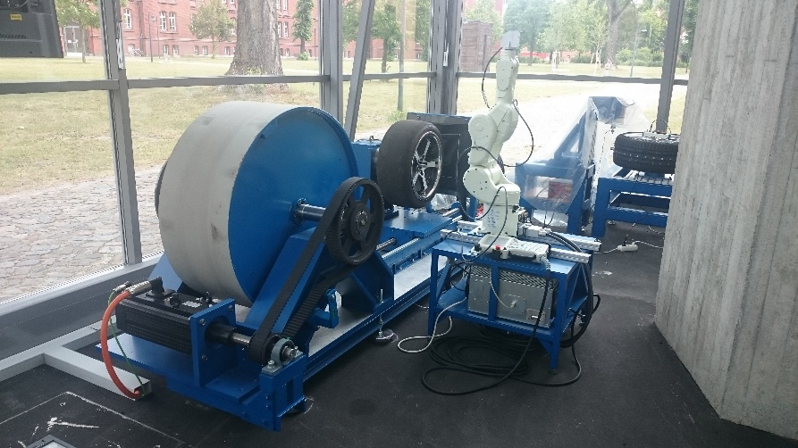
Tyre Test Rig:
Vertical Stiffness Tests
Contact Patch Test
Eigenfrequency Test
Uniformity Tests
TEST RIG CONTROL - Daniel Suárez Freile
2016

Slide 5
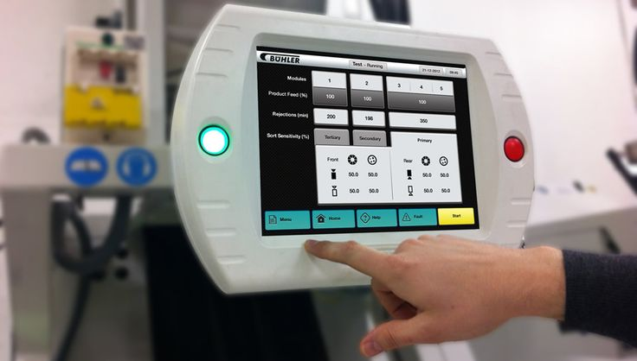
Graphic User Interfaces:
Type of Interface
Allows users
Interact with electronic devices
Visual indicators
TEST RIG CONTROL - Daniel Suárez Freile
2016

Slide 6
Software:
. NET -> Software framework
User interface, data access, communication, etc.
C++ -> General-purpose programming language
Object-oriented.
Design platform and development environment.
Visual programming language.
Software and code integration
Dynamic-Link Libraries.
TEST RIG CONTROL - Daniel Suárez Freile
2016

Slide 7
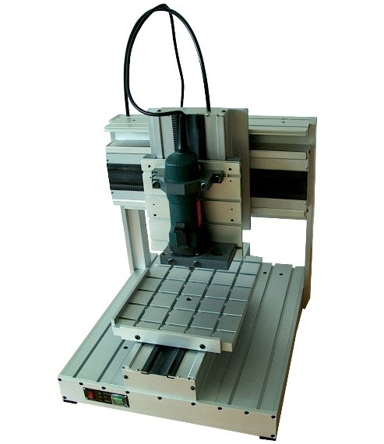
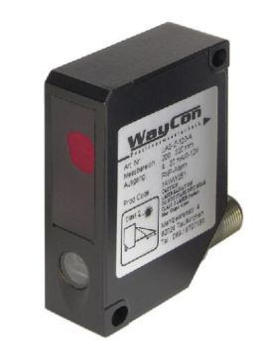
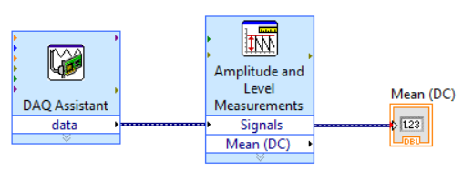
Tyre cross section test rig:
TEST RIG CONTROL - Daniel Suárez Freile
2016

Slide 8
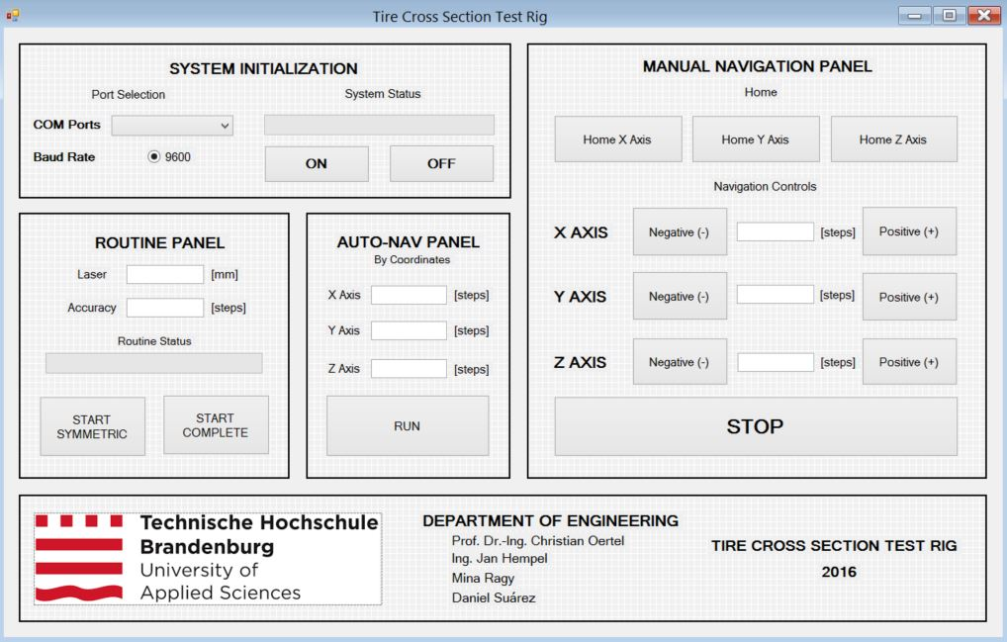
Graphic User Interface:
TEST RIG CONTROL - Daniel Suárez Freile
2016

Slide 9
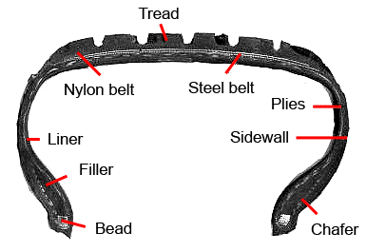
Algorithm:
TEST RIG CONTROL - Daniel Suárez Freile
2016

Slide 10
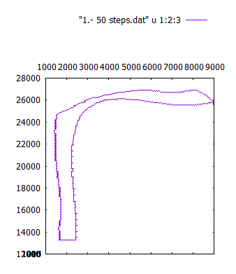
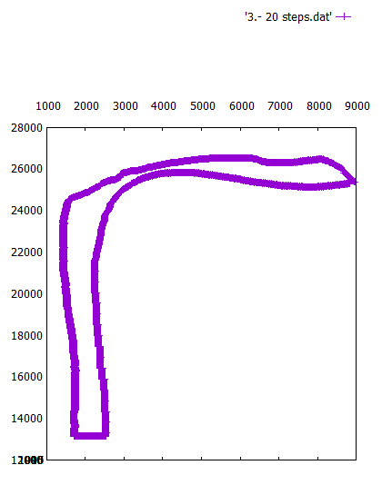
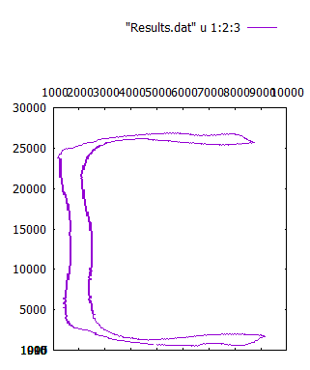
Results:
TEST RIG CONTROL - Daniel Suárez Freile
2016

Slide 11
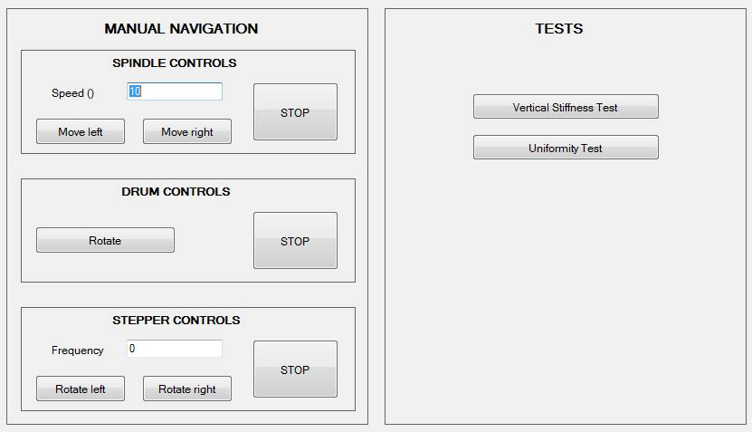
Tyre Test Rig GUI design:
TEST RIG CONTROL - Daniel Suárez Freile
2016

Slide 12
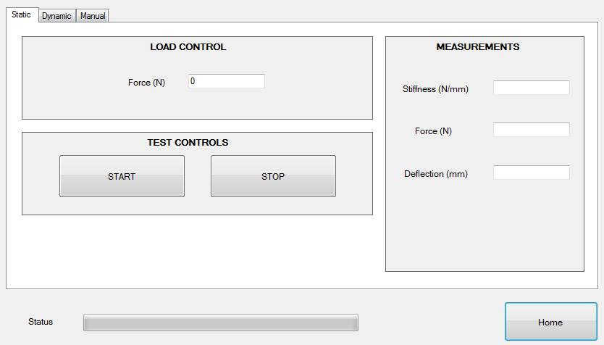
Vertical stiffness test design:
TEST RIG CONTROL - Daniel Suárez Freile
2016

Slide 13
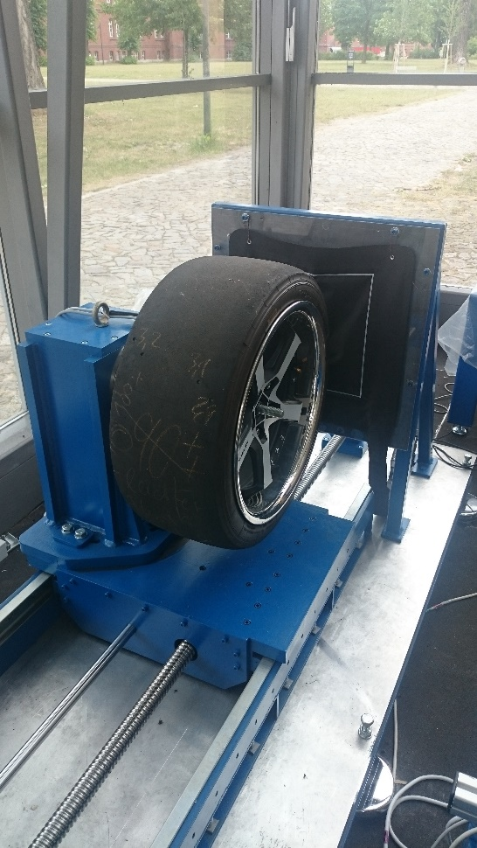
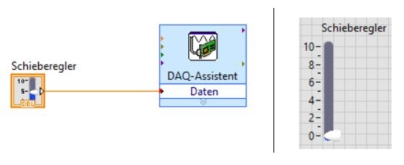
Vertical stiffness test design:
Spindle_Speed(0);
SEnable(0);
TEST RIG CONTROL - Daniel Suárez Freile
2016

Slide 14
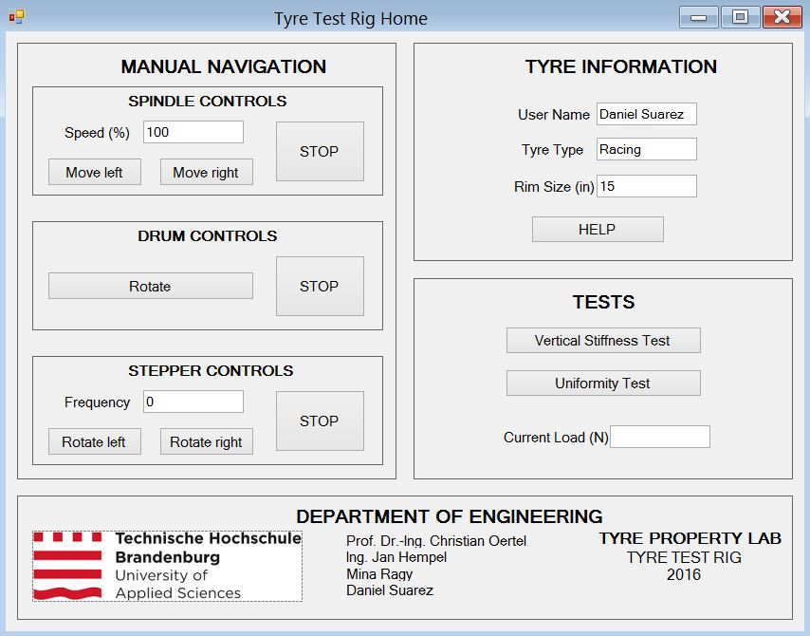
Tyre Test Rig GUI implementation:
TEST RIG CONTROL - Daniel Suárez Freile
2016

Slide 15
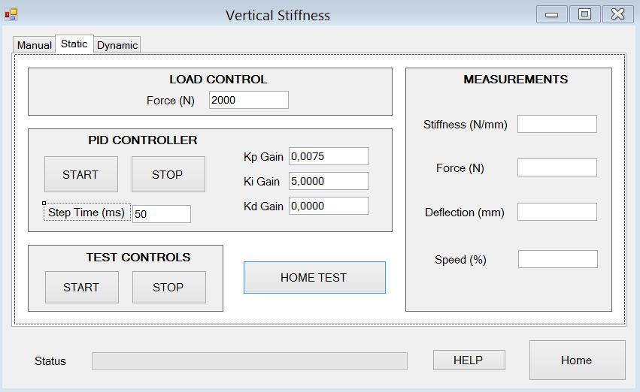
Vertical stiffness test implementation:
TEST RIG CONTROL - Daniel Suárez Freile
2016

Slide 16
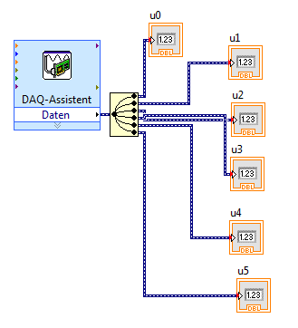
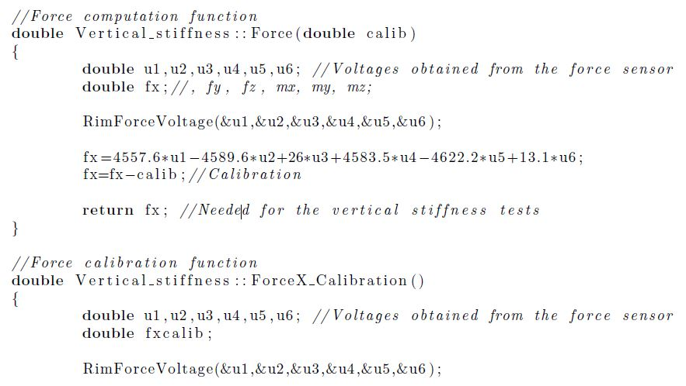
Force acquisition:
TEST RIG CONTROL - Daniel Suárez Freile
2016

Slide 17
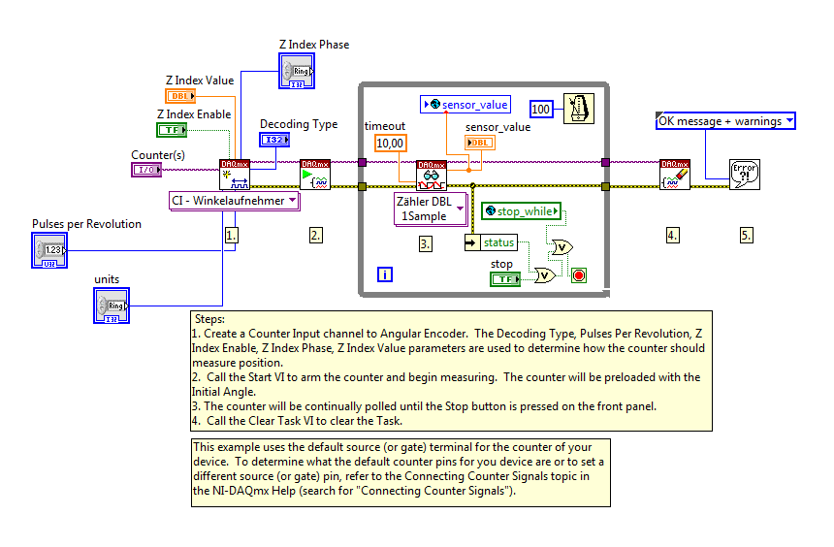
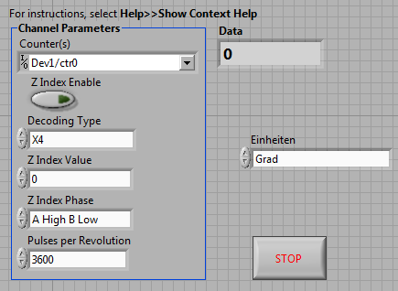
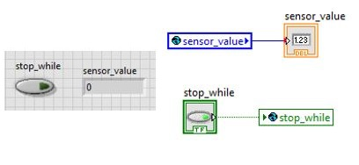
Angle acquisition:
TEST RIG CONTROL - Daniel Suárez Freile
2016

Slide 18
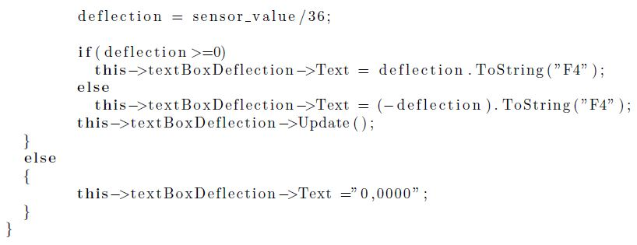
Angle acquisition:
TEST RIG CONTROL - Daniel Suárez Freile
2016

Slide 19
Conclusion:
Tyre cross section test rig.
Home Window.
Vertical Stiffness Window.
Uniformity Test Window.
User Manual
Recommendation:
PID Controller.
Uniformity Test.
Tyre Information
TEST RIG CONTROL - Daniel Suárez Freile
2016

Slide 20
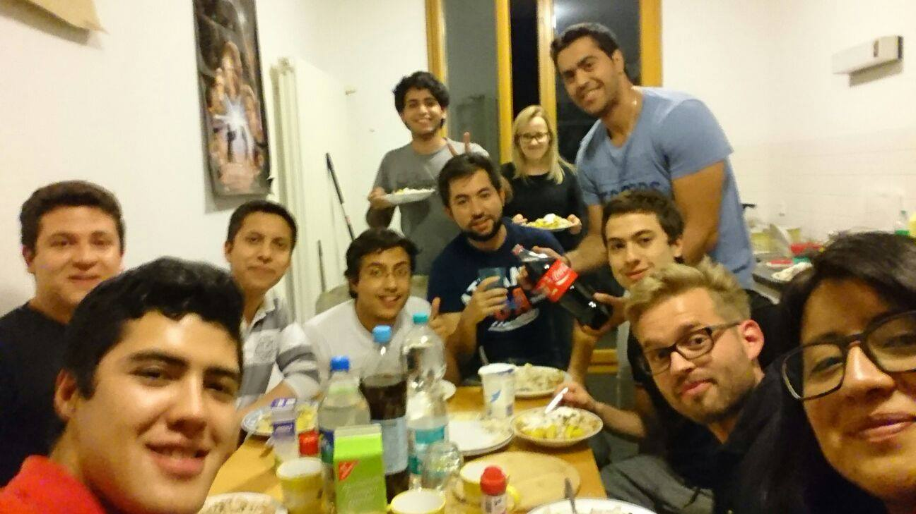
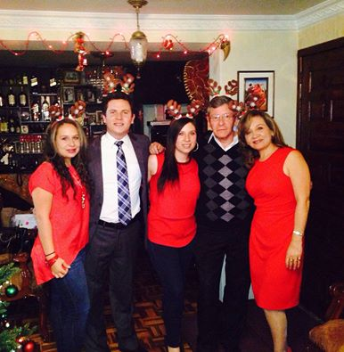
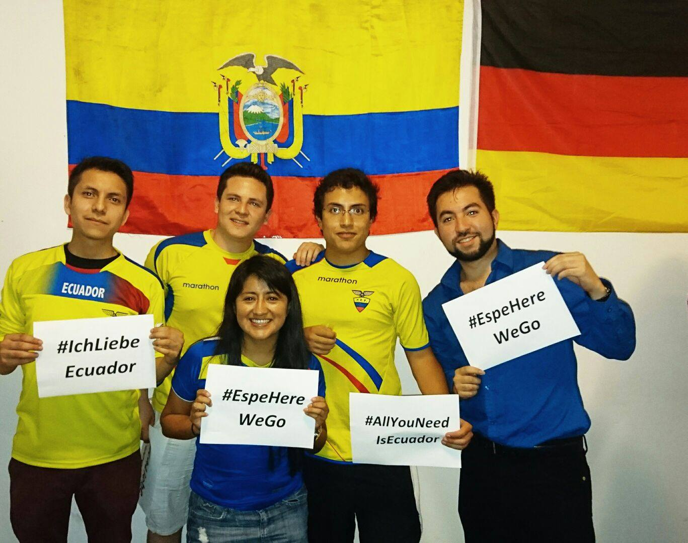
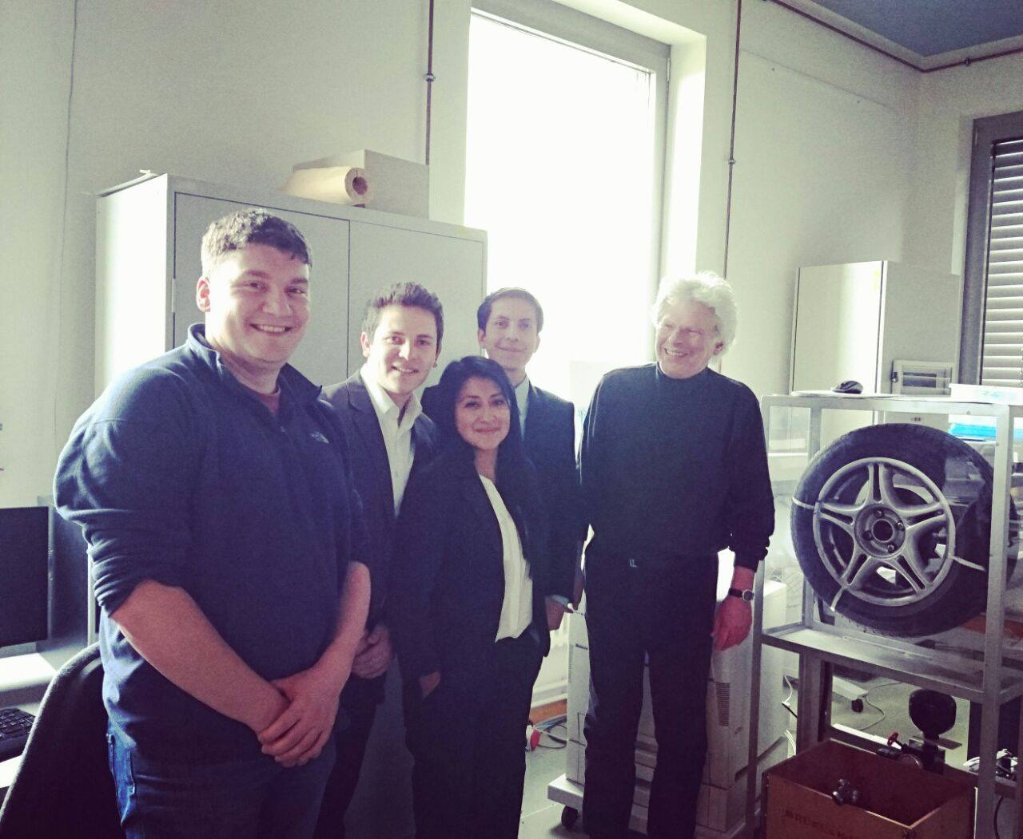
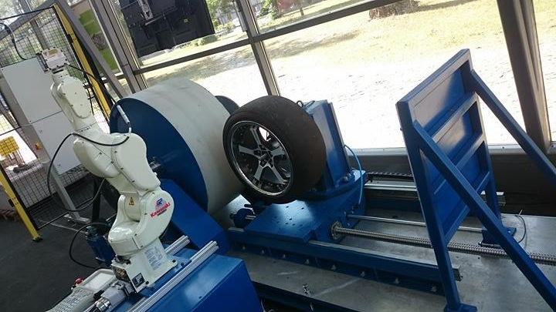
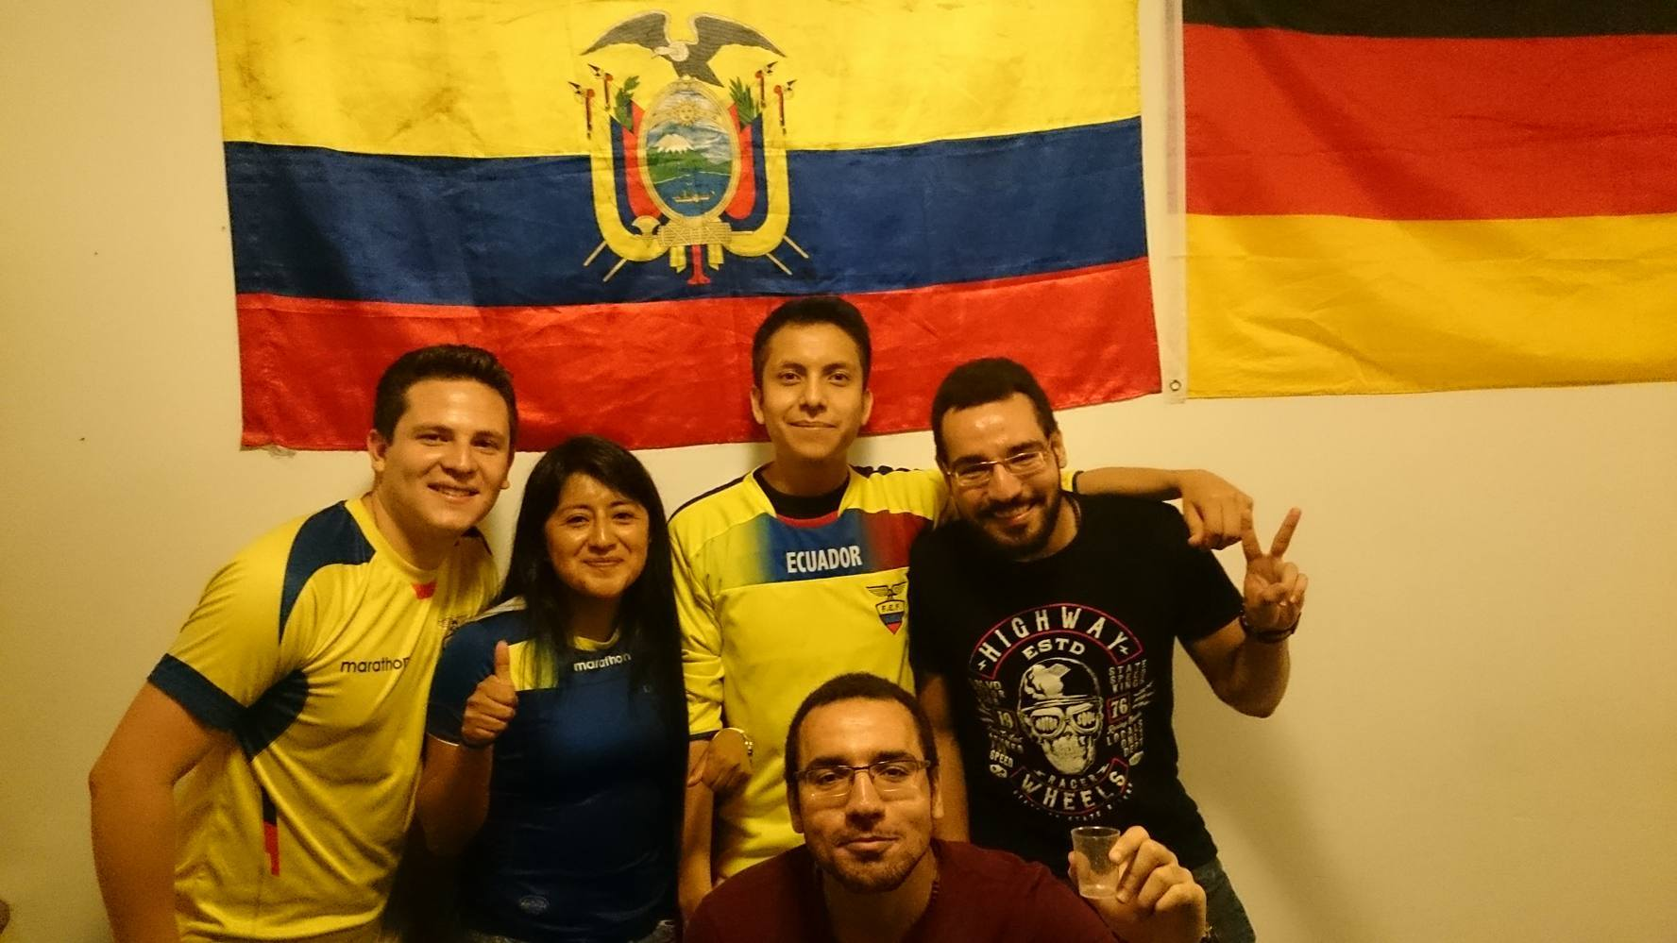
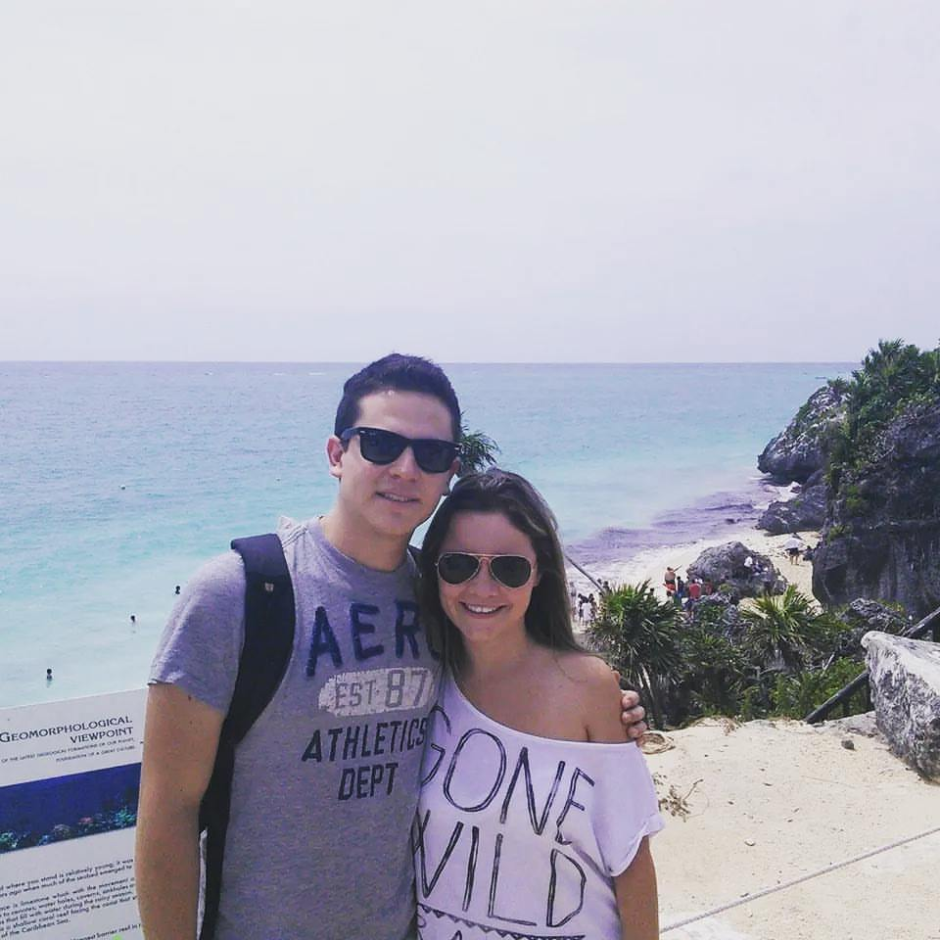
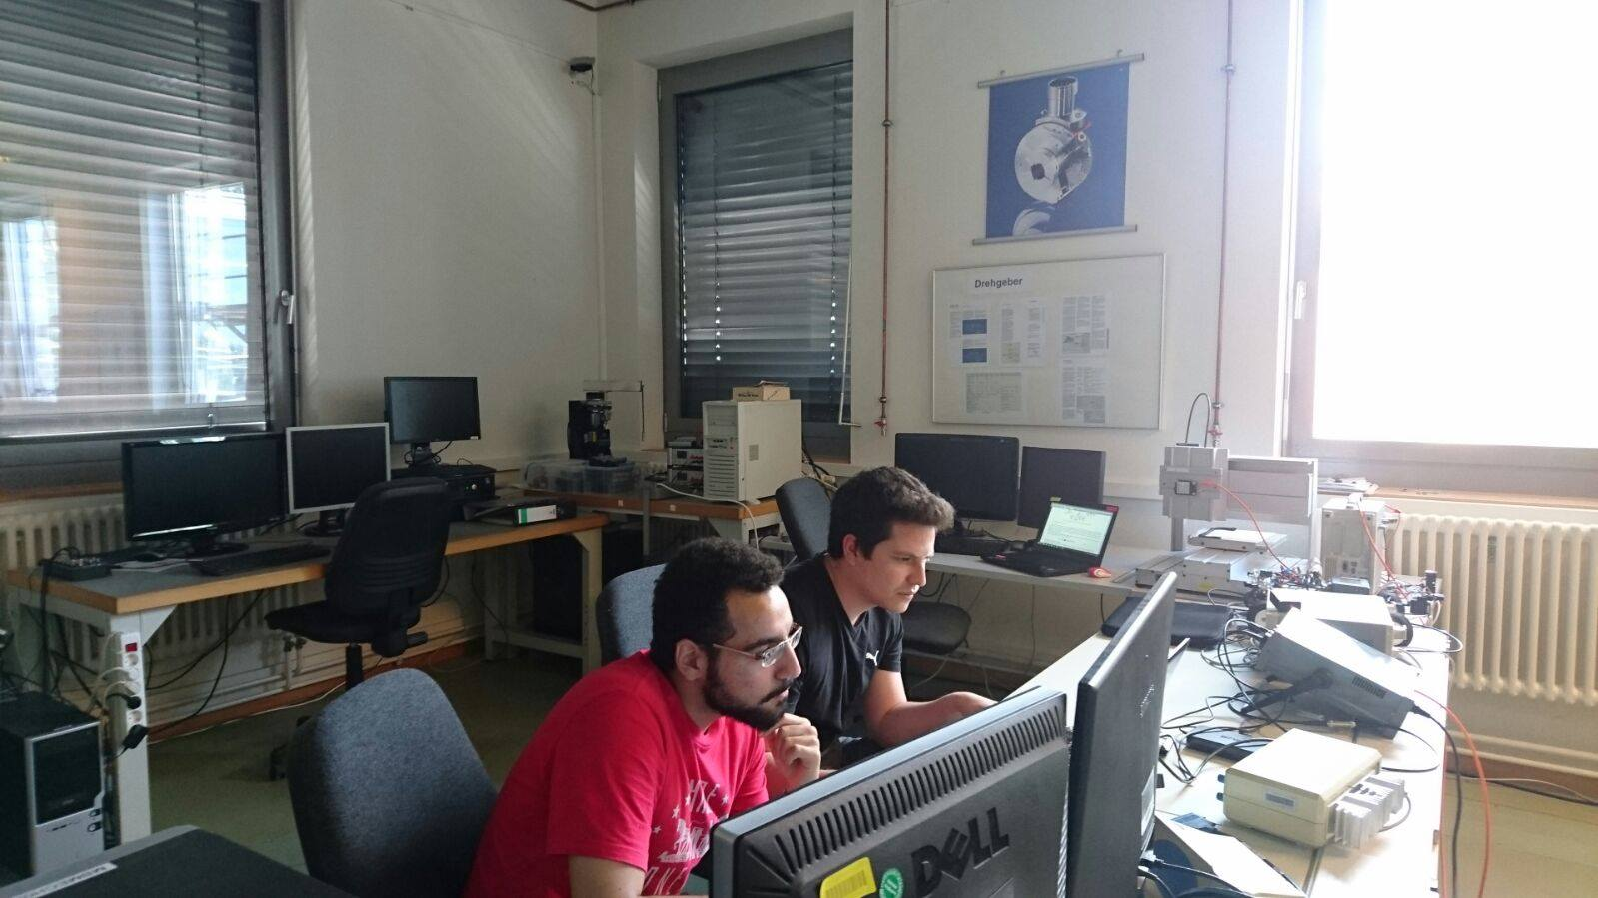
Thank you!
TEST RIG CONTROL - Daniel Suárez Freile
2016

