Slide 1
DEPARTAMENTO DE CIENCIAS HUMANAS Y SOCIALES
CARRERA DE LICENCIATURA EN LINGÜÍSTICA APLICADA AL IDIOMA INGLÉS
TRABAJO DE TITULACIÓN, PREVIO A LA OBTENCIÓN DEL TÍTULO DE LICENCIADO EN LINGÜÍSTICA APLICADA AL IDIOMA INGLÉS
“ENGLISH SONGS TO DEVELOP THE SPEAKING AND LISTENING SKILLS IN TEENAGERS WITH VISUAL IMPAIRMENTS AT “UNIDAD EDUCATIVA INTERNACIONAL PENSIONADO ATAHUALPA” DURING THE SCHOOL YEAR 2016-2017 ”
AUTORA: ZAMORA VILLOTA ANDREA ESTEFANY
DIRECTOR: PUMA CHADÁN GONZALO EFRAIN
SANGOLQUÍ

Slide 2
PART ONE RESEARCH PROBLEM

Slide 3
Problem identification of blind children and English
Visual impairment early in life has profound implications in terms of reduced education, outcomes and social experiences Vision plays an important role in education and learning in children and young people.
It is known that up to 80 percent of learning occurs through vision and it could be the reason why we do not see an important number of children with this visual disability in regular education. Teachers do not know how to manage the classes for these people.

Slide 4
1.1 Problem identification
School desertion
Demotivation for learning English
Low grades
Discrimination
Student may have low self-esteem, shy.
Blind children have difficulties to learn English
No curricular adaptations for blind children
Use of inappropriate methodology for blind children
No easy access or inclusion to regular education for blind children
Presence of blindness in some students

Slide 5
VARIABLES | DIMENSIONS | SUBDIMENSIONS
INDEPENDENT VARIABLE English Songs It is a short poem or other set of words set to music or meant to be sung. A song is a single work of music that is typically intended to be sung by the human voice using sound and silence and a variety of forms that often include the repetition of sections. Written words created specifically for music or for which music is specifically created, are called lyrics. (Schoepp, 2001) | 1. Visual Impairments 2. Planning for the using of songs in Classes 3. Motivation to the students in the Class | 1.1 Eye injury 1.2 Using media in the class 2.1 Examine the skill to develop 2.2 Grade language level on the class 3.1 Listen to the song 3.2 Focus on the target grammar 3.3 Focus on the vocabulary 3.4 Cultural issues

Slide 6
VARIABLES | DIMENSIONS | SUBDIMENSIONS
DEPENDENT VARIABLE Speaking Speaking Speaking is to say something in order to convey information or to express a feeling. To utter words or articulate sounds with the ordinary voice. (Schoepp, 2001) Listening Listening is a psychological phenomenon, which takes place on a cognitive level inside people’s heads, and a social phenomenon, which develops interactively between people and the environment surrounding them. | 4. Speaking 5. Listening 6. English Songs to develop Listening and Speaking skills. | 4.1 Pronunciation 4.2 Vocabulary 4.3. Fluency 4.4. Intonation 4.5 Stress and accent 5.1 Pre Listening activities 5.2 During Listening activities 5.3 After Listening activities 6.1 Song as a vehicle for motivating and training students when working in listening practices 6.2 Students attitudes and reflections towards the listening activities based on songs 6.3 the extent students had of understanding the songs 6.4 Practicing pronunciation and natural reductions that occur in spoken English 6.5 Cultural themes involved in songs 6.6 student’s reflections on the social context around them 6.7 Using songs to compare cultural differences

Slide 7
OBJECTIVES
General Objective
To determine the incidence of English songs on listening and speaking skills of English language on teenagers with visual disabilities at “Unidad Educativa Internacional Pensionado Atahualpa” during the school year 2016-2017
Specific objectives
To set up the scientific and theoretical bases as references in the use of the English Songs on listening and speaking skills on teenagers with visual disabilities through a documentary research.
To identify the most common problems that students with visual disabilities have on the development of listening and speaking skills during a pre-test.
To analyze the effectiveness of the English songs on the development of listening and speaking skills on teenagers with visual disabilities through pre and post –tests.

Slide 8
Justification
This research project is developed in order to determine the incidence of the English songs on the development of the listening and speaking skills on teenagers with visual impairments at Unidad Educativa Internacional Pensionado Atahualpa with different techniques to use of English songs in class.
I can emphasize that it is a benefit for society, due to the songs, gives an interactive environments for blind children and that helps to problem solving to listening and speaking skills.

Slide 9
PART TWO THEORICAL FRAMEWORK

Slide 10
SPEAKING SKILL
Speaking is to say something in order to convey information or to express a feeling. To utter words or articulate sounds with the ordinary voice. (Schoepp, 2001)
Pronunciation
Vocabulary
Fluency

Slide 11
LISTENING SKILL
Listening is a psychological phenomenon, which takes place on a cognitive level inside people’s heads, and a social phenomenon, which develops interactively between people and the environment surrounding them.
Pre- listening activities
During listening activities:
After listening activities

Slide 12
2.5 Hypothesis formulation
WORKING HYPOTHESIS
The adequate application of didactic sources influences in the development of speaking and listening skills in children with visual impairments at “Unidad Educativa Internacional Pensionado Atahualpa”.
NULL HYPOTHESIS
The application of the English Songs do not influence in the development of speaking and listening skills in teenagers with visual impairments at “Unidad Educativa Internacional Pensionado Atahualpa”.
ALTERNATIVE HYPOTEHSIS
The presence of use of braille technique influences in the development of speaking and listening skills in teenagers with visual impairments at “Unidad Educativa Internacional Pensionado Atahualpa”.

Slide 13
PART THREE METHODOLOGICAL DESIGN

Slide 14
Research Type and Design
The type of research is experimental, because there are only one group, the pre-test and post-test designed was applied for all students.
Population Size and Sample
In this study was observed the effect of English songs (independent variable) in an English class and the incidence on the speaking and listening skill (dependent variable) with the students of level 4 at Unidad Educativa Internacional Pensionado Atahualpa.

Slide 15
Field Work
The research work field took place at Unidad Educativa Internacional Pensionado Atahualpa located in Ibarra, Imbabura province during the second term of 2016-2017 academic years.
Instruments for data collection
A survey was applied to the authorities, teachers and parents in order to how much they know about any project applied in the institution.

Slide 16
PART FOUR TESTING THE HYPOTHESIS

Slide 17
Data matrix
Men | 1 | 1
Women | 3 | 3
Total sample: |  | 4
Sample: Because the population includes an adequate number to investigate, it was established that:
N = n
4 = 4

Slide 18
Graphical presentation of results
RESULTS OF THE SURVEY OF THE AUTHORITIES
¿You as an authority in this Educational Institution, do you devise any kind project that involves English Language development in the students with blindness?

Slide 19
RESULTS OF TYE SURVEY OF THE TEACHERS
¿Do you know if the institution has any kind project that involves English Language development in students with blindness?

Slide 20
RESULTS OF TYE SURVEY OF THE PARENTS
¿Most of the teachers understand what are the needs of your children during the classes?

Slide 21
UNIDAD EDUCATIVA INTERNACIONAL PENSIONADO ATAHUALPA
AÑO LECTIVO 2016 - 2017
8th EGB
PRE - TEST: To evaluate the productive speaking skill in a presentation
No | LAST NAME AND NAMES |  | Rubric
 |  |  | Grammar and Vocabulary | Pronunciation | Comprehension | Background Knowledge | Fluency | TOTAL
 |  |  | 2,0 | 2,0 | 2,0 | 2 | 2
1 | AYALA HERNANDEZ | HUGO JAVIER | 1,0 | 0.5 | 1,0 | 1 | 1 | 4,0
2 | FARINANGO ANDRADE | VERÓNICA GABRIELA | 1,0 | 1,0 | 1,0 | 1 | 1 | 5.0
3 | GUAMÁN ARMENDARIZ | SANDRA PATRICIA | 1,0 | 0.5 | 1,0 | 1 | 1 | 4.5
4 | GUAMÁN QUINTEROS | MELANY DANIELA | 1,0 | 1.0 | 1,0 | 1 | 0.5 | 4.0
 |  |  | 4,0 | 2.5 | 4.0 | 4.0 | 3.5

Slide 23
UNIDAD EDUCATIVA INTERNACIONAL PENSIONADO ATAHUALPA
AÑO LECTIVO 2016 - 2017
8th EGB
POST - TEST: To evaluate the productive speaking skill in a presentation
No | LAST NAME AND NAMES |  | Rubric
 |  |  | Grammar and Vocabulary | Pronunciation | Comprehension | Background Knowledge | Fluency | TOTAL
 |  |  | 2,0 | 2,0 | 2,0 | 2 | 2
1 | AYALA HERNANDEZ | HUGO JAVIER | 2,0 | 2,0 | 2,0 | 2 | 2 | 10,0
2 | FARINANGO ANDRADE | VERÓNICA GABRIELA | 2,0 | 2,0 | 2,0 | 2 | 1 | 9,0
3 | GUAMÁN ARMENDARIZ | SANDRA PATRICIA | 2,0 | 2,0 | 2,0 | 2 | 2 | 9,5
4 | GUAMÁN QUINTEROS | MELANY DANIELA | 2,0 | 2,0 | 2,0 | 2 | 2 | 10,0
 |  |  | 8,0 | 8,0 | 8,0 | 7,5 | 7,0

Slide 25
SPEAKING SKILLS
CATEGORY
 | Needs Improvement 2.5pts | Satisfactory 2.5pts | Good 2.5pts | Excellent 2.5pts
GRAMMAR AND VOCABULARY | Student was difficult to understand and had a hard time communicating their ideas and responses because of grammar mistakes. Student had inadequate vocabulary words to express his/her ideas properly, which hindered the students in responding. | Student was able to express their ideas and responses adequately but often displayed inconsistencies with their sentence structure and tenses. Student was able to use broad vocabulary words but was lacking, making him repetitive and cannot expand on his ideas. | Student was able to express their ideas and responses fairly well but makes mistakes with their tenses, however is able to correct themselves. Student utilized the words learned in class, in an accurate manner for the situation given. | Student was able to express their ideas and responses with ease in proper sentences structure and tenses. Rich, precise and impressive usage vocabulary words learned in and beyond of class.
PRONUNCIATION | Student was difficult to understand, quiet in speaking, unclear in pronunciation. | Student was slightly unclear with pronunciation at times, but generally is fair. | Pronunciation was good and did not interfere with communication. | Pronunciation was very clear and easy to understand.
COMPREHENSION | Student had difficulty understanding the questions and topics that were being discussed. | Student fairly grasped some of the questions and topics that were being discussed. | Student was able to comprehend and respond to most of the questions and topics that were being discussed. | Student was able to comprehend and respond to all of the questions and the topics that were being discussed with ease.

Slide 26
SPEAKING SKILLS
CATEGORY
 | Needs Improvement 2.5pts | Satisfactory 2.5pts | Good 2.5pts | Excellent 2.5pts
BACKGROUND KNOWLEDGE | Student was lacking in background knowledge which hindered his/her responses to the questions regarding class materials. | Student showed decent background knowledge of class material, making his responses incomplete. | Student displayed well knowledge of class information and topics. | Student presented excellent background knowledge from class topics and was able to add more information in their response.
FLUENCY | Speech is very slow, stumbling, nervous, and uncertain with response, except for short or memorized expressions. difficult for a listener to understand. | Speech is slow and often hesitant and irregular. Sentences may be left uncompleted, but the student is able to continue. | Speech is mostly smooth but with some hesitation and unevenness cause primarily by rephrasing and groping for words. | Speech is effortless and smooth with speed that comes close to that of a native speaker.

Slide 27
RESULTS OF THE PRE TEST Y POST TEST
UNIDAD EDUCATIVA INTERNACIONAL PENSIONADO ATAHUALPA
AÑO LECTIVO 2016 - 2017
8TH EGB
PRE - TEST: To evaluate the productive listening skill in a presentation
No | LAST NAME AND NAMES |  | Rubric |  |  |  | TOTAL
 |  |  | Ability to focus | General Understanding | Listening for details | Accuracy of answers
 |  |  | 2.5 | 2,5 | 2,5 | 2,5
1 | AYALA HERNANDEZ | HUGO JAVIER | 1,0 | 1,0 | 1,0 | 1,0 | 4
2 | FARINANGO ANDRADE | VERÓNICA GABRIELA | 1,5 | 1,0 | 1,0 | 1,5 | 5
3 | GUAMÁN ARMENDARIZ | SANDRA PATRICIA | 1,0 | 1,0 | 1,0 | 1,0 | 4
4 | GUAMÁN QUINTEROS | MELANY DANIELA | 1,5 | 1,0 | 1,0 | 1,0 | 5
 |  |  | 5,0 | 4,0 | 4,0 | 4,5 | 17,5

Slide 29
UNIDAD EDUCATIVA INTERNACIONAL PENSIONADO ATAHUALPA
AÑO LECTIVO 2016 - 2017
8th EGB
POST - TEST: To evaluate the productive listening skill in a presentation
No | LAST NAME AND NAMES |  | Rubric |  |  |  | TOTAL
 |  |  | Ability to focus | General Understanding | Listening for details | Accuracy of answers
 |  |  | 2,5 | 2,5 | 2,5 | 2,5
1 | AYALA HERNANDEZ | HUGO JAVIER | 2,5 | 2,5 | 2,5 | 1,5 | 9
2 | FARINANGO ANDRADE | VERÓNICA GABRIELA | 2,5 | 2,5 | 2,0 | 2,5 | 10
3 | GUAMÁN ARMENDARIZ | SANDRA PATRICIA | 2,0 | 2,5 | 2,0 | 2,5 | 9
4 | GUAMÁN QUINTEROS | MELANY DANIELA | 2,5 | 2,5 | 2,5 | 2,0 | 10
 |  |  | 9,5 | 10,0 | 9,0 | 8,5 | 37,0

Slide 31
LISTENING SKILLS
CATEGORY
 | AREA OF CONCERN 2 pts | NEEDS WORK 2pts | GOOD 2pts | VERY GOOD 2pts
ABILITY TO FOCUS | The student was not able to concentrate on the listening task and was easily distracted and inattentive. | The student found it difficult to concentrate on the listening task, but was able to attend occasionally. | The student was mostly attentive and usually able to listen with good concentration. | The student was able to concentrate fully and listen very attentively throughout the assessment.
GENERAL UNDERSTANDING | Student was unable to grasp specific details when listening, and did not include them in the answers. | While the student did not understand a lot of the vocabulary and information, he was able to complete some of the questions. | The student showed a good general understanding of the vocabulary and information, with most questions completed. | The student showed a very good general understanding of all vocabulary and information, completing all the questions.
LISTENING FOR DETAILS | Student was unable to grasp specific details when listening, and did not include them in the answers. | Although the student showed a limited ability to listen for details, specific information was occasionally included. | The student was able to include most specific information and details in her answers. | The student included all the specific information and details in her answers.
ACCURACY OF ANSWERS | The student’s answers were mostly left out or unrelated to the information given. | The student included a small amount of information, however, a lot was left out or was not accurate. | Answers were mostly accurate and related to the information given, with a only a few errors. | The content was always accurate and related to the information given.

Slide 33
Test t shows that there is a significant difference in the results of the pre and post test tests with a reliability level of 95%
 | VARIABLE 1 | VARIABLE 2
Average | 12,33 | 19
Variance | 5,33 | 7
Observations | 3 | 3
Hypothetical difference of means | 0
Degrees of freedom | 4
Statistic t | -3,29
P (T <= t) a tail | 0,02
Critical value of t (a tail) | 2,13
P (T <= t) of the tails | 0,03
Critical value of t (two tails) | 2,78

Slide 35
Test t shows that there is a significant difference in the results of the pre and post test tests with a reliability level of 95%
 | Variable 1 | Variable 2
Average | 8,5 | 13
Variance | 6,33 | 4
Observations | 4 | 4
Hypothetical difference of means | 0
Degrees of freedom | 6
Statistic t | -2,80
P (T <= t) a tail | 0,02
Critical value of t (a tail) | 1,94
P (T <= t) of the tails | 0,03
Critical value of t (two tails) | 2,45

Slide 36
PART FIVE CONCLUSIONS AND RECOMMENDATIONS

Slide 37
conclusions
It is necessary to use different techniques to develop listening and speaking skills by the use of songs in this ways these facilitate students with disabilities, work the teaching-learning process in this case blindness, based on more or less extensive modifications made to the regular curriculum.
Creativity is an important part of maintaining motivation but it should not be limited to the teaching approach. Depending on the factors highlighted in the first part of this post (age, language level, cultural specifics, and so on.), you might want to try finishing things off with an activity that stimulates creative thought.

Slide 38
recommendaTIONS
The teachers are considering the development of new teaching techniques for students with disabilities are based on the student´s improvement of listening and speaking skills on the regular curriculum, in this way the can adapt these techniques to the whole class.
The main proposal is to find adequate techniques to improve the quality of the student´s life by the design and implementation of plants using the Mother Tongue as a reference for the Second Language learning in the regular education.

Slide 39
PART SIX PROPOSAL

Slide 40
Study Guide
Stories
1.- Family Members
2.- Greetings and Farewells
3.- Numbers
4.- The days of the week
5.- Address
Descriptions
1.- My family
2.- In the morning, afternoon and night
3.- Numers 1 to 100
4.- Name the days of the week
5.- Places like home, high school
The proposal is based Study Guide of Didactic English Songs, it has been designed according to the instructional material and all the needs of the students of level 4 with visual impairments at Unidad Educativa Internacional Pensionado Atahualpa.

Slide 41
EXAMPLE Study Guide
Learning activity 1 Topic: “Family Members”
Activities | Listen the following link of Family members' Song: https://www.youtube.com/watch?v=FHaObkHEkHQ 2. Use the Reproductor Windows Media or any other program you know to listen the song. 3. Teacher change some words in the song and students correct mistakes. 4. Students count how many times a given word or phrase is repeated. 5. Teacher writes in extra words in the song. Students listen and correct mistake. 6. Students are all given one or two words and stand up when they hear them. They can only seat down. 7. You need at least 20 questions. Students answer the question while or after they listen. 8. Students can act out the story of the song. You need a suitable song and give them time to prepare for this. 9. Rhyming words can be extracted from the song. Weak forms, contractions and unstressed words are commonplace in song lyrics.
Objective | To present a speech about the topic with the help of the Didactic Songs in order to improve the listening and speaking skill of the English language.
Evaluation criteria | The score assigned will depend on the clearness and relevance of your work. The Rubric will be applied in each work.

Slide 42
annex

Slide 43
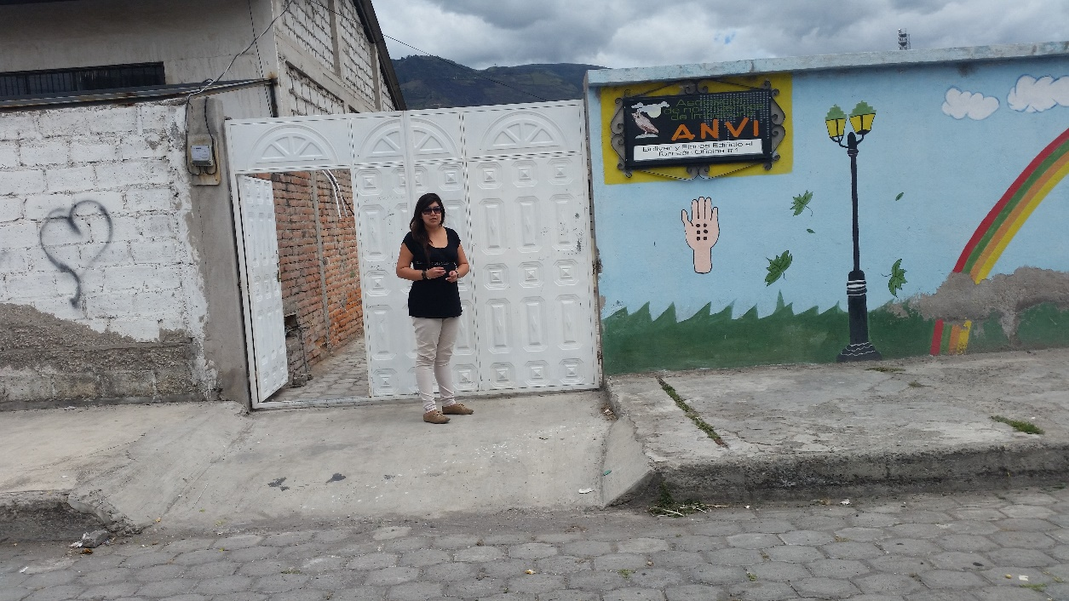
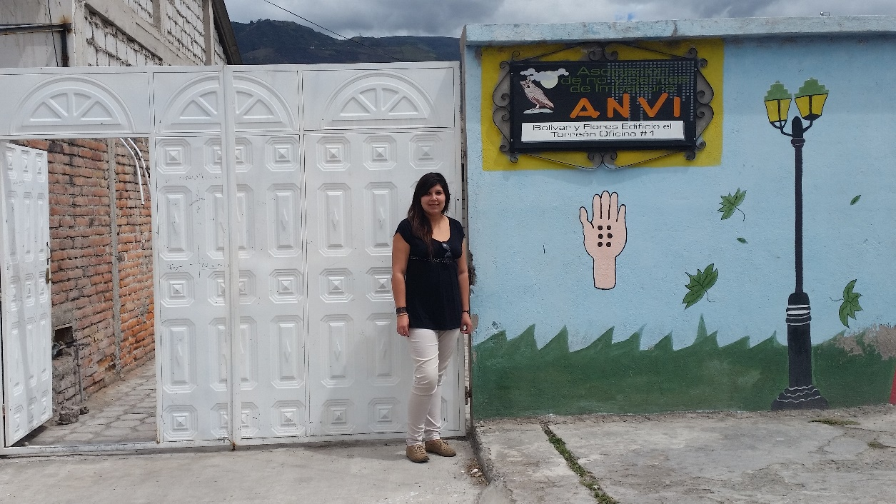

Slide 44
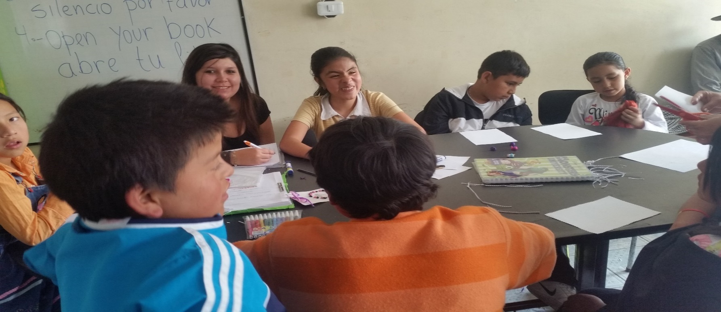
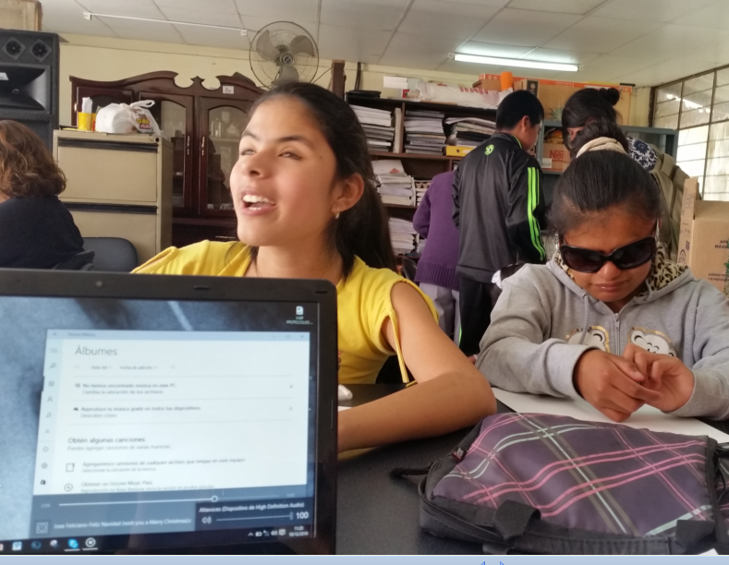

Slide 45
