Slide 1
DEPARTMENT OF HUMAN AND SOCIAL SCIENCES
APPLIED LINGUISTICS IN ENGLISH PROGRAM
“Use of mobile learning activities to improve the low level in Speaking Skill in the Tenth year of EGB at ‘Gran Colombia’ High School, in Quito, during the first term, September 2016 – November 2016”
Calvache Cueva, Jeanneth del Rocío
DIRECTOR: Dr. Villa Tixe, Oswaldo
Sangolquí
2018

Slide 2
PART ONE
RESEARCH PROBLEM
Problem identification
Technology is changing constantly and alters everything for this reason, teachers are facing a new reality where students get bored and demotivated easier than some years ago.
Causes
Distraction and disruption.
Fear of using technology → Untrained teacher
Traditional methods → Teacher-centred approach.
Effects
Restriction of mobile phones.
Demotivated and uninterested students.
Limited language input.
Problem formulation
What are the tools that can be used for improving the low level in speaking skill?

Slide 3
Objectives
General Objective
To design and apply mobile learning activities through the use of technological devices like the mobile phones in order to enhance the students’ speaking skill.
Specific Objectives
To explain the function of the speaking skill.
To determine the correct methodological strategies to be used for the purpose of this study.
To determine the mobile learning activities that will permit students to improve and gain confidence for spoken production.
To practice using all of the language they know in real situations.
Justification
Updated Curriculum 2016
Students are participant of their learning process.
Use of ICT
Environment of real communication → Technological tools.
Active learners.
Innovative activities → Challenges in class
Teachers → Open-minded

Slide 4
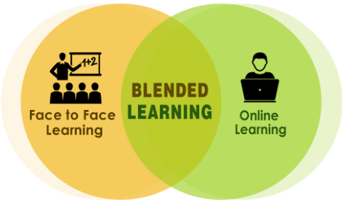
PART TWO
THEORETICAL FRAME
Mobile technologies
Mobile devices: mobile phone
Widespread infiltration of the market.
Relatively inexpensive.
Tool for collaborative learning.
Blended learning
Communicative skills – Curriculum
Spoken production → Fluency over accuracy.
Spoken interaction → collaborative learning.

Slide 5
Use of Mobile Learning Activities
Methodology
Method
As an overall plan for the orderly presentation of language material. Richards and Rodgers (2014)
Traditional method
Interactive method
Interactive environment – Active learning process.
Teachers and students involved in the learning process.
Interaction techniques – online interactions.
Relieves stress and fosters communication.

Slide 6
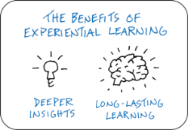
Techniques
Experiential
Link between formal learning, work experience and personal development.
Way of doing something.
Opportunity to integrate technology.
Interactive
Student-content
Teacher-student
Student-student
Strategies
Mobile learning
Combination of mobile devices with learning-people interaction.
Lifelong learning.
Mobile device: mobile phone
Emission of real-time classroom teaching.
Interaction and collaboration.
Used in a wide variety of tasks.

Slide 7
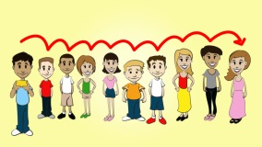
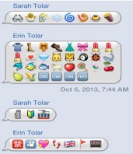
Methodological strategies
Description
Photo story
A visual resource
Captures student’s attention.
Learning through production, collaboration and creation.
Uses student’s experience and knowledge.
Promotes communicative and interactive activities.
Broken phone
Messages change from person to person when they are transmitted verbally.
Allows communication.
Development of listening, speaking and pronunciation awareness.
Reinforcement of vocabulary.
Emoji story
A graphic symbol.
Representation of facial expressions.
Connection with familiar visual elements.
Enjoyment.
Storytelling
Development of speaking skill.
Teacher as facilitator.
Involvement of students.
Guess the story
Fosters comprehension, participation and collaboration.
Skills: guessing, inferring, comparing, etc.
Active learning.
What is it?
Practice of listening and speaking.
Description.
Introduction of vocabulary.

Slide 8
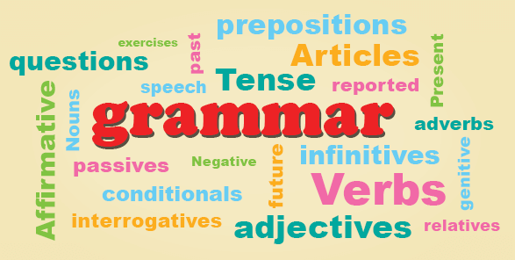
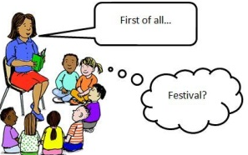
Speaking Skill
Spoken interaction
Language performance
Discussions about daily activities and traditions
Familiar topics
Confidence to share experiences to one another.
Grammar
Grammar rules → improvement of speaking skill.
Spoken Production
Vocabulary
The most important part of foreign language learning.
Helpful for comprehension.
Independent learners.
Fluency
Important for a good communication.
Exposure of students in front of their peers.
Practice → improvement of fluency to become good communicators
Pronunciation
Achievement of meanings being conveyed in context.
Oral exposition
Format assessment.
Explanation of something.
Intelligibility
Appropriate use of volume.
Variation of volume for differentiation.

Slide 9
Improvement of Speaking Skill
Technological tools
Culture of participation, collaboration, student engagement and distributed knowledge.
Collaborative work
Tips for implementing collaborative work in class
Motivation
Active learning
Communication
Decision-making skills
Self-confidence
Help each other
Mobile phones
Learner-centred-learning.
Construction of skills and knowledge.
Creating groups
Use as many variations as possible.
Any topic is useful: grammar, vocabulary, birthday/months, etc.
Audio
Personalisation learning in a self-directed way.
Pair work - Group work
DO: move, mime and draw.
Description
Remember
Student´s picture
Video
Comprehension of the target language in context.

Slide 10
Hypothesis System
Alternative Hypothesis
The use of mobile learning activities will improve the low level in Speaking Skill in the Tenth year of EGB students.
Null Hypothesis
The use of mobile learning activities will not improve the low level in Speaking Skill in the Tenth year of EGB students.

Slide 11
PART THREE
METHODOLOGICAL DESIGN
Instruments for data collection
Pre-test / Post-test administered before and after the process.
Research type and design
Descriptive – data and characteristics about the sample
Quasi-experimental – qualitative - numerical descriptions
Applied – use of a part of students at Gran Colombia High School.
Population size and sample
Sample: 80 Students attending the tenth year of EGB “ A and B”
Experimental group: 10 EGB “A”
Control group: 10 EGB “B”
Processing and analysis.
Descriptive statistics
Z-score

Slide 12
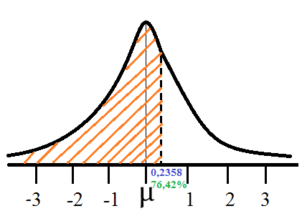
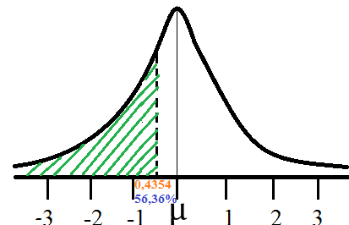
PART FOUR
TESTING THE HYPOTHESIS
Graphical exposition of results
Analysis of results
Experimental Group
.Critical value→ 0, 7179; this means that the variable is 0, 7179 standards deviations from the mean and according to the Z-scores table the area is 0, 2358.
According to the results, the alternative hypothesis accepted that the use of mobile learning activities improve the low level of speaking skill in the experimental group and the null hypothesis is rejected.
Z-score
 | PRE-TEST | POST-TEST
MEAN | 4,52 | 5,92
MEDIAN | 4,75 | 6,00
ST. DEVIATION | 1,95 | 0,98
VARIANCE | 3,81 | 0,97
Control Group
Critical value→–0, 1777; this means that the variable is 0, 1777 standards deviations from the mean and according to the Z-scores table the area is -0, 4364.

Slide 13
PART FIVE
PROPOSAL
Theme
Show students how to use mobile learning activities in class in order to enhance their speaking skill, at Gran Colombia High school.
Objectives
General Objective
To use some mobile learning activities to improve the speaking skill for students attending the Tenth year at G. C. High School in Quito.
Theoretical Framework
Consideration of English as a foreign language.
Construction of knowledge – Mobile learning activities.
Communication in real time and without fears.
Engagement, motivation and active participation.
Exposure of language input.
Interaction
Specific Objective
To plan some mobile learning activities to improve the speaking skill for students attending the Tenth year at G. C. High School in Quito.

Slide 14
Conclusions
Recommendations
According to the results of the pre-test students obtained a low score making evident their low level of English and hence their low level of speaking skill.
For the purpose of this study, students needed some worksheet as a support in order to accomplish the activities.
Students felt fear because they had to use the target language in front of their classmates.
Mobile learning activities were planned in order to encourage students to participate in class and gain confidence.
As a result, the post-test revealed that students improved their level of speaking skill and were more confident at the moment to work in a group and to share their ideas, experiences and feelings.
Students need more time to be exposed to the target language in order to obtain better outcomes in future researches.
The use of mobile learning activities promotes the 21st century skills as collaboration, solidarity, problem-solving and challenges which help them to face the real world in real situations.
Mobile learning activities enhance students’ speaking skill since they were applied in real situations.
Mobile learning activities involve shy students into the learning process due to the fact that their peers give them the opportunity to interact to one another and encourage them to feel more comfortable.
Mobile learning activities should be used in class since they only use mobile phones, a kind of technology that does not need any training because these devices are used by teachers and students in their daily lives.
Mobile learning activities should be applied not only for learning English but also for learning subjects.

Slide 15
Mobile Learning Activities
Research Design
Photo Story
What is it?
Emoji Story
Discussion of traditions

Slide 16
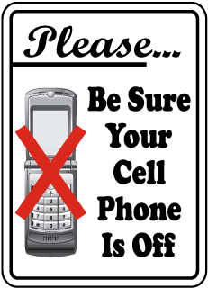
Other Issues Concerning the Research
Implications
Lack of critical thinking
Avoidance of the mental process: perception, memory, thinking volition and emotion.
Mobile phones restriction in class
Does not allow students to share experiences.
Avoids shy students have the opportunity to participate in class.
Poor oral communication
Limited exposure to the target language.
Being in need of opportunities to improve their knowledge and vocabulary.

Slide 17
RESULTS OF THE CONTROL GROUP
PRE-TEST
Mean | 7,54
Median | 7,60
Standard deviation | 1,35
Variance | 1,81
POST-TEST
7,30
7,29
1,15
1,31

