Slide 1

ARMY POLYTECHNIC SCHOOL
DEPARTMENT OF LANGUAGES
APPLIED LINGUISTICS IN ENGLISH CAREER
“THE ROLE ENGLISH PLAYS IN THE ECONOMIC, SOCIAL, AND INTELLECTUAL DEVELOPMENT OF TEACHERS AT MADRE MARIA BERENICE SCHOOL, QUITO, SEPTEMBER 2010”
ADVISORS: AUTHOR:
Director: Lic. Mg. Miguel Ponce M. Teresa Chiliquinga
Co-Director: Lic. Mg. Rocío Ortega

Slide 2

PART ONE
RESEARCH PROBLEM

Slide 3
PROBLEM TREE
High interest to teach English to children.
Globalized world based in business.
Important information is written in English.
Family and friends are living in other countries and speak English..
Children learn English from a young age.
Businesses are more united.
Students have more resources to look for information.
Ecuadorian people are in contact with foreign people.
EFFECTS
The need for an international language for the economic, social and intellectual development of teachers.
CORE PROBLEM
CAUSES
English plays a positive role.
English is a global language.
Important companies use English.
Everybody wants to speak English.
English is a tool to do many good activities.
English is present in each important aspect.
English is an important factor to achieve good results in companies.
Interesting information and documents are written in English.

Slide 4

PROBLEM FORMULATION
Does English play a role in the economic, social, and intellectual development of teachers at Madre María Berenice School, Quito, September 2010?

Slide 5
VARIABLES
Does English play a role in the economic, social, and intellectual development of teachers?
INDEPENDENT VARIABLE
DEPENDENT VARIABLE
THE ENGLISH LANGUAGE ROLE
THE ECONOMIC, SOCIAL AND INTELLECTUAL DEVELOPMENT AT MADRE MARIA BERENICE SCHOOL

Slide 6
OBJECTIVES
To establish the benefits of English in teachers at Madre María Berenice School.
GENERAL
*To investigate the improvement of the quality of life of English speaking teachers at Madre María Berenice School.
*To know the intellectual progress of English speaking teachers at Madre María Berenice School.
*To establish the benefits of applying English when teachers at Madre María Berenice School need to get employment.
SPECIFIC

Slide 7

JUSTIFICATION
Nowadays our world is globalized and technological; computers, calculators, televisions, medical machines, dictionaries, books are made in countries where English is spoken. Our future improves with the learning of English because documents from instructions to cook to instructions to manage complex machines are expressed in English. People need to do business, meet people or just study, and English is the second most spoken language around the world, it is a universal language.

Slide 8

PART TWO
THEORETICAL FRAMEWORK

Slide 9
CHAPTER
I
MADRE MARIA BERENICE SCHOOL
CHAPTER
II
THE POSITIVE ROLE OF ENGLISH
CHAPTER
III
THE ECONOMIC, SOCIAL, AND INTELLECTUAL DEVELOPMENT OF THE PEOPLE
THE POSITIVE ROLE OF ENGLISH IN THE ECONOMIC, SOCIAL, AND INTELLECTUAL DEVELOPMENT OF ENGLISH SPEAKERS.
CHAPTER
IV
OTHER CAUSES OF THE CORE PROBLEM
CHAPTER
V

Slide 10

CHAPTER I: MADRE MARIA BERENICE SCHOOL
Educational Model:
Constructivism
According to Piaget it is the psychological focus which establishes that the central poitn of the human being learning is the costruction of the knowledge on his/her own.
MADRE MARIA BERENICE SCHOOL
Hermanitas de la Anunciación are from Colombia
Curricular Model:
Competences
According to Marta Vasquéz it intends to focus the problems of professional people as principal point for design.

Slide 11





CHAPTER II: THE POSITIVE ROLE OF ENGLISH
According to Ana Raquel Galán Mendoza, nowadays it is very important to learn English. Each day it is used in almost every area of human knowledge and development.
75% of scientific bibliography
80% of the information

Slide 12
CHAPTER II: THE POSITIVE ROLE OF ENGLISH
According to Margery Berube the levels of English usage are shown below:
STANDARD ENGLISH:
*Public discourses
*The news media, government.
INFORMAL ENGLISH:
It incorporates many of the familiar features of Spoken English.
ENGLISH USAGE
NONSTANDARD ENGLISH:
Regional expressions such as: might, could
FORMAL ENGLISH:
Serious public discourse, it avoids expressions that we might use in more casual situations.

Slide 13
CHAPTER II: THE POSITIVE ROLE OF ENGLISH
Second language teaching methods
The Audio Lingual Method: According to Nelson Brooks the audio lingual method advised that students be taught a language directly without using the students’ native language.
2. The Direct Method: According to Sauveur and Franke the characteristic of the direct method are: teaching concepts and vocabulary through real life objects., teaching grammar by using an inductive approach focusing on spoken language, focus on question-answer patterns, teacher-centering.
3. The Grammar-Translation Method: According to Omaggio: 1. The explicit explanation of grammatical rules using the native language; 2. the use of translation to explain the meaning of vocabulary.
4. The Natural Method: According to Gouin: 1. Speech comprehension, 2 speech production, 3. reading and 4. writing.
5. The Communicative Approach: According to Robert Langs this approach gives full credence to the unconscious side of emotional life and has rendered it highly sensible and incontrovertible by discovering a new, validated, and deeply meaningful way of decoding unconscious messages.

Slide 14
CHAPTER II: THE POSITIVE ROLE OF ENGLISH
NECESSITY TO LEARN THE LANGUAGE
It is the second most spoken language in the world.
The International Colleges demand the presentation of an exam of foreign language, English is selected by the majority of students around the world.
It is the business language, of tourism, of entertainment, etc.
English is helpful to be in contact with American people and their culture.
On the internet 85 per cent of the information is in English.
75 per cent of the specialized scientific bibliography is in English.
http://es-es.facebook.com/note.php?note_id=273475646009885

Slide 15
CHAPTER III: THE ECONOMIC, SOCIAL, AND INTELLECTUAL DEVELOPMENT OF THE PEOPLE
ECONOMICAL
DEVELOPMENT
According to Reuters the economy has grown to 8,0 per cent in 2011 from 3,58 per cent in 2010.
SOCIAL DEVELOPMENT
Peace, security and social investment
INTELLECTUAL DEVELOPMENT
The educational system has improved since the last report in 2006.
Democracy
Biodiversity Conservation
Other enterprises
The majority of students have completed the basic education.
According to the USAID the social development refers to:

Slide 16
CHAPTER IV: THE POSITIVE ROLE OF ENGLISH IN THE ECONOMIC, SOCIAL, AND INTELLECTUAL DEVELOPMENT OF ENGLISH SPEAKERS.
According to Shormishtha Panja business and English are historically linked together.
*According to Esteban Ruíz the tourism generates 52 sources of work per year.
*According to Henry Bischoff each migrant labor consigns approximately one thousand dollars.
The positive role of English in the Economic development of English speakers.
The positive role of English in the social development of English speakers.
*English teachers have several opportunities.
*Foreign people teach English.
*According to Alba Luz Mora people get scholarships if they master English.
*Some post graduates have specific requests.
The positive role of English in the intellectual development of English speakers.

Slide 17
CHAPTER V: OTHER CAUSES OF THE CORE PROBLEM
According to Opal Dunn
LITTLE CHILDREN LEARN ENGLISH
According to Victor García
STUDENTS HAVE MORE RESOURCES TO LOOK FOR INFORMATION
According to David Cristal
ENGLISH IS A GLOBAL LANGUAGE
According to Edison Santacruz
EVERYBODY WANTS TO SPEAK ENGLISH

Slide 18

HYPOTHESIS SYSTEM
WORKING HYPOTHESIS
NULL HYPOTHESIS
The English language plays an important role in the economic, social and intellectual development of teachers at Madre María Berenice School, Quito, September 2010.
English does not play any role in the economic, social and intellectual development of teachers at Madre María Berenice School, Quito, September 2010.

Slide 19
PART THREE
METHODOLOGICAL DESIGN

Slide 20
METHODOLOGICAL DESIGN
RESEARCH TYPE AND DESIGN:
*Applied
*Descriptive
*Of field
*Correlational and quantitative
POPULATION AND SAMPLE:
*30 teachers
FIELDING:
The field group work took place at Madre María Berenice School in September 2010.
PROCESSING AND ANALYSIS:
*Descriptive statistics
*Measures of central tendency and dispersion.
INSTRUMENTS FOR DATA COLLECTION:
The survey was the technique used to gathering data.

Slide 21
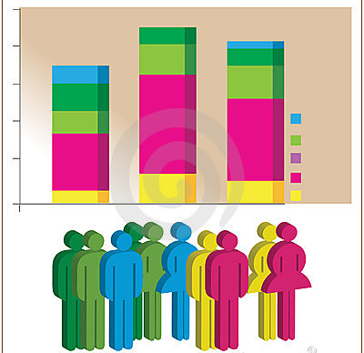
PART FOUR
Testing the hypothesis

Slide 22
STATEMENT N 1
ENGLISH LANGUAGE IS A FACTOR OF LABOUR MOBILITY.
ITEM | FREQUENCY | PERCENTAGE
Totally agree | 30 | 100%
Agree | 0 | 0%
Neutral | 0 | 0%
Do not agree | 0 | 0%
Totally disagree | 0 | 0%
Analysis:
It shows that all the teachers of “Madre María Berenice” School are in agreement that English language is a factor of labour mobility, they know the benefits that exist if people speak English, every day more English speakers are required.

Slide 23
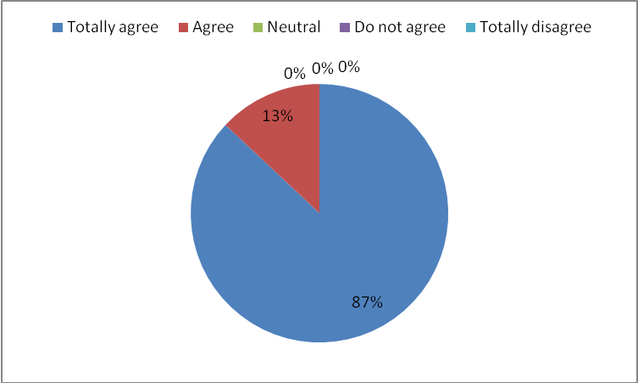
STATEMENT N 4
ENGLISH LANGUAGE IMPROVES BUSINESS MANAGEMENT
ITEM | FREQUENCY | PERCENTAGE
Totally agree | 26 | 87%
Agree | 4 | 13%
Neutral | 0 | 0%
Do not agree | 0 | 0%
Totally disagree | 0 | 0%
Analysis:
This shows that English increases business because there are more opportunities to deal with foreign businessmen and accomplish contracts or associations. English helps to get better contracts with important foreign companies because of expositions, suggestions and explanations are clear. In this way every day there is more business thanks to the English language.

Slide 24
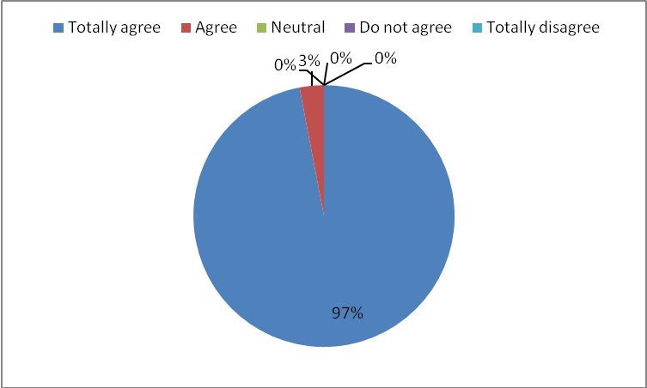
STATEMENT N 6
ENGLISH LANGUAGE IMPROVES THE QUALITY OF LIFE
ITEM | FREQUENCY | PERCENTAGE
Totally agree | 29 | 97%
Agree | 1 | 3%
Neutral | 0 | 0%
Do not agree | 0 | 0%
Totally disagree | 0 | 0%
Analysis:
Teachers think that English improves the quality of life because English speakers have better jobs and in this way they have better salaries, English speakers have better possibilities to acquire good products including food and other products, besides they have more comfortable workplaces and have more possibilities to solve economic problems.

Slide 25

GRAPHICAL RESULT S
Ho Acceptance zone
Ho Rejection zone
Degrees of freedom: 36
Critical value: 53,672
Chi-square calculated: 109,603
0 53,672 109,603
STATISTICAL DECISION:
Once chi-square was calculated 109,603 and the critical value 53,672 it is notable that chi-square is higher than the critical value, therefore the working hypothesis is accepted and the null hypothesis is rejected.

Slide 26

CONCLUSIONS
Once the data were processed it is evident that Null Hypothesis is rejected.
English language is a factor of labor mobility because it is the global language; it is present in business, in the economy, in the field of academics and in the social aspect.
Bilingual teachers have better relationships with English speakers and can communicate better.
The tourism is improving because there are English speakers who are able to guide foreigners on a tour.
English speakers have a better quality of life because they get better salaries.

Slide 27

RECOMMENDATIONS
The English language plays an important role in the economic, social and intellectual development of people; therefore it is necessary to learn this language to be a good professional.
English language must be emphasized in schools because it opens several opportunities in every aspect of life nowadays.
Teachers must learn English to express ideas to native English speakers and in this way be present in other countries.
Tour companies must focus on improving the techniques to teach English to their tour guides to get a better quality of English speakers, in order to improve their economy.
Teachers must learn English to improve their quality of life in all aspects; parents must motivate their children to acquire this language.

Slide 28
PART FIVE
proposal
THE ENGLISH LANGUAGE PLAYS AN IMPORTANT ROLE IN THE ECONOMIC, SOCIAL AND INTELLECTUAL DEVELOPMENT OF TEACHERS.

Slide 29
Capacity of communicating ideas in English language.
Business with foreign people to improve the quality of life.
GOAL
GOAL
The need for an international language for the economic, social
And intellectual development of societies.

Slide 30
Create interest about English language to improve the quality of life.
High exposition and acceptability of English.
Well developed activities.
Good performance of international products.
English acts as an important tool.
High degree of use of English language.
International and national companies use a high level of English.
Everybody is interested in learning English.
The need for an international language for the economic, social
And intellectual development of societies.

Slide 31
ACTIVITIES
1. The training of teachers in English language using the technologies, for example courses on-line.
2. The exposition of English in movies, songs and stories to familiarize teachers with the language.
3. The creation of a club of English for teachers, they will go twice in the week and they will learn new contents.
4. To look for information about scholarships to teachers to travel to other countries to learn English.

Slide 32

Thank you!

