Slide 1
DEPARTMENT OF LANGUAGES APPLIED LINGUISTICS IN ENGLISH PROGRAM
AUTHORS: María Eugenia Guerrero Andrade
Martha Catalina Puga Cevallos
ADVISORS:
Director: MS. Miguel Ponce Medina
Co-Director: MG. Néstor Bonilla Bonilla
Quito, January 2014

Slide 2
RESEARCH WORK:
“THE INCIDENCE OF THE COMMUNICATIVE APPROACH ON THE LEVEL OF THE SPEAKING SKILL DEVELOPMENT IN STUDENTS ATTENDING THE FIRST YEAR OF BASIC EDUCATION AT THE RUDOLPH STEINER SCHOOL DURING THE SECOND TERM,
2007– 2008 SCHOOL YEAR”

Slide 3
INTRODUCTION:
Students and foreign language
Students are not familiarized with daily life language
Students and the writing skill

Slide 4
PROBLEM FORMULATION
What is the incidence of the Communicative Approach on the level of speaking skill development in students attending the first year of basic education at the Rudolf Steiner School during the second term 2007 – 2008 school year?

Slide 5
VARIABLES MATRIX
INDEPENDENT VARIABLE
DEPENDENT VARIABLE
THE SPEAKING SKILL
THE COMMUNICATIVE
APPROACH
LINGUISTIC
KNOWLEDGE
LINGUISTIC
DEVELOPMENT

Slide 6
OBJECTIVES
GENERAL
Facilitate the learning
process of a second language
Help students
to use the second language
Determine the incidence of the
Communicative Approach on the level
of speaking skill development.

Slide 7
Get students to work
with task-based activities
Emphasize meaning
rather perfect grammar
SPECIFIC
OBJECTIVES
Develop
communicative competence
Improve
the current planning
Involve students
in oral interaction
Help teachers
in their classrooms

Slide 8
JUSTIFICATION
Interaction between the speaker and listener to make meaning clear.
Very young children did not internalize the language.
The Communicative Language approach in the classroom (experimental group)

Slide 9
PART TWO THEORETICAL FRAME

Slide 10
General Information
RUDOLF STEINER SCHOOL
History traits
Facilities
School document

Slide 11
PRINCIPLES FOR TEACHERS
PRINCIPLES FOR LEARNERS
ORIGINS
COMMUNICATIVE
APPROACH
ACTIVITIES
EVALUATION
(The Communicative Approach in English as a Foreign language Teaching)
(What is the Communicative Approach)
(Sasson)
(Larsen & Robinson, 2000, 1986)

Slide 12
SPEAKING SKILL
LINGUISTICS
STAGES OF
LINGUISTIC DEVELOPMENT
Language form
(grammar)
Language meaning
(semantics)
Language in context
(pragmatics)
Pre Linguistic Period
Echolalia: the baby makes noises
The Holophrastic Period
A child understands very simple instructions
and questions
The Telegraphic Period
The words that are used are the absolute
minimum required to convey the meaning.
The Complex Period
The first example of grammatical markers
appears
The Intuitive Linguistic Period
Children use larger words and longer sentences
^{(Matthews, 1996)}
^{(Linguistics C. f.)}

Slide 13
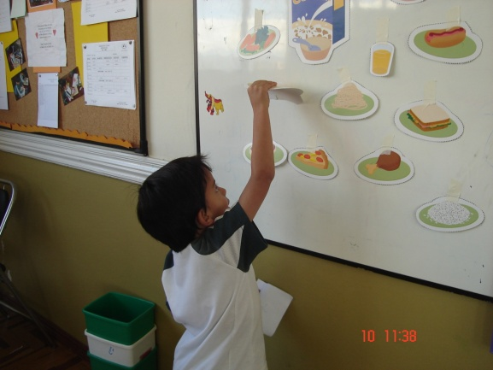
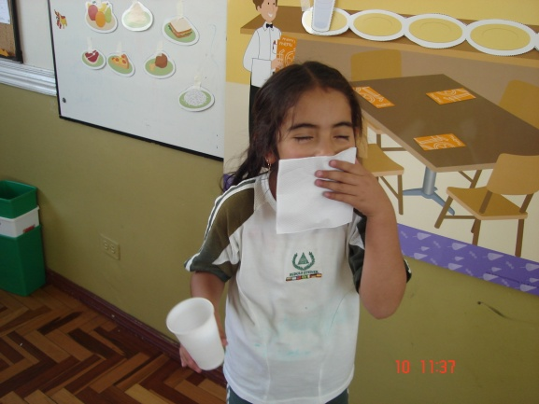
COMMUNICATIVE APPROACH
AND THE SPEAKING SKILL
The class was adapted similar to a restaurant using a poster and realia, and helped students to act out and speak in the restaurant.
Students learned the vocabulary related to the function before doing the constructivist activities

Slide 14
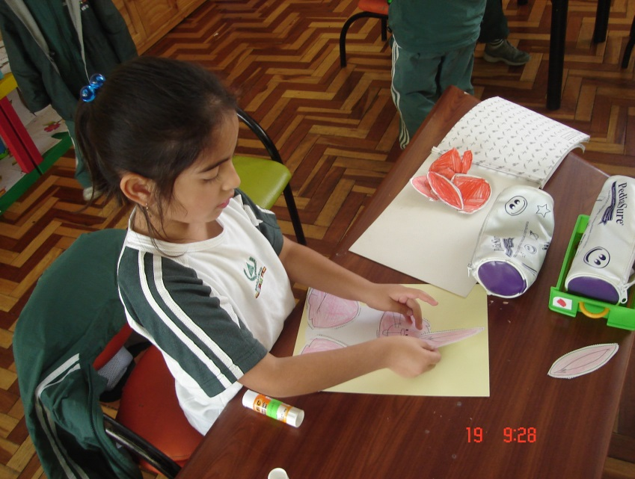
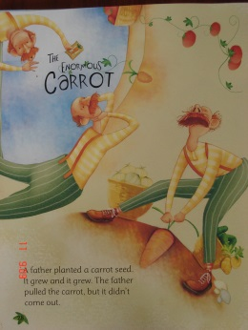
Students practiced listening, understanding and following instructions
Students listened to native language using an Audio CD and a book

Slide 15
HYPOTHESIS SYSTEM
HYPOTHESIS
NULL HYPOTHESIS
WORKING HYPOTHESIS
Communicative Approach
does not affect the level
of speaking skill development
in students attending the
first year of basic education
at the Rudolf Steiner School.
Communicative Approach affects
positively the level of speaking
skill development in students
attending the first year of basic
education at the
Rudolf Steiner School

Slide 16
METHODOLOGICAL DESIGN
1. TYPE OF RESEARCH AND DESIGN
Basic, descriptive, of field
Quasi-experimental, quantitative and transversal
2. POPULATION AND SAMPLE
Whole population, no sample.

Slide 17
METHODOLOGICAL DESIGN
3. FIELD WORK
Pre - test
Post - test
4. DATA COLLECTION
Tests

Slide 18
TESTING THE HYPOTHESIS
GRAPHICAL EXPOSITION OF RESULTS

Slide 19
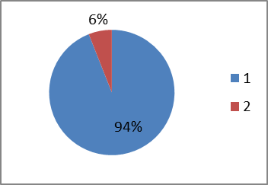
EXAMPLE OF THE ANALYSIS OF EACH QUESTION ON THE TESTS
PRE – TEST (SPEAKING)
CONTROL GROUP
KINDER A
Question 5 What is this?
OPTION | FREQUENCY | PERCENTAGE
Right Wrong | 15 1 | 94 % 6 %
Total | 16 | 100%

Slide 20
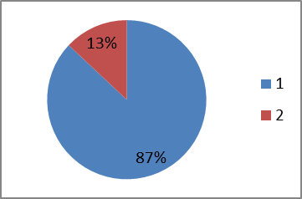
PRE – TEST (SPEAKING)
EXPERIMENTAL GROUP KINDER B
Question 5 What is this?
OPTION | FREQUENCY | PERCENTAGE
Right Wrong | 15 3 | 87 % 13 %
Total | 18 | 100%

Slide 21
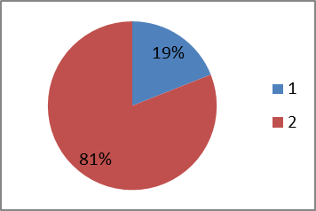
POST – TEST (SPEAKING)
CONTROL GROUP KINDER A
Question 6
Where is the bee? look and answer
OPTION | FREQUENCY | PERCENTAGE
Right answer Wrong answer | 3 13 | 19 % 81 %
Total | 16 | 100%

Slide 22
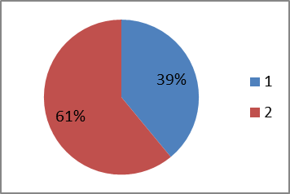
POST – TEST (SPEAKING)
EXPERIMENTAL GROUP KINDER B
Question 6
Where is the bee? look and answer
OPTION | FREQUENCY | PERCENTAGE
Right answer Wrong answer | 7 11 | 39 % 61 %
Total | 18 | 100%

Slide 23
STUDENTS | PRE-TEST CG | PRE-TEST EG
1 | 3 | 6
2 | 8 | 7
3 | 5 | 4
4 | 9 | 8
5 | 9 | 5
6 | 8 | 5
7 | 7 | 7
8 | 8 | 8
9 | 6 | 5
10 | 9 | 9
11 | 9 | 6
12 | 8 | 9
13 | 8 | 9
14 | 9 | 8
15 | 8 | 8
16 | 9 | 9
17 |  | 8
18 |  | 8

Slide 24
STUDENTS | POST-TEST CG | POST-TEST EG
1 | 2 | 10
2 | 8 | 10
3 | 2 | 5
4 | 8 | 5
5 | 3 | 5
6 | 8 | 4
7 | 5 | 9
8 | 4 | 6
9 | 1 | 5
10 | 5 | 9
11 | 5 | 9
12 | 7 | 10
13 | 4 | 9
14 | 7 | 8
15 | 6 | 6
16 | 8 | 9
17 |  | 9
18 |  | 9

Slide 25
PRE-TEST STATISTICS VALUES
STUDENTS | PRE-TEST CG | PRE-TEST EG
1 | 3 | 6
2 | 8 | 7
3 | 5 | 4
4 | 9 | 8
5 | 9 | 5
6 | 8 | 5
7 | 7 | 7
8 | 8 | 8
9 | 6 | 5
10 | 9 | 9
11 | 9 | 6
12 | 8 | 9
13 | 8 | 9
14 | 9 | 8
15 | 8 | 8
16 | 9 | 9
17 |  | 8
18 |  | 8
 | CG | EG
Mean | 7,6875 | 7,1667
Standard Deviation | 1,7017 | 1,6179
Size | 16 | 18
Standard error | 0,5713
t= | 0,9116
degree of freedom= | 32
p-value = | 0,1844

Slide 26
PRE-TEST T- STUDENT ANALYSIS
We can not reject the null hypothesis, there is no difference between the means of the pre tests applied to the two groups of students
p-value
The value of p (0.1844) is higher and greater than 0.05 (5% significance level), which means that the compared results are the same

Slide 27
POST-TEST STATISTICS VALUES
STUDENTS | POST-TEST CG | POST-TEST EG
1 | 2 | 10
2 | 8 | 10
3 | 2 | 5
4 | 8 | 5
5 | 3 | 5
6 | 8 | 4
7 | 5 | 9
8 | 4 | 6
9 | 1 | 5
10 | 5 | 9
11 | 5 | 9
12 | 7 | 10
13 | 4 | 9
14 | 7 | 8
15 | 6 | 6
16 | 8 | 9
17 |  | 9
18 |  | 9
 | CG | EG
Mean | 5,1875 | 7,6111
Standard Deviation | 2,3726 | 2,1182
Size | 16 | 18
Standard error | 0,7753
t= | 3,1260
degree of freedom= | 32
p-value = | 0,0019

Slide 28
POST-TEST T- STUDENT ANALYSIS
p-value
The results of the t - student of this application let us state that the null hypothesis is rejected.
p-value (0.0019), less than 0.05 (5% significance level), there is difference in the results of the post-test between the two groups.

Slide 29
PRE-TEST AND POST-TEST CONTROL GROUP
 | PRE TEST CG | POST TEST CG
Mean | 7,6875 | 5,1875
Standard Deviation | 1,7017 | 2,3726
Size | 16 | 16
It is observed that the POST-TEST exam is more complicated than PRE-TEST and control group students obtained lower grades.
Standard error = | 0,7299
t = | -3,4249
degree of freedom = | 30
p-value = 0,0009

Slide 30
PRE-TEST AND POST-TEST EXPERIMENTAL GROUP
 | PRE TEST EG | POST TEST EG
Mean | 7,1667 | 7,6111
Standard Deviation | 1,6179 | 2,1182
Size | 18 | 18
The group could maintain or even raise five tenths, average rating, although the post-test examination had greater difficulty.
Standard error = | 0,6283
t = | -0,7074
degree of freedom = | 34
p-value = 0,2421

Slide 31
CONCLUSIONS
The incidence of Communicative Approach
Students reaction towards the English language
The speaking skill
The age 5 years old of the experimental and control group

Slide 32
RECOMMENDATIONS
Communicative Approach to develop the speaking skill
Reinforce of grammar
Link Communicative Approach and Constructivism
Develop speaking by contacting students from an English speaking country

Slide 33
THE PROPOSAL
Three Hours Workshop: “Communicative Approach and its use in the classroom.” (to be held in the school)
Definition, techniques to apply in the classroom.
Ongoing training to keep Communicative Approach updated after the workshop.
End of the week vocabulary contest in the class.

Slide 34
THANK YOU

