Slide 1
AUTHOR: GABRIELA OSORIO
UNIVERSIDAD DE LAS FUERZAS ARMADAS “ESPE”
DEPARTAMENTO DE CIENCIAS HUMANAS Y SOCIALES
APPLIED LINGUISTICS IN ENGLISH MAJOR
TITLE:
“THE INFLUENCE OF THE TOTAL PHYSICAL RESPONSE (TPR) METHOD IN THE DEVELOPMENT OF LISTENING SKILL IN THE KINDERGARTEN CHILDREN ATTENDING AT “ÁNGEL POLIBIO CHAVES SCHOOL”, DURING THE SCHOOL YEAR 2013-2014”

Slide 2
“IMAGINATION IS MORE IMPORTANT THAN KNOWLEDGE ”
Albert Einstein

Slide 3
SUMMARY
This research is based on the influence of the Total Physical Response (TPR) method in the development of listening skill in the kindergarten children attending at “Angel Polibio Chaves School”, for teaching and learning English as a second language in the Early Years.

Slide 4
This study benefits every one of the students because it promotes the development of different learning styles, covering various educational activities focused on the interests, tastes and preferences of them; where the teacher can implement the Total Physical Response method in teaching English.

Slide 5
Research problem
Effect 1
Children demotivation
Effect 2
Low listening comprehension level
Effect 3
Low social interaction level
Main Problem:
Low children´s listening skill development
Cause 1
Insufficient teachers or student´s motivation
Cause 2
Inefficient strategies for listening skill development
Cause 3
A few didactic resources
Cause 1.1
Low teachers’ preparation
Cause 2.1
Inefficient professional development plan
Cause 3.1
Low investment

Slide 6
PROBLEM FORMULATION
¿How does the total physical response (TPR) method influence in the development of listening skill in the kindergarten children attending at “Ángel Polibio Chaves School” during the school year 2013-2014 ?

Slide 7
VARIABLEs
Total Physical Response (TPR) method
Listening skill
INDEPENDENT VARIABLE
DEPENDENT VARIABLE

Slide 8
OBJECTIVES
To set up the effect of the Total Physical Response (TPR) method in the development of listening skill in the kindergarten children attending at “Angel Polibio Chaves School” during the school year 2013-2014.
Specific Objectives
To analyze the the learning strategies used in the Total Physical Response (TPR) method.
To determine what kind of problems kindergarten children at "Angel Polibio Chaves School" have to develop the listening skills and the reasons for them.
To develop a guide for “Angel Polibio Chaves School" teachers in order to use the Total Physical Response (TPR) method to improve the listening skill for acquisition of English language in kindergarten students.

Slide 9
justification
Children acquire the necessary vocabulary with a good motivation.
(TPR) a methodological strategies to develop listening skills in learning the English language.
Teaching-learning process will be better and fun for children and teachers.
To develop social interaction.

Slide 10
THEORETICAL FRAME
THE TOTAL PHYSICAL RESPONSE (TPR) METHOD AND BENEFITS
BODY EXPRESSION AND EMOTIONS
TEACHING AND LEARNING ENLIGH IN EARLY AGES
Concept and benefits
Commands
Cognitive
Aptitude and motivation
Pronunciation
Vocabulary
Body language and the brain
Concept and importance
The movement and gesture.
The listening skill
Benefits of listening
Develop an incentive listening skill.
How to design intervention strategies?
Methodological Strategies for listening
Narrative Voice
Motivation
Facial Expression
Staging
Use onomatopoeia
Playing and teaching
Meaningful learning
The gesture and movement
The teachers in the classroom.

Slide 11
Hypothesis formulation
Working Hypothesis
H1:There is a positive influence of the Total Physical Response (TPR) method in the development of listening skill for kindergarten children.
Null Hypothesis
Ho: There is not an influence of the Total Physical Response (TPR) method in the development of listening skill for kindergarten children.

Slide 12
Methodological design
Research Paradigm
Modality Research
Field?
Type of Research
Descriptive
Quasi-experimental

Slide 13
Population size and sample
Population
Sample
Field work
Instruments for data collection
Data Processing and analysis
Preparatory students level.
Two sections: Preschool
Total of 40 children.
Consists of 40 children.
The research was managed with the entire population.
Preparatory Level for the first basic year education.
Sections “A” and “B”
The survey and direct observation:
Teachers and students for gathering information.
The results from the survey, observations and questionnaires was analyzed by using descriptive statistics.

Slide 14
ANALYSIS AND INTERPRETATION OF RESULTS

Slide 15
Teachers´ Questionnaire Preparatory Level Section “A and B”
1. Do you think that is important to develop listening skills in children?
OPTIONS | RESULTS | PERCENTAGE
ALWAYS | 1 | 25%
USUALLY | 2 | 75%
SOMETIMES | 0 | 0%
NEVER | 0 | 0%
TOTAL | 3 | 100%

Slide 16
4. The knowledge you have about the Total Physical Response (TPR) method to develop listening skills in kindergarten children is?
OPTIONS | RESULTS | PERCENTAGE
VERY APPROPRIATE | 2 | 75%
APPROPRIATE | 1 | 25%
A FEW APPROPRIATE | 0 | 0%
INAPPROPRIATE | 0 | 0%
TOTAL | 3 | 100%

Slide 17
5. Do you use the Total Physical Response (TPR) method?
OPTIONS | RESULTS | PERCENTAGE
ALWAYS | 0 | 0%
USUALLY | 1 | 25%
SOMETIMES | 2 | 75%
NEVER | 0 | 0%
TOTAL | 3 | 100%

Slide 18
6. Which methods and techniques do you apply to develop listening skills in the English classroom? (You can choose more than one option).
OPTIONS | RESULTS | PERCENTAGE
Role play and staging | 1 | 11%
Dynamic and creative games | 2 | 22%
Puppet workshop | 1 | 11%
Reading bits | 3 | 34%
Tales | 2 | 22%
All above | 0 | 0%
None of the above | 0 | 0%
TOTAL | 9 | 100%
Puppet workshop

Slide 19
10. Do you consider important to use a methodological guide for teachers in order to use the Total Physical Response (TPR) method in the development of listening skill for learning English language in kindergarten students?
OPTIONS | RESULTS | PERCENTAGE
VERY APPROPRIATE | 2 | 75%
APPROPRIATE | 1 | 25%
A FEW APPROPRIATE | 0 | 0%
INAPPROPRIATE | 0 | 0%
TOTAL | 3 | 100%

Slide 20
Teachers´ Observation Preparatory Level Section “A and B”
3. The teacher carries out interactive activities to develop the listening skill in the children.
 | SECTIONS |  | PREPARATORY LEVEL
ALTERNATIVES | A | B | TOTAL | PERCENTAGE
YES | 0 | 0 | 0 | 0%
NO | 0 | 1 | 1 | 50%
SOMETIMES | 1 | 0 | 1 | 50%
TOTAL | 1 | 1 | 2 | 100%

Slide 21
4. The teacher uses the TPR as a methodological strategy to enhance the learning of English.
 | SECTIONS |  | PREPARATORY LEVEL
ALTERNATIVES | A | B | TOTAL | PERCENTAGE
YES | 0 | 0 | 0 | 0%
NO | 1 | 1 | 2 | 100%
SOMETIMES | 0 | 0 | 0 | 0%
TOTAL | 1 | 1 | 2 | 100%

Slide 22
7. The teacher use commands for the activities in the classroom.
 | SECTIONS |  | PREPARATORY LEVEL
ALTERNATIVES | A | B | TOTAL | PERCENTAGE
YES | 1 | 0 | 1 | 50%
NO | 0 | 0 | 0 | 0%
SOMETIMES | 0 | 1 | 1 | 50%
TOTAL | 1 | 1 | 2 | 100%

Slide 23
8. The teacher uses onomatopoeia, diction and modulation in the narration of the tale.
 | SECTIONS |  | PREPARATORY LEVEL
ALTERNATIVES | A | B | TOTAL | PERCENTAGE
YES | 0 | 0 | 0 | 0%
NO | 0 | 1 | 1 | 50%
SOMETIMES | 1 | 0 | 1 | 50%
TOTAL | 1 | 1 | 2 | 100%

Slide 24
9. The teacher uses correct sentences (syntax) with a good pronunciation for the kindergarten children.
 | SECTIONS |  | PREPARATORY LEVEL
ALTERNATIVES | A | B | TOTAL | PERCENTAGE
YES | 0 | 0 | 0 | 0%
NO | 1 | 1 | 2 | 100%
SOMETIMES | 0 | 0 | 0 | 0%
TOTAL | 1 | 1 | 2 | 100%

Slide 25
Students´ Observation Preparatory Level Section “A and B”
3. The children are connected with space and qualities of movement when receiving commands.
 | SECTIONS |  | PREPARATORY LEVEL
ALTERNATIVES | A | B | TOTAL | PERCENTAGE
YES | 1 | 0 | 1 | 50%
NO | 0 | 1 | 1 | 50%
TOTAL | 1 | 1 | 2 | 100%

Slide 26
5. The children act and interpret everyday scenes by using the linguistic expression.
 | SECTIONS |  | PREPARATORY LEVEL
ALTERNATIVES | A | B | TOTAL | PERCENTAGE
YES | 1 | 1 | 2 | 100%
NO | 0 | 0 | 0 | 0%
TOTAL | 1 | 1 | 2 | 100%

Slide 27
7. The children respond to commands issued by the teacher.
 | SECTIONS |  | PREPARATORY LEVEL
ALTERNATIVES | A | B | TOTAL | PERCENTAGE
YES | 1 | 0 | 1 | 50%
NO | 0 | 1 | 1 | 50%
TOTAL | 1 | 1 | 2 | 100%

Slide 28
8. The children are involved in the process of the narration of tales actively.
 | SECTIONS |  | PREPARATORY LEVEL
ALTERNATIVES | A | B | TOTAL | PERCENTAGE
YES | 0 | 0 | 0 | 0%
NO | 1 | 1 | 2 | 100%
TOTAL | 1 | 1 | 2 | 100%

Slide 29
9. The children have developed listening skills through class activities.
 | SECTIONS |  | PREPARATORY LEVEL
ALTERNATIVES | A | B | TOTAL | PERCENTAGE
YES | 0 | 0 | 0 | 0%
NO | 1 | 1 | 2 | 100%
TOTAL | 1 | 1 | 2 | 100%

Slide 30
CONCLUSIONS
There is a positive influence of the Total Physical Response (TPR) method in the development of listening skill in the kindergarten children, because it facilitates the acquisition of a second language in children as a tool that is pleasing, interesting and promotes curiosity for students. Then, the working hypothesis is confirmed.

Slide 31
Most of the teachers do not apply the adequate strategies with the activities in the classroom to enhance the development of listening skill that facilitates the teaching-learning process through the Total Physical Response (TPR) as a tool of satisfactory work.
The teachers at “Angel Polibio Chaves School” consider it is necessary to have a guide in order to use the Total Physical Response (TPR) method to improve the listening skill for acquisition of English language in kindergarten students.

Slide 32
RECOMMENDATIONS
It is important to implement the Total Physical Response (TPR) method in the early years of schooling, since early acquisition makes it much easier because it involves curiosity, interest and good participation; where the children have the need to give an actively answer to what others say.
The methodology of TPR also facilitates socialization, teamwork and role play as implemented in the classroom, so students move on acquisition of a second language, begin to construct simple sentences using the vocabulary known, therefore the skill of listening is improved, the understanding and communication; articulated movement, memory and physical response.

Slide 33
Total Physical Response (TPR) is a methodology that can be implemented in the different learning styles of our students, because it involves the use of all body and the five senses. It is an effective and viable tool that can be established in pre-school education, so learning English becomes a fun time, entertainment and promoted dynamic environments in classrooms.
To design a guide with meaningful activities using strategies of Total Physical Response (TPR) method that can help as a tool for teachers to engage students in the activities in a dynamic and interactive way.

Slide 34
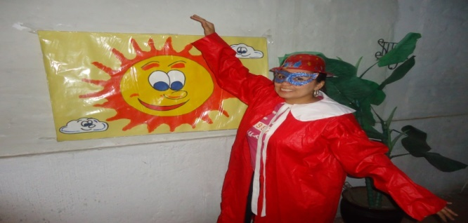
PROPOSAL
TITLE OF THE PROPOSAL:
“GUIDE TO IMPROVE THE LISTENING SKILL IN KINDERGARTEN STUDENTS THROUGH THE TOTAL PHYSICAL RESPONSE (TPR) METHOD”
AUTHOR: GABRIELA OSORIO

Slide 35
INDEX OF CONTENTS
Introduction
Impact
Activities and strategies using the Total Physical Response (TPR)
The Role of Teacher
Commands
Flashcard Games
Pictograms
Attitude of Teaching English in class using TPR method
TPR Songs
Storytelling
Role-play
Playing with puppets
Shadow Theatre
Skit Lyrics
Dances
Dramatization of poems and jingles
Development of vocabulary and semantic
Phonologycal system development
Interactive whiteboard (ICT)
Conclusion

Slide 36
INTRODUCTION
(TPR) a good way to get started!
This guide allows motivating the teacher to use the Total Physical Response (TPR) method to improve listening and speaking skills in kindergarten students to promote learning English as a second language.
The total physical response method appears as an interactive methodology as it has substantial characteristics for children learning, such as: movement, games, imitation and gestures.
The main purpose is to implement this method and spark the children´s interest for a second language.

Slide 37
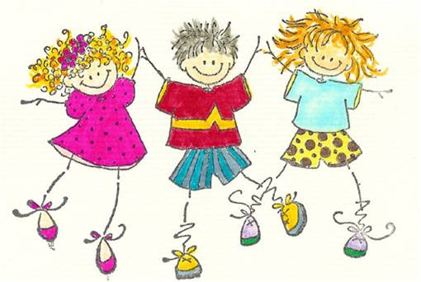
IMPACT
The following proposal aims to present Total Physical Response (TPR) as a method with its components such as: gestures, movement, game, and others; to be applied in the kindergarten students.
Another purpose of this method is to encourage teachers to see Total Physical Response method as a useful tool to be included in class and make it appealing for students as well as a methodological support that facilitates the classroom teaching.

Slide 38
ACTIVITIES AND STRATEGIES USING THE TOTAL PHYSICAL RESPONSE (TPR)
Child's play is an elementary form of expression, understood as an internal event where they use their imagination.
It is useful also make a file of games, where they are classified as:
Age of students: progression.
Factors or elements that develop through play: learning objectives.
Materials and resources needed.

Slide 39
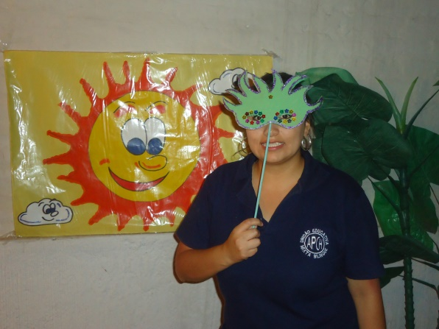
The role of Teacher
The matter is proposed that future Initial Teachers Level can:
Familiarize with space and qualities of movement.
Use of pictures to communicate an idea, an image, a message.
Develop as viewers and readers of the artistic act
Familiarize with the fundamental theories and teaching options.
Be able to design intervention strategies.
Perform project and activities.

Slide 40
Attitude of teaching english in class using tpr method
Aptitude, attitude and motivation
shared responsibilities
respect for individuality
proper pronunciation of the teacher
internal and external organizationio
vocation of teaching
meaningful learning
cooperative learning

Slide 41
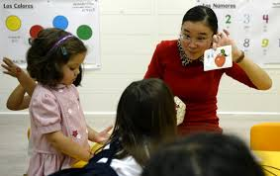
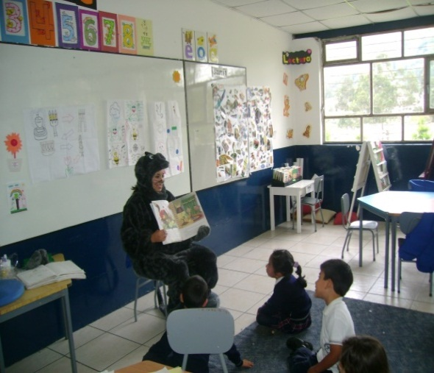
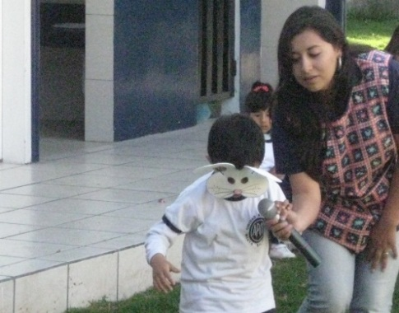
COMMANDS- TPR
-Say Simon says…………. -Put one hand on your arm. -Put your hand on the back of your chair. -Put your hand on your back. -Touch one ear. -Give that pencil (or book) to me. -Put one hand on your leg. -Take a match out of a box of matches. - Ask a question. -Read a book. -Do you sit at desk or a table?
Flashcards games
TPR SONGS
Storytelling

Slide 42
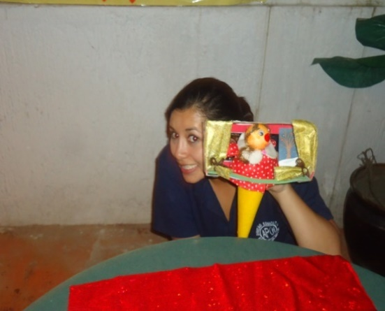
Role-play
Pictograms
Shadow Theatre
Puppets
Interactive whiteboard (ICT)

Slide 43
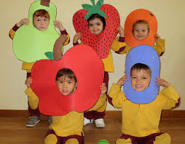
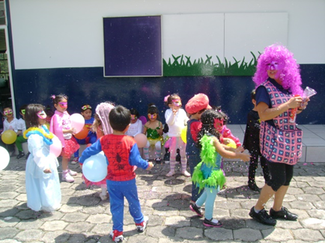
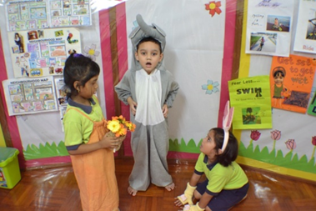
Dances
Skit lyrics
Use onomatopoeia
Dramatization
Phonological development

Slide 44
conclusion
The Total Physical Response is a methodology that facilitates the acquisition of a second language in children since it covers a number of effective tools .
Total Physical Response (TPR) is an activity that develops the imagination, sensitivity, creativity and communication. It is a language through which the individual may feel, perceive, know and express emotions and feelings for meaningful learning.
It is important to implement this methodology in the early years of schooling since early acquisition makes it much easier, similar to the acquisition of the mother tongue, where the child repeats what the mother says in order to have communication. The same applies to the English in children when faced with this, they have the need to respond actively to others.

