Slide 1
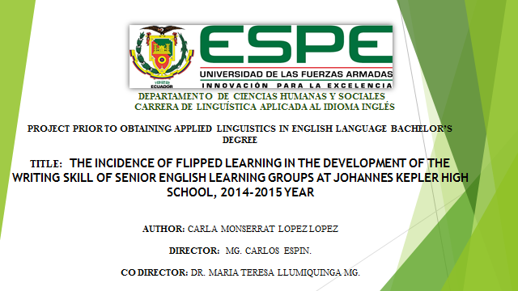

Slide 2

THE INCIDENCE OF FLIPPED LEARNING IN THE DEVELOPMENT OF THE WRITING SKILL OF SENIOR ENGLISH LEARNING GROUPS AT JOHANNES KEPLER HIGH SCHOOL, 2014-2015 YEAR

Slide 3

PART ONE
THE RESEARCH PROBLEM
PART THREE
METHODOLOGICAL
DESIGN
PART TWO
THEORETICAL FRAMEWORK
PART FOUR
ANALYSIS OF RESULTS
PART FIVE
PROPOSAL

Slide 4


PROBLEM IDENTIFICATION
English acquisition along history
Structural Problems
Lack of technology appliance
Traditional Methodology

Slide 5

Problem Formulation
What is the incidence of flipped learning in the development of the writing skill of senior English learning groups at Johannes Kepler High School, 2014-2015 year?

Slide 6


Slide 7
VARIABLES | DEFINITION | DIMENSIONS | SUBDIMENSIONS | SUBDIMENSIONS
I.V Flipped Learning | Flipped classroom is a teaching method that changes the traditional learning and moves it to a more significant learning when the roles of teacher and students change according to the development of the class. Students have the class as the place to experiment and their homes as the place in which they are able to learn and investigate in order to construct knowledge.
 |  | Flipped Classroom | History
 |  |  | Methodology | -Modern Methodology -Learner´s interaction. -Instructor´s interaction. -Learning Process
D.V Writing Skill | Is the process of using symbols like letters of the alphabet, punctuation and spaces in order to communicate ideas, feelings and thoughts in a readable form. | Genres and Types Strategies Assessment | Genres Types Brainstorm Outline First Draft Proofreading 1 Second Draft Proofreading 2 -Rubrics | Academic Writing Job Related Writing Personal Writing Imitative Intensive Responsive Extensive -Content -Accuracy -Efficiency -Mechanics

Slide 8

Objectives
General
Specific
To develop writing skills
To determine the incidence of flipped learning in the development of the writing skill of senior English learning groups at Johannes Kepler high school, 2014-2015 year.
To differentiate between types of writing
To develop simple and complex sentence structures
To change the traditional learning way of teaching ESL writing skills
To apply technology for teaching ESL writing skills
To acknowledge students point of view about flipped classroom

Slide 9
Learning English in the World
Learning English in Ecuador
Learning English at Johannes Kepler

Slide 10
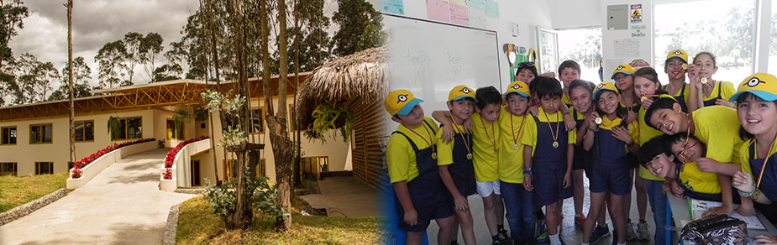
Chapter One
JOHANNES KEPLER
FLIPPED LEARNING

Slide 11
C3 METHODOLOGY

Slide 12
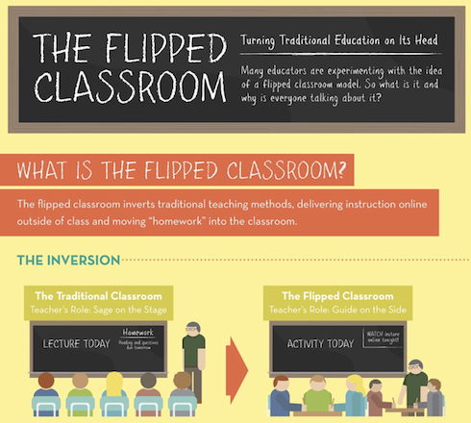

Slide 13
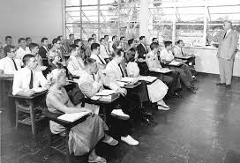

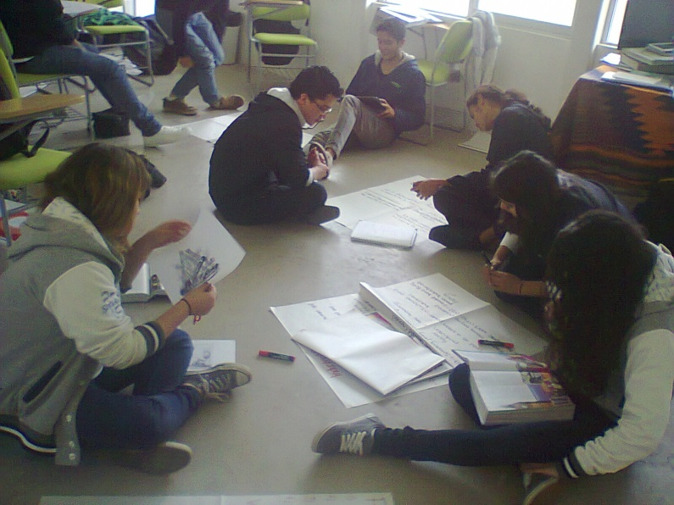

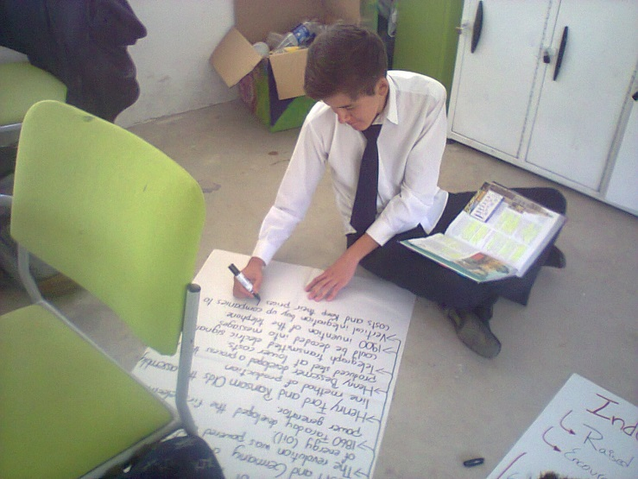


Slide 14

CHAPTER TWO
TYPES
STRATEGIES
GENRES
ASSESSMENT
Writing Skill

Slide 15




GENRES

Slide 16
Types of Writing
Imitative
Intensive
Responsive
Extensive

Slide 17

Brainstorm
Outline
1st Draft
Proofreading 1
Proofreading 2
2nd Draft

Slide 18

ASSESSMENT

Slide 19

Content
Accuracy
Vocabulary
Effectiveness
Mechanics

Slide 20

CHAPTER THREE

Slide 21

The incidence of flipped learning in the development of the writing skill
Mireille Farah (2014)
Female Emirati Students
Previous Research on the influence of flipped classroom in general education
Johnson and Renner (2012); Computer Class.
Successfully Flipping the English Classroom for Learning Autonomy
Han (2015); English as a Second Language (ESL)
IELTS
Development improve
Lage (2010); Female students of Economic Class
Camel (2011); Science Classes

Slide 22

Research Questions
Does flip learning influence in the writing skill?
Are there differences between students that learned through the use of flip classroom learning and the students that had in-class learning?
What is the attitude of students of Senior year at Johannes Kepler High School towards Flip classroom learning?

Slide 23
Methodological Design
Population and Sample
Johannes Kepler 480 Students.
Field Work
Johannes Kepler High School
Data Collection
Pre and Post Test. (Farah, 2014)
Data Processing and Analysis
TOEFL rubric system
Senior Years
Student´s perception Questionnaire
Kwik surveys sent through Edmodo.

Slide 24

PART FOUR
ANALYSIS OF RESULTS

Slide 25
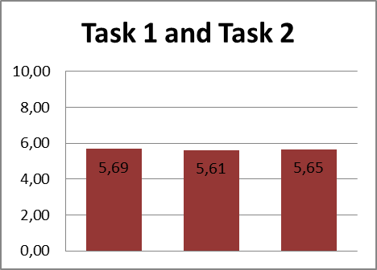
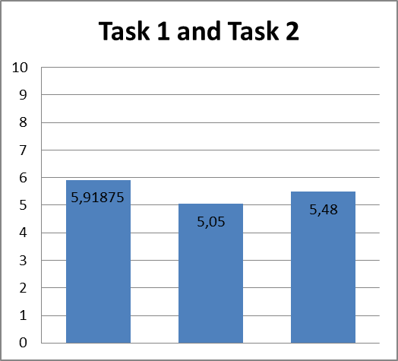
Control and Experimental Group
Results of Pre-Test

Slide 26
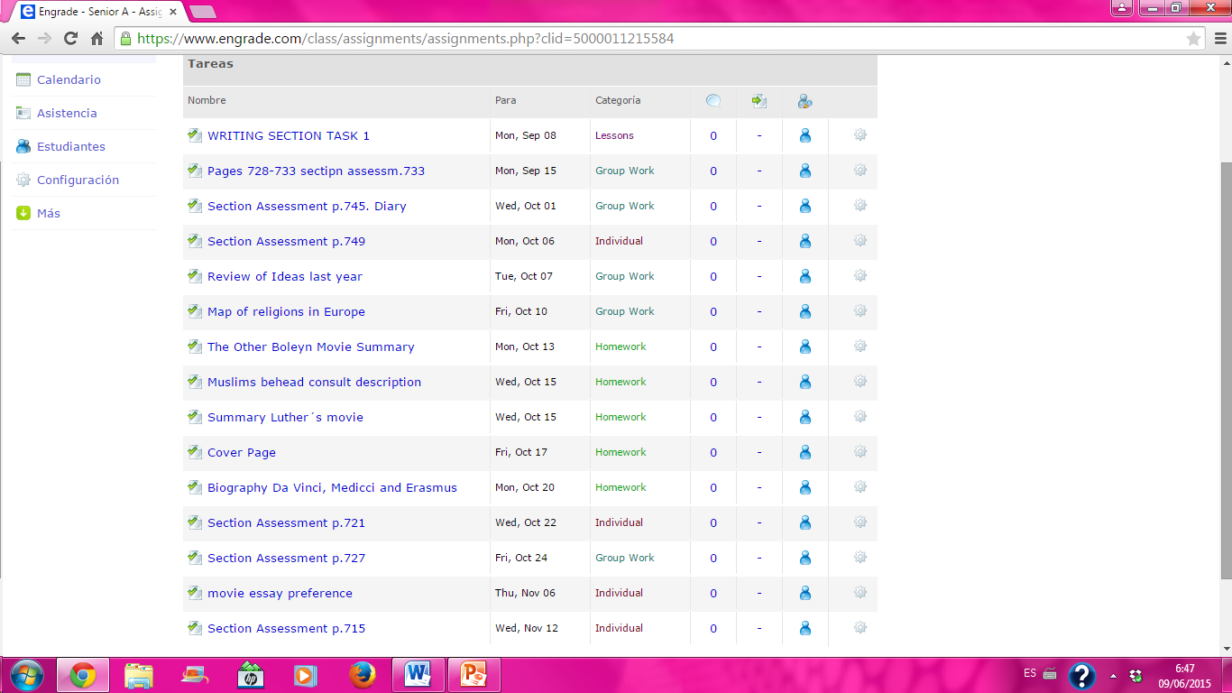
Engrade

Slide 27
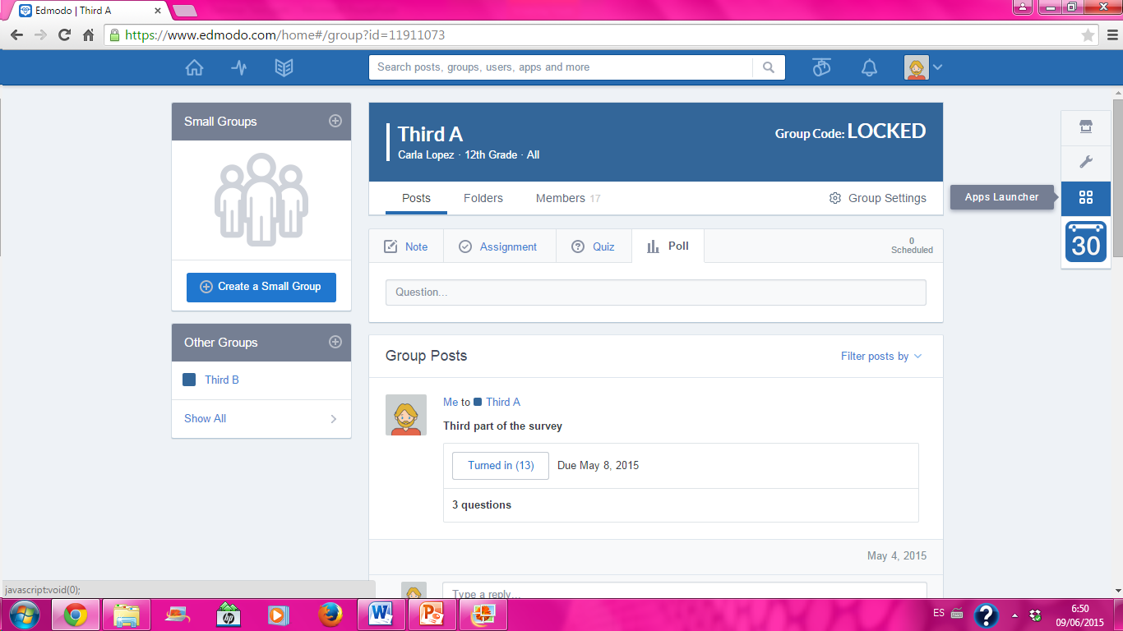
Edmodo

Slide 28
Control and Experimental Group
Comparison results

Slide 29
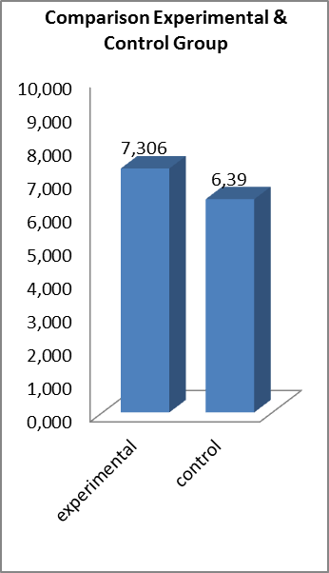
Comparison of the Final Results
Of the Control and Experimental Groups

Slide 30
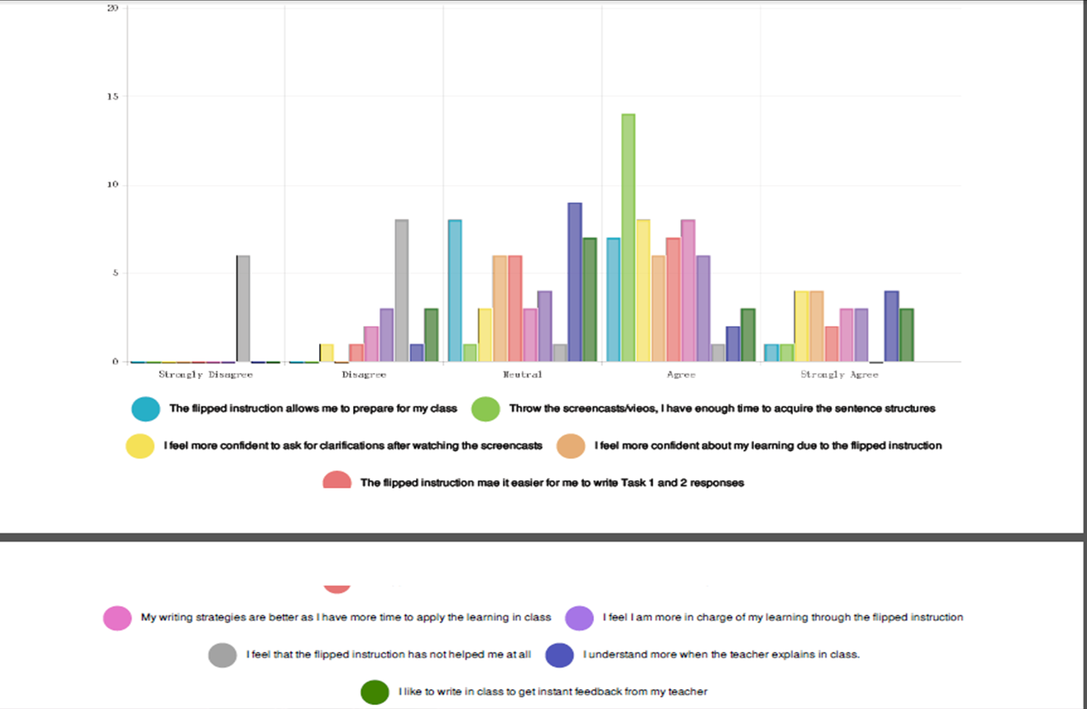

Slide 31
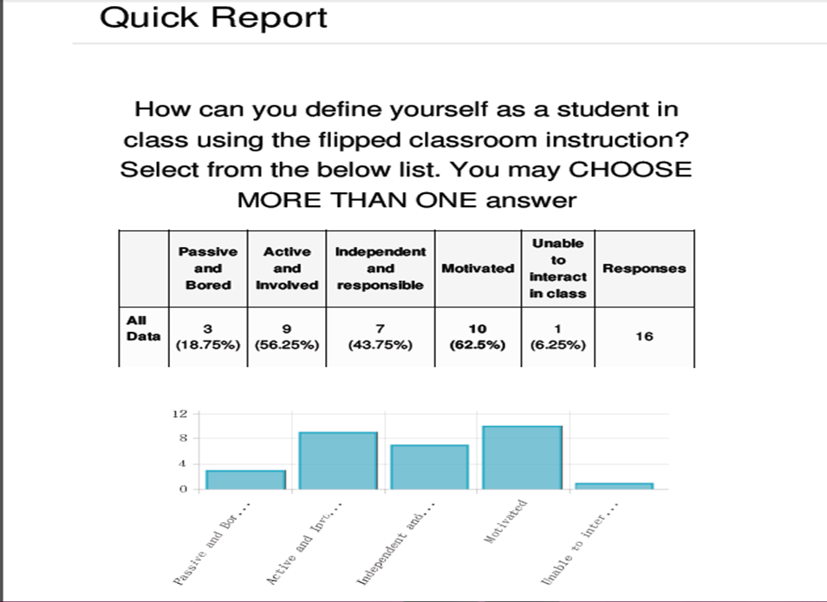

Slide 32
Discussion of General Results

Slide 34
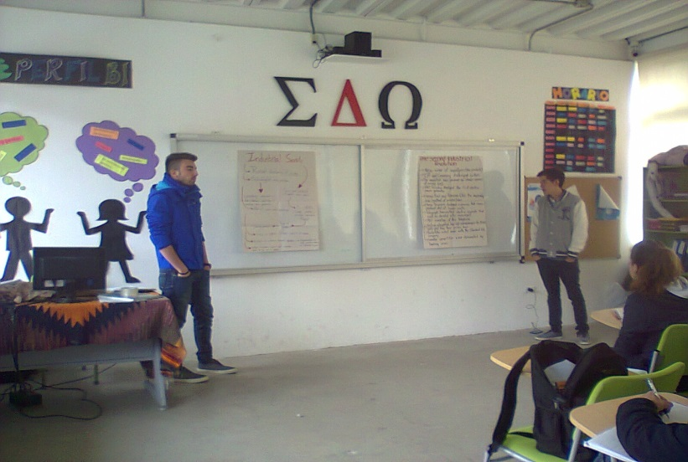
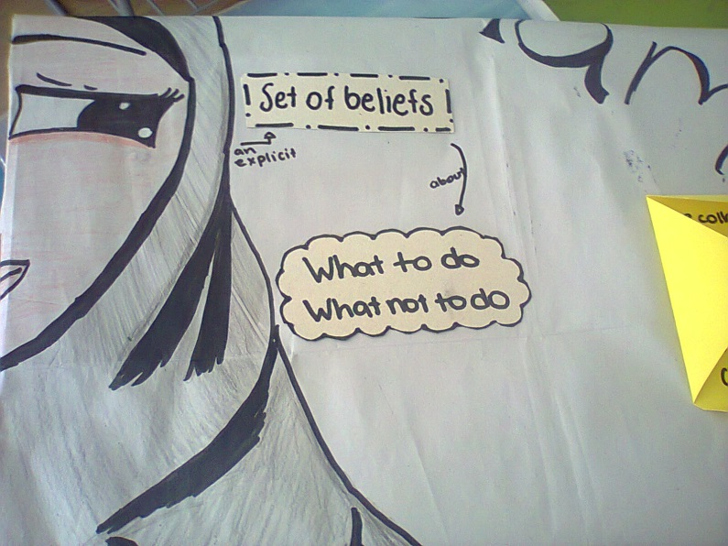

Slide 35
Conclusions & Recommendations
Improvement of Skills and sub-skills
Active participation of students
Students became more independent
Skills within writing became easier to achieve
Workshops
Written objectives to open the class
Have a greater sample
Other skills should be analyzed
The implementing og the proposal

Slide 36
Proposal

Slide 41
Activities | Month 1 |  |  |  | Month 2 |  |  |  | Month 3 |  |  |  | Month 4 |  |  |  | Month 5 |  |  |  | Month 6
 | 1 | 2 | 3 | 4 | 1 | 2 | 3 | 4 | 1 | 2 | 3 | 4 | 1 | 2 | 3 | 4 | 1 | 2 | 3 | 4 | 1 | 2 | 3 | 4
1.1 To develop interactive material using e-learning technology to explain about flipped classroom.
1.2 To deepen into the rules of flipped classroom for teachers and students
1.3 To emphasize the use of technologies
2.1 To prepare workshops about flipped classroom bibliography, programs and e-learning.
2.2 To provide guidelines about programs like Edmodo, Engrade, Khan Academy among others.
3.1 To implement English learning in general classes taught in the language, like English, Science and Social Studies.
3.2 To encourage the virtual communication through the use of network appliances and connection with other teachers and students
Timetable
Table 7. Timetable Proposal Activities

Slide 42
Evaluation of Objectives

