Slide 1
UNIVERSITY OF THE ARMED FORCES - ESPE
DISTANCE LEARNING EDUCATION
DEPARTMENT OF HUMAN AND SOCIAL SCIENCES
APPLIED LINGUISTICS IN ENGLISH PROGRAM
RESEARCH PROJECT PROPOSAL

Slide 2
RESEARCH PROJECT
“THE EFFECT OF COOPERATIVE LEARNING ON THE SPEAKING SKILL DEVELOPMENT FOR STUDENTS OF THE FIRST YEAR OF BACHILLERATO AT JOSE MARIA VELAZ HIGH SCHOOL, IN HUAQUILLAS, DURING 2015- 2016 SCHOOL YEAR”
NELLY MARIBEL JARAMILLO JARA
ELSSY ELENA PORRAS MALDONADO

Slide 3
PROBLEM IDENTIFICATION
Effect Nº 1.1
Low learning level
Effect Nº 2.1
Indiscipline problems
Effect Nº 3.1
Diminution ability to develop the Speaking skill.
Effect Nº 4.1
Academic goals non- satisfactory
Effect N° 1
Low performance in the classroom
Effect N°2
Inappropriate execution to practice English language.
Effect N°3
Unproductive Communication
Effect N°4
Non- compliance of workgroup activities
LOW SPEAKING SKILL DEVELOPMENT
Cause N°1
Low professional profile
Cause N°2
Students are not in an English Speaking environment
Cause N°3
Lack of incentive in the oral communication
Cause N°4
Absence of cooperative climate in the class
Cause N°1.1
Techniques of cooperative learning are not being applied properly
Cause N°2.1
Uninterest of student in the language
Cause N°3.1
Inadequate application of
components of communication
Cause N°4.1
Decrease in the learning process on the speaking skill

Slide 4
PROBLEM IDENTIFICATION
VARIABLES MATRIX
INDEPENDENT VARIABLE:
COOPERATIVE LEARNING
DEFINITION DIMENSIONS SUBDIMENSIONS
DEPENDENT VARIABLE:
SPEAKING SKILL
DEFINITION DIMENSIONS SUBDIMENSIONS

Slide 5
GENERAL OBJECTIVE
TO DETERMINE THE EFFECT OF COOPERATIVE LEARNING ON THE SPEAKING SKILL DEVELOPMENT OF THE ENGLISH LANGUAGE FOR STUDENTS OF THE FIRST YEAR BACHILLERATO AT JOSE MARIA VELAZ HIGH SCHOOL IN HUAQUILLAS, DURING 2015- 2016 SCHOOL YEAR.

Slide 6
SPECIFIC OBJECTIVES
To enhance classroom activities organization with the aid of cooperative learning to achieve a successful learning.
To identify the problems on the speaking skill that do not allow the development the components and the oral communication.
To achieve an effective production of the communication through the combination of the different didactical activities that offer the cooperative learning .

Slide 7
COOPERATIVE LEARNING
Involves teams work.
Exchanges the experiences, ideas and criteria among them.
Face-to-face interaction.
Develops the social skill in the student.

Slide 8

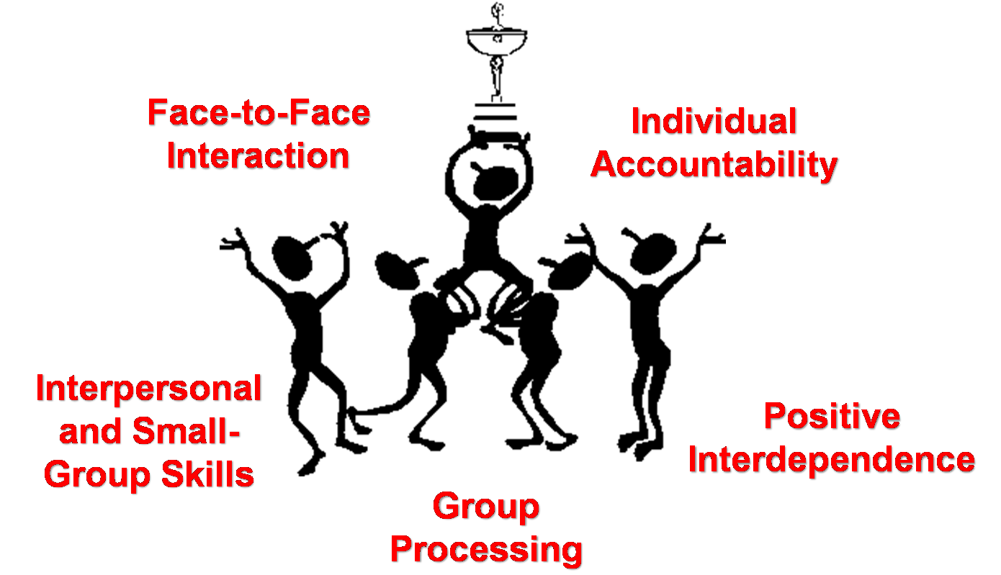
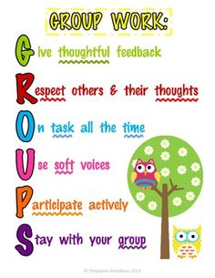

COOPERATIVE LEARNING

Slide 9
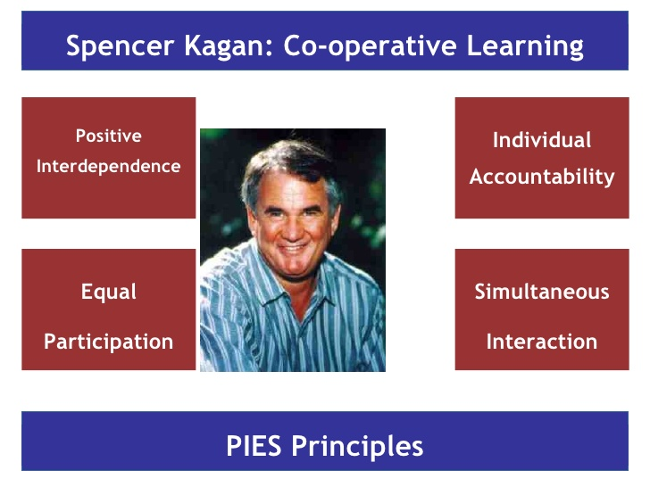
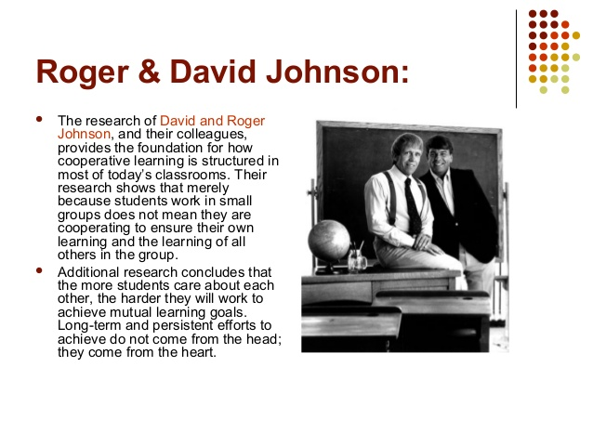
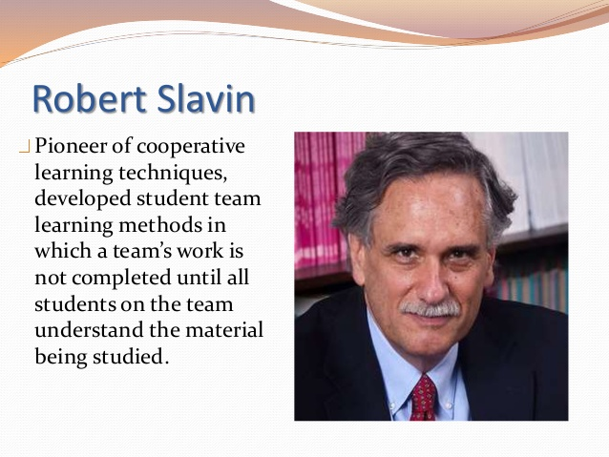
COOPERATIVE LEARNING

Slide 10
SPEAKING SKILL
Interactive process
Productive and effective communication
Includes the components of communication
Emits clear and precise the message to the receiver

Slide 11
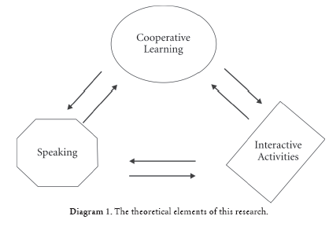




SPEAKING SKILL
INVOLVES
FLUENCY
ACCURACY
GRAMMAR
VOCABULARY
PRONUNCIATION
STRESS

Slide 12
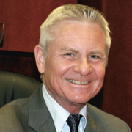

SPEAKING SKILL
DAVID NUNAN
HAYRIYE KAYI
Speaking is a set to the process for constructing and receiving information.
It is neccesary linguistics habits because the communication should be real and productive.

Slide 13

SPEAKING SKILL
HARMER JEREMY
There are three basic reasons to provide Speaking task to the students:
Rehearsal: Free discussion
Feedback: Remember
Engagement: Maintain activities effectiveness.

Slide 14
COOPERATIVE LEARNING AND SPEAKING SKILL RELATION
Working together and developing components of communication
Group work for teaching how to speak
Classroom activities organization and oral communication

Slide 15
OTHER CAUSES OF CORE PROBLEM
Students are not in an English Speaking environment
Uninterest of students in the language
Lack of incentive in the oral communication
Inadequate application of the components of communication
Absence of cooperative climate in class
Decrease in the learning process on the Speaking skill

Slide 16
HYPOTHESIS FORMULATION
WORKING HYPOTHESIS
The cooperative Learning affects the Speaking skill development for students of the first year bachillerato at Jose Maria Velaz high school in Huaquillas, during 2015-2016 school year.
NULL HYPOTHESIS
The cooperative Learning does not have any effect on the Speaking skill development for students of the first year bachillerato at Jose Maria Velaz high school in Huaquillas, during 2015-2016 school year.

Slide 17
PART III
METHODOLOGICAL DESIGN
RESEARCH TYPE AND DESIGN
It was applied of the field. The research was quantitative, quasi experimental and transversal.
POPULATION SIZE AND SAMPLE ( 30 Students)
FIELD WORK ( In situ)
INSTRUMENTS FOR DATA COLLECTION : ( Pre-test Control Group) (Post-test Experimental Group)
DATA PROCESSING AND ANALYSIS.
They were analyzed by statistical descriptive and inferential procedures.

Slide 18
RESEARCH VALIDITY AND RELIABILITY
To establish the content of validity of the oral test including the scoring rubrics, the students were validated and tested by piloting.

Slide 19
T- STUDENT: RESULTS
1. Student's t-Test: Results
Student's t-Test: Results
The results of an unpaired t-test performed at 09:01 on 1-MAR-2016
t= -8.47
sdev= 0.927
degrees of freedom = 28 The probability of this result, assuming the null hypothesis, is less than .0001
Group A: Number of items= 15
5.00 5.00 5.00 5.00 6.00 6.00 6.00 6.00 6.00 6.00 6.00 7.00 7.00 7.50 9.00
Mean = 6.17
95% confidence interval for Mean: 5.676 thru 6.657
Standard Deviation = 1.10
Hi = 9.00 Low = 5.00
Median = 6.00
Average Absolute Deviation from Median = 0.700

Slide 20
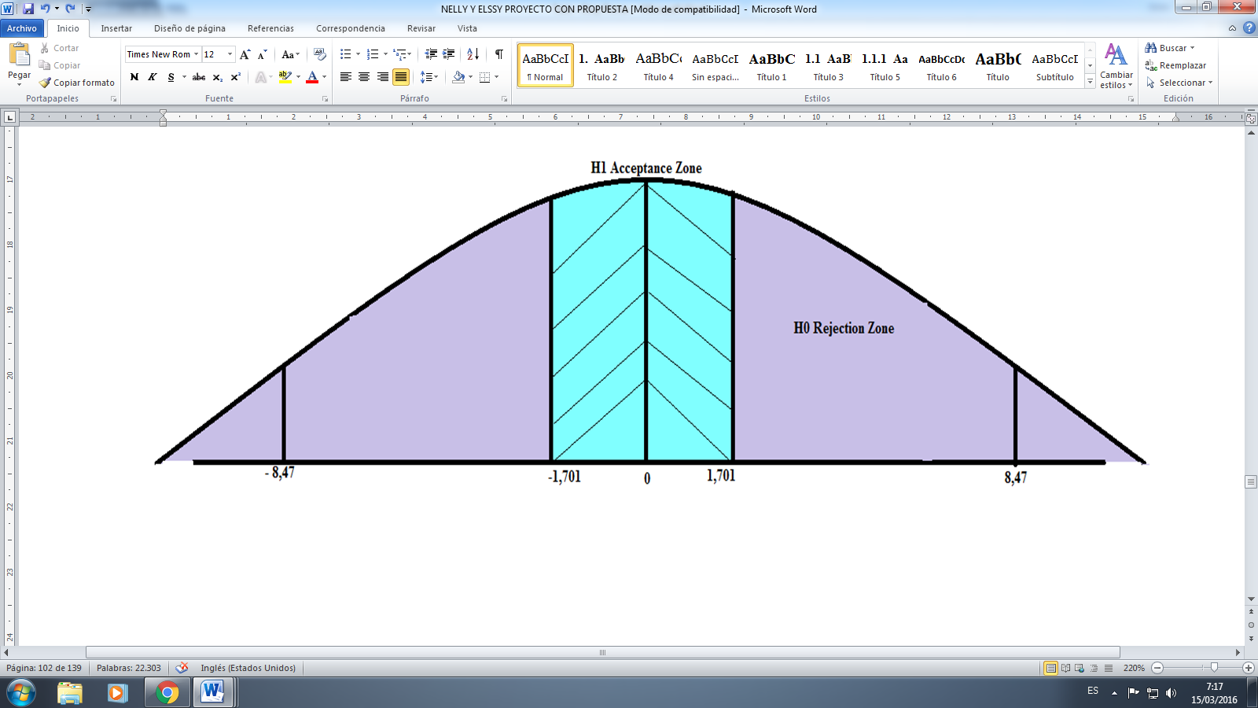
T STUDENT: RESULT
Group B: Number of items= 15
8.00 8.00 8.00 8.50 9.00 9.00 9.00 9.00 9.00 9.00 9.00 10.0 10.0 10.0 10.0
Mean = 9.03
95% confidence interval for Mean: 8.543 thru 9.524
Standard Deviation = 0.719
Hi = 10.0 Low = 8.00
Median = 9.00
Average Absolute Deviation from Median = 0.500
Data Reference: 666E

Slide 21
CONCLUSIONS
NULL HYPOTHESIS
1
Cooperative Learning affects the speaking skill development for students
2
Cooperative Learning Tecniques were not apply correctly
There is not an adequate environmet to learn English
3
Inadequate application of communication in classroom
Absence of cooperative climate in class.
5
4

Slide 22
RECOMMENDATIONS
1
Teachers use the cooperative learning techniques
Teachers learn about cooperative learning techniques
To foment English Speaking environment
2
3
Teachers include components of oral communication
To develop the cooperative learning climate
4
5

Slide 23
OBJECTIVE TREE
Effect Nº 1.1
High learning level.
Effect Nº 2.1
There are not indiscipline problems.
Effect Nº 3.1
Growth ability to develop the Speaking skill.
Effect Nº 4.1
Academic goals are satisfactory.
Effect N° 1
Adequate performance in the classroom.
Effect N°2
Appropriate execution to practice English language.
Effect N°3
Productive Communication.
Effect N°4
Good compliance of Group work.
HIGH SPEAKING SKILL DEVELOPMENT
Cause N°1
High professional profile
Cause N°2
Students are in an English Speaking environment.
Cause N°3
More incentive in the oral communication.
Cause N°4
Presence of cooperative climate in the class.
Cause N°1.1
Techniques of cooperative learning are being applied properly.
Cause N°2.1
Interest of student in the language.
Cause N°3.1
Adequate application of components of communication.
Cause N°4.1
Increase in the learning process in the speaking skill.

Slide 24
STRATEGIES MATRIX
PROBLEM | CAUSE | OBJECTIVE | STRATEGY
SPEAKING SKILL DEVELOPMENT DECREASE. | The teachers do not apply the oral communication in class. | To practice constantly the oral communication to a conversation effective. | Attend seminars or workshops. Maintaining the practice using the components of communication. -Use the cooperative learning techniques in classroom always.
 | Inappropriate climate to teach the English language. | To Provide the necessary conditions to facilitate the English learning process. | -Create an environment funny to apply the didactic resources. -Combine different activities of teams work.
 | Non-application of cooperative learning techniques in class. | To apply different activities to develop the learning in the second language. | -Promote the techniques that involve the cooperative learning in classroom.

Slide 25
ANALYTIC STRUCTURE OF PROPOSAL
To achieve an acceptable development level of the speaking skill with the application of Cooperative Learning to an adequate performance in classroom
GOAL
SPEAKING SKILL DEVELOPMENT IMPROVEMENT
PURPOSE
COMPONENTS
To generate a cozy and cooperative environment.
To promote in class the oral communication .
ACTIVITIES
To apply of properly form the cooperative learning techniques .
To employ correctly the components of communication .

Slide 26
LOGICAL FRAMEWORK MATRIX
NARRATIVE SUMMARY | INDICATORS | VERIFICATION MEDIA | SUPPOSES
GOALS To achieve an acceptable development level of the speaking skill development with the application of Cooperative Learning. | 90% of teachers apply the cooperative learning techniques. | -Rubrics -Oral test -Interviews | -Teachers enhance the practice of the oral communication.
PURPOSE SPEAKING SKILL DEVELOPMENT IMPROVEMENT | -95% of the teachers use adequately the components of the communication . | -Oral test -Interviews | -Teachers attend seminaries.
COMPONENTS 1.- To create a comfortable and cooperative climate 2.- to motivate in classroom the oral communication | -80% of students are prepared to work in group. -85% of students are using the components of communication. | -Oral test -Interviews -Oral test -Rubrics -Interviews | -Students wish to learn in an enjoyable and trustworthy environment. -Teachers apply different activities that involve the oral communication effective.
ACTIVITIES Workshops Seminaries Participate in the activities. | RESOURCES Coordinator Teachers Folders Sheet with information about Cooperative Leaning refreshments Teachers book Information about Cooperative Leaning | BUDGET $1000 $700

Slide 27
EVALUATION
The evaluation was focused on the activities done by students and their indicators. It was evaluated by means of oral test using the rubric`s criteria.

Slide 28
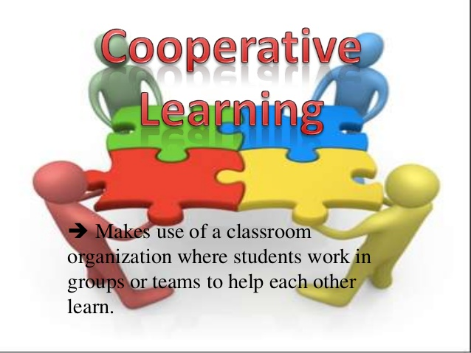
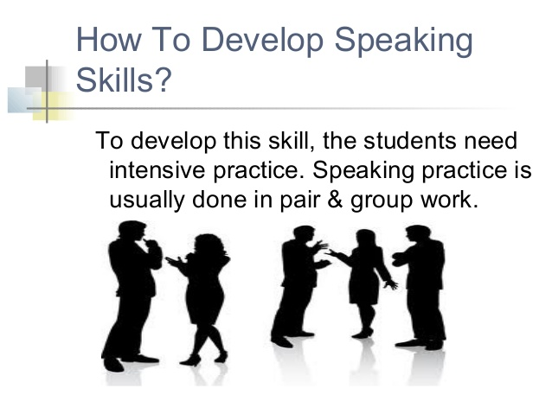
THANK YOU FOR YOUR ATTENTION AND PATIENCE
SINCERELY
NELLY MARIBEL JARAMILLO JARA
ELSSY ELENA PORRAS MALDONADO

