Slide 1

ARMY POLYTECHNIC SCHOOL
DEPARTMENT OF LANGUAGES
APPLIED LINGUISTICS IN ENGLISH PROGRAM
¨ INCIDENCE OF DIDACTIC MATERIAL IN THE ENGLISH LANGUAGE LEARNING OF TENTH YEAR STUDENTS OF BASIC EDUCATION AT “TELMO HIDALGO DIAZ” HIGH SCHOOL, IN SAN PEDRO-SANGOLQUÍ, THIRD TRIMESTER, SCHOOL YEAR 2008-2009.”
BY: MIGUEL GUZMAN P.
MILTON GERMAN C.
Advisors: Dra. María Teresa Llumiquinga
MSC. DANIEL HERRERA

Slide 2
IDENTIFICATION OF THE PROBLEM
The lack of the use of didactic material affects to the English language learning, without the use of an appropriate text would be impossible carry out the teaching learning-process.

Slide 3
MAIN PROBLEM
¿How does the lack of a didactic material affect english learning in students in the tenth year of basic education in the “telmo hidalgo diaz “ high school during the school year 2008-2009?

Slide 4
SECONDARY PROBLEMS
how does the didactic material used in the “telmo hidalgo diaz “ high school enhance the efficiency of english learning?
how does an english laboratory help to improve the quality of english learning?
how does the lack of teachers affect the english learning?
how does the deficient preparation of an english teacher decrease the level of english learning?

Slide 5
OBJECTIVES
OBJECTIVES
GENERAL
To elaborate a proposal for the use of an appropriate didactic material for English language learning at “Telmo Hidalgo Diaz” High School.

Slide 6
OBJECTIVES
SPECIFIC
TO ENCOURAGE THE ENGLISH TEACHER TO MAKE SOME UPDATING COURSE.
to look for alternatives to find some possible didactic materials and recommend one of them, which could be implemented for teaching of the english language at telmo hidalgo diaz” high school.
To conscience the authorities, English teacher and students about the role of the English lab play during the English language learning.
To achieve so the authorities and the English teacher conscience about the need to have more English teachers.

Slide 7
JUSTIFICATION
these days, globalization demands that all people should have a knowledge of the english language in a proficient way due to the English language being universal and it is used in many fields such as social, political, economic, etc. For these reasons many countries around the world have English as the official language and others include it in their syllabuses as mandatory.
To carry out English learning is so important to use some didactic material, where students can base their learning because in some institutes many students do not recall what the last lesson dealt with.
Students often need to use didactic material to follow the English lessons step by step , to have both feedback and reinforcement it also helps students become inclusively autonomous in their English learning.

Slide 8
THEORETICAL FRAMEWORK
CHAPTER ONE
ENGLISH LEARNING
CONCEPT
acquisition of different types of knowledge
TYPES OF ENGLISH LEARNING
ENHANCING
COLLABORATIVE
DISTANCE
ORGANIZATIONAL
AUTONOMOUS
use most of helps to study any subject
students´ team work together
teachers and students are separated by physical distance
discipline of a group interaction students work organized
students be responsible for their own learning climate

Slide 9
THEORETICAL FRAMEWORK
PROBLEMS OF ENGLISH LANGUAGE
SPEAKING
READING
LISTENING
WRITING
PRONUNCIATION
SPELLING
TRANSLATION
UNKNOW WORDS
COMPREHENSION
UNDERSTANDING
EDITING
GRAMMAR ERROR
how different elements that form the speech Are put together
forming words from letters
interpretation of the meaning ofa atext
from sorce text to larget language
where do words come from?
combinations of word we knew already
capacity to understand ideas and facts.
ability to think and act flexibly with what one knows
TO MAKE ADDITIONS DELETIONS OR OTHER CHANGES IN DOCUMENTS FOR PUBLICATION
UNKOWLEDEGE GRAMMATICAL RULESOR MAYBE STUDENTS ARE CONFUSED.

Slide 10
THEORETICAL FRAMEWORK
DIDATIC MATERIAL
DEFINITION
TEXTS
AUDIOVISUAL MATERIALS
OTHERS
medium materials that is used to facilitate or stimulate the learning
workbooks
CD’s
software
DVD’s
mp3
newspaper
magazines
internet
STORE INFORMATION AND ALLOWS STUDENTS TO LEARN BY LISTENING
OPTIC STORAGE A GREAT ADVANTAGE IS IT HAS VIDEO AND AUIDO
THE ADVANTAGE OF THIS KIND OF MEDIA IT SERVES TO STORE A GREAT QUANTITY OF MUSIC
GROUP OF PROGRAMMS INSTRUCCIONS WHOSE PRIMARY PURPOSE IS TO TEACH OR SELF LEARNING
PUBLICATION DIFFERENT TOPICS WHICH HELP TO STUDENTS TO IMPROVE THE SKILLS LIKE READIND AND WRITING
IT IS TYPE OF DIDACTIC ACTIVITY BECAUSE IT CONTAINS EDUACTIONAL TASKS
important feature of the learning enviroemnt for teenagers
CONTAINS EXERCISES AND QUESTIONS TO DO BY STUDENTS

Slide 11




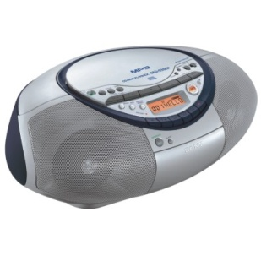
DIDACTIC MATERIAL
DM. definition say that there are different elements, mediums or resources, tangible and intangible that are used how support in the educative teaching-learning process, such as projectors, books, texts, blackboards, magazines, newspapers, slides, computers, soft wares, files, web pages etc.,
We should remember that the most important objective of learning a foreign language is to develop communicative skills in the language.
The principal components of D.M; are: Workbooks. Audio V.M. CDs, DVDs, software, newspapers, magazines, Internet, etc.

Slide 12
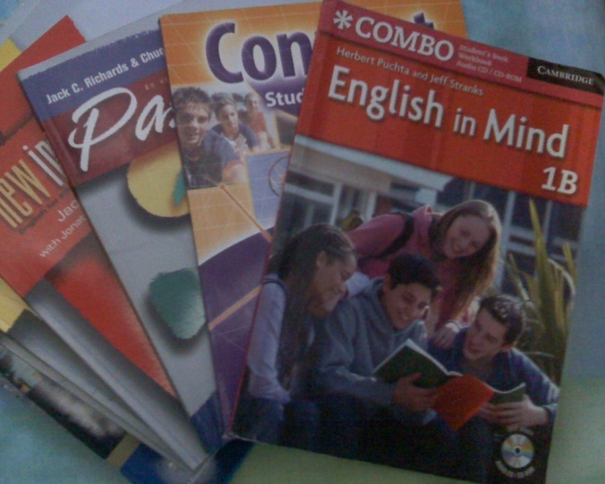
WORKBOOKS
The workbook is based on a textbook or course of study, which contains exercises and questions for use by students.
The Main objective of a Workbook is to integrate the four skills of listening, speaking, reading, and writing.
The texts or student books are the appropriate skills for practical communications in natural and effective ways.

Slide 13

AUDIOVISUAL MATERIALS
There are resources that use the senses of vision and hearing to stimulate and enrich learning experiences. The correct use of motion pictures and other visual aids in education work become in the more important tool in the teaching learning process.
For example we have a filmstrips, recordings, films, video-tape, slides, transparencies, audio tapes, compact discs, video cassettes, records, used for many purposes and especially in educative learning.

Slide 14


CDs. (Compact Disc)
It’s a dispositive that serves for storage large amounts of information such as audio, video, documents and another data; its use was applied to educative camp changing the class in a dynamic motivation.
DVDs (Versatile Digital Disc)
It is a format of optic storage that serves to save high quantity of data, including movies with high quality of audio video and its uses are diverse.
Nowadays, some practical techniques exist for video implication in the classroom and the great advantage of video is that it provides authentic language input.

Slide 15

SOFTWARE
It's a group of programs, instructions and computer rules to execute certain tasks in a computer.
Educational software is computer software whose primary purpose is to teaching and self learning.

Slide 16
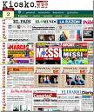
NEWSPAPERS
The Newspaper is a publication with a variety of topics and offers to teachers the chance to work with students, parents and others and to increase learner achievement, connecting young people to the real world and affirming their role in the society.

Slide 17
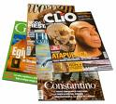
MAGAZINES
Are publications similar to a newspaper but with the difference that its publications are weekly or monthly and this contain specific themes, such as socials, cultural, economics, educative, and so, A Educative Magazine is a type of didactic activity based on constructivism of the learning in the education applying specific techniques.

Slide 18

INTERNET
Nowadays the Internet has become a progressively more important attribute of the learning environment for all types of people, especially students. Research realized recently shows that students use the Internet as an essential study aid outside the classroom and that the Internet increasingly has a place inside the classroom.

Slide 19
HYPOTHESIS SYSTEM
NULL HYPOTHESIS
THERE IS NO INTERACTION BETWEEN DIDACTIC MATERIAL AND ENGLISH LANGUAGE LEARNING IN THE STUDENTS OF THE TENTH YEAR AT “TELMO HIDALGO DIAZ” HIGH SCHOOL”.
ALTERNATIVE HYPOTHESIS
THERE IS INTERACTION BETWEEN DIDACTIC MATERIAL AND THE ENGLISH LANGUAGE LEARNING IN THE STUDENTS OF THE TENTH YEAR AT “TELMO HIDALGO DIAZ” HIGH SCHOOL”.

Slide 20

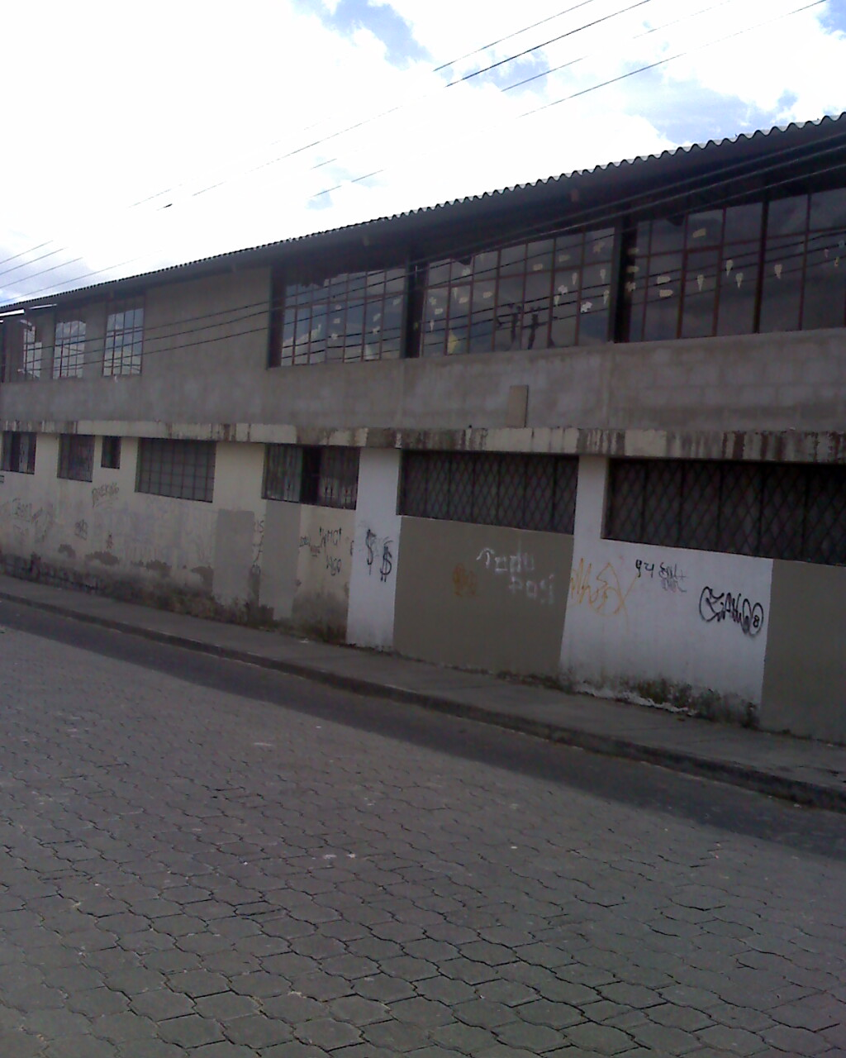
“TELMO HIDALGO DIAZ” HIGH SCHOOL
HIGH SCHOOL

Slide 21

ENGLISH TEACHER

Slide 22
TEACHER´S SURVEY
QUESTION | YES /NOT | WHY?
DO YOU THINK IT IS NECCESARY TO USE TEXTS AS GUIDES TO TEACH ENGLISH? | YES | Because, a text helps to improve the four skills such as speaking, reading listening and writing.
DO YOU THINK THAT THE ENGLISH LANGUAGE WILL BE USEFUL IN THE STUDENTS’ PROFESSIONAL LIFE AT “TELMO HIDALGO DIAZ” HIGH SCHOOL? | YES | Because, English language is applied to technology.
HAVE YOU EVER USED ANY KIND OF TEXT TO TEACH ENGLISH? | NOT | Because, at High School there is not any text
DO YOU BELIEVE THAT THE TIMETABLE ASSIGNED TO TEACH ENGLISH IS ENOUGH? | NOT | Because, the timetable assigned to English subject is only two hours per week.

Slide 23

ASSISTAN DIRECTOR

Slide 24
ASSISTANT DIRECTOR’S SURVEY
QUESTION | YES /NOT | WHY?
Do you believe that the English language should be learned with the help of texts as guides? | YES | Because, a text eases and enhances the efficiency in the learning of the English language.
Do you know if “Telmo Hidalgo Diaz” High School uses texts to teach English? | NOT | Because, there is not any English text at “Telmo Hidalgo Diaz” High School, and students receive classes with a handout provided by their English teacher
Do you believe that the time assigned to teach English is enough? | NOT | Because, students hardly receive 2 hours per week and they should receive at least 4 or 5 hours per week.
Do you think that the English language will be useful in the students’ professional life at “Telmo Hidalgo Diaz” High School? | YES | Because, the catalogs and documents about mechanics are written in English and it is the main foreign language in our country.

Slide 25
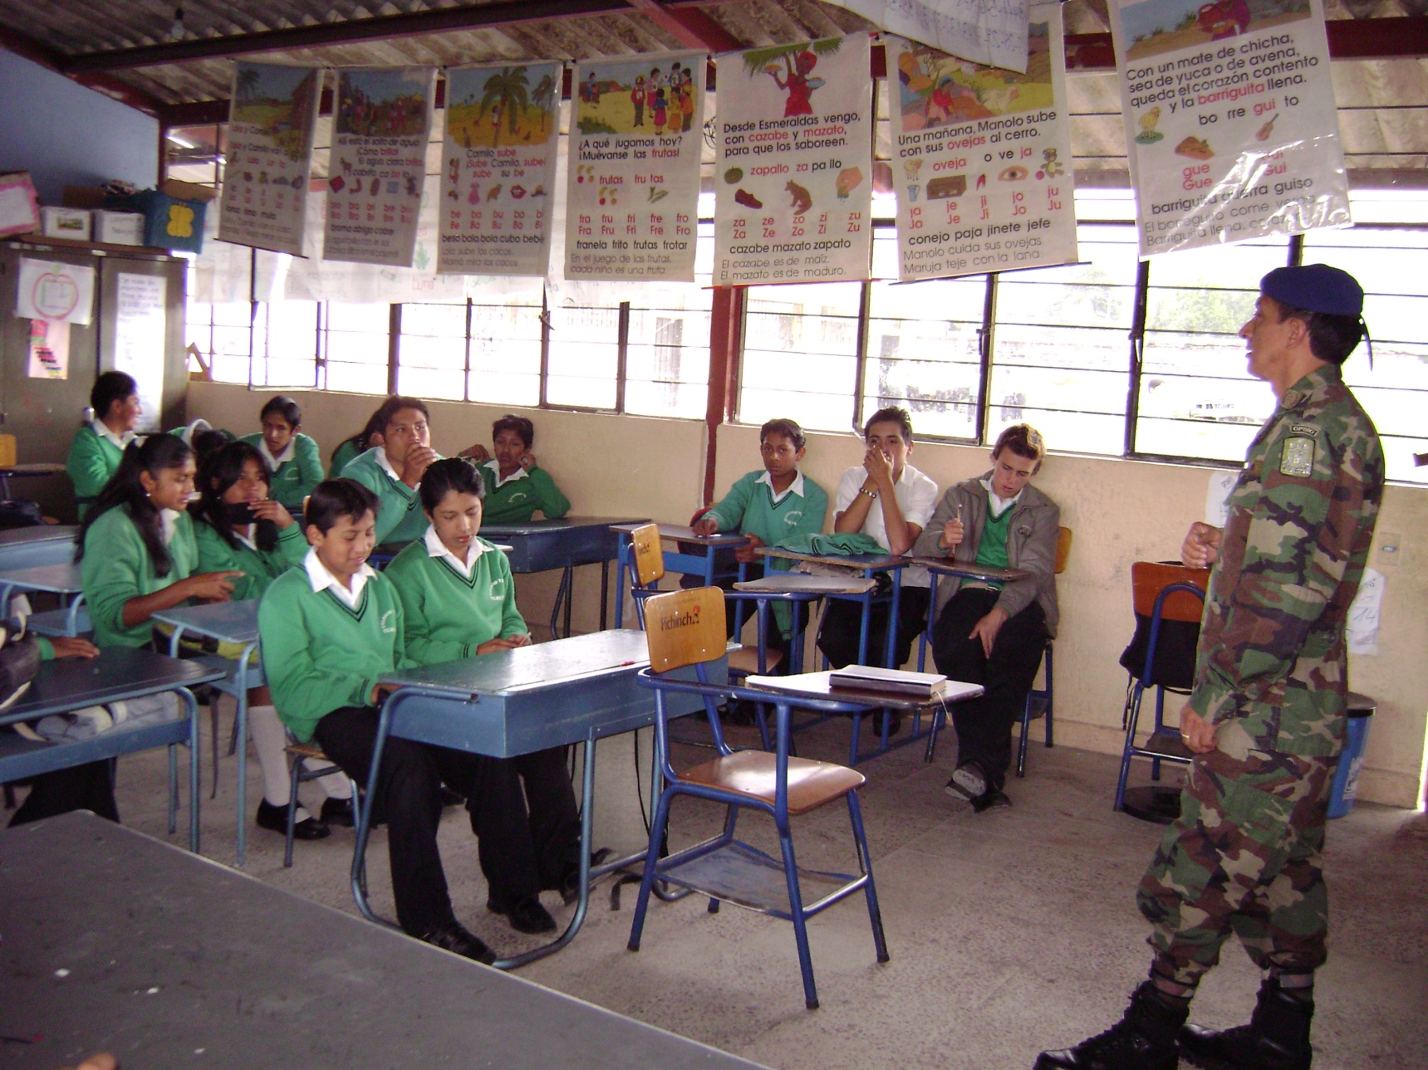
STUDENTS

Slide 26
STUDENTS’ SURVEY
QUESTION | YES | % | NOT | %
Do you believe that english should be learned with texts as guides? | 43 | 79,63 | 11 | 20,37
Have you ever used texts to learn english? | 23 | 42,59 | 31 | 57,41
Should english be learned with the help of a text? | 46 | 85,18 | 8 | 14,82
Have you had difficulties in learning english? | 45 | 83,33 | 9 | 16,67
Would you like to use texts to learn english in a better way? | 49 | 90,74 | 5 | 9,26
Do you believe that the time assigned to learn english at high school is enough? | 16 | 29,63 | 38 | 70,37
Do you think that english will be useful in your professional life? | 54 | 100 | 0 | 0

Slide 27
ANALYSIS AND INTERPRETATION STUDENTS’ SURVEY

Slide 28
ANALYSIS AND INTERPREATION STUDENTS’ SURVEY

Slide 29
ANALYSIS AND INTERPRETAION STUDENTS’ SURVEY

Slide 30
CONCLUSION & RECOMMENDATIONS
CONCLUSION
RECOMMENATIONS
Most of the students would like to learn the English language using texts as guides.
Students would like to receive English classes at least 4 or 5 hours per week.
The English language can improve students opportunities in their working lives.
To propose and suggest the use of an appropriate English text to learn the English language at “Telmo Hidalgo Diaz” High School.
To increase the time assigned to learning English as a Subject from 2 hours to 4 or 5 hours.
To give conferences to students in order to teach them that learning the English language is essential in every aspect of their lives in the world in which they live.

Slide 31
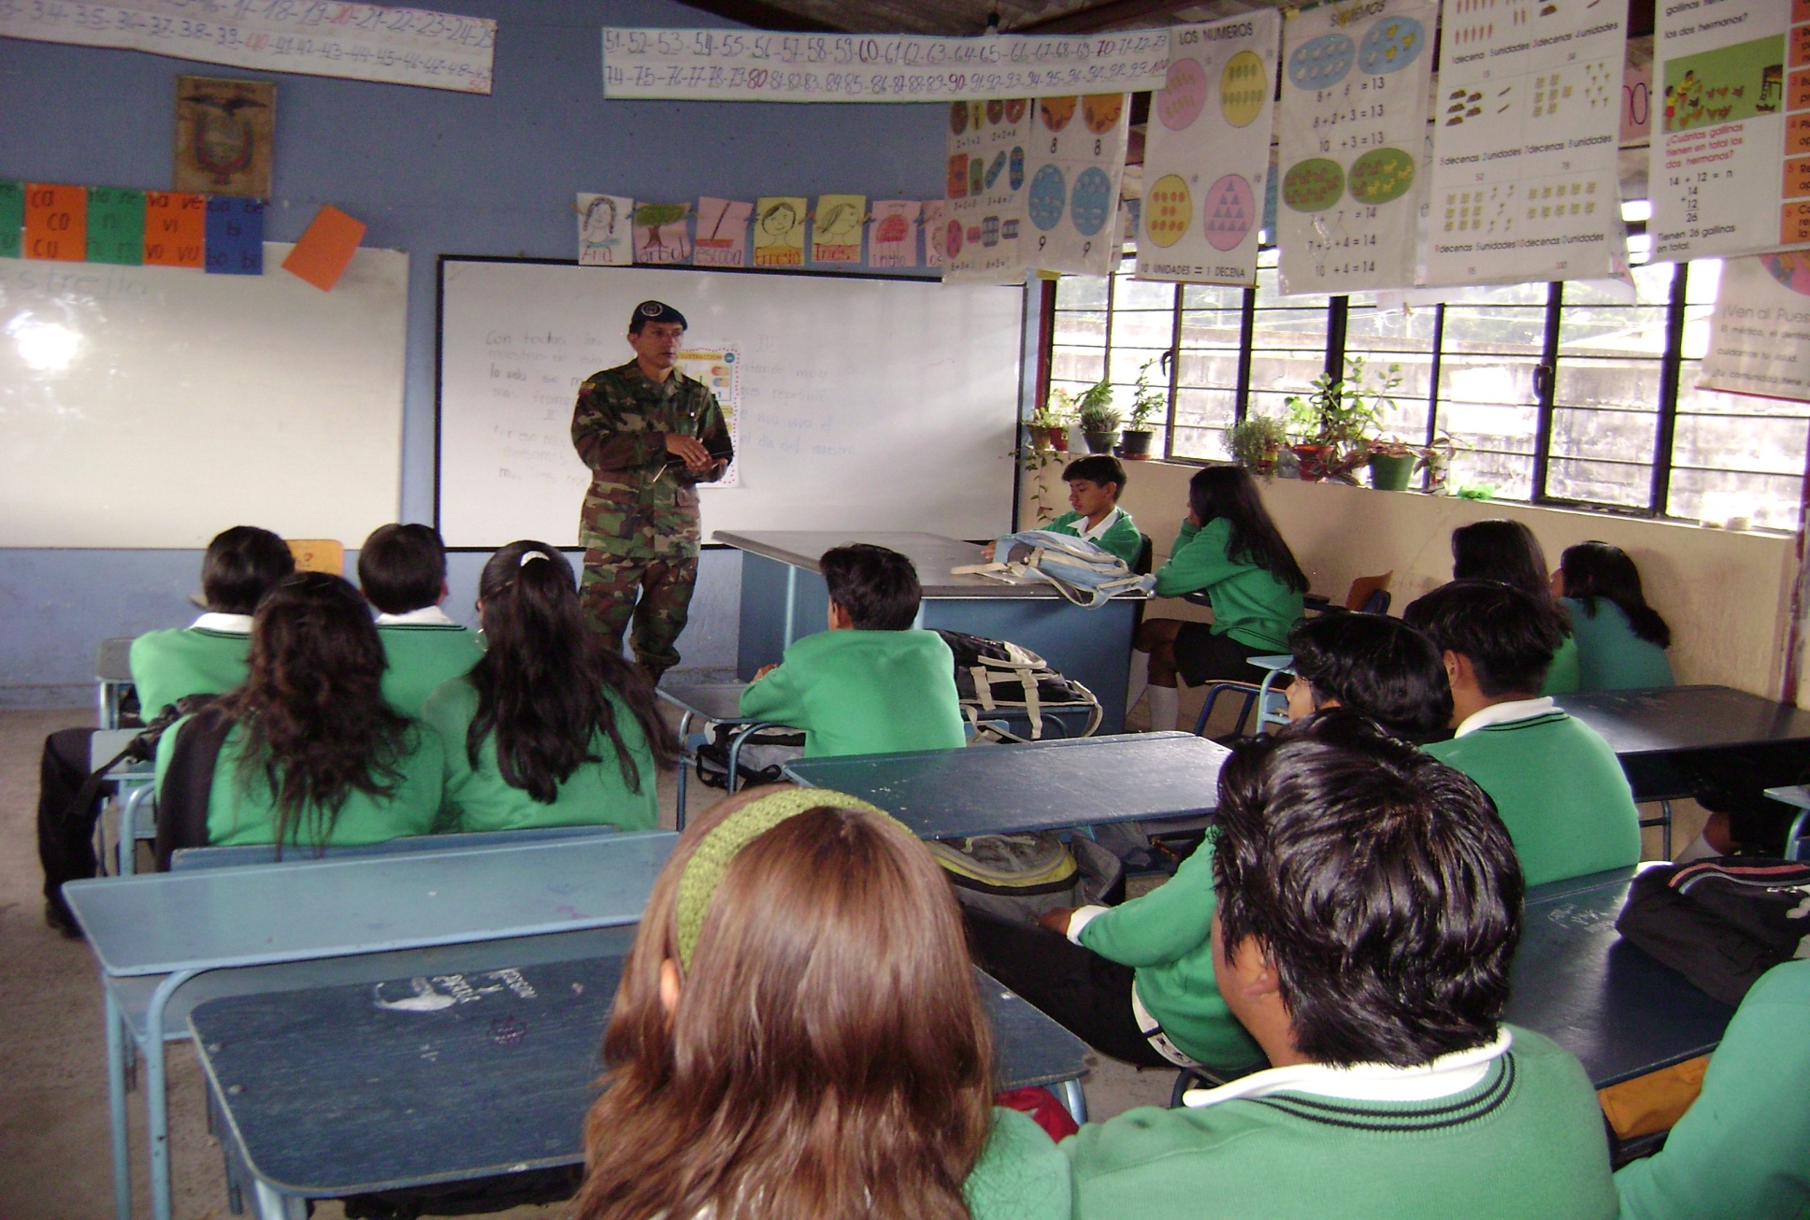
STUDENTS in CLASS

Slide 32
PROPOSAL
AS WE CAN EXPLAIN BEFORE THE MAIN PROBLEM IN THE ENGLISH LEARNING IN THE HIGH SCHOOL IS THE LACK OF A TEXT TO SUPPORT STUDENTS´LEARNING.
TO CARRY OUT THIS RESEARCH WE VISITED SOME EDITORIALS
TRYING TO FIND A GOOD BOOK THAT SATISFY THE STUDENTS´ NEEDS BOTH IMPORTANT ASPECTS ECONOMICAL AND EDUCATIONAL.

Slide 33
OBJECTIVES
GENERAL OBJECTIVE
TO OFFER AN ACADEMIC PROPOSAL BY MEANS OF THE USE OF A TEXT FOR THE TEACHING- LEARNING PROCESS .

Slide 34
OBJECTIVES
SPECIFIC OBJECTIVES
TO PROPOSE AND CONVICE TO THE SCHOOL’S AUTHORITIES THE IMPLEMETATION OF A ENGLISH TEXT ACCORDING TO STUDENTS’ ECONOMICAL SITUATION.

Slide 35
EDITORIALS’PRESENTATION
SANTILLANA
BOOK CENTRE
PEARSON
CRADLE

Slide 36
EVALUATION OF TEXTS OF ENGLISH LANGUAGE
One of the tasks inherent in the work of an English teacher’s, is the evaluation of a text. To evaluate a text is to compare the objectives of the text and its contents, the curriculum, their needs and preferences of the teachers interested in using it, and how to present them to potential users (both teachers and Students).
In this sense, many authors assert that to evaluate a textbook is examine it to the light of the two main variables of the educational process, namely, the objectives of education and type of users to whom it is addressed.
On the other hand, others argue that evaluating a book is basically a process of confrontation between the needs of a teaching-learning in particular and the solutions available. Several reasons may motivate a teacher to evaluate a textbook for teaching English as a Foreign Language.

Slide 37
MAIN VARIABLES FOR EVALUATE TEXTS OF ENGLISH LANGUAGE
Purpose of the evaluation,
Methodology
Objectives of the English program,
Type of users to whom it is directed,
Identification of user’s needs,
Design of languages with which the English’s program work.
The syllabus, description of book "A", and description of "B",
Procedures for working with favorites tasks and activities in the classroom prefers for this users.

Slide 38
OFFERS OF LIBRARIES
PEARSON Editorial offer the “Gateway to English” book, that book includes: Consistent structure chapters which fully integrate the skill-development required by the syllabus, but the disadvantage is its price 16,50 USD.
SANTILLANA Editorial offer the “Elevator International” book, whose content has clear presentation of grammar sections and its Workbook and Student book deal with the real life situation. But its price is 13,85 USD.
BOOK CENTRE Editorial offer the “English in Mind” book whose content has modern methodology to learn listening, speaking writing and reading English Language, also has six levels divided in 80 to 90 hours of classes for each level, and its advantage is the clear contents and its price 10,50 USD.
CRADLE Project offer the “Our World Through English” book whose contents are not clear on the contrary these texts have a lot print mistakes, and do not deal with the real situation (USA. UK.) where the language comes from, its price is 5,50 USD.

Slide 39
Comparison among editorials’ offers
EDITORIAL
SANTILLANA
ADVANTAGES
-clear presentation of grammar sections
- Workbook deal with the real life situation
DISADVANTAGES
- PRICE $ 13,85
BOOK CENTRE
ADVANTAGES
- PRICE $10,75
- MODERN METHODOLOGY TO TEACH LISTENING, SPEAKINGWRITING AND READING.
- SIX LEVELS
- 80- 90 HOURS CLASS PER EACH LEVEL
PEARSON
CRADLE
DISADVANTAGES
-there are not disadvantages
ADVANTAGES
Opportunities to learn through songs and games
DISADVANTAGES
PRICE $16,50
ADVANTAGES
- PRICE $5,50
DISADVANTAGES
- TEXTS HAVE A LOT PRINT MISTAKES
- CONTENTS NOT CLEAR
Do not deal with the real situation (usa. Uk.)

Slide 40
CONCLUSION AND RECOMMENDATION
We can conclude that the economic and academic characteristics offered by the book "English in Mind" tendered by Book Centre Editorial, is the most optioned and recommended and will fill the basic requirements of the High School.
Furthermore, we must note that the Authors has undertaken a program of academic feedback and supervision to all educational institutions to purchase their texts, personally attending to these campuses to carry out an assessment of both the area of English teachers and their students, also identified gaps in proposed objectives will be involved called teachers to attend refresher courses and training in the handling of the above text, without any cost also directed and programmed by the same author and supervised by the University of Cambridge in London, etc.

Slide 41
SPECIFIC CHARACTERISTICS OF BOOK
You’ll like English in Mind because, The Teachers can attract and maintain teenagers interest with imaginative topics. Chose a starting point appropriate for thier students.
Rely on fexible support from the extra photocopiables activities.
Provide eductional insights into the culture of the English speaking world througt the Culture in Mind.
Give students s solid basis for effective language learning trhought a strong focus on grammar qnd vocabulary.
Prepare students for ESOL exams with the “Writing bank”
The students can develop learning skils and build up portafolios of their own work.
Practice what they have learnt at their own pace.
Get a fill- for contemporary spoken english introducied through photostories.
Find extra support and guidance in the “Study help” and “Skills tips” sections in the workbook.
Measure their own progress against the Common Euopean Framework framework competencies using the free 16 page Portafolio Builder.
Enjoy further reading practice with the carefully chosen “Fiction in Mind” In level 3 and Literature in Mind in level 4 and 5.

Slide 42


Slide 43
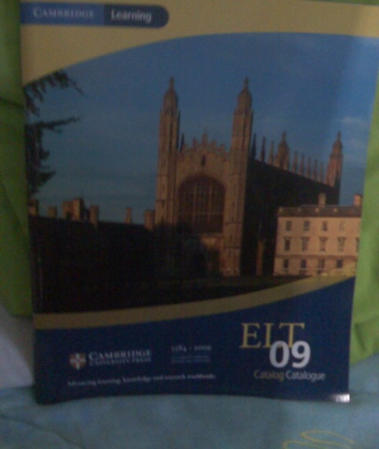
CONCLUSION & RECOMMENDATION
CONCLUSION
RECOMMENDATION
WE CONCLUDE THAT THE “ENGLISH IN MIND” TEXT IS THE BEST CHOICE.
WE RECOMMEND THAT THE “ENGLISH IN MIND” TEXT BE ACQUIRED IN BASE TO THE REQUIREMENTS OF THE HIGH SCHOOL.

Slide 44



END
THANKS

