Slide 1

ESCUELA POLITÉCNICA DEL EJÉRCITO
DEPARTAMENTO DE CIENCIAS DE LA VIDA
CARRERA DE INGENIERÍA EN CIENCIAS AGROPECUARIAS
SANTO DOMINGO DE LOS TSÁCHILAS
PRESENTACIÓN DEL PROYECTO INVESTIGATIVO DE TESIS

Slide 2
“EVALUACIÓN DEL EFECTO DE UN PROBIÓTICO NATIVO ELABORADO EN BASE A Lactobacillus acidophilus y Bacillus subtilis EN POLLOS BROILER ROSS-308 EN SANTO DOMINGO DE LOS TSÁCHILAS.”

Slide 3
Presentación
Autor:
    Juan Carlos Aguavil Enríquez
Blgo. Néstor Saltos Ing. M.Sc. Gustavo Nuñez
Director Codirector
Ing. Vinicio Uday
Biometrista

Slide 4
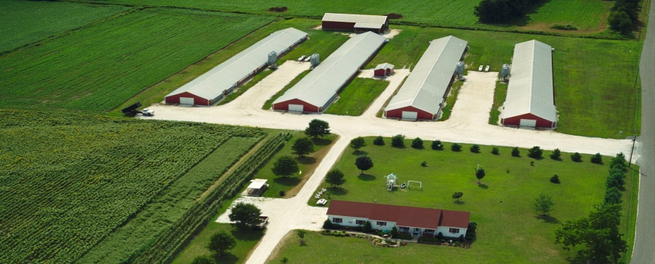
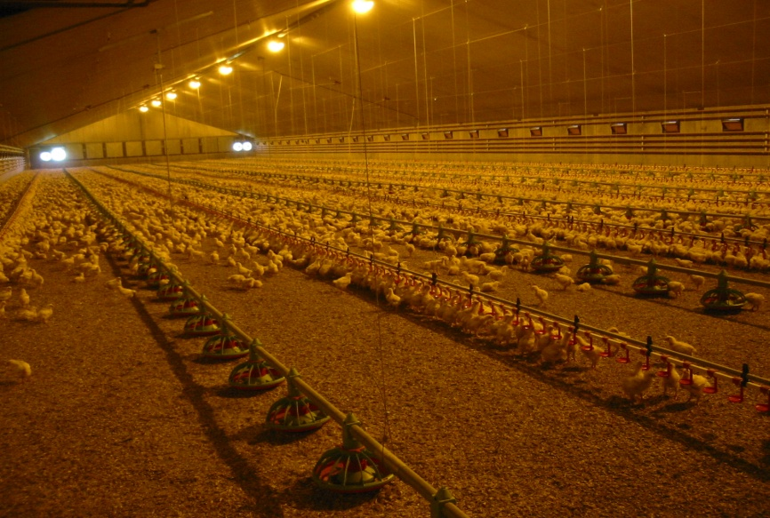
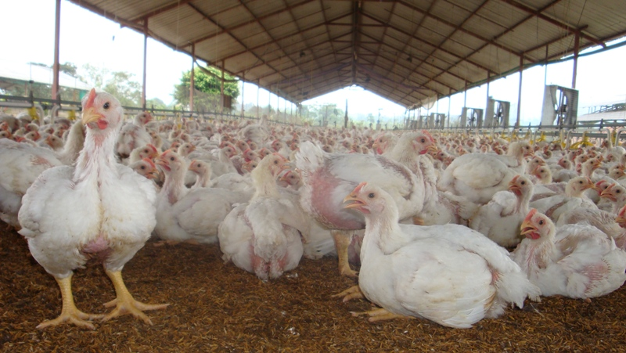
INTRODUCCIÓN
La Industria Avícola Ecuatoriana ha incrementado su producción a
diferencia de otros tipos de carne, siendo el consumo pér-cápita (kg/hab./año)
Fuente: CONAVE y AFABA
El Censo Avícola Nacional 2011 realizado por CONAVE y AMEVEA fue:
  215258015 de la línea de broilers
  10600000 de postura
  600000 pavos.
El censo determinó que la cadena avícola equivale al 23,1% del PIB agropecuario.
AÑO | Carne de pollo | Huevos
1990 | 7 | 91
2000 | 12 | 90
2006 | 23 | 120
2011 | 30 | 140

Slide 5
Antioxidantes
Ácidos orgánicos
mananoligosacaridos
selenio orgánico
probióticos
prebióticos
Biotecnología
Nutricionistas
Competitivo
RESULTADOS

Slide 6
OBJETIVO GENERAL
Determinar los efectos de la inclusión de probióticos durante la etapa de crianza en pollos broilers (Línea ROSS-308), para el mejoramiento de los parámetros sanitarios, productivos y económicos.

Slide 7
Aislar e identificar las cepas nativas de Lactobacillus acidophilus y Bacillus subtilis
Formular el probiótico a base de Lactobacillus acidophilus y Bacillus subtilis.
Objetivos
Específicos
Determinar la relación de la inclusión de probióticos a través del consumo de agua en la ganancia de peso para pollos Broiler Ross 308.
Evaluar la adición de probióticos en la dieta, en relación con la Conversión Alimenticia en pollos Broiler Ross 308.
Determinar la tasa de Mortalidad.
Determinar el tratamiento más económico para incluir el uso de probióticos en la dieta utilizando la metodología Perrin et al.
Notes:
Animated pointer and light-up text
(Advanced)
To reproduce the background effects on this slide, do the following:
On the Home tab, in the Slides group, click Layout, and then click Blank.
Right-click the slide background area, and then click Format Background. In the Format Background dialog box, click Fill in the left pane, select Solid fill in the right pane, and select White, Background 1 (first row, first option from the left).
To reproduce the rectangle on this slide, do the following:
On the Home tab, in the Drawing group, click Shapes, and then under Rectangles click Rounded Rectangle (second option from the left). On the slide, drag to draw a rounded rectangle.
Select the rectangle. Drag the yellow diamond adjustment handle to the left to decrease the amount of rounding on the corners.
With the rounded rectangle still selected, under Drawing Tools, on the Format tab, in the Size group, do the following:
In the Shape Height box, enter 3.5”.
In the Shape Width box, enter 0.25”.
Under Drawing Tools, on the Format tab, in the bottom right corner of the Shape Styles group, click the Format Shape dialog box launcher. In the Format Shape dialog box, click Fill in the left pane. In the Fill pane, select Solid fill, click the button next to Color, and then under Theme Colors click White, Background 1, Darker 15% (third row, first option from the left).
Also in the Format Shape dialog box, click Line Color in the left pane. In the Line Color pane, select No line.
Also in the Format Shape dialog box, click Shadow in the left pane. In the Shadow pane, click the button next to Presets, under Outer select Offset Bottom (first row, second option from the left), and then do the following:
In the Transparency box, enter 0%.
In the Size box, enter 100%.
In the Blur box, enter 8.5 pt.
In the Angle box, enter 90°.
In the Distance box, enter 1 pt.
Also in the Format Shape dialog box, click 3-D Format in the left pane. In the 3-D Format tab, do the following:
Under Bevel, click the button next to Top, and then under Bevel click Circle (first row, first option from the left). Next to Top, in the Width box, enter 5 pt, and in the Height box, enter 5 pt.
Under Surface, click the button next to Material, and then under Standard click Matte (first row, first option from the left). Click the button next to Lighting, and then under Neutral click Soft (first row, third option from the left).
On the slide, select the rounded rectangle. On the Home tab, in the Clipboard group, click the arrow to the right of Copy, and then click Duplicate.
Select the duplicate rectangle. On the Home tab, in the Drawing group, do the following:
Click the arrow next to Shape Fill, and then click No Fill.
Click the arrow next to Shape Outline, and then click No Outline.
Drag the second rectangle above the first rectangle until the lower edge overlays the top edge of the first rectangle. (Note: When the spinning animation effect is created later for these rectangles, the spin will center where the edges of the rectangles meet.)
Press and hold CTRL, and then select both rectangles. On the Home tab, in the Drawing group, click Arrange, and do the following:
Point to Align, and then click Align Selected Objects.
Point to Align, and then click Align Center.
Click Group.
On the slide, drag the group until it is centered horizontally on the left edge of the slide (straddling the edge).
On the Home tab, in the Drawing group, click Arrange, point to Align, and then do the following:
Click Align to Slide.
Click Align Middle.
To reproduce the dashed arc on this slide, do the following:
On the Home tab, in the Drawing group, click Shapes, and then under Basic Shapes click Arc (third row, 12th option from the left). On the slide, drag to draw an arc.
Select the arc. Under Drawing Tools, on the Format tab, in the Size group, do the following:
In the Shape Height box, enter 7.5”.
In the Shape Width box, enter 7.5”.
With the arc still selected, on the Home tab, in the Drawing group, click the arrow next to Shape Outline and then do the following:
Under Theme Colors, click White, Background 1, Darker 15% (third row, first option from the left).
Point to Dashes, and then click Dash (fourth option from the top).
On the slide, drag the yellow diamond adjustment handle on the right side of the arc to the bottom of the arc to create a half circle.
Drag the arc until the yellow diamond adjustment handles are on the left edge of the slide.
With the arc still selected, on the Home tab, in the Drawing group, click the arrow under Arrange, point to Align, and then do the following:
Click Align to Slide.
Click Align Middle.
To reproduce the half circle on this slide, do the following:
On the slide, select the arc. On the Home tab, in the Clipboard group, click the arrow to the right of Copy, and then click Duplicate.
Select the duplicate arc. Under Drawing Tools, on the Format tab, in the Size group, do the following:
In the Shape Height box, enter 3.33”.
In the Shape Width box, enter 3.33”.
With the second arc still selected, under Drawing Tools, on the Format tab, in the Shape Styles group, click the arrow next to Shape Fill, and then under Theme Colors click White, Background 1, Darker 5% (second row, first option from the left).
Under Drawing Tools, on the Format tab, in the Shape Styles group, click the arrow next to Shape Outline, and then click No Outline.
Under Drawing Tools, on the Format tab, in the Shape Styles group, click Shape Effects, point to Shadow, and then click Shadow Options. In the Format Shape dialog box, click Shadow in the left pane. In the Shadow pane, click the button next to Presets , under Inner click Inside Right (second row, third option from the left), and then do the following:
In the Transparency box, enter 86%.
In the Blur box, enter 24 pt.
In the Angle box, enter 315°.
In the Distance box, enter 4 pt.
On the slide, drag the second arc until the yellow diamond adjustment handles are on the left edge of the slide. On the Home tab, in the Drawing group, click Arrange, and then do the following:
Point to Align, and then click Align to Slide.
Point to Align, and then click Align Middle.
Click Send to Back.
To reproduce the button shapes on this slide, do the following:
On the Home tab, in the Drawing group, click Shapes, and then under Basic Shapes click Oval (first row, second option from the left). On the slide, drag to draw an oval.
Select the oval. Under Drawing Tools, on the Format tab, in the Size group, do the following:
In the Shape Height box, enter 0.34”.
In the Shape Width box, enter 0.34”.
Under Drawing Tools, on the Format tab, in the Shape Styles group, click More, and then click Light 1 Outline, Colored Fill – Olive Green, Accent 3 (third row, first option from the left).
Under Drawing Tools, on the Format tab, in the bottom right corner of the Shape Styles group, click the Format Shape dialog box launcher. In the Format Shape dialog box, click Fill in the left pane. In the Fill pane, select Solid Fill. Click the button next to Color, and then under Theme Colors click Olive Green, Accent 3, Lighter 80° (second row, seventh option from the left).
Also in the Format Shape dialog box, click Line Color in the left pane. In the Line Color pane, select No line.
Also in the Format Shape dialog box, click Shadow in the left pane. In the Shadow pane, click the button next to Presets, under Outer click Offset Bottom (first row, second option from the left), and then do the following:
In the Transparency box, enter 0%.
In the Size box, enter 100%.
In the Blur box, enter 8.5 pt.
In the Angle box, enter 90°.
In the Distance box, enter 1 pt.
Also in the Format Shape dialog box, click 3-D Format in the left pane, and then do the following in the 3-D Format pane:
Under Bevel, click the button next to Top, and then under Bevel click Art Deco (third row, fourth option from the left). Next to Top, in the Width box, enter 5 pt, and in the Height box, enter 5 pt.
Under Contour, click the button next to Color, and then under Theme Colors click White, Background 1 (first row, first option from the left). In the Size box, enter 3.5 pt.
Under Surface, click the button next to Material, and then under Standard click Matte (first row, first option from the left). Click the button next to Lighting, and then under Neutral click Soft (first row, third option from the left).
On the slide, select the oval. Under Drawing Tools, on the Format tab, in the bottom right corner of the Size group, click the Size and Position dialog box launcher. In the Format Shape dialog box, click Position in the left pane, and in the Position pane, do the following to position the third and fourth ovals:
In the Horizontal box, enter 2.98”.
In the Vertical box, enter 1.5”.
Select the oval. On the Home tab, in the Clipboard group, click the arrow under Paste, and then click Duplicate.
Select the duplicate oval. Under Drawing Tools, on the Format tab, in the bottom right corner of the Size group, click the Size and Position dialog box launcher. In the Format Shape dialog box, click Position in the left pane, and in the Position pane, do the following to position the third and fourth ovals:
In the Horizontal box, enter 3.52”.
In the Vertical box, enter 2.98”.
Repeat step 9 two more times, for a total of four ovals. Under Drawing Tools, on the Format tab, in the bottom right corner of the Size group, click the Size and Position dialog box launcher. In the Format Shape dialog box, click Position in the left pane, and in the Position pane, do the following to position the third and fourth ovals:
Select the third oval on the slide, and then enter 3.52” in the Horizontal box and 4.27” in the Vertical box.
Select the fourth oval on the slide, and then enter 2.99” in the Horizontal box and 5.66” in the Vertical box.
To reproduce the text on this slide, do the following:
On the Insert tab, in the Text group, click Text Box, and then on the slide, drag to draw the text box.
Enter text in the text box and select the text. On the Home tab, in the Font group, do the following:
In the Font list, select Corbel.
In the Font Size list, select 22.
Click the arrow next to Font Color, and then under Theme Colors click White, Background 1, Darker 50% (sixth row, first option from the left).
On the Home tab, in the Paragraph group, click Align Text Left to align the text left in the text box.
On the slide, drag the text box to the right of the first oval.
Select the text box. On the Home tab, in the Clipboard group, click the arrow to the right of Copy, and then click Duplicate.
Click in the text box and edit the text.
Drag the second text box to the right of the second oval.
Repeat steps 5-7 to create the third and fourth text boxes, dragging them to the right of the third and fourth ovals.
To reproduce the animation effects on this slide, do the following:
On the Home tab, in the Editing group, click Select, and then click Selection Pane.
In the Selection and Visibility task pane, select the rectangle group.
On the Animations tab, in the Advanced Animation group, click Add Animation, and then under Emphasis click Spin.
Also on the Animations tab, in the Animation group, click the Effect Options dialog box launcher. In the Spin dialog box, do the following:
On the Effects tab, in the Amount list, in the Custom box, enter 123°, and then press ENTER. Also in the Amount list, click Counterclockwise.
On the Timing tab, in the Duration box, select 1.00.
On the Timing tab, in the Start list, select With Previous.
On the slide, select the first oval. On the Animations tab, in the Advanced Animation group, click Add Animation, and then click More Emphasis Effects. In the Add Emphasis Effect dialog box, under Basic, click Fill Color.
On the Animations tab, in the Animation group, click the Effect Options dialog box launcher. In Fill Color dialog box, the do the following:
On the Effects tab, in the Fill Color list, click More Colors. In the Colors dialog box, on the Custom tab, enter values for Red:130, Green:153, Blue: 117.
On the Timing tab, in the Duration box, , enter 0.50.
On the Timing tab, in the Start list, select After Previous.
On the slide, select the first text box. On the Animations tab, in the Advanced Animation group, click Add Animation, and then under Entrance click Fade.
Also on the Animations tab, in the Timing group, do the following:
In the Start list, select With Previous.
In the Duration box, enter 0.50.
In the Selection and Visibility task pane, select the rectangle group. On the Animations tab, in the Advanced Animation group, click Add Animation, and then under Emphasis click Spin.
Also on the Animations tab, in the Animation group, click the Effect Options dialog box launcher. In the Spin dialog box, do the following:
On the Effects tab, in the Amount list, in the Custom box, enter 22°, and then press ENTER. Also in the Amount list, click Clockwise.
On the Timing tab, in the Start list, select On Click.
On the Timing tab, in the Duration box, enter 0.50.
On the slide, select the second oval. On the Animations tab, in the Advanced Animation group, click Add Animation, and then click More Emphasis Effects. In the Add Emphasis Effect dialog box, under Basic, click Fill Color.
On the Animations tab, in the Animation group, click the Effect Options dialog box launcher. In the Fill Color dialog box, do the following:
On the Effects tab, in the Fill Color list, click More Colors. In the Colors dialog box, on the Custom tab, enter values for Red:130, Green:153, Blue: 117.
On the Timing tab, in the Start list, select After Previous.
On the Timing tab, in the Duration box, enter 0.50.
On the slide, select the second text box. On the Animations tab, in the Advanced Animation group, click Add Animation, and then under Entrance click Fade.
Also on the Animations tab, in the Timing group, do the following:
In the Start list, select With Previous.
In the Duration box, enter 0.50.
On the slide, select the third oval. On the Animations tab, in the Advanced Animation group, click Add Animation, and then click More Emphasis Effects. In the Add Emphasis Effect dialog box, under Basic, click Fill Color.
On the Animations tab, in the Animation group, click the Effect Options dialog box launcher. In the Fill Color dialog box, do the following:
On the Effects tab, in the Fill Color list, click More Colors. In the Colors dialog box, on the Custom tab, enter values for Red:130, Green:153, Blue: 117.
On the Timing tab, in the Start list, select After Previous.
On the Timing tab, in the Speed list, select Very Fast.
On the slide, select the third text box. On the Animations tab, in the Advanced Animation group, click Add Animation, and then under Entrance click Fade.
Also on the Animations tab, in the Timing group, do the following:
In the Start list, select With Previous.
In the Duration box, enter 0.50.
On the slide, select the fourth oval. On the Animations tab, in the Advanced Animation group, click Add Animation, and then click More Emphasis Effects. In the Add Emphasis Effect dialog box, under Basic, click Fill Color.
On the Animations tab, in the Animation group, click the Effect Options dialog box launcher. In the Fill Color dialog box, do the following:
On the Effects tab, in the Fill Color list, click More Colors. In the Colors dialog box, on the Custom tab, enter values for Red:130, Green:153, Blue: 117.
On the Timing tab, in the Start list, select After Previous.
On the Timing tab, in the Duration box, enter 0.50.
On the slide, select the fourth text box. On the Animations tab, in the Advanced Animation group, click Add Animation, and then under Entrance click Fade.
On the Animations tab, in the Timing group, do the following:
In the Start list, select With Previous.
In the Duration box, enter 0:50.

Slide 8
HIPÓTESIS
La inclusión de probióticos durante la etapa de crianza mejorará los parámetros productivos, sanitarios y económicos en pollos Broiler Ross-308.

Slide 9
REVISIÓN DE LITERATURA

Slide 10
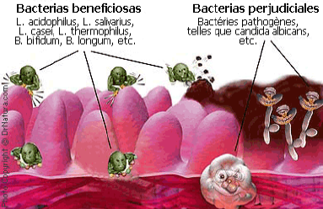
SISTEMA DIGESTIVO DEL POLLO
Según Heinz (2000), el intestino es un órgano complejo que forma parte del tracto gastrointestinal y es el paso obligado de los nutrimentos que sirven de base para el metabolismo, el crecimiento y el mantenimiento.

Slide 11
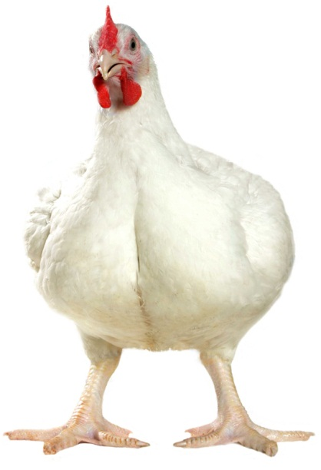
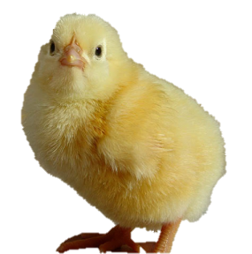
INTEGRIDAD INTESTINAL
PESO
C.A
FUNCIÓN ÓPTIMA
PRIMORDIAL
TRACTO DIGESTIVO
V. DIG
Enteritis bacteriana
Coccidias
FLORA MICROB.
VIDA
EQUILIBRIO
Notes:
aspecto primordial en la crianza de pollos de carne que les permite alcanzar el peso y la conversión alimenticia esperada para la línea genética en cuestión.
Este ecosistema digestivo está en equilibrio y permanece normalmente constante durante toda la vida de un animal adulto.

Slide 12
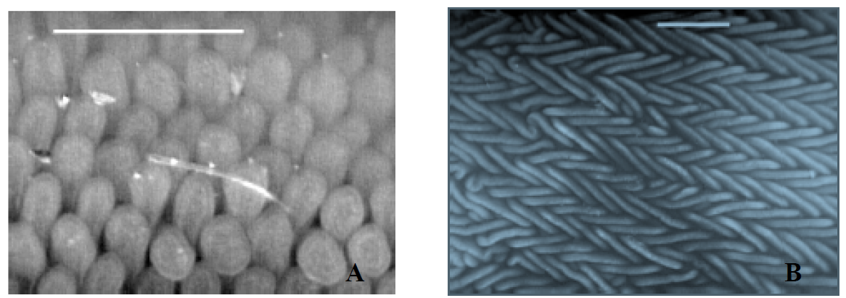
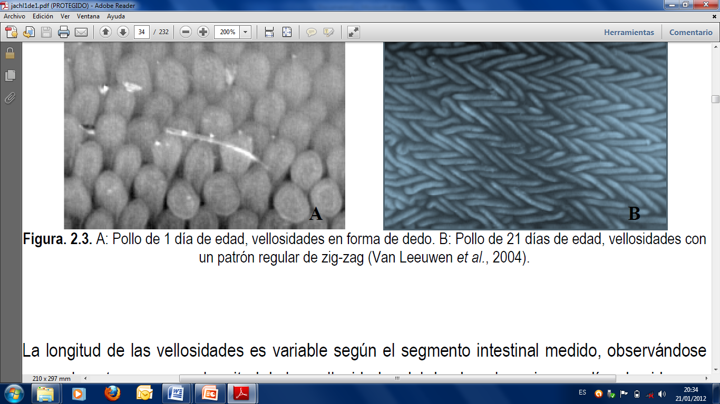
Tipos de Vellosidades en pollos boiler

Slide 13
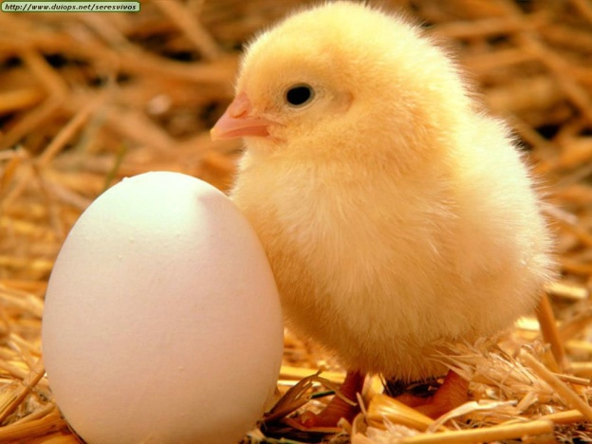
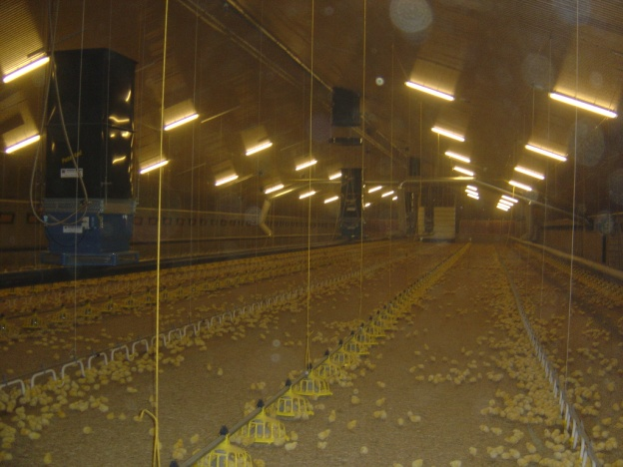
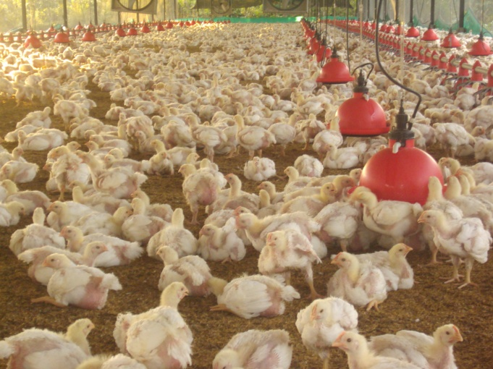
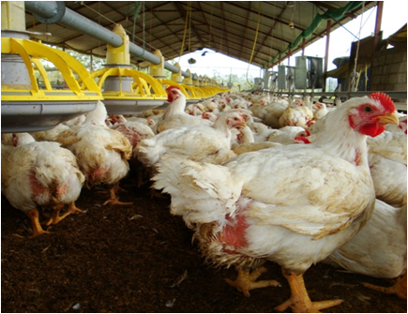
DESARROLLO DE LA MICROFLORA INTESTINAL

Slide 14
MICROFLORA EN LOS DISTINTOS TRAMOS INTESTINALES
Cuadro 1. Tabla de diversidad bacteriana del tracto gastrointestinal de pollos, en función de la variación del pH y el tiempo medio de retención, en minutos (TMR) de la digesta en la fase solida.
Sección intestinal | Contenido digestivo |  | Bacterias
 | pH | TMR
Buche | 4,5 | 31-41 | Lactobacillus ⁺, Estreptococcus⁺ E. coli⁻, Staphylococcus⁺,
Proventrículo | 4,4-4,8 | 39 | Estreptococcus⁺, coliformes⁻
Molleja | 2,6 | 33 | Lactobacillus ⁺
Duodeno | 5,7-6 | 5-10 | Coliformes⁻
Yeyuno | 5,8 | 71-84 | Clostridium ⁺
Íleon | 6,3 | 90-97 | coliformes⁻, Eubacterium⁺, Bacteroides⁻, Staphylococcus⁺, Estreptococcus⁺ Lactobacillus ⁺
Ciegos | 5,7 | 119 | Clostridium ⁺ ,Bacteroides⁻, Eubacterium⁺, Bacillus, Fusobacterium ⁻, Bofidobacteria ⁻
Fuente: Choque (2008).

Slide 15
FUNCIONES Y EQUILIBRIO DE LA FLORA INTESTINAL
Producción de vitaminas y ácidos grasos de cadena corta.
Degradación de sustancias alimenticias no digeridas.
Integridad del epitelio intestinal,
Estímulo de la respuesta inmunitaria.
Protección frente a microorganismos enteropatógenos.

Slide 16
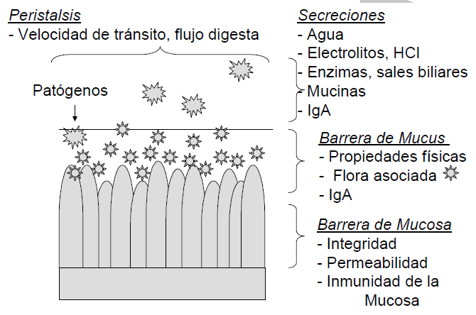
FÍSICO
BIOLÓGICO
QUÍMCO
Exclusión Competitiva
(EC)
BIOQUÍMICO
NUTRICIONAL

Slide 17
LOS PROBIÓTICOS
Un probiótico se define como "un suplemento alimenticio microbiano vivo que beneficia al animal huésped mediante el mejoramiento de su equilibrio microbiano intestinal“. (Yegani, 2010)
El papel más importante de las bacterias probióticas es actuar en resistencia en contra de la colonización de agentes exógenos, patógenos potenciales.
Lactosa
Ac. Láctico, acético
pH 4
Bifidobacterium
Lactobacillus
Notes:
FUNCIONAN COMO ANTI

Slide 18
Potenciar defensas inmunitarias del huésped
Producir sustancias antimicrobianas
Seguridad Biológica
CRITERIOS
PARA UN
PROBIÓTICO
Capacidad de adherirse
mucosa intestinal
Capacidad de ser Toleradas S.I.
Resistir la acción A.G. V y S.B
Nava (2008)
Notes:
ACIDOS GASTRICOS Y SALES BILIARES
Mucosa intest y segmento gastro

Slide 19
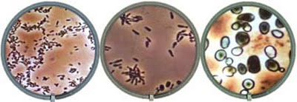
Bacterias ácido lácticas usadas como probióticos
Lactobacillus | Streptococcus | Bifidobacterium
L. acidophilus | S. cremoris | B. bifidum
L. casei | S. salivarius subsp. thermophilus | B. adolescentis
L. delbrueckii subsp. bulgaricus | S. faecium | B. animalis
L. brevis | S. diacetylactis | B. infantis
L. cellobiosus | S. intermedius | B. longum

Slide 20
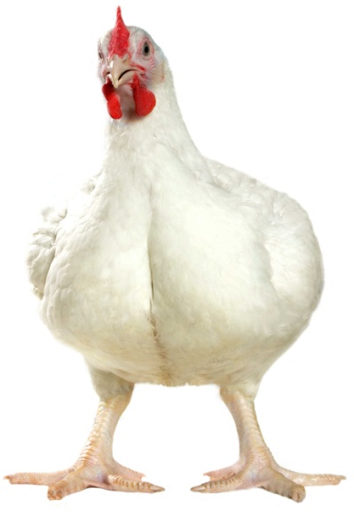
Mecanismos de Acción de los Probióticos
Antibacteriano
Reducción pH
Bacteriocinas
Competencia
Ácidos grasos volátiles
H2O2
Subtilisina
Acidofilina
Nisina
Acidolina
Acidofilina
Espacio físico
Nutrientes
Sitios de adhesión
Incremento Digestibilidad Nutrientes
Reducción pH
Síntesis de vitaminas
Síntesis ácidos grasos volátiles
Producción de enzimas
SUPERIOR USO DE NUTRIENTES
Superior uso de Nitrógeno
Estímulo Respuesta Inmune

Slide 21
BACTERIAS ÁCIDO LÁCTICAS

Slide 22
Co-Existencia
Bacillus subtilis
Bacterias Fototróficas
Levaduras
Bacterias
Acidolácticas

Slide 23
BACTERIOCINAS
Se definen como proteínas y péptidos biológicamente activos, que tienen propiedades bactericidas contra otras especies estrechamente relacionadas, miembros de la misma especie o especies muy relacionadas con la cepa productora (Dolz, 2000).
Son derivados del metabolismo principalmente de algunas bacterias ácido lácticas (BAL), con función antimicrobiana, de naturaleza peptídica, sintetizadas ribosomalmente.

Slide 24
MATERIALES Y METODOS

Slide 25
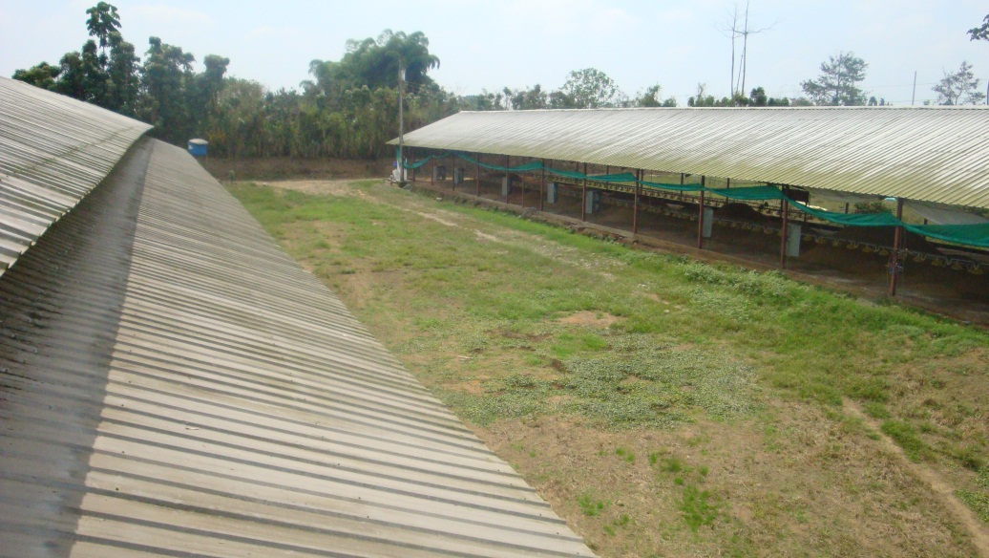
CARACTERÍSTICAS DEL CAMPO EXPERIMENTAL
Ubicación Política
El ensayo de investigación se realizó en la Granja Avícola la Tolita, Integrado de la Empresa Pronaca, Parroquia Luz de América, Provincia Santo Domingo de los Tsáchilas, km 7 de la Vía Santo Domingo-Quevedo margen izquierdo, cinco kilómetros vía a la Reforma.
Notes:
ZONA DE VIDA Bosque Húmedo Tropical
Altitud : 665 msnm.
Temperatura : 18 - 28 ºC
Precipitación : 1600 mm/año

Slide 26
FASE DE LABORATORIO

Slide 27
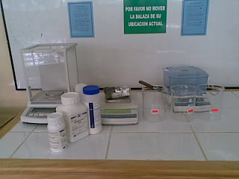
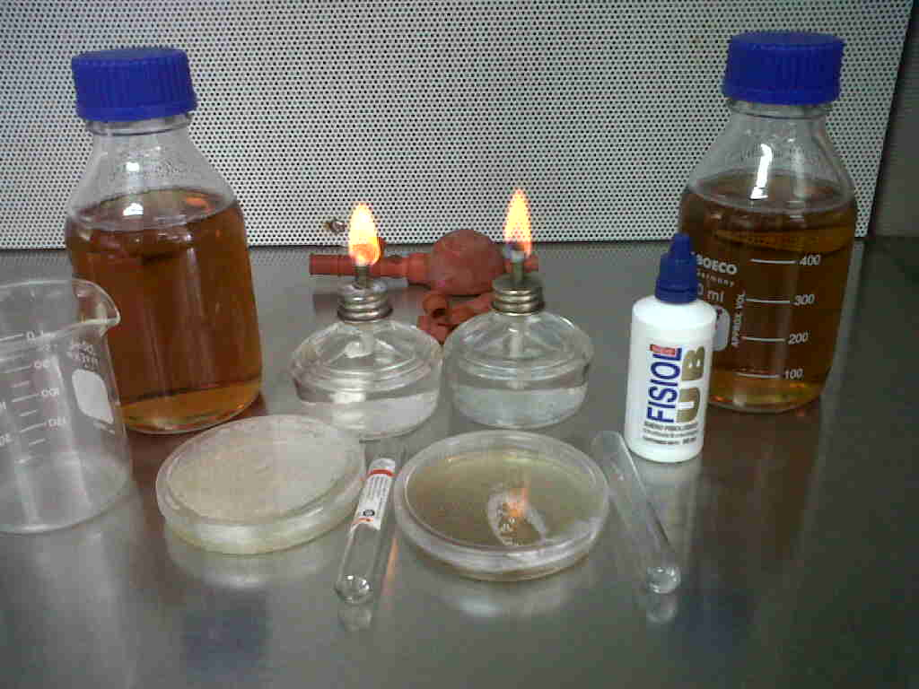
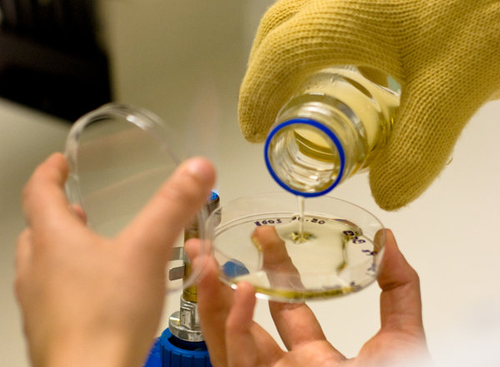
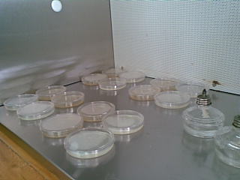
Purificación de colonias
Preparación de medios de cultivos
64 g/l agua destilada
Autoclave 15min/121°C
AGAR MRS

Slide 28
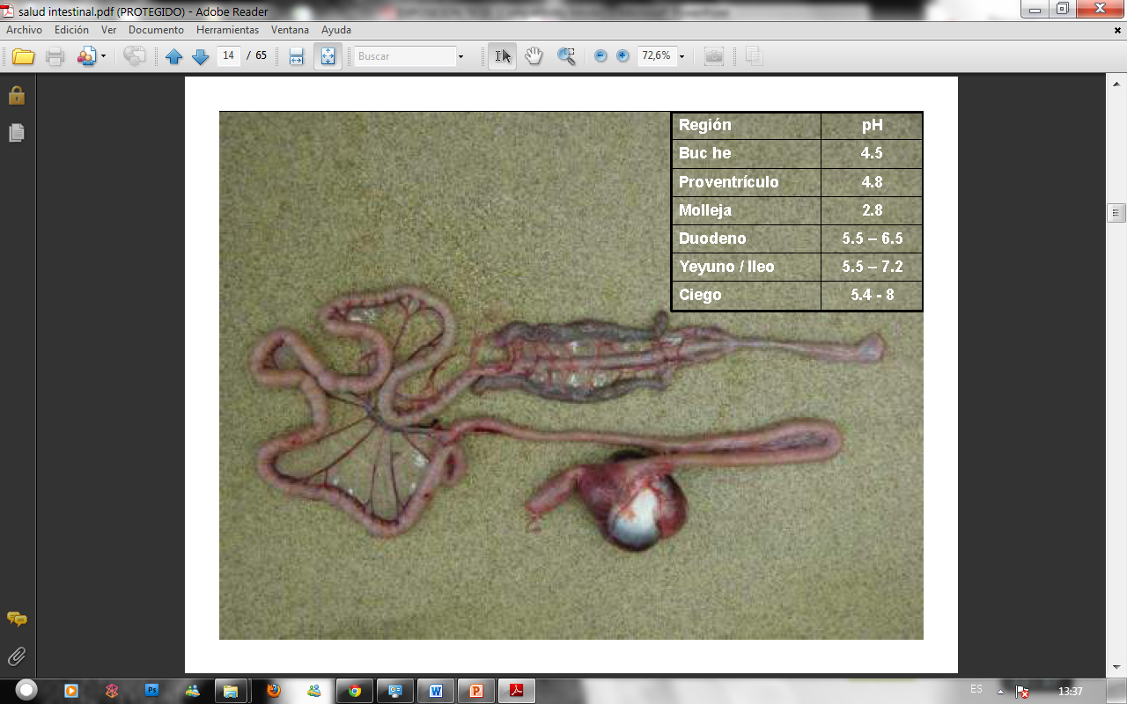
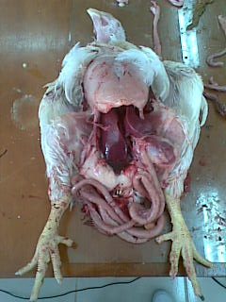
Recolección de muestra
Íleon
Ciegos
Yeyuno
Duodeno
Molleja
Notes:
raspado de la mucosa del íleon y de los ciegos
colocado en 5 ml de suero fisiológico
siembra en cajas petri conteniendo medios específicos para el desarrollo de Bacterias Acidolácticas, Agar y Caldo MRS
incubadora a 28ºC por 48 horas para Lactobacillus
72 horas para Bacillus.

Slide 29
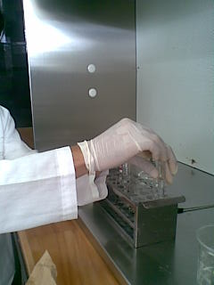
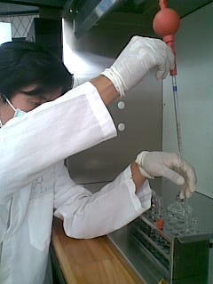
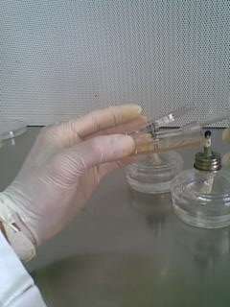
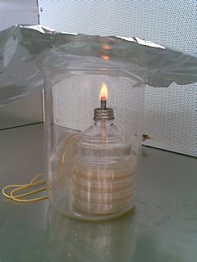
Siembra en medios de cultivo
Lactobacillus a 28 °C x 48 horas
Bacillus a 28 °C x 72 horas

Slide 30
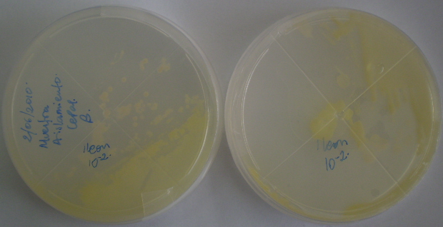
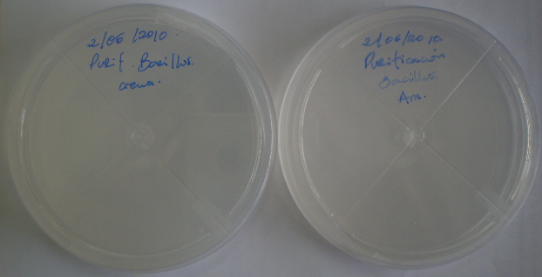
IDENTIFICACIÓN DE CEPAS NATIVAS
Identificación
B - L
med
características
color - textura
Lactobacillus a 28 °C x 48 horas
Bacillus a 28 °C x 72 horas

Slide 31
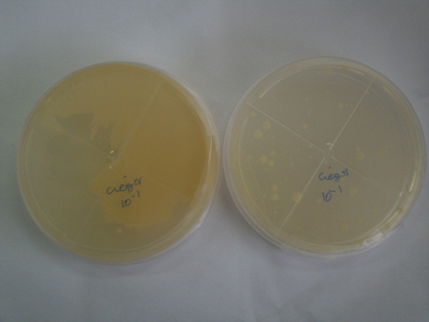
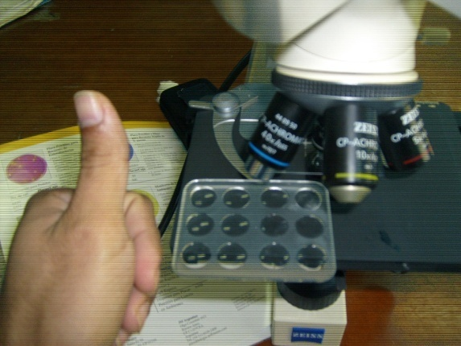
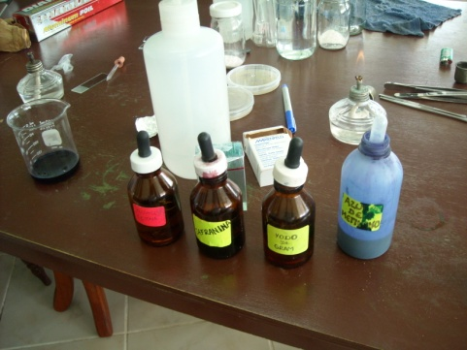
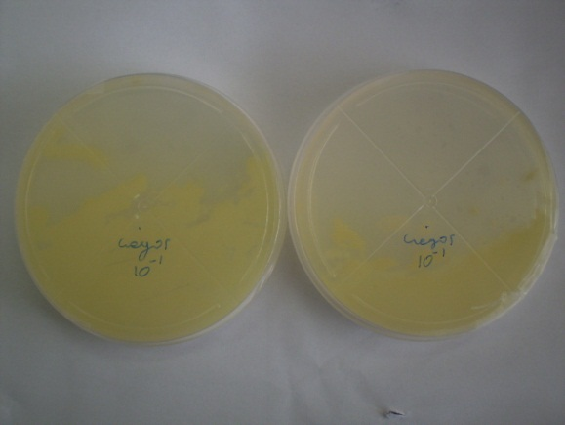
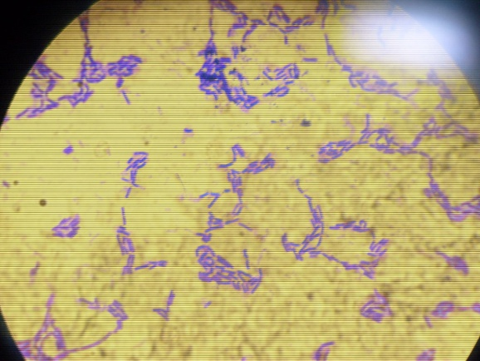
IDENTIFICACIÓN DE CEPAS NATIVAS
Pruebas morfológicas
Azul de metileno
Yodo de gram
Alcohol cetona
zafranina
Notes:
purificar las cepas sembradas características del género Lactobacillus (Borde uniforme y liso, Colonias grandes y densas)
Bacillus (Bordes irregulares, Color blanco a crema, Rugosas, Colonias grandes)

Slide 32
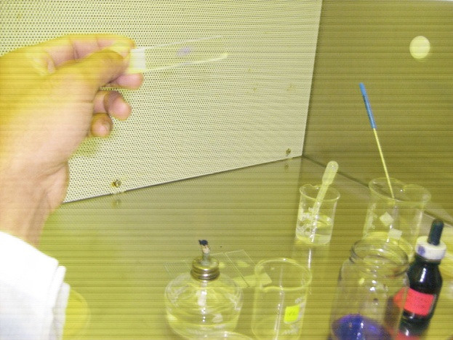
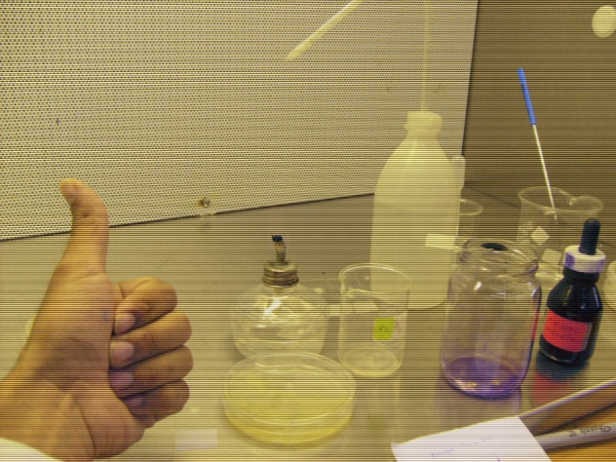
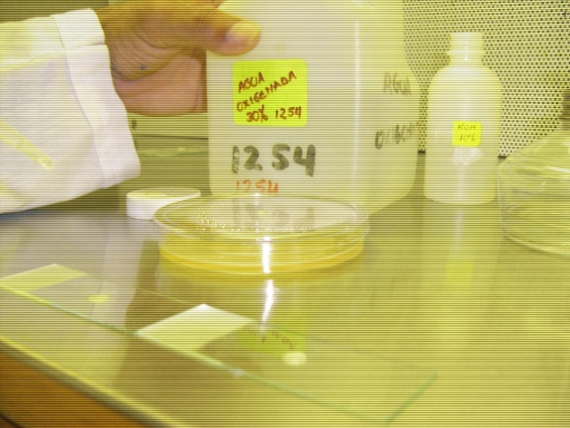
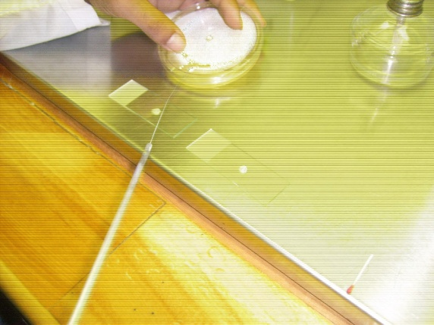
IDENTIFICACIÓN DE CEPAS NATIVAS
Pruebas Bioquímicas

Slide 33
Pruebas Moleculares
IDENTIFICACIÓN DE CEPAS NATIVAS
Se enviaron muestras al laboratorio Concepto Azul

Slide 34
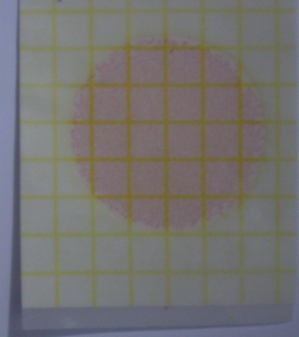
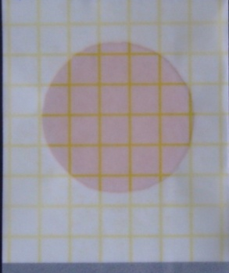
Concentración de bacterias
Lactobacillus 1x10⁷
Bacillus 1x10⁶
La formulación del probiótico permitió el suministro de bacterias viables a las aves en
una cantidad de 10⁷ ufc de Lactobacillus acidophilus y 10⁶ ufc de Bacillus subtilis.

Slide 35
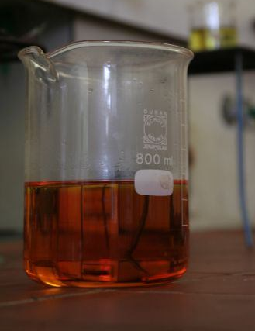
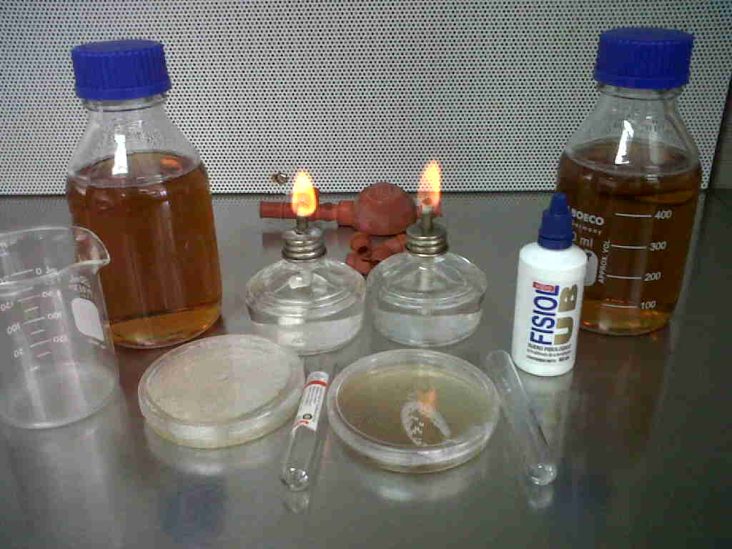
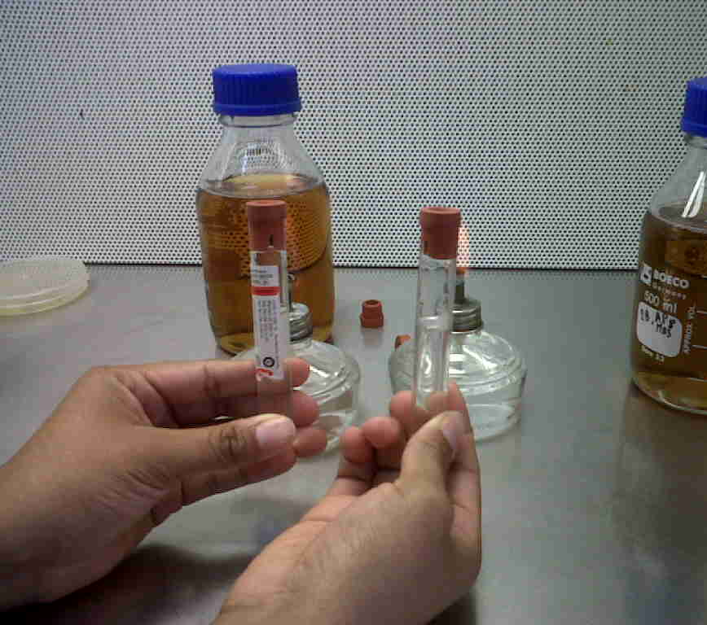
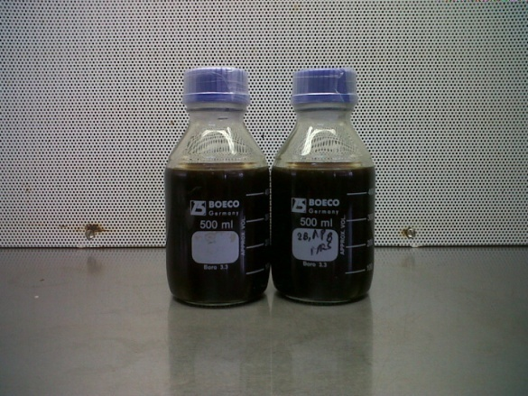
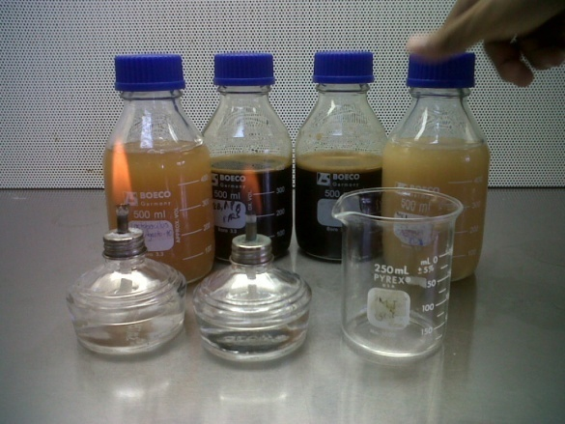
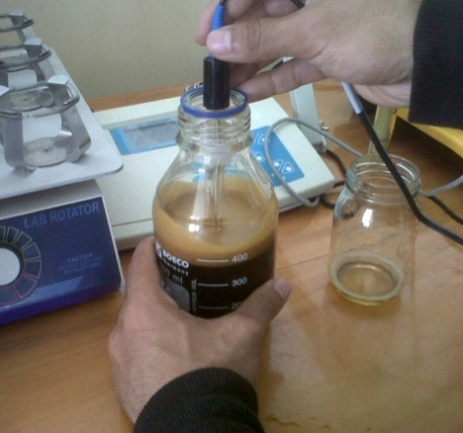
FORMULACIÓN DEL PROBIÓTICO
51 g/l agua destilada
Notes:
Se seleccionó una caja petri purificada de cada bacteria.
Se tomó una muestra de cada caja petri y se inoculó en el medio de cultivo Caldo MRS
para obtener una solución madre del probiótico nativo (SMPN)
se colocó en la incubadora a 28⁰C por 48 horas.
Para la activación del probiótico nativo se tomó una muestra de 10 ml de la solución madre con una pipeta para ser inoculada en una solución de agua más melaza.
De la misma manera se activo el probiótico comercial.

Slide 36
Se seleccionó una caja petri purificada, se inoculó en el medio de cultivo Caldo MRS, para obtener una solución madre del probiótico nativo y se colocó en la incubadora a 28°C por 48 horas.
Para la activación del probiótico nativo se tomó una muestra de 50 ml de la solución madre, 400 ml de agua y 50 ml de melaza. Se dejó fermentar por tres días.
De la misma manera se activo el probiótico comercial, utilizando 100 g del producto liofilizado más 100 ml de melaza y 800 ml de agua obteniendo una solución probiótica de 1000 ml. La activación duró tres días.
Los dos probióticos activados fueron adicionado al agua de bebida dependiendo de la dosis y el consumo diario.
Activación del Probiótico

Slide 37
CALCULO DEL PROBIÓTICO
Edad: 20 días
Consumo de alimento tabla Ross-308: 100 g
Relación agua/alimento: 1,8 l/kg alimento consumido
Aves por tratamiento: 285 pollos
Cantidad de alimento: 285x100: 28,5 kilos
1,8 l agua -----------------kg alimento
x -----------------28,5 kg alimento
X: 51,3 litros de agua/24 horas
51,3 l agua --------------- 24 horas
x --------------- 8 horas
X: 17,1 l agua
X: 25,65 ml del probiótico
X: 51,3 ml del probiótico
X: 76,95 ml del probiótico

Slide 38
Diseño experimental

Slide 39
Factores a probar
Diseño experimental
Tipo y Dosis de probióticos
T₀: 0 ml/l agua
T₁: Probiótico nativo: 1,5; 3,0; 4,5 ml
T₂: Probiótico comercial: 1,5; 3,0; 4,5 ml
b) Lote

Slide 40
Tratamientos a comparar
Diseño experimental
TRATAMIENTO | CÓDIGO | DESCRIPCIÓN
T₁ | Pn₁ | 1,5 ml probiótico nativo/l agua
T₂ | Pn₂ | 3,0 ml probiótico nativo/l agua
T₃ | Pn₃ | 4,5 ml probiótico nativo/l agua
T₄ | Pc₁ | 1,5 ml probiótico comercial/l agua
T₅ | Pc₂ | 3,0 ml probiótico comercial/l agua
T₆ | Pc₃ | 4,5 ml probiótico comercial/l agua
T₇ | Sp | Testigo

Slide 41
Diseño experimental
Tipo de diseño
Diseño de Bloques Completos al Azar DBCA
Observaciones
La investigación constó de tres bloques. Cada bloque fue un ciclo productivo.

Slide 42
Diseño experimental
Características de la UE
Número de UE : 21
Área Total : 297 m²
Área Útil : 231 m²
Forma : Rectangular
Largo : 11 m
Ancho : 3 m
Número total de aves : 5985
Número de aves por bloque : 1995
Número de aves por tratamiento : 285
Número de aves por repetición : 95
3
7

Slide 43
Esquema del análisis de varianza
Fuente de Variación | Gl
Tratamiento | 6
Testigo vs resto |  | 1
P nativo vs P comercial |  | 1
P nativo lineal |  | 1
P nativo cuadratica |  | 1
P comercial lineal |  | 1
P comercial cuadratica |  | 1
Lote | 2
Tratamiento*lote |  | 12
Error experimental | 12
Error de muestreo | 42
Total | 62
Análisis estadístico
DBCA, con 7T, 3Bloques; en diferentes épocas.
Análisis funcional
Prueba de significancia Tukey al 5%

Slide 44



Datos tomados y métodos de evaluación
Peso
Conversión Alimenticia
Mortalidad
Análisis bacteriológico
Eficiencia Europea

Slide 45
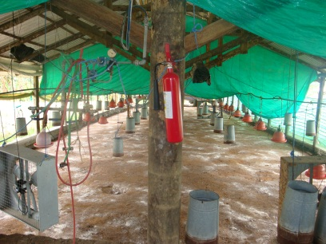
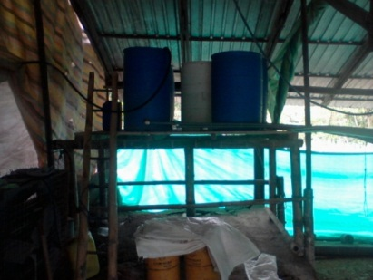
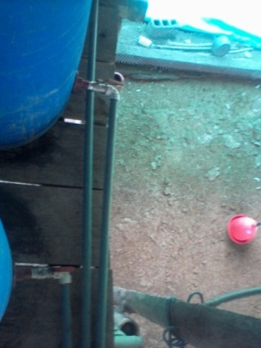
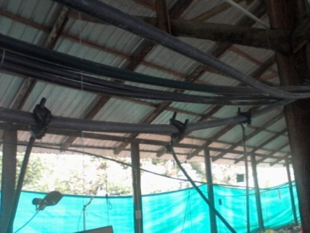
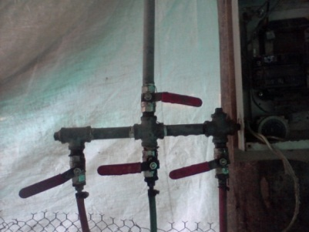

MÉTODOS ESPECÍFICOS DE MANEJO DEL EXPERIMENTO

Slide 46






Slide 47
DATOS DE CONSUMO
LOTES | Cons. Alim (kg)
1 | 9240
2 | 9387
3 | 9499
TOTAL | 28126
TRATAMIENTO | Cons. Probiótico
1 | 0
2 | 65 l
3 | 1 kg

Slide 48
Diseño experimental

Slide 49
FASE DE LABORATORIO
Identificación de los aislamientos bacterianos
En las pruebas bioquímicas y caracterización morfológica realizadas en el Laboratorio de Control Biológico de la Carrera de Ingeniería en Ciencias Agropecuarias Santo Domingo, se obtuvieron los siguientes resultados
Pruebas morfológicas de los géneros Lactobacillus y Bacillus
Género | Forma | Tamaño | Color | Superficie | Tinción gram | Agrupación
Lactobacillus | Bacilar | 2-5 mm | Crema | Cóncava | Positivo | Cadena
Bacillus | Bacilar | 1,2-10 μm | Amarillo | Cóncava | Positivo | Cadena

Slide 50


FASE DE LABORATORIO
Pruebas Bioquímicas de los géneros Lactobacillus y Bacillus
Género | Catalasa | Oxidasa
Lactobacillus | Negativo | Negativo
Bacillus | Positivo | Positivo

Slide 51
FASE DE LABORATORIO
Identificación Molecular de las Cepas Nativas

Slide 52
RESULTADOS DEL LABORATORIO
Secuenciación
Bacillus
1508 pares de bases = 100% de homología
Bacillus subtilis .
Lactobacillus:
1352 pares de bases= 100% de homología
Lactobacillus acidophilus..

Slide 53
FASE DE CAMPO

Slide 54
GANANCIA DE PESO
Fuente de Variación | SC |  | Gl |  | CM | F | Prob.
Tratamiento | 76872,41 |  | 6 |  | 12812,07 | 29,61 | <,0001*
Testigo vs resto |  | 59664,02 |  | 1 | 59664,02 | 302,11 | <,0001*
P nativo vs P comercial |  | 8189,35 |  | 1 | 8189,35 | 41,47 | <,0001*
P nativo lineal |  | 72,00 |  | 1 | 72,00 | 0,36 | 0,5492 ns
P nativo cuadratica |  | 18,96 |  | 1 | 18,96 | 0,10 | 0,7582 ns
P comercial lineal |  | 8888,88 |  | 1 | 8888,88 | 45,01 | <,0001 *
P comercial cuadratica |  | 39,18 |  | 1 | 39,18 | 0,20 | 0,6583 ns
Lote | 4666,95 |  | 2 |  | 2333,47 | 5,39 | 0,0213 *
Tratamiento*lote ¹ |  | 5192,82 |  | 12 | 432,73 | 2,19 | 0,0305 *
Error experimental | 9859,78 |  | 12 |  | 704,27
Error de muestreo | 3627,72 |  | 42 |  | 197,49
Total | 95026,86 |  | 62
CV (%) |  |  |  |  | 0,53
PRUEBA DE TUKEY
Tratamiento | Medias | n | E.E.
T₄ | 2710,00 | 9 | 4,68 | A
T₅ | 2685,22 | 9 | 4,68 | A | B
T₆ | 2665,56 | 9 | 4,68 |  | B
T₁ | 2664,89 | 9 | 4,68 |  | B
T₂ | 2661,11 | 9 | 4,68 |  | B
T₃ | 2660,89 | 9 | 4,68 |  | B
T₇ | 2586,67 | 9 | 4,68 |  |  | C

Slide 55


T | (g)
T4-T1 | 45,11
T4-T7 | 123,33
T1-T7 | 78,22
Hoyos (2008), Cortes y Ávila (2000)
Araujo (2005)
Análisis de correlación

Slide 56
CONVERSIÓN ALIMENTICIA
Fuente de Variación | SC |  | Gl |  | CM | F | Prob.
Tratamiento | 0,1 |  | 6 |  | 0,02 | 39,76 | <,0001 s
Testigo vs resto |  | 0,0715 |  | 1 | 0,0715 | 170,71 | <,0001 s
P nativo vs P comercial |  | 0,0163 |  | 1 | 0,0163 | 39,05 | <,0001 s
P nativo lineal |  | 0,0018 |  | 1 | 0,0018 | 4,30 | 0,0444 s
P nativo cuadrática |  | 0,0000 |  | 1 | 0,0000 | 0,00 | 1,0000 ns
P comercial lineal |  | 0,0098 |  | 1 | 0,0098 | 23,39 | <,0001s
P comercial cuadrática |  | 0,0004 |  | 1 | 0,0004 | 1,13 | 0,2936 ns
Lote | 0,0113 |  | 2 |  | 0,0056 | 13,55 | <,0001 s
Tratamiento*lote² |  | 0,0029 |  | 12 | 0,0002 | 0,58 | 0,8430 ns
Error experimental | 0,01 |  | 12 |  | 0,001 | 2,44 | 1,94 s
Error de muestreo | 0,0087 |  | 42 |  | 0,0004
Total | 0,13 |  | 62
CV (%) |  |  |  |  | 1,11
PRUEBA DE TUKEY
Tratamiento | Medias | n | E.E.
4 | 1,78 | 9 | 0,01 | A
5 | 1,82 | 9 | 0,01 | A | B
6 | 1,83 | 9 | 0,01 | A | B
1 | 1,83 | 9 | 0,01 | A | B
2 | 1,84 | 9 | 0,01 |  | B
3 | 1,85 | 9 | 0,01 |  | B
7 | 1,92 | 9 | 0,01 |  |  | C

Slide 57



T | (g)
T1-T4 | 0,05
T4-T7 | 0,14
T1-T7 | 0,09
Análisis de correlación

Slide 58
MORTALIDAD
Fuente de Variación | SC |  | Gl |  | CM | F | F tab
Tratamiento | 2,79 |  | 6 |  | 0,47 | 8,90 | <,0001
Testigo vs resto |  | 1,392 |  | 1 | 1,39 | 26.63 | <.0001 s
P nativo vs P comercial |  | 0,799 |  | 1 | 0,79 | 15.29 | 0.0003 s
P nativo lineal |  | 0,236 |  | 1 | 0,23 | 4.53 | 0.0393 s
P nativo cuadratica |  | 0,0002 |  | 1 | 0,00021 | 0.00 | 0.9495 ns
P comercial lineal |  | 0,3210 |  | 1 | 0,321 | 6.14 | 0.0173 s
P comercial cuadratica |  | 0,0427 |  | 1 | 0,042 | 0.82 | 0.3711 ns
Lote | 0,18 |  |  | 2 | 0,0899 | 1,72 | 0,1911 s
Tratamiento*lote³ |  | 0,0029 |  | 12 | 0,0002 | 0,58 | 0,8430 ns
Error experimental | 0,54 |  | 12 |  | 0,04
Error de muestreo | 1,91 |  | 42 |  | 0,05
Total | 5,42 |  | 62
CV (%) |  |  |  |  | 11,57
PRUEBA DE TUKEY
Trat | M | n | E.E.
7 | 2,34 | 9 | 0,07 | A
3 | 2,14 | 9 | 0,07 | A | B
2 | 2,04 | 9 | 0,07 |  | B | C
1 | 1,92 | 9 | 0,07 |  | B | C | D
6 | 1,89 | 9 | 0,07 |  | B | C | D
5 | 1,85 | 9 | 0,07 |  |  | C | D
4 | 1,63 | 9 | 0,07 |  |  |  | D

Slide 59



Análisis de correlación

Slide 60
FACTOR EFICIENCIA EUROPEA (FEE)
TRAT. | DOSIS (ml/l) | F.E.E
4 | 1,5 | 342,56
5 | 3 | 338,15
6 | 4,5 | 332,21
1 | 1,5 | 330,49
2 | 3 | 335,08
3 | 4,5 | 330,44
7 | 0,0 | 309,12

Slide 61


RESULTADOS MICROBIOLOGICOS PARA EL TRATAMIENTO TESTIGO

Slide 62

RESULTADOS MICROBIOLOGICOS PARA EL PROBIÓTICO NATIVO

Slide 63

RESULTADOS MICROBIOLOGICOS PARA EL PROBIÓTICO COMERCIAL

Slide 64
Costos variables y beneficios para los tratamientos con la adición de probióticos a base de L. acidophilus y B. subtilis
Trat. | Dosis Prob. (ml) | Total de Costos que varían ($/Trat) | Beneficios Bruto ($/Trat) | Beneficios Netos ($/Trat) | Dom.
7 | 0 | 0 | 2884,2391 | 2884,2391 | nd
1 | 1,5 | 4 | 3026,6321 | 3022,6321 | nd
2 | 4,5 | 8 | 3007,618 | 2999,618 | d
4 | 3 | 9 | 2992,7623 | 2983,7623 | d
3 | 3 | 12 | 3111,5205 | 3099,5205 | nd
5 | 1,5 | 18 | 3057,10618 | 3039,10618 | d
6 | 4,5 | 28 | 3031,06328 | 3003,06328 | d

Slide 65
Análisis marginal de tratamientos no dominados
Trat. | Dosis Prob. | Total de Costos que varían | Beneficios netos | CV marg | BN marg | TRM%
7 | 0 | 0 | 2884,2391 | - | - | -
1 | 1,5 | 4 | 3022,6321 | 4 | 138,393 | 2,8903196
3 | 3 | 12 | 3099,5205 | 8 | 76,8884 | 10,4046904

Slide 66
CONCLUSIONES
Los probióticos no son antibióticos, pero si se usan correctamente junto con medidas nutricionales de manejo y de bioseguridad, pueden ser una herramienta poderosa para mantener la salud del tracto gastrointestinal de las aves, mejorando así su rendimiento zootécnico.
Las bacterias benéficas si contribuyen a inhibir el crecimiento de las bacterias patógenas mediante diversos mecanismos, además de estimular al aparato inmunocompetente, sintetizan vitaminas, que ayudan a mantener sano al animal.
En cuanto a las variables de peso, conversión alimenticia y mortalidad los mejores resultados se obtuvieron con la dosis de 1,5 ml tanto el probiótico nativo y comercial por litro de agua.
La aplicación de bacterias probióticas hace más eficiente el uso y consumo de alimento balanceado ya que con el mismo consumo de alimento permite tener una mejor ganancia de peso final y esta constatado con una conversión de 1,78 que corresponde al T₄.

Slide 67
CONCLUSIONES
Los microorganismos benéficos ayudan a mantener una flora saprofita equilibrada en el sistema digestivo y se obtuvo una mejora en la digestión de los nutrimentos ya que se observó heces consistentes y libres de alimento balanceado.
La inclusión de bacterias probióticas contribuyó a mejorar el estado sanitario de las aves, siendo más efectivas en el tratamiento uno y cuatro con la dosis de 1,5 ml fue la que alcanzó mayor ganancia de peso.
Considerando la alternativa más recomendable económicamente, los tratamientos que presentaron una mejor relación beneficio costo fueron el T₁ y T₃; ambos pertenecientes al probiótico nativo. Las ganancias obtenidas al incrementar la dosis a 3 ml son mayores que las dosis de los tratamientos T₇ y T₁ pero con un incremento de los costos que varían.
Todos los tratamientos a los cuales se les aplicó los probióticos obtuvieron una eficiencia europea adecuada superando la constante cuyo valor es 300. Pero el que mostro ser más eficiente fue el tratamiento cuatro del probiótico comercial debido a que obtuvo un peso más alto, menor mortalidad y baja conversión alimenticia.

Slide 68
RECOMENDACIONES
Se recomienda la inclusión de probiótico nativo o comercial en dosis de 1,5 ml por litro a través del consumo de agua, puesto que mejora la ganancia de peso, mejor conversión alimenticia y sanidad de las aves.
Es necesario buscar nuevas alternativas en la multiplicación de bacterias ácido lácticas nativas, diversos sustratos con y sin esterilización para la reducción de costos en la producción de los probióticos y obtener un producto competitivo y al alcance de los avicultores.
Se recomienda utilizar neutralizante de cloro antes de realizar la inoculación en el agua de bebida, ya que las bacterias mueren en presencia de cloro y otros productos desinfectantes.
Realizar nuevos estudios empleando levaduras u otros microorganismos con características probióticas.
El manejo y preparación de las bacterias debe ser lo mas estéril posible a fin de evitar posibles contaminaciones, alterando la microbiota de la solución.
Se trata de microorganismos vivos y no debemos abusar de ellos.

Slide 69
Para ser competitivo en los mercados actuales, el productor agropecuario moderno debe innovar constantemente y buscar nuevas herramientas y técnicas de producción.
Teruo Higa
GRACIAS

