Slide 1
THE INFLUENCE OF SELF-REGULATED LEARNING IN THE DEVELOPMENT OF ENGLISH SPEAKING SKILL

Slide 2
PART ONE
RESEARCH PROBLEM
SRL AND THE ENGLISH SPEAKING SKILL
PART FIVE
PROPOSAL
PART TWO
THEORETICAL FRAMEWORK AND HYPOTHESIS
PART FOUR
ANALYSIS AND INTERPRETATION OF DATA
PART THREE
METHODOLOGICAL DESIGN

Slide 3
Why Self-Regulated Learning?
Responsibility
Motivation
Learning Strategies

Slide 4
Why the Speaking Skill?
Lack of Knowledge
Shyness
Lack of interest

Slide 5
What is the Self-Regulated Learning?

Slide 6
PARTICIPANTS
Teacher (Guide)
Students
Helps students to:
Define goals, develop a sense of competence, control of behavior, return the sense of challenge
Set goals, have a sense of competence, have control of behavior, live in the sense of challenge

Slide 7
Planning
Monitoring
PROCEDURE
Control
Reaction and reflection

Slide 8
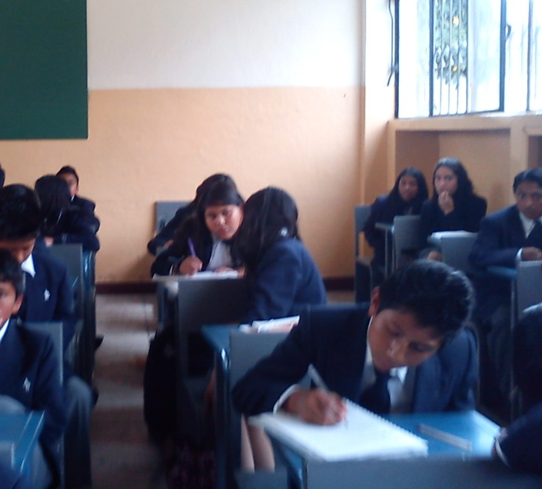
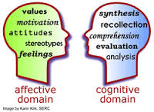
COMPONENTS
Cognitive
Affective
Behavior
Environment

Slide 9
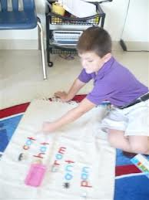
Questionnaires
Causal attributions
INSTRUMENTS
Learning Strategies
Concentrate on school subjects
Take notes
Organize schoolwork
Arrange a place to study
Motivate oneself
Be active participant in class

Slide 10
SPEAKING SKILL
Direct approach
Indirect approach
METHODS
FUNCTIONS
Transaction
Interaction
SOCIAL –CULTURAL RULES AND NORMS
Rate of speech
Length of pauses between speakers
Relative roles of participants

Slide 11
How was the work with the Self-Regulated Learning?

Slide 12
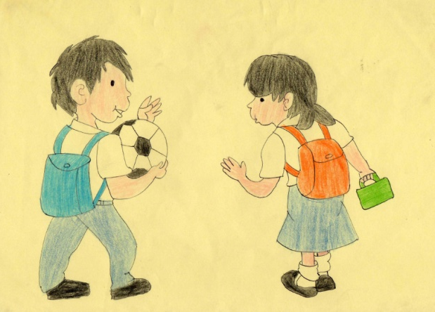
Preparing the instruments...
ANNEX 1
QUESTIONNAIRE OF PRE – POST INTERVIEW
Estimated time: 2 minutes
PERSONAL DATA
What is your name?
How old are you?
What do you do in your free time?
What do you want to be in the future? Why?
ABOUT YOUR HOME TOWN
Where do you live?
Is it quiet or noisy?
Are there any parks or green areas?
ABOUT YOUR FAMILY
Talk me about your family.
Do you have any brothers or sisters? / What are their names? / What are their occupations? Do you have pets?
ABOUT YOUR STUDIES
Do you like to study English? Why?
What subject do you like?
TASK
Could you describe the picture please?
(Annex 2)
ANNEX 2

Slide 13
RUBRIC
To determine the speaking skill level of students attending the eight basic year at Andres Bello High School, before and after the application of the SRL.
 | 0 | 1 | 2 | 3 | 4 | 5
To answer questions about personal information. | No answer (the question was not understood). | Incorrect answer | Indicates an answer using only single words, without a grammatical structure. | Answer mixing the languages English and Spanish | Unstructured but understandable answers, little grammatical and of pronunciation demand. | Well-structured and understandable answers (grammar and pronunciation).

Slide 14
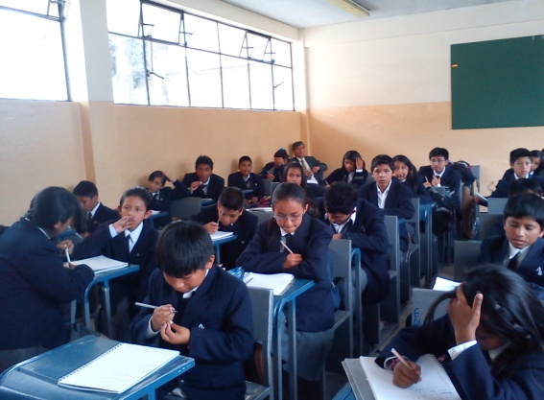
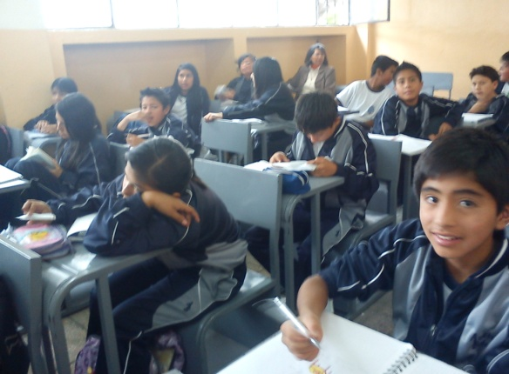
Experimental Group
Course “A”
40 students
Control Group
Course “D”
40 students
Pre-Post interview

Slide 15
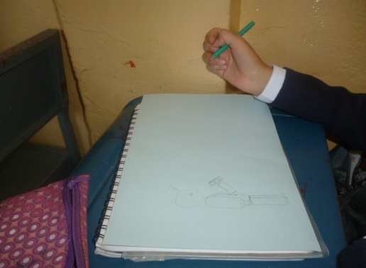
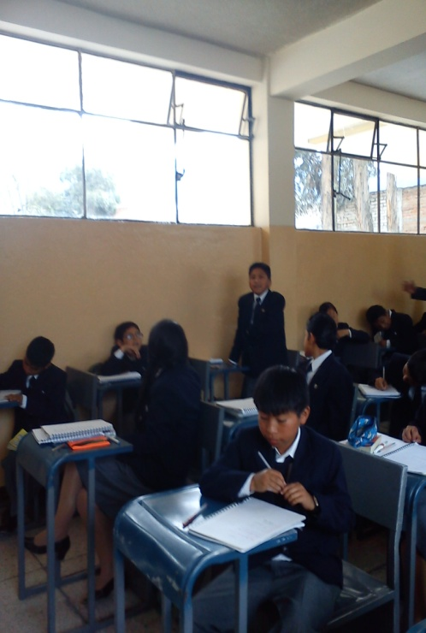
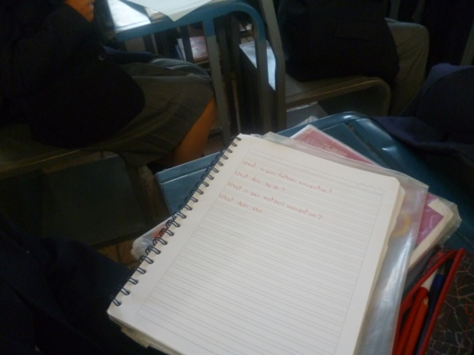
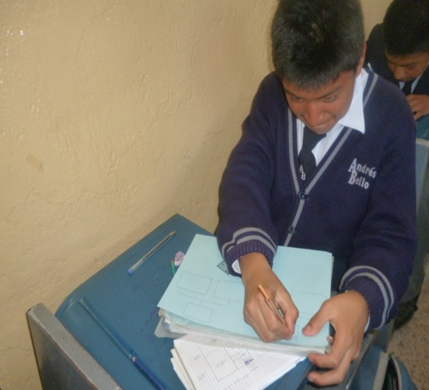
Drawings
Mind Maps
Concept Maps
Memorization
Writing

Slide 16
Was it proved the Hypothesis of The Relationship between the SRL and the development of the speaking skill?

Slide 17
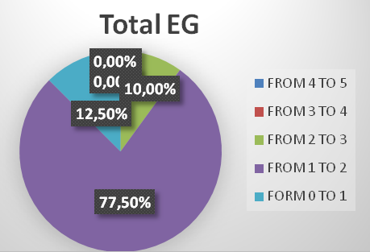
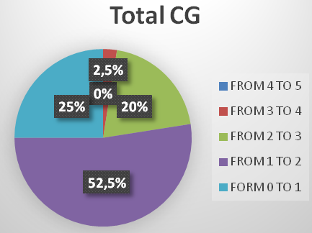
PRE-INTERVIEW
EXPERIMENTAL GROUP - TOTAL BY SCORES |  |  |  | CONTROL GROUP - TOTAL BY SCORES
SCORE | QUANTITY | % |  | SCORE | QUANTITY | %
FROM 4 TO 5 | 0 | 0 |  | FROM 4 TO 5 | 0 | 0
FROM 3 TO 4 | 0 | 0 |  | FROM 3 TO 4 | 1 | 2,5
FROM 2 TO 3 | 4 | 10 |  | FROM 2 TO 3 | 8 | 20
FROM 1 TO 2 | 31 | 77,5 |  | FROM 1 TO 2 | 21 | 52,5
FROM 0 TO 1 | 5 | 12,5 |  | FORM 0 TO 1 | 10 | 25
 | 40 | 100 |  |  | 40 | 100

Slide 18
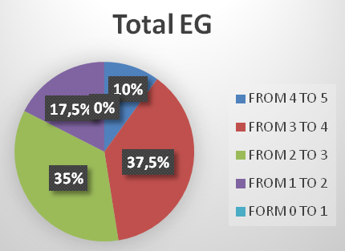
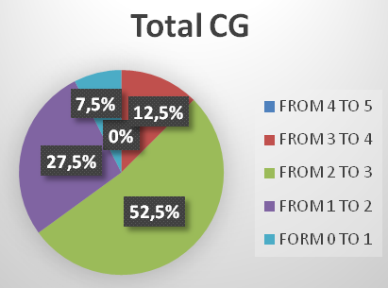
POST-INTERVIEW
EXPERIMENTAL GROUP - TOTAL BY SCORES
SCORE | QUANTITY | %
FROM 4 TO 5 | 4 | 10,0
FROM 3 TO 4 | 15 | 37,5
FROM 2 TO 3 | 14 | 35,0
FROM 1 TO 2 | 7 | 17,5
FORM 0 TO 1 | 0 | 0,0
 | 40 | 100
CONTROL GROUP - TOTAL BY SCORES
SCORE | QUANTITY | %
FROM 4 TO 5 | 0 | 0
FROM 3 TO 4 | 5 | 12,5
FROM 2 TO 3 | 21 | 52,5
FROM 1 TO 2 | 11 | 27,5
FORM 0 TO 1 | 3 | 7,5
 | 40 | 100

Slide 19
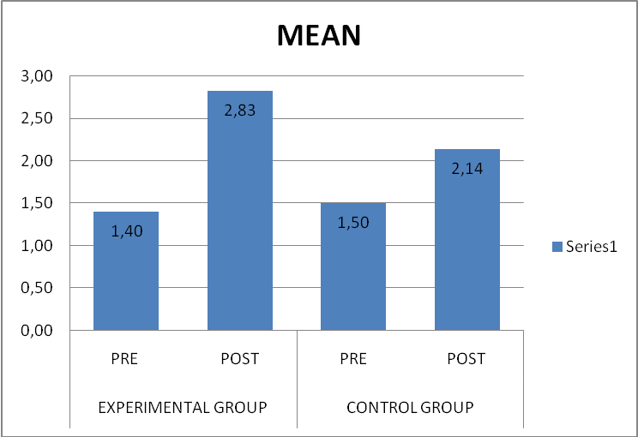
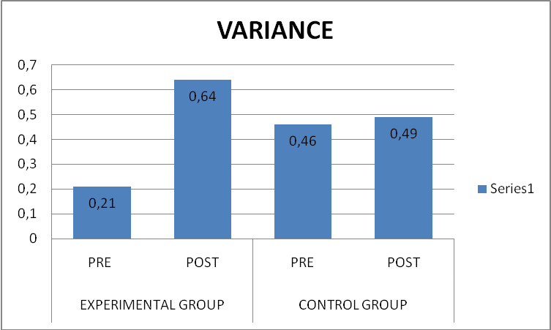
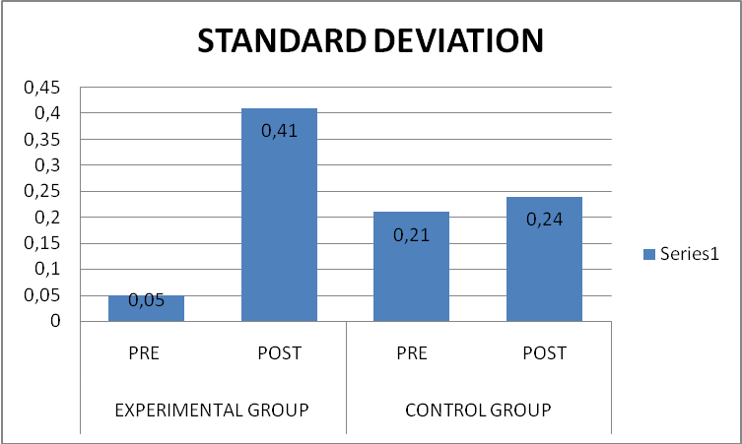
FINAL RESULTS - COMPARISON OF BOTH GROUPS
1.43
0.03
0.64
0.43
0.03
0.36

Slide 20
Conclusion
The self-regulated learning was accepted by students and they developed a positive interest in learning English.
Recommendation
The school should apply the SRL in order to develop the speaking skill, due to the fact that this kind of learning was accepted by the students and it brought about good results.

Slide 21
What is the proposal?
Workshop at Andrés Bello High School for English teachers about the Self-Regulated Learning Method in classroom.

Slide 22
What is the objective of the proposal?
To train the English teachers in order they are ready to handle situations in the actual educational field.

Slide 23
GENERAL INFORMATION
PLANNING
PROPOSAL
CURRICULA
SCHEDULE

Slide 24
General Information
Units and Time
MACRO PLANNING
Resources and Evaluation
Denomination of Each Unit
Methodology

Slide 25
Watching videos
Rain of ideas
LEARNING ACTIVITIES
Exposition
Individual / Group Work
Open-time to doubts/questions

Slide 27
Schedule
January 2014 | Week 1 | Week 2 | Week 3
Organizing the information | X
Elaboration of work material |  | X
Set the date for meeting |  | X
February 2014
Training Theory Background |  | X
Workshop |  | X
Exposition of the group work |  | X
Second period of school year
Project follow
June 2014
Project evaluation
Bibliography
Annexes

Slide 28
Remember that:
Self-Regulated Learning can be applied in order to develop students’ capacities, abilities, skills, and critical thinking in order to improve their language learning.
THANK YOU!

