Slide 1

“THE INFLUENCE OF MOTIVATION IN THE DEVELOPMENT OF READING SKILLS IN STUDENTS ATTENDING 8TH YEAR OF BASIC EDUCATION AT INEPE HIGH SCHOOL DURING THE SCHOOL YEAR 2012-2013”
UNIVERSITY OF THE ARMED FORCES-ESPE
DEPARTMENT OF LANGUAGES
APPLIED LINGUISTICS CAREER
Research project
by: Gabriela Salgado
THESIS DIRECTOR: MG. MARCOS MORALES
THESIS CO-DIRECTOR: MSC. LILIAN AVALOS

Slide 2
Part one
RESEARCH PROBLEM

Slide 3
Problem identification
Cause | Effect
Lack of sufficient vocabulary Lack of motivation Low academic performance | Problems to understand the text Lack of interest in the class Confusing explanations

Slide 4

Problem setting
Main Problem
How does motivation influence in the development of reading skills in the students from 8th year of basic education at INEPE High School?
Secondary problems
How do inadequate texts affect the development of the reading skills of students from 8th year of basic education?
How do old practices influence in the development of reading skills with the students from 8th year of basic education?
How do the lack of teachers’ training affect the improvement of reading in students from 8th year of basic education?

Slide 5
Objectives
General objectives
To analyze the influence of motivation in the development of reading skills in students attending 8th grade at INEPE high school.
Specific Objectives
To involve the students with authentic material in order to increase the interest for reading
To apply appropriated motivational strategies in order to develop reading skills
To design a sample of interactive reading activities for teachers

Slide 6
PART TWO
THEORICAL FRAME

Slide 7
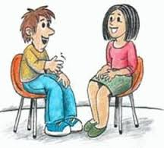



Motivation
Motivation in a second language
internal and external forces that lead to the initiation, direction, intensity and persistence of behavior.
Gardner defined motivation as a “combination of effort plus desire to achieve the goal of learning the language plus favorable attitudes towards learning the language”
Types of motivation
INTRINSIC(satisfaction and interest that people feel when develop an activity)
EXTRINSIC (to get a reward or achieve a goal)
Two kinds of motivations affect language acquisition
Integrative motivation (to participate in the life community)
Instrumental motivation (for utilitarian reasons)

Slide 8



Motivational strategies in class
MOTIVATIONAL STRATEGIES IN CLASS
Group work
Games ( creative and spontaneous use of the language , promotes communicative competence , motivates and entertains. )
Using realia, flash cards, Stories and songs
Using audio visual material: cassette player, video, computer…

Slide 9

READING
Reading is a receptive skill like listening, it involve s responding to the text rather than producing it.
Kinds of reading skills Reading Strategies
Decoding (produce sounds)
Comprehension ( construct meaning)
Fluency ( read using proper expressions)
Vocabulary ( know phrases, phrasal verbs, idioms)
Reading for specific information or scanning
Reading for gist or skimming
Extensive reading (long pieces of text )
Intensive reading (examine language)

Slide 10



Planning activities to improve reading
Before reading
During reading
Predicting from words
Comprehend the text and recognize vocabulary
Predicting for title or first sentence
Pausing and predicting
After reading
Predicting for key illustration
use the new words in a story
Make cartoon strips and make story or a dialogue in speech bubbles.

Slide 11

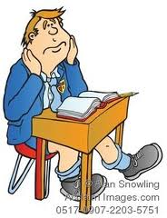

MOTIVATION IN THE DEVELOPMENT OF READING SKILLS
Without motivation a reading program is impossible and it can result incomplete .
Intrinsic reading motivation is refers to the excitement or enjoyment that students feel when they are reading a book
Extrinsic reading it refers to external rewards or recognition
Curiosity
Involvement
Preference for challenge
Recognition
Grades
Social reading
Competition
Compliance

Slide 12


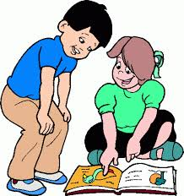

Strategies to motivate students to read
Teachers’ enthusiasm (presenting activities in an interesting way)
Help students to understand the text (unfamiliar words, lack of back knowledge, complex syntax, polysemy)
Authentic reading material ( magazines, newspapers, comics, stories, lyrics songs)
Web resources ( students’ world is related to the web)

Slide 13
Part III
METODOLOGICAL DESIGN

Slide 14


Descriptive of field
METHODOLOGICAL DESIGN
POPULATION AND SAMPLE SIZE
31 students from 8th grade of basic education
FIELD WORK
INEPE High school
INSTRUMENTS FOR DATA COLLECTION
Survey s directed to teachers and students

Slide 15


Hypothesis system
Working hypothesis
Motivation in students does influence in a positive way in the development of reading skills
Null hypothesis
Motivation in students does not influence in a positive way in the development of reading skills

Slide 16
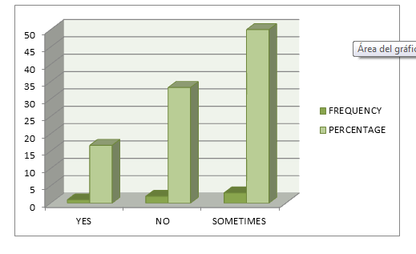
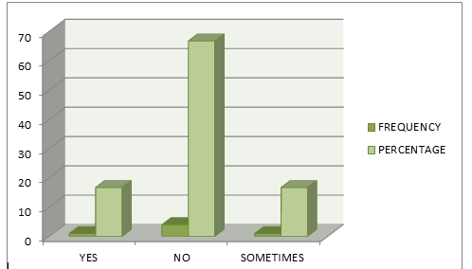
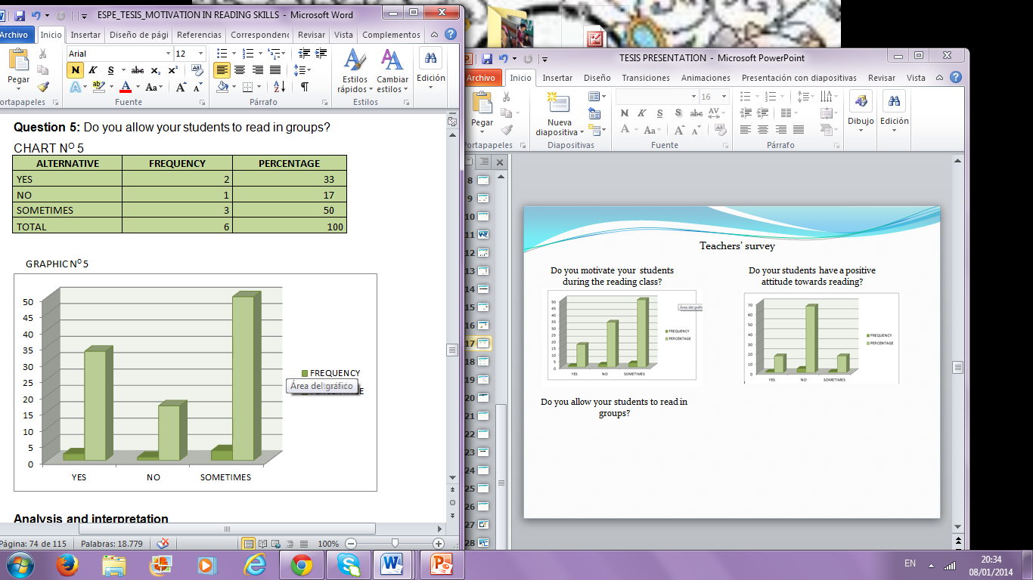
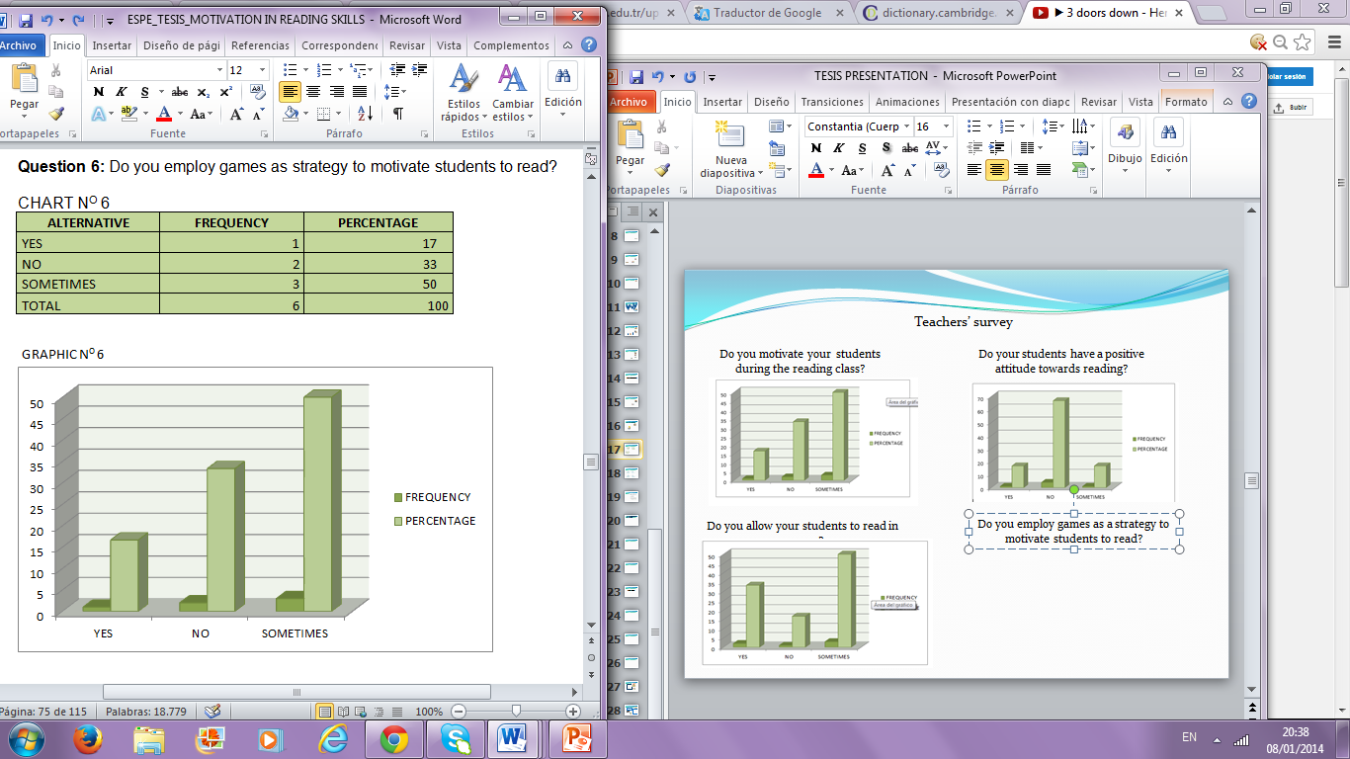
Teachers’ survey
Do you motivate your students during the reading class?
Do your students have a positive attitude towards reading?
50%
33%
66%
17%
17%
17%
Do you allow your students to read in groups?
Do you employ games as a strategy to motivate students to read?
50%
50%
33%
33%
17%
17%

Slide 17
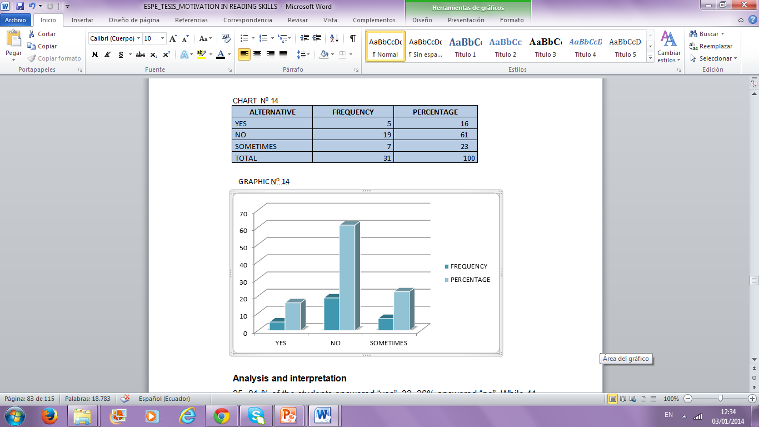
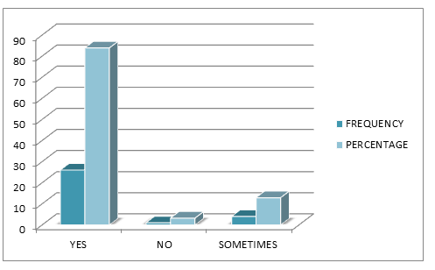
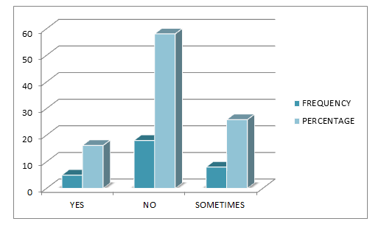
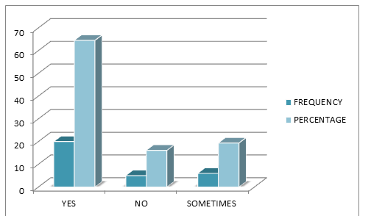
Students‘ survey
Do you like to read in English ?
Do you like to read in groups?
61%
84%
16%
23%
3%
13%
Are you interested in your English class?
Do you enjoy reading topics as fashion, music or technology?
58%
65%
26%
16%
16%
19%

Slide 18
Chi square calculation
Significance level
α = 0.05 significance level
95% reliability
Theoretical chi square
GL = (c – 1) (f – 1)
GL = (3 – 1) (2 – 1)
GL = 2 x 1
GL= 2
x²_{t} = 5, 99
Chi square calculation
If x^{2<} x^{2 non accepted}
If x^{2>}x ^{accepted}

Slide 19
Statistical Decision for Specific Hypothesis
Once calculated chi squared (10,9), it is higher than the theoretical chi squared (5, 99). So , the working Hypothesis is accepted. This means that there is a meaningful relationship between the influences of motivation in the development of reading skills.

Slide 20
Conclusions | Recommendation s
Most of teachers don’t use strategies to motivate students to read however motivation is consider essential in the reading process. The use of motivational strategies helps students to improve and increase their reading skills and involve them in a positive attitude towards reading. Interesting reading material is considered important in order to increase students’ reading motivation. | In order to involve students into the reading process teachers must use motivational strategies to increase students’ interest. In order to increase student motivation teachers must use effective strategies to motivate their students in the reading class. Therefore teachers need to learn new ways to present the activities in an interesting way. It is important the use of attractive material to increase students’ interest. If the material is interesting and not too difficult , students will enjoy reading and will be encouraged to read more.

Slide 21
Proposal
Interactive reading games as a motivational strategy to improve reading skills

Slide 22
Data Information
Institution: INEPE high school
Address: Barrio La Dolorosa de Chilibulo, Calle Chilibulo Oe 10-189
Location: Quito-Ecuador
The proposal consists of suggest some reading activities through games in order to motivate students to read. Games are frequently used by teachers in their English class because it is a useful tool to acquire English in a natural way.
Background

Slide 23
OBJECTIVES
General objectives
To propose interactive reading activities to motivate students to read
Specific objectives
To adapt some games for the reading class
To provide teachers with innovative reading activities to improve students’ reading skills
FEASIBILITY AND ANALYSIS
The proposal is acceptable because it only requires some copies about short readings that will be provided by the school, the teachers’ predisposition and time and also the equipment that exist in the same school like a projector and a computer.

Slide 24
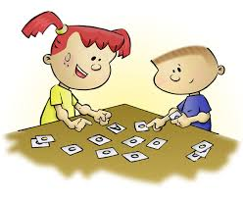
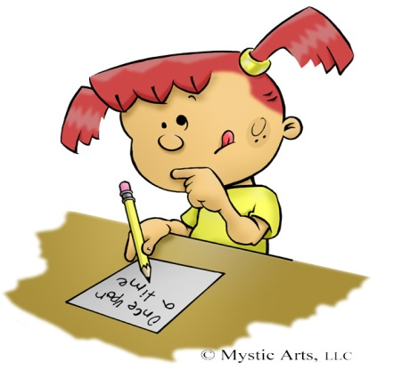

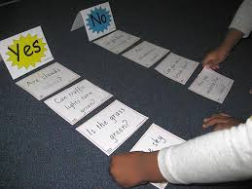

ACTIVITIES
Activities # 1.- Read run and write
Objective: To retell information about the text
Methodology: the class is divided in groups of three, and the students are given different roles to be performed.
Development of activity # 1
The teacher divides the class in groups of three and assigns the roles of “writer, reader and runner”, then the teacher gives the students interesting short text readings with easy vocabulary.
Activity # 2: Read and retell
Objective: to retain new vocabulary
Strategy: the teacher divides the class in two groups and carefully explains what each group has to do and also the purpose of this activity.

Slide 25
Thanks

