Slide 1
UNIVERSITY OF THE ARMED FORCES-ESPE DEPARTMENT OF LANGUAGES APPLIED LINGUISTICS CAREER
Research project
“THE INFLUENCE OF DIGITAL CLASSES AS DIDACTIC MATERIAL TO IMPROVE THE ENGLISH TEACHING – LEARNING PROCESS FOR STUDENTS ATTENDING FOURTH GRADE OF BASIC EDUCATION, AT UNIDAD EDUCATIVA FAE Nº 4, DURING THE ACADEMIC THIRD TERM 2012 – FEB 2013”
by: Karla Guayasamín
THESIS DIRECTOR: MSC. OSWALDO VILLA.
THESIS CO-DIRECTOR: MSC. MARCELA ROSERO.

Slide 2
Part one
RESEARCH PROBLEM

Slide 3
Problem identification
Cause | Effect
Lack of teacher’s initiative to create their own teaching material. Scarce application of strategies. Lack of teacher’s motivation for using the technological equipment. | Few application of teaching materials. The English teaching learning process is traditional. Few active participation of the students.

Slide 4
Problem setting
MAIN PROBLEM
Do the digital classes as didactic material influence the English teaching
Learning process for students attending the fourth grade of Basic
Education, at Unidad Educativa FAE Nº 4 ?
SECONDARY PROBLEMS
Are there sufficient teaching materials for the teaching – learning process for students of fourth grade of Basic Education?
What types digital materials are being used in the English teaching-learning process for students of fourth grade of Basic Education ?
What are the most adequate teaching materials and equipment to work with children of fourth grade of Basic Education?

Slide 5
VARIABLES MATRIX
VARIABLES
Independent Variable
The digital classes as didactic material.
Dependent Variable
The English –Teaching learning process.

Slide 6
OBJECTIVES
To analyze the impact of the digital classes as educational support to the classroom practices in the English language teaching – learning process for students of fourth grade of Basic Education, at Unidad Educativa FAE Nº 4 .
General
Specifics
To evaluate the perception of teachers and students about the digital classes.
To design a set of digital classes as an experiment.

Slide 7
PART TWO
THEORETICAL FRAME

Slide 8
The digital classes as didactic material.
Digital equipment
Digital resources
Computer
Tablet
DVD
Projector
Games and activities
Free lesson using power
point.
Videos on internet for kids
Songs on internet
Matching activities

Slide 9
The English teaching – learning process
Methods
Techniques
Strategies
Curriculum & pedagogy
Classroom environment & culture
Types of
Methods
Types of
Techniques
Types of
Strategies
-Teaching approach.
-Scaffolds for learning.
Physical environment
-Grammar translation method.
-Direct Method.
-Audio Lingualism.
-Total Physical Response.
-Design thinking.
-Self learning.
-Gamification.
-Free online learning tools.
-Learn to think language.
-Select language situation.

Slide 10
Hypothesis system
Working hypothesis
The development of digital classes as didactic material will improve teaching- learning process at UNIDAD EDUCATIVA FAE No 4, fourth grade of Basic Education.
Null hypothesis
The development of digital classes as didactic material will not improve teaching- learning process at UNIDAD EDUCATIVA FAE No 4, fourth grade of Basic Education.

Slide 11
Part III
METHODOLOGICAL DESIGN

Slide 12
METHODOLOGICAL DESIGN
Quasi Experimental
Experimental group: 26 students
Control group :26 students
POPULATION AND SAMPLE
FIELD WORK
Unidad Educativa FAE No 4
INSTRUMENTS FOR DATA COLLECTION
Survey based on questionnaire for teachers.
Pre and post test.

Slide 13
Part IV
TESTING THE HYPOTHESIS

Slide 14
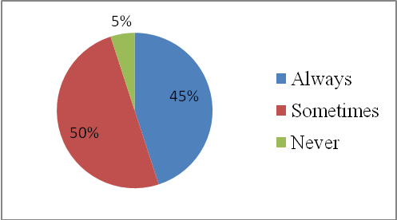
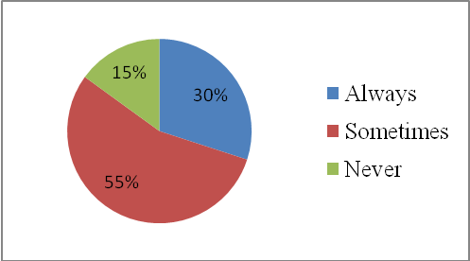
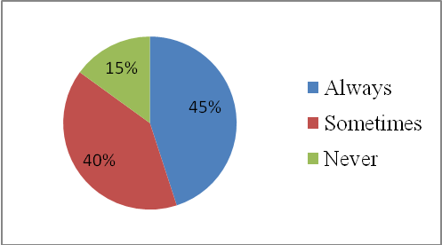
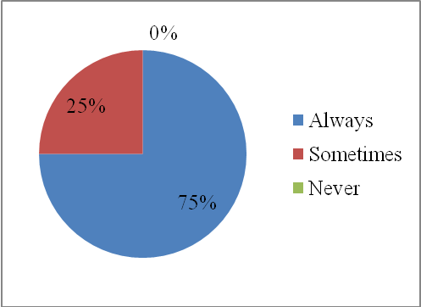
Teachers’ survey
¿Are you motivated to teach by applying digital classes in this educational institution?
¿Are the digital classes easy to apply in your institution?
¿Do the digital classes help to students in the educational process?
¿Do your students use the didactic materials to do activities in their classroom?

Slide 15
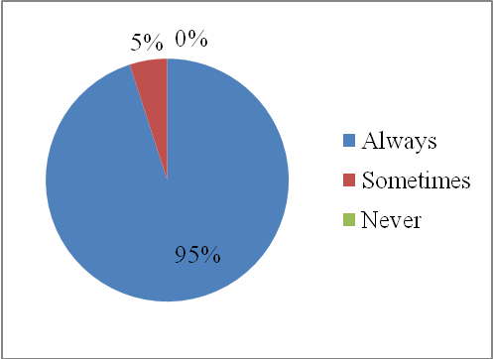
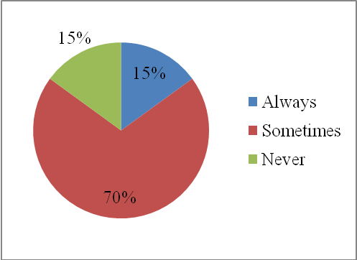
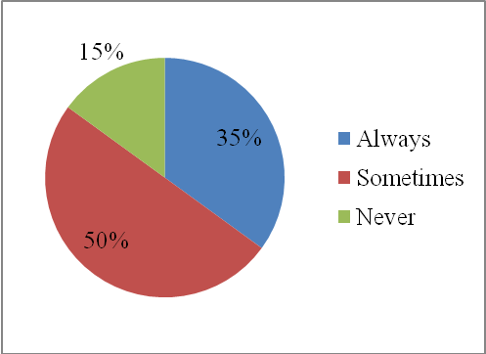
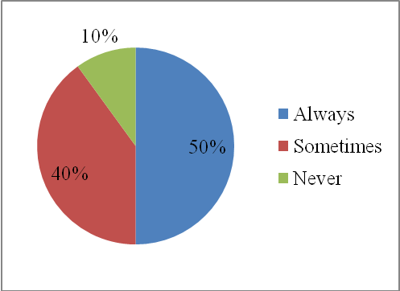
¿Are the digital classes motivating for the students in the teaching – learning process?
¿Is technology available in the institution for teachers and students to do their tasks?
Among the technological tools available at the institution, ¿ Do you use with most frequency the computer - projector?
¿Do you like to apply the technology in the classroom?

Slide 16
SUMMARY OF THE TEACHERS´ SURVEY RESULTS
Level of confidence : 95
Significance level : 0,05
Critical value: 12,338
X ²: 87,67
The working hypothesis is accepted and the null is reject, because the chi – square value is higher 87, 67 than the critical value 12,338.

Slide 17
POST TEST RESULTS
POST - TEST
 | CONTROL GROUP B | EXPERIMENTAL GROUP A
MEAN | 14,98 | 18,48
VARIANCE | 11,97 | 2,29
STANDARD DEVIATION | 3,40 | 1,51
In the investigation the result of T student value is – 4,76, the probability α = 5% and the
degrees of freedom is 50 with the critical value of 2, 01 in the region of acceptation, then I accepted the logic hypothesis: The development of digital classes as
didactic material will improve teaching –learning process at UNIDAD EDUCATIVA FAE
No 4, fourth grade of Basic Education.

Slide 18
Conclusions | Recommendations
Digital Classes improved the teaching -learning process. Incorporate digital classes in a dynamic way. This research was conducted with the intention of finding a pedagogical strategy to help children in fourth grade of Basic Education, at Unidad Educativa FAE No 4. | To continue working with children this kind of projects. English teachers for searching in the field of technology for the incorporation of new technological tools in their classes.

Slide 19
Part V
PROPOSAL

Slide 20
Proposal
How use the digital classes in the learning process for students attending the fourth grade of basic education, at Unidad Educativa FAE Nº4.
Notes:
Fae

Slide 21
Institution: Unidad Educativa FAE Nº4
Address: Vía a Jaramijo
Location: Manta-Ecuador
Data Information
The proposal consists in the application of digital classes in the classroom with the correct use of technological tool .
Background

Slide 22
OBJECTIVES
General objectives
To design digital classes to help English language teachers to know, manage and develop techniques in the implementation of technological tool, for the teaching -learning process.
Specific objectives
To provide teachers with more ideas and strategies to incorporate technology in the classroom.
To develop on the teachers professional competencies that allow their students to learn in a fun and dynamic way.

Slide 23
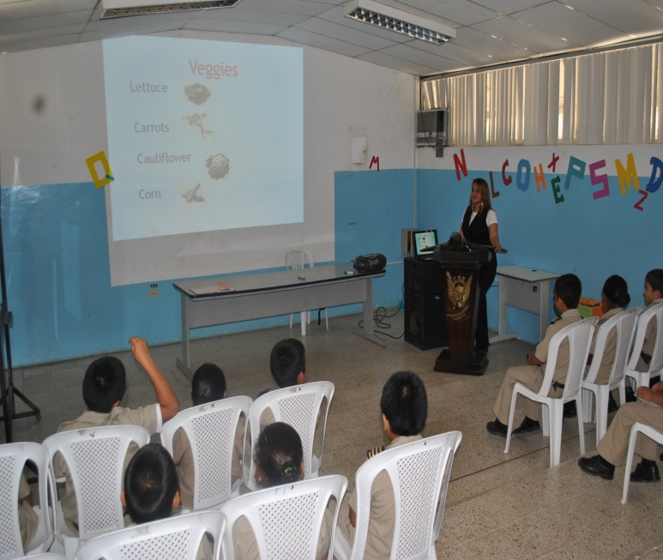
ACTIVITIES
Activities # 1.- Presentation of vocabulary in power point.
Objective: To motivate to the students in the learning of the vocabulary.
Human and technological resource:
Computer
Projector
Teacher
Students
Development of activity # 1
The teacher presents the vocabulary to the students, then the students identify each word and practice the pronunciation of words.

Slide 24
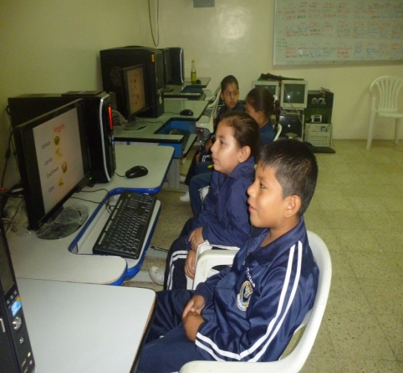
Activities # 2.- Matching
Objective: To choose the correct answer.
Human and technological resource:
Computer
Teacher
Students
Development of activity # 2
The teacher explain the activity to the students then the students listen the possible answers and they match the correct.

