Slide 1

DEPARTAMENTO DE ELÉCTRICA Y ELECTRÓNICA
INGENIERÍA EN ELECTRÓNICA Y TELECOMUNICACIONES
TEMA: ‘CARACTERIZACIÓN DE SEÑALES SÍSMICAS DEL VOLCÁN COTOPAXI UTLIZANDO ESTIMADORES ESPECTRALES CLÁSICOS Y DE MÁXIMA ENTROPÍA’
AUTORA: JARAMILLO ARANHA, CAROLINA ESTEFANÍA
DIRECTOR: MSC. LEÓN, RUBÉN
CODIRECTOR: MSC. LARA. ROMÁN
SANGOLQUÍ, MAYO 2015

Slide 2


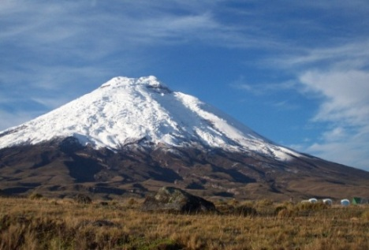



Caracterización de Señales Sísmicas del Volcán Cotopaxi utilizando Estimadores Espectrales Clásicos y de Máxima Entropía

Slide 3

Agenda
Introducción
Metodología
Diagrama de bloques de procesamiento
Descripción de Etapas
Resultados
Gráficos Resultantes caracteristicos de eventos de interés
Características de eventos analizados
Conclusiones y Trabajos Futuros
Impacto y Beneficiarios
Propuesta
Notes:
We wil continued

Slide 4
Agenda
Introducción

Slide 5


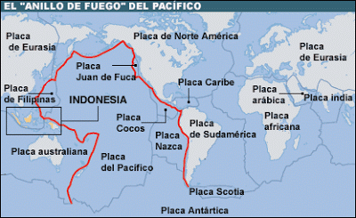
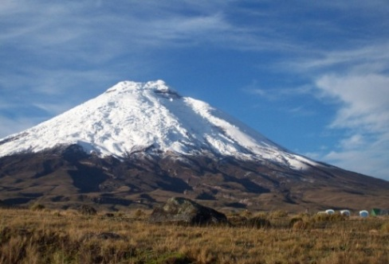
INTRODUCCIÓN
En etapas de Erupción
En cambios de actividad sísmica
Permite el estudio
Patrones de comportamientos volcánicos
Cotopaxi
Intensa actividad sísmica y volcánica
Anillo de Fuego del Pacífico
Notes:
Volcanic seismic activity allows us to study behavior patterns of volcanoes in eruption stages or in changes in level of seismic activity.
In our study we use a data set of seismic events from Cotopaxi volcano located near to Quito, Ecuador(5897). Its seismic activity is due to belonging to the Pacific Ring of Fire, the same which is characterized by Intense Seismic and Volcanic Activity.

Slide 6

INTRODUCCION
LP
TRE
HYB
VT
VT
Seismic and Volcanic Activity
Notes:
The volcanic seismic activity is particular and own each volcano, however have been defined 4 categories of seismic events or behaviors according to their development in time domain, frequency and source. These types of events are: Long Period (LP), thremor, hybrid, volcano tectonic all with different characteristics in each volcano.
Experts volcanologists say that for Cotopaxi volcano, An intensification of VT events can involve an increase in volcanic activity that could precede an eruption.
These studies are important to define prevention strategies to volcanic activity that could cause disasters with potential social, economic and environmental impacts.

Slide 7
INTRODUCTION
LP
TRE
Ruido
VT
HYB
Amplitud [cuentas]
Tiempo [s]
Notes:
This is an example of a seismic record where the x axis represent the time domain and y axis the amplitud of the signal in cuentas.
Inn the signal is possible find one or more volcanic events, and also noise signals product from various sources such as vibrations caused by lightning strikes, gusts of wind, landslide, movement of stones, among other sources.
Is this the reason to use different processing techniques of signals, for to try to identify volcanic events from signal contaminated with noise .

Slide 8
Agenda
Metodologia

Slide 9
METODOLOGIA
PROPUESTA
Procesador de la Señal
Entrenamiento
Sistema de Monitorización (WSN)
Datos brutos
Reglas de decisión
EWBS
(Early warning Broadcast System)
Alerta
Notes:
This a diagram of a early warning broadcast system deploy to alert in cases of volcanic eruptions.
This system consists of various stages such as the deployment of network sensors, signal processing, training systems or processes for making decisions to define correctly alerts.
System like this and other to look for detected and find characterized the seismic signal need the stage of procesing data.
Our investigation is centered on Processing data stage.
In the study of seismic signals there are two important stages: the detection and identification of seismic events.
Actually for the detection of volcanic events, Short Term Average to Long Term Average (STA/LTA) are the most used techniques to detect events in the time domain. In this study, we present a detector that operates in binary hypothesis test. We are interested in determining if this method presents a good detection rate, that will later allow us with the maximum entropy method to characterize seismic events of type VT and LP.

Slide 10

METODOLOGIA
Etapas de Análisis Propuesto
Notes:
The proposed analysis method consists of 3 main stages: detection, spectral characterization and event analysis.
The seismic signals are investigated through time-frequency analysis. In time domain the signal is considered like a local stationary process, and using a detector based on a binary hypothesis test, is possible define the presence of zones of interest which are then analyzed in frequency domain using classical digital spectral and parametric estimators, with the aim of finding unique characteristics to differentiate LP and VT.

Slide 11
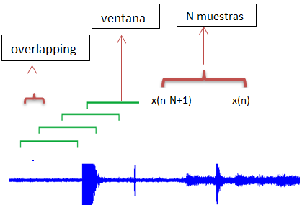
METHODOLOGY
METODOLOGIA
Descripcción de Etapas
ETAPA 1: Detección
Intervalo de Observación
Notes:
The records of seismic signals are processed through a sliding window with a N number of samples, each with overlapping.
The length of the sliding window should be short enough to ensure the local stationary of the signal within the window, but also not too short to affect the reliability of the estimators.
The value of overlapping implies peculiarities on the fidelity of the results and the speed of data processing. In the case of a high overlapping, the processing speed decreases since the number of windows that are created is lower (however it also decreases the fidelity since between the end and the beginning of a new sliding window may be bypassing data that may or may not be located in zones of events of interest). Therefore, in order to obtain a greater reliability on the result, this study was performed with an overlapping equal to 1.

Slide 12
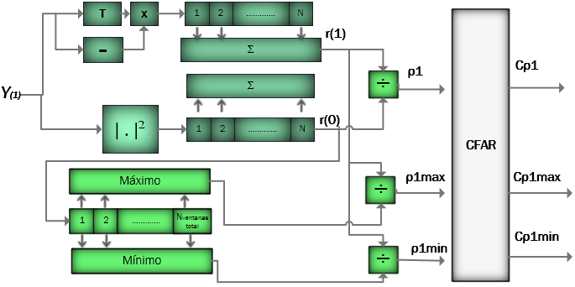

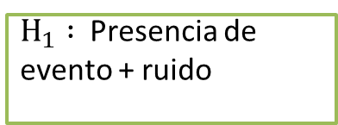
METHODOLOGY
METODOLOGIA
Description of stages
Descripcción de Etapas
ETAPA 1: Detección
$H_{1} :$ Presencia de evento + ruido
Detector
$H_{0} :$ Ruido
Notes:
This is the detector that we are proposing.
The detection processor operates in binary hypothesis test where the hypotheses represent:
$H_{0} :$ Noise component
$H_{1} :$ Presence of an event of interest+ Noise component
The upper branch may be matched to the presence of an event of interest on the signal plus noise, while the lower branch may be matched to the noise component. The lower branch monitors the power of the noise in the signal similarly to the clutter map in radar signal processing.

Slide 13
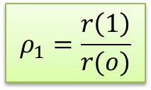
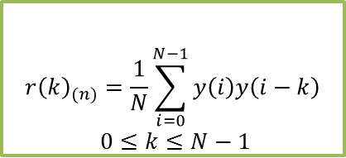
METHODOLOGY
METODOLOGIA
Descripcción de Etapas
STAGE 1: Detection
ETAPA 1: Detección
Detección de Eventos usando función de autocorrelación
Normalización en linea
$${r\left(k\right)}_{(n)}=\frac{1}{N}\sum_{i=0}^{N−1}{y\left(i\right)y\left(i−k\right)}$$
$$0≤k≤N−1$$
r(1)
K=1
$$ρ_{1}=\frac{r\left(1\right)}{r(o)}$$
K =0
r(0)
Notes:
With the purpose to maximize the presence of events and minimize the absence of these we present a detection processor that uses the autocorrelation function with lags 0 and 1 as shows this equation….
where y are the samples of the seismic record, N is the number of samples in each sliding window and k is the possible range of lags, this is done with the purpose of detecting events of interest in the seismic record.
It was observed that when k = 0, the function determines the mean square value, corresponding to the average power of the window
The autocorrelation function of each sliding window is analyzed with r(0) and r(1) lags defining a normalization p.

Slide 14

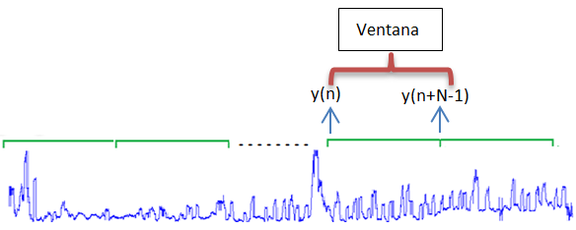









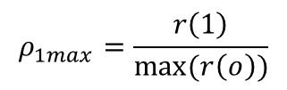


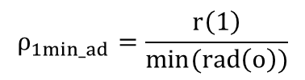
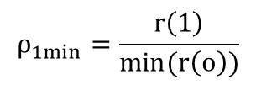












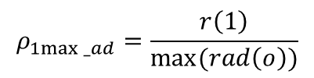
METODOLOGIA
METHODOLOGY
Descripcción de Etapas
ETAPA 1: Detección
Normalización en Linea
Normalización Adaptativa
$${r\left(1\right)}_{1}$$
$${r\left(1\right)}_{2}$$
$${r\left(1\right)}_{3}$$
$$……..$$
$${r\left(1\right)}_{NventanasconO}$$
$${r\left(1\right)}_{1}$$
$${r\left(1\right)}_{2}$$
$${r\left(1\right)}_{3}$$
$$……..$$
$${r\left(1\right)}_{NventanasconO}$$
$${r\left(0\right)}_{1}$$
$${r\left(0\right)}_{2}$$
$${r\left(0\right)}_{3}$$
$$……..$$
$${r\left(0\right)}_{NventanasconO}$$
$${r\left(0\right)}_{1}$$
$${r\left(0\right)}_{2}$$
$$……..$$
$${r\left(0\right)}_{NventanassinO}$$
$NventanasconO$> $NventanassinO$
$$ρ_{1}=\frac{r\left(1\right)}{r\left(o\right)}$$
$$ρ_{1max}=\frac{r\left(1\right)}{max(r\left(o\right))}$$
$$ρ_{1_ad}=\frac{r\left(1\right)}{r_{ad}(0)}$$
$$ρ_{1min}=\frac{r\left(1\right)}{min(r\left(o\right))}$$
$$ρ_{1max⁡_ad}=\frac{r\left(1\right)}{max(rad\left(o\right))}$$
$$ρ_{1min_ad}=\frac{r\left(1\right)}{min(rad\left(o\right))}$$
Notes:
As shown in the processor, parameters r (0) r (1) are obtained in parallel, one r (0) and r (1) corresponding to each sliding window, creating an equal number of parameters. So this normalization is called online .
We also present The relationship between the autocorrelation r(1) and the minimum or maximum value of r (0) like another normalization.
As a comparative process presents an adaptive normalization. This normalization uses another autocorrelation r (0) called r_ad (0) is defined but remains r (1) obtained above. Its adaptative because the numer of rad(0) parameter created is different from the number of r(1) parameters .

Slide 15
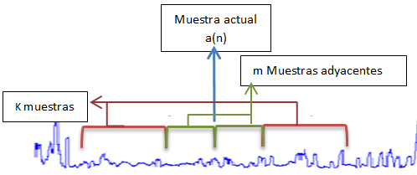












METODOLOGIA
METHODOLOGY
Descripcción de Etapas
ETAPA 1: Detección
Procesador CFAR
$$ρ_{1}$$
$$Cρ_{1}$$
$$ρ_{1max}$$
$${Cρ}_{1max}$$
$$ρ_{1min}$$
C$ρ_{1min}$
$$ρ_{1_ad}$$
$${Cρ}_{1_ad}$$
$$ρ_{1max⁡_ad}$$
$${Cρ}_{1max⁡_ad}$$
$$ρ_{1min_ad}$$
$${Cρ}_{1min_ad}$$
Notes:
As shown in the processor, parameters r (0) r (1) are obtained in parallel, one r (0) and r (1) corresponding to each sliding window, creating an equal number of parameters. So this normalization is called online .
We also present The relationship between the autocorrelation r(1) and the minimum or maximum value of r (0) like another normalization.
As a comparative process presents an adaptive normalization. This normalization uses another autocorrelation r (0) called r_ad (0) is defined but remains r (1) obtained above. Its adaptative because the numer of rad(0) parameter created is different from the number of r(1) parameters .

Slide 16
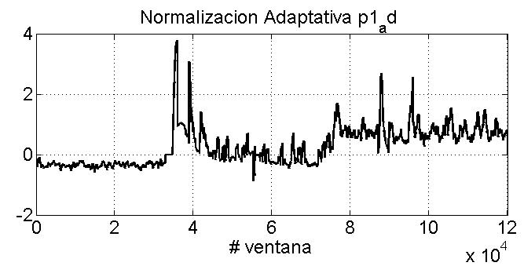
METODOLOGIA
Descripción de Etapas
ETAPA 1: Detección
NORMALIZACION EN LINEA
NORMALIZACION ADAPTATIVA
1
4
ρ(1)
2
d
ρmax(1)
5
3
6
ρmin(1)
c
f

Slide 17
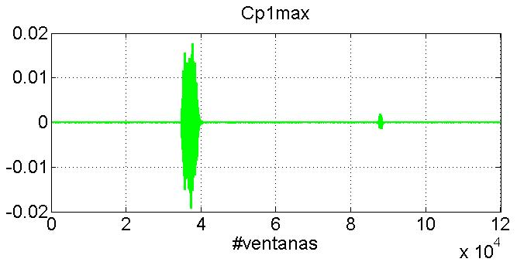
METODOLOGIA
Descripción de Etapas
ETAPA 1: Detección
CFAR de NORMALIZACION EN LINEA
CFAR de NORMALIZACION ADAPTATIVA
7
10
Cρ(1)
8
11
Cρmax(1)
9
12
Cρmin(1)

Slide 18
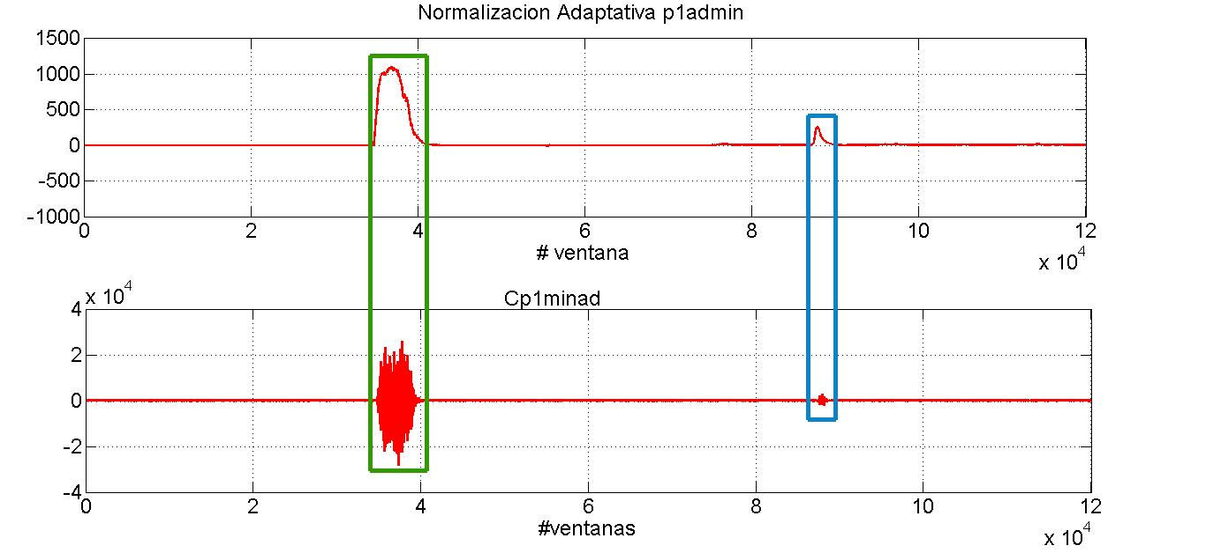

METODOLOGIA
Descripción de Etapas
EATAPA 1: Deteccion

Slide 19
METHODOLOGY
Description of stages
ETAPA 2: Caracterización Espectral
Estimador Clásico
Periodograma
Máxima Entropía de Burg
Notes:
In the second stage the spectral content of the events of interest detected is performed using the classical periodogram estimator and with the parametric estimation using an autoregressive model where the coefficients are estimated under the Maximum entropy method of Burg.

Slide 20
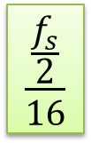

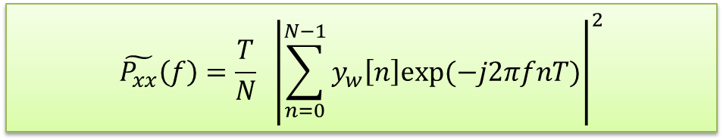
Etapa 2 ➔ Caracterización Espectral
METODOLOGIA
DESCRIPCIÓN DE ETAPAS
Descripción de Etapas
ETAPA 2: Caracterización Espectral
Periodograma
$$\tilde{P_{xx}}\left(f\right)=\frac{T}{N} {\left|\sum_{n=0}^{N−1}{y_{w}\left[n\right]exp(−j2πfnT)}\right|}^{2}$$
Suavizados falsos
Picos falsos
$$\frac{\frac{f_{s}}{2}}{16}$$
$f_{s}=100 [Hz]$
Notes:
The PSD was estimated by the method of periodogram that uses the discrete Fourier transform to generate a spectral estimate of the samples set.
There are 3 amendments to the original definition of the periodogram , the method used in this project was the Welch that uses windowing in each sequence of N samples.
The preriodogrma is a metod that need attention to selected de number of samples in each window and overlapping, the frequency resolution for don’t obtain a result so smoothing or with false peaks.

Slide 21

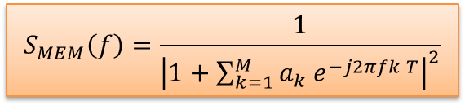
METODOLOGIA
Descripción de Etapas
ETAPA 2: Caracterización Espectral
Máxima Entropía de Burg
$$S_{MEM}\left(f\right)=\frac{1}{{\left|1+\sum_{k=1}^{M}{a_{k} e^{−j2πfk T}}\right|}^{2}}$$
Modelo Paramétrico
Autoregresivo
Mejor Resolución Frecuencial
Selección de orden del Modelo
Notes:
For a parametric estimate of the power spectral density we use an autoregressive model (AR) .
The estimated autoregressive DSP is indicated by the maximum entropy method of Burg, trying to improve the location of the spectral peaks.
The choice of the model order was done under the criteria of the Akaike Information Theory (AIC) and Rissanen with Minimum-Description Length Theory (MDL) . Akaike uses maximum likelihood criterion trying to minimize the role of information theory
The criteria were applied to each of the sliding windows created, and an average estimation error end was performed.
by the two criteria we analyzed the model order with overlapping 1 and 50 , as it can be observed from order 7 both AIC and MDL values are weakly decreasing, stating that the model order can be considered from this value onwards.
The computational cost depends on the processing software, so in order to optimize the algorithm to reduce this cost we chosse order 7 for the model.

Slide 22
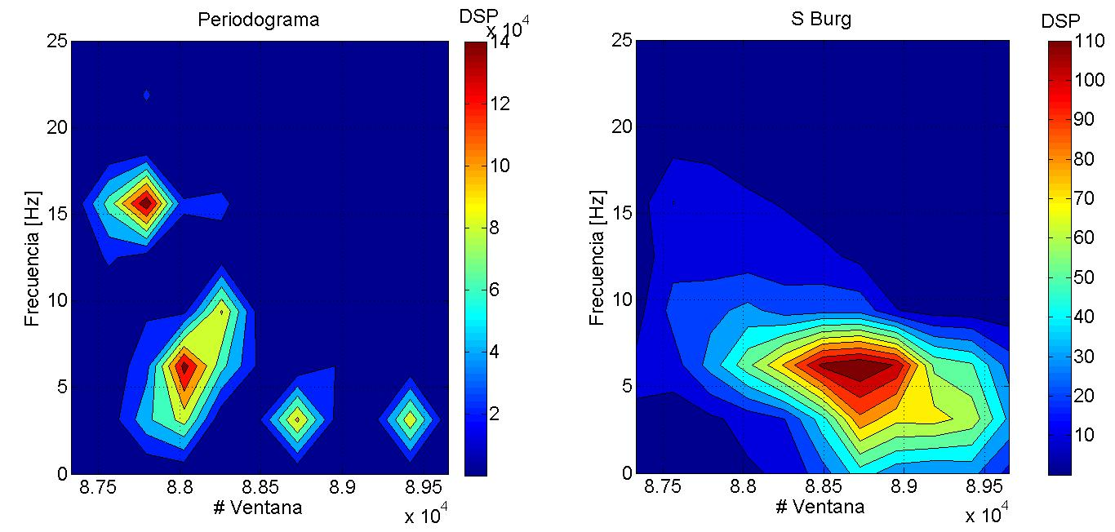
Etapa 2 ➔ Caracterización Espectral
METODOLOGIA
Descripción de etapas
ETAPA 2: Caracterización Espectral
PERIODOGRAMA
MAXIMA ENTROPIA DE BURG
Notes:
During the detection stage, it was possible to distinguish several areas of greater concentration of power, 2 zones IN THE EXAMPLE. The spectral analysis of each observed zones was then performed using PSD graphs, BY the spectral estimation methods proposed.

Slide 23
Agenda
RESULTADOS
Notes:
A seismic data set, provided by the Instituto Geofísico de la Escuela Politécnica Nacional (IGEPN), was used to test the algorithm. Data correspond to the seismologic monitoring network of Cotopaxi Volcano.
The IGEPN data set provides labels for the type of event that has occurred in each record and its respective timestamp. With this information was possible to study VT and LP events and distinguish their spectral content.

Slide 24
Etapa 3 ➔ Análisis de Resultados
RESULTS
ETAPA 3: ANALISIS DE RESULTADOS
LP
Duración | Between 25 and 80 second
Rango de contenido Espectral | <10 HZ
Frecuencia de pico DSP | 3.125 Hz
Notes:
It can be clearly seen that the behavior of the spectral content for LP event is in range below 10 Hz and has a higher concentration of frequency about of 3.15 Hz

Slide 25
RESULTS
ETAPA 3: ANALISIS DE RESULTADOS
VT
Duración | Between 20 and 40 second
Rango de contenido Espectral | <20 HZ
Frecuencia de pico DSP | ~6 Hz
Notes:
In the case of the spectral content for the VT events, it can be seen that it mainly evolves at frequencies below 15 Hz with a higher concentration of approximately 6 Hz.

Slide 26
RESULTS
LP
VT
Notes:
In this slide is possible distinguish the difference between Lp and VT events. Lp with its spctral content under te 10 Hz and Vt under 20 HZ

Slide 27
RESULTADOS
ETAPA 3: ANALISIS DE RESULTADOS
Rayos , Otros
Duración | <20 second
Rango de contenido Espectral | 15 < r <35 HZ
Frecuencia de pico DSP | ~25 Hz
Notes:
For rays or others the highest concentration of power is centered between 15 Hz and 35 Hz

Slide 28
Agenda
Conclusiones y Trabajos futuros

Slide 29
CONCLUSIONS AND FUTURE WORKS
Conclusiones
Mediante los 8 procesadores de mejor desempeño se consigue maximizar la presencia de un evento de interés y minimizar la ausencia de este, determinando que la detección propuesta, ampliamente usada en aplicaciones de sistemas de radar, presenta buenos resultados en la detección de eventos sismo-volcánicos.
Los procesadores propuesto para la detección permite determinar la ubicación en el tiempo donde los eventos de interés se llevan a cabo, maximizando la probabilidad de detección y manteniendo una tasa de falsa alarma constante.
Bajo el análisis espectral autoregresivo se consiguen características del contenido espectral que nos han permitido diferenciar entre eventos del tipo LP, VT u otros. Se consigue similares resultados con el método del periodograma, sin embargo mediante el método de máxima entropía de Burg se consigue una mejor resolución

Slide 30
CONCLUSIONES AND TRABAJOS FUTUROS
Trabajos Futuros
Determinación automática de la presencia de eventos mediante técnicas de detección adaptativa, definiendo de manera experimental el mapa de clutter (concepto similar al utilizado en radar) de la zona donde opera la red de geófonos que adquiere los registros sísmicos en diferentes épocas del año .
Mejora de la tasa de falsa alarma en la detección de eventos mediante el uso del procesador de la razón de verosimilitud o procesador Bayesiano que detecta un proceso gaussiano de interés en la presencia de ruido blanco y ruido colorido gaussiano

Slide 31
Agenda
Impacto

Slide 32






Impacto y beneficiarios
BENEFICIARIOS
Soluciones Integrales para la seguridad
Colaborando
Optimizando y disminuyendo el análisis visual actual
Intercambio de conocimientos
  Nuevas expectativas de investigaciones
  Independencia cognitiva

Slide 33
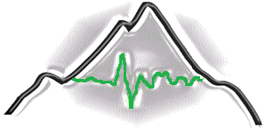
Gracias

