Slide 1
DEPARTAMENTO DE CIENCIAS HUMANAS Y SOCIALES
CARRERA DE LINGÜÍSTICA APLICADA AL IDIOMA INGLÉS
RESEARCH PROJECT PRIOR TO OBTAINING THE APPLIED LINGUISTICS IN ENGLISH DEGREE
THEME:
THE INCIDENCE OF THE WEBQUEST TO IMPROVE WRITING SKILL DEVELOPMENT IN AN ENGLISH FOREIGN LANGUAGE CLASSROOM WITH STUDENTS OF NINTH YEAR OF BASIC EDUCATION LEVEL AT “GEORGE WASHINGTON” HIGH SCHOOL, DURING THE SCHOOL YEAR 2014-2015
AUTHORS: DORIS ADRIANA LUGUAÑA GUALOTO
MARICELA ANDREA BENAVIDES FERNÁNDEZ
DIRECTOR: M.A. MARICELA MADRID
CO-DIRECTOR: DR. GONZALO PUMA
SANGOLQUÍ
2015

Slide 2
Why was this theme chosen?
Importance of English Foreign Language.
Low grammar structure knowledge
Writing demotivation
Inappropriate resources and technological tools use
Insufficient students’ technological strategies in writing skill development

Slide 3
PROBLEM TREE
Writing demotivation
Insufficient students’ technological strategies in writing skill development
Low academic performance
Effects
LOW ENGLISH WRITING SKILL DEVELOPMENT
Few opportunities to apply writing update methods in teachers
Inappropriate resources and technological tools use in class
Causes
Low grammar structure knowledge

Slide 4
RESEARCH QUESTIONS
Can the WebQuest improve the writing skill development?
How does the webQuest affect in the writing skill development?

Slide 5
GENERAL OBJECTIVE
TO DETERMINETHE INCIDENCE OF THE WEBQUEST TO IMPROVE IN THE WRITING SKILL DEVELOPMENT IN AN ENGLISH FOREIGN LANGUAGE CLASSROOM WITH STUDENTS OF NINTH YEAR OF BASIC EDUCATION LEVEL AT “GEORGE WASHINGTON” HIGH SCHOOL, DURING THE SCHOOL YEAR 2014-2015

Slide 6
specific OBJECTIVES
* TO ANALYZE THE DEVELOPMENT OF WRITING SKILL
* TO IDENTIFY THE STUDENT’S PROBLEMS HAVE TO WRITE.
* TO IMPLEMENT A WORKSHOP TO SHARE WITH THE TEACHERS ABOUT THE USE OF THE WEBQUEST TO IMPROVE THE WRITING SKILL.

Slide 7
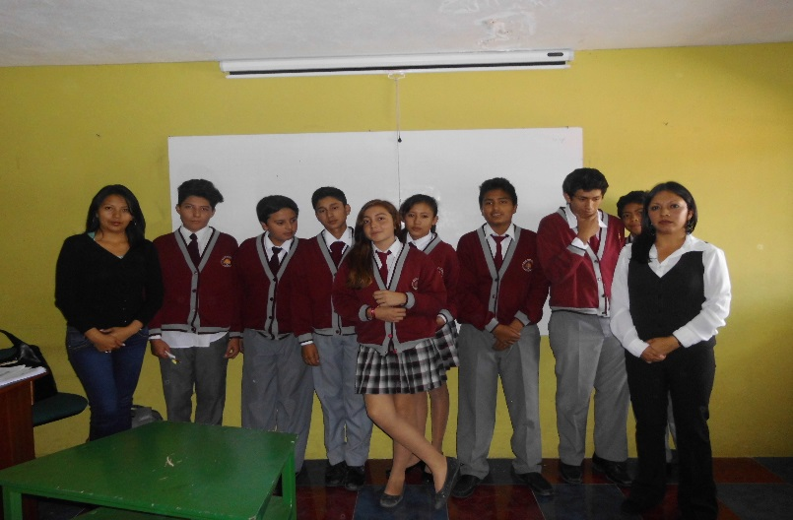
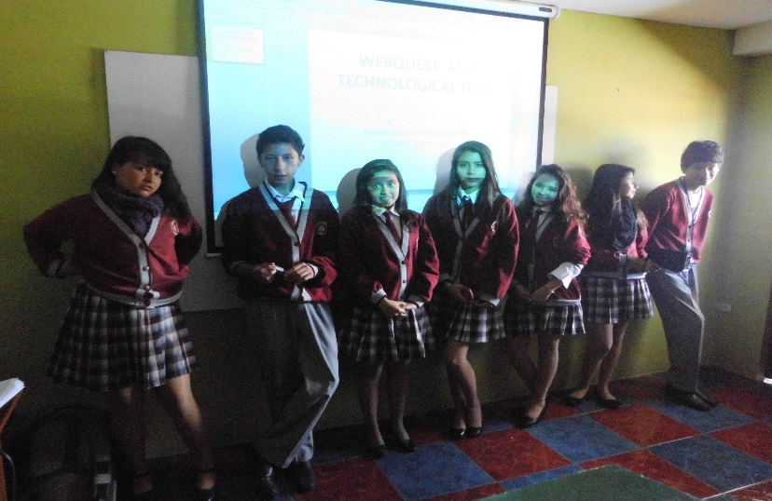
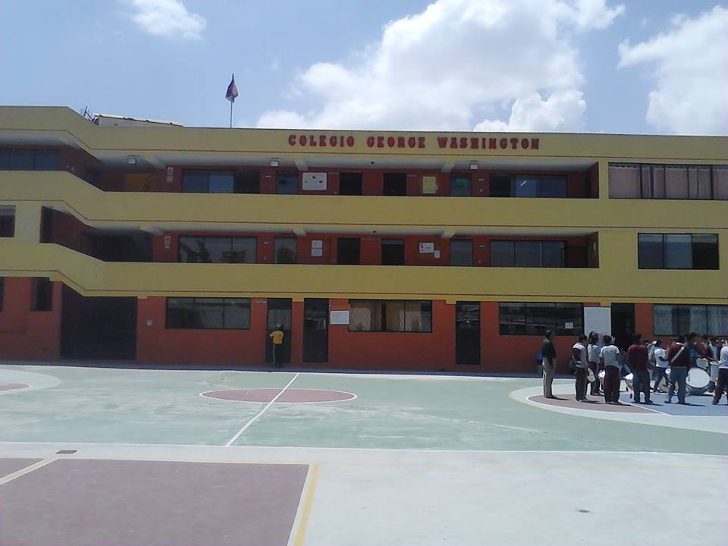
FIELD WORK
Control Group
Experimental Group

Slide 8
Theoretical framework

Slide 9
Vygotsky states cognitive development stems from social interactions from guided learning within the zone of proximal development as children and their partners co-construct knowledge For Vygotsky, the environment in which children grow up will influence how they think and what they think about
Ausubel (1967:10) focused on meaningful learning, as "a clearly articulated and precisely differentiated conscious experience that emerges when potentially meaningful signs, symbols, concepts, or propositions are related to and incorporated within a given individual's cognitive structure"

Slide 10
The WebQuest
WebQuests are designed to use the time of students, to focus on using information rather than looking for, and to support the students' thinking at the levels of analysis, synthesis and evaluation. (Dodge, 1997)
Learning methodology.

Slide 11
The WebQuest was created in response to a difficulty that teachers face in the teaching of English language. (Dodge, 1997)

Slide 12
STRUCTURE OF THE WEBQUEST
A WebQuest has 6 essential parts
1.Introduction
2.Task
3.Process
4.Resources
The introduction is the most essential part of the work
The task is the formal description
These are the steps
These provide helps focus on the exercise
5.Evaluation
6.Conclusion
It refers the way in which the students’ performance will be evaluated
Summarize the experience, encourage reflection about the process

Slide 13
DESIGNING OF THE WEBQUEST
Select a topic appropriate for the WebQuest
Design the process
DESIGNING OF THE WEBQUEST
Select a design
Describe how the learners will be evaluated

Slide 14
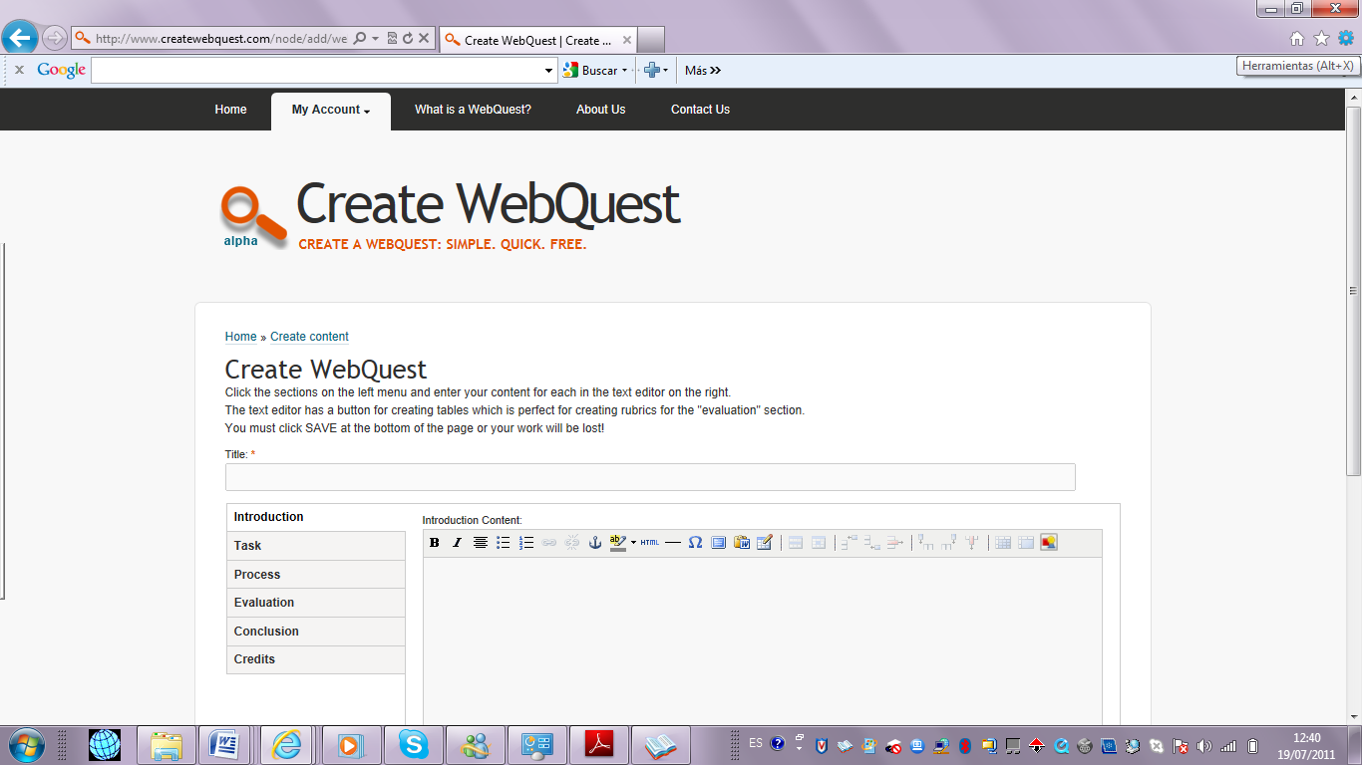
WEBQUEST STRATEGY DEVELOPMENT
Step 1: Go to the platform page to create the WebQuest and click button

Slide 15
Step 2: Write the title of the topic. The first page shows links to the other parts of the WebQuest.

Slide 16
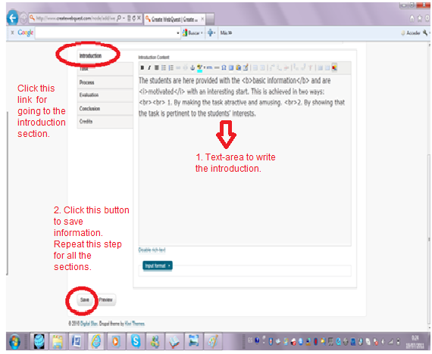
Step 3: The topic will be placed by clicking the Introduction link. Save the information in each section by clicking button.

Slide 17
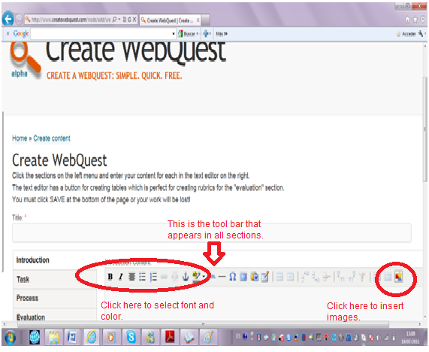
Step 4: Click the option on the tool bar that appears in all sections to select font, color, and insert images.

Slide 18
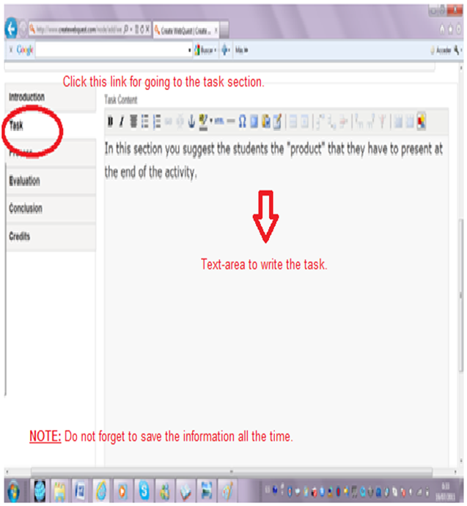
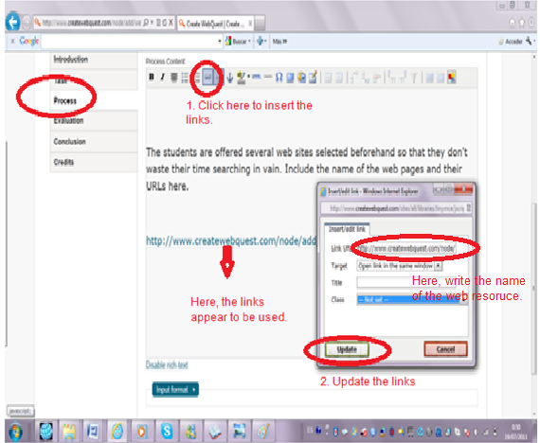
Step 5: The TASK and the PROCESS sections follow the same steps as in the introduction part.

Slide 19
Step 6: The RESOURCES are linked in the process section, by clicking the link button on the tool bar. Write the name of the website and update it.

Slide 20
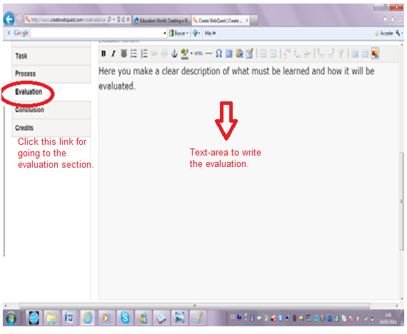
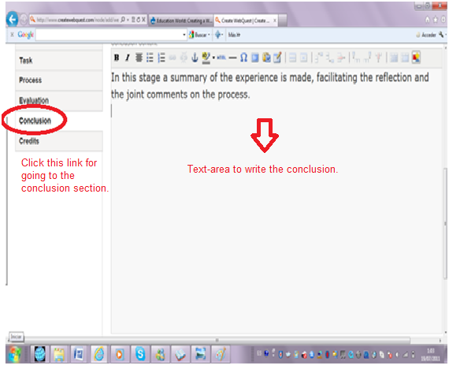
Step 7: The EVALUATION and the CONCLUSION sections follow the same steps as in the introduction part.
http://www.webquest.es/wq/educacion-secundaria-obligatoria-eso/how-to-improve-the-writing-skill

Slide 21
WEBQUEST ADVANTAGES
According to Blazer (2003), he breaks down some of the advantages of using WebQuest in language learning:
Motivation
Collaboration and Cooperation
Cognitive processes

Slide 22
WEBQUEST DISADVANTAGES
The WebQuest is not designed properly unwanted information will be found
A webQuest can take a considerable amount of class time
Students can get easily distracted using the web

Slide 23
WRITING SKILL
Students can write their feeling and ideas on paper.
Organize their knowledge and beliefs.

Slide 24
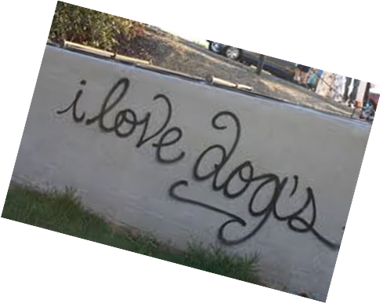
PRINCIPAL PROBLEMS OF WRITING
Criteria | 1
Main Idea Topic Sentence | Main Idea/ Topic sentence is unclear and is not restated in the closing sentence.
Supporting Details | Each Paragraph does not have supporting detail sentences that relate to the main idea.
Observes Basic Writing Conventions | It contains many errors in punctuation, spelling and/or grammar that make the piece illegible.
Neatness | Many distracting errors making it illegible.

Slide 25
Development of writing
There are three principal elements to write:
In the structure students must take into account the organization, development and sequence of text
The style is related to how to organize the content
Content is what the student thinks and writes, and it is the information provided in the text

Slide 26
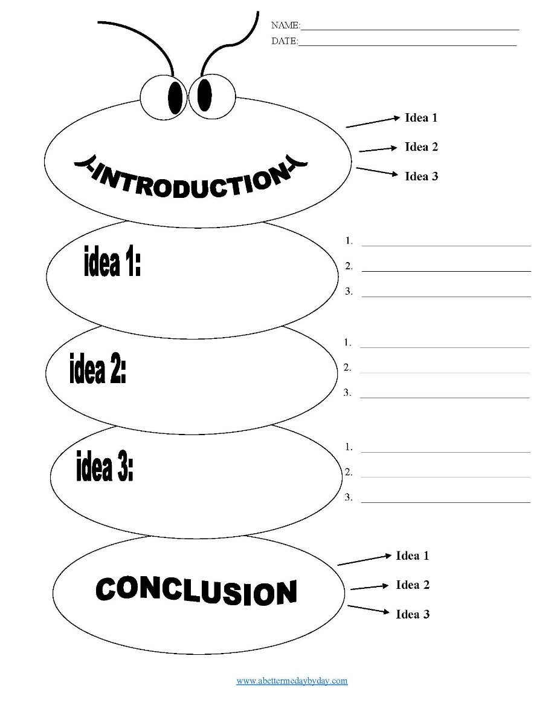
FIVE-PARAGRAPH ESSAY FORMAT USEFUL IN WRITING
INTRODUCTION
SUPPORTING PARAGRAPHS
CONCLUSION

Slide 27
DOMAIN KNOWLEDGE IN EDUCATION
The domain knowledge is a skill
Teachers evaluate the workplace

Slide 28
COGNITIVE PSYCHOLOGY RELATED WITH WRITING SKILL
The cognitive psychology is the study of mental processes such as attention, language use, memory, perception, problem solving, creativity, and thinking

Slide 29
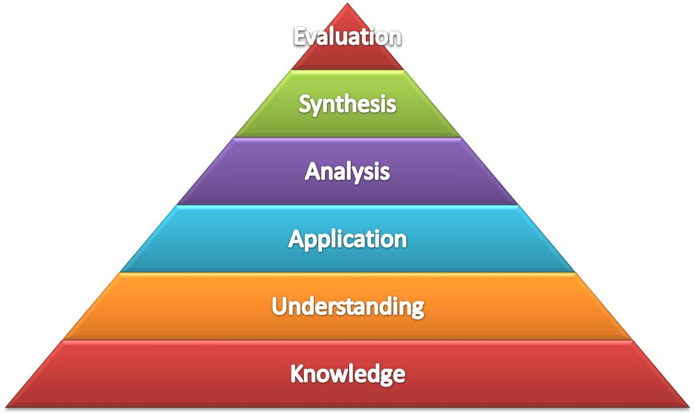

Slide 30
THE WEBQUEST TO DEVELOP WRITING SKILLS
The WebQuest helps students to develop writing at the beginning of learning, in the next stage the students test their linguistic hypotheses to finish with the written production acquired in the target language

Slide 31
HYPOTHESIS FORMULATION
Working Hypothesis : The use of WebQuest affects positively to students in order to develop writing skills of ninth year of basic education level at “George Washington” High School.

Slide 32
Operational Hypothesis :The WebQuest is a learning activity, inquiry-oriented by the students.

Slide 33
Alternative Hypothesis :The use of English Attack can help student to develop writing skills of ninth year of basic education level at “George Washington” High School.

Slide 34
Null Hypothesis:The use of WebQuest does not affect positively to students in order to develop writing skills of ninth year of basic education level at “George Washington” High School.

Slide 35
METHODOLOGICAL DESIGN

Slide 36
METHODOLOGICAL DESIGN
DESCRIPTIVE
QUASI-EXPERIMENTAL
Examine the characteristics of the chosen problem
Formulation of the variables
Set out the hypothesis
Analyse and interpret data
It has two variables: an independent (WebQuest) and a dependent one (writing skills).
The students for control and experimental group are selected to get relevant information that contributes to the validation of this research through a pre-test and post-test to analyze the principal problem.

Slide 37
“George Washington” High school
Field Work
Population
Section | Men | Women | Total
Ninth year “A” Control | 5 | 4 | 9
Ninth year “B” Experimental | 3 | 8 | 11
Total | 8 | 12 | 20
Sample
Instruments for data collection
Pre-test
Post- test
Statistical calculations, tables and figures
Data processing and analysis

Slide 38
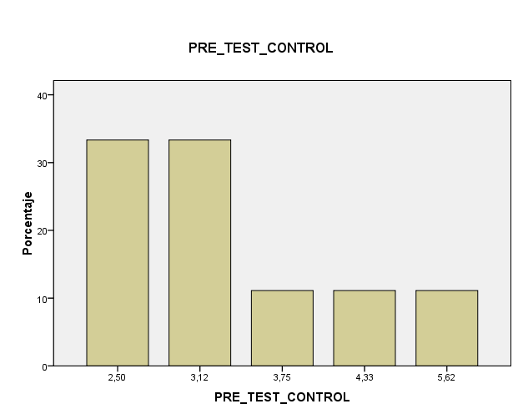
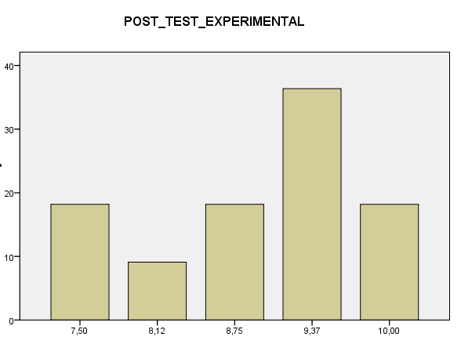
RESULTS
 |  | PRE_TEST_ EXPERIMENTAL | POST_TEST_ EXPERIMENTAL | PRE_TEST_ CONTROL | POST_TEST_ CONTROL
N | Valid | 11 | 11 | 9 | 9
 | Missed | 9 | 9 | 11 | 11
Mean |  | 3,7482 | 8,9182 | 3,3956 | 3,6078
Error mean |  | ,20698 | ,26754 | ,34522 | ,57764
Media |  | 3,7500 | 9,3700 | 3,1200 | 3,1200
Moda |  | 3,75 | 9,37 | 2,50ª | 3,12
Standard Deviation |  | ,68648 | ,88732 | 1,03567 | 1,73293
Variance |  | ,471 | ,787 | 1,073 | 3,003
Range |  | 1,88 | 2,50 | 3,12 | 5,62
Minimum |  | 3,12 | 7,50 | 2,50 | 2,50
Maximum |  | 5,00 | 10,00 | 5,62 | 8,12
Total |  | 41,23 | 98,10 | 30,56 | 32,47
Elaborated by the researchers (2015)
MINIMUM
MAXIMUM
MEDIA
MEAN
MODA
MINIMUM
MODA
MAXIMUM
MEDIA
MEAN

Slide 39
Student’s pre-test results
Student’s post-test results
Criteria | 4 | 3 | 2 | 1
Main Idea Topic Sentence | Strong main idea/ topic sentence is clear, and is restated in the closing sentence. | Adequate main idea/ topic sentence is restated in the closing sentence. | Main Idea/ topic sentence is unclear is weakly restated in the closing sentence. | Main Idea/ Topic sentence is unclear and is not restated in the closing sentence.

Slide 40
Student’s pre-test results
Student’s post-test results
Criteria | 4 | 3 | 2 | 1
Supporting Details | Each paragraph has three or more supporting detail sentences that relate to the main idea. | Each paragraph has two supporting detail sentences that relate to the main idea. | Each paragraph has one supporting detail sentence that relates to the main idea. | Each Paragraph has no supporting detail sentences that relate to the main idea.

Slide 41
Student’s pre-test results
Student’s post-test results
Criteria | 4 | 3 | 2 | 1
Observes Basic Writing Conventions | Contains few, if any punctuation, capitalization, and spelling errors. | Contains several errors in punctuation, spelling or grammar that do not interfere with meaning. | Contains many errors in punctuation, spelling and/or grammar that interfere with meaning. | Contains many errors in punctuation, spelling and/or grammar that make the piece illegible.

Slide 42
Student’s pre-test results
Student’s post-test results
Criteria | 4 | 3 | 2 | 1
Neatness | Legibly handwritten or typed with no distracting errors. | Legibly written, easy to read with 1-2 distracting errors. | Several distracting errors that make portions difficult to read. | Many distracting errors making it illegible.

Slide 43
TESTING HYPOTHESIS

Slide 44
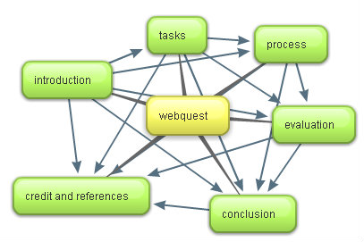
HYPOTHESIS
In the general analysis the experimental group had a progress in writing skill using a WebQuest as a technological tool while the control group there was not a progress, so that, it is noted that the treatment applied to the experimental group affected in a positive way in the results, so, the null hypothesis is rejected.

Slide 45
CONCLUSIONS
The results obtained in the pre-test show that students had an inappropriate use of grammatical structures when writing a paragraph.
The use of WebQuest (independent variable) as a technological tool helped to develop the writing skill (dependent variable) in students at “George Washington” High School.
The WebQuest had a positive impact in the experimental group, since good results were obtained. Students learned to use grammatical structures, used basic steps to write a paragraph.
The WebQuest had a positive result in the teaching-learning process in a second foreign language.

Slide 46
RECOMMENDATIONS
With the use of WebQuest students can develop collaborative work and responsibility in the task.
The WebQuest is an educational, methodological strategy and, as such, requires that the students to be more creative and critical when they make a task.
The development of language skills in students depends on the teaching resources that the teachers use in the classroom, it is very important to work with technological tools, to make students show interest in learning and acquiring new knowledge in a second language.
The WebQuest are activities carried out with the use of the internet. In this way students perform tasks preselected by the teacher using technological tools to develop the homework.

Slide 47
PROPOSAL

Slide 48
PROPOSAL
A WORKSHOP FOR TEACHERS TO DEVELOP AND TO IMPLEMENT THE WEBQUEST IN ORDER TO IMPROVE THE WRITING SKILL AT “GEORGE WASHINGTON” HIGH SCHOOL
STARTING DATE: MONDAY, MAY 4TH 2015
CLOSING DATE: FRIDAY, MAY 8TH 2015

Slide 49
PROBLEM IDENTIFICATION
Low English writing skill development in an English foreign language classroom with students of ninth year of basic education level at “George Washington” High school, during the school year 2014-2015.

Slide 50
1. PARTICIPATION ANALYSIS
On the basis of the available information, the following groups can be identified.
INSTITUTIONS | INTEREST GROUPS | OTHERS
“George Washington” High School | Teachers Students | Authorities

Slide 51
 | TEACHERS
PROBLEMS | Few opportunities to apply writing update methods in teachers. Inappropriate resources and technological tools use in class. Writing demotivation
INTERESTS | How to develop and to implement the WebQuest in order to improve the writing skill.
POTENTIALS | Able to influence in the problem
LINKAGES | Dependent upon the teacher’s cooperation and an application of the WebQuest.

Slide 52
2. PROBLEM ANALYSIS
Writing demotivation
Insufficient students’ technological strategies in writing skill development
Low academic performance
Effects
LOW ENGLISH WRITING SKILL DEVELOPMENT
Low grammar structure knowledge
Few opportunities to apply writing update methods in teachers
Inappropriate resources and technological tools use in class
Causes

Slide 53
3. OBJECTIVES ANALYSIS
Writing motivation
Sufficient students’ technological strategies in writing skill development
High academic performance
HIGH ENGLISH WRITING SKILL DEVELOPMENT
High grammar structure knowledge
Teachers have enough opportunities to apply writing update methods
Appropriate resources and technological tools use in class

Slide 54
4. ALTERNATIVES ANALYSIS
Writing motivation
Sufficient students’ technological strategies in writing skill development
High academic performance
HIGH ENGLISH WRITING SKILL DEVELOPMENT
High grammar structure knowledge
Teachers have enough opportunities to apply writing update methods
Appropriate resources and technological tools use in class
English Attack
Workshop
Option 1
Option 2

Slide 55
4.1 ALTERNATIVES ANALYSIS CONTINUED
 | OPTION 1 English Attack | OPTION 2 Workshop
COST | High | Low
CHANCE OF SUCCESS | Low | High
COST/BENEFIT | High | Low
TIME HORIZON | Long | Short
SOCIAL RISK | Small | Small

Slide 56
5. DEFINING THE MAIN PROJECT ELEMENTS (PM)
1. GOAL
High English writing skill development for the students
2. PURPOSE
Writing skill improvement
3. OUTPUTS
WORKSHOP Description of the WebQuest Advantages of WebQuest Steps to create a WebQuest Activities that can be developed with the WebQuest Writing activities using WebQuest
4. ACTIVITIES | 5. INPUTS
Plan the workshop Invite the teachers Run the workshop | WebQuest Funds to buy the materials

Slide 57
6. DETERMINING THE ASSUMPTIONS (PM)
1. GOAL |  | ASSUMPTIONS
High English writing skill development for the students |  | Students write paragraphs accurately
2. PURPOSE |  | ASSUMPTIONS
Writing skill improvement |  | Students use WebQuest to write
3. OUTPUTS |  | ASSUMPTIONS
WORKSHOP Description of the WebQuest Advantages of WebQuest Steps to create a WebQuest Activities that can be developed with the WebQuest Writing activities using WebQuest |  | Teachers have enough opportunities to apply writing updated methods
4. ACTIVITIES | 5. INPUTS | ASSUMPTIONS
Plan the workshop Invite the teachers Run the workshop | WebQuest Funds to buy the materials | Create a WebQuest The WebQuest to develop writing skill

Slide 58
7. ESTABLISHING THE INDICATORS
1. GOAL | INDICATORS | ASSUMPTIONS
High English writing skill development for the students | Students write a paragraph using appropriate structure, style, good content, grammar and spelling. | Students write paragraphs accurately
2. PURPOSE | INDICATORS | ASSUMPTIONS
Writing skill improvement | Use of technological tools | Students use WebQuest to write
3. OUTPUTS | INDICATORS | ASSUMPTIONS
WORKSHOP Description of the WebQuest Advantages of WebQuest Steps to create a WebQuest Activities that can be developed with the WebQuest Writing activities using WebQuest | The teachers apply the WebQuest in writing skill development | Teachers have enough opportunities to apply writing updated methods
4. ACTIVITIES | 5. INPUTS | ASSUMPTIONS
Plan the workshop Invite the teachers Run the workshop | WebQuest Funds to buy the materials | Create a WebQuest The WebQuest to develop writing skill

Slide 59
ANNEXES

Slide 60
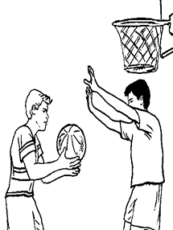
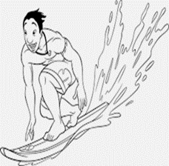
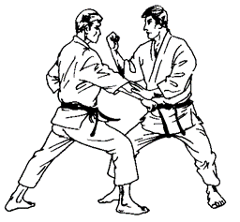
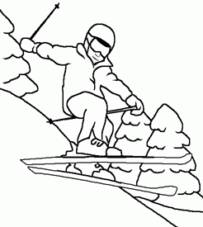
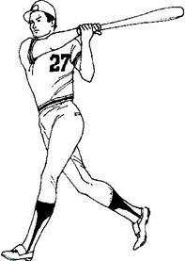
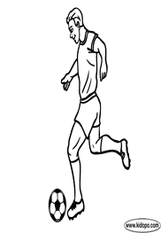
PRE-WRITING TEST
Student’s name: ______________________________________
Year EGB: _______________________
Date: ____________________________
Objective:
Assess basic knowledge and skills in usage and mechanics (punctuation, basic grammar and usage, and sentence structure) as well as more rhetorical skills such as writing strategy, organization, and style.
Introduction:
This evaluation has been designed to assess students’ level in writing.
Task:
Look at the picture and answer the given questions. Then write an 80-word paragraph.
What are the people doing?
What are the names of the sports?
In which places are these sports practiced?
Do you like these sports?
What is your favorite sport and why?
SPORTS IN TEENAGERS
________________________________________________________________________________________________________________________________________________________________________________________________________________________________________________________________________

Slide 61
POST-WRITING TEST
Student’s name:_______________________
Year EGB: _____________
Date: _________________
Objective:
To evaluate the writing skill in a real situation at the end of the research
Introduction:
This evaluation has been designed to meet student’s level in writing a paragraph.
Task:
Look at the picture and answer the given questions. Then write an 80-word paragraph.
What are the people doing?
What are the names of the sports?
In which places are these sports practiced?
Do you like these sports?
What is your favorite sport and why?
SPORTS IN TEENAGERS
________________________________________________________________________________________________________________________________________________________________________________________________________________________________________________________________________

Slide 62
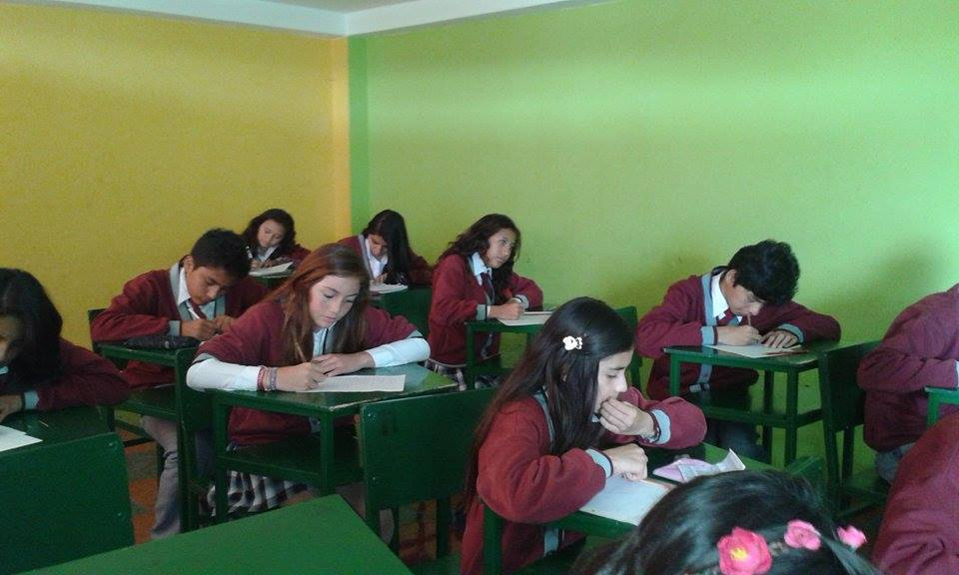
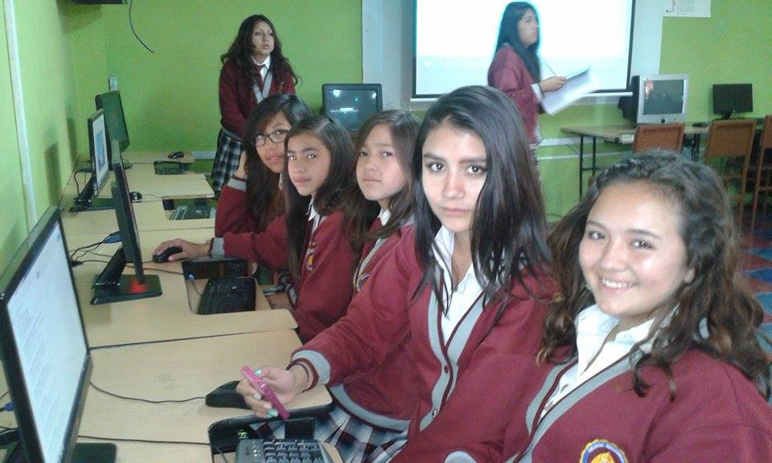
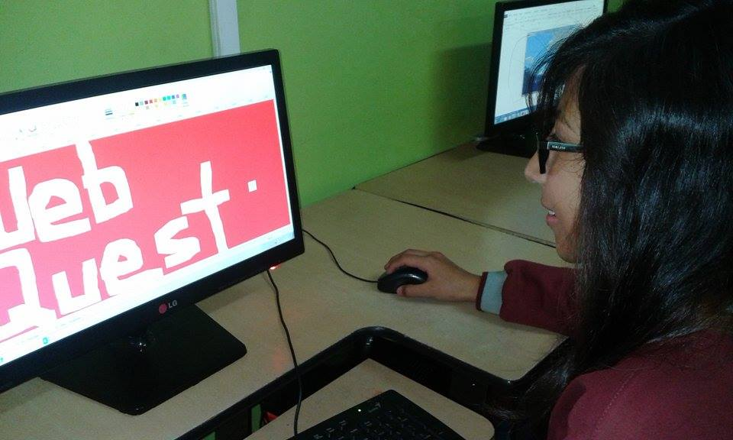

Slide 63
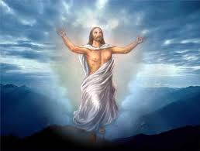
THANKS FOR YOUR ATTENTION!!

