Slide 1
DEPARTAMENTO DE CIENCIAS HUMANAS Y SOCIALES CARRERA DE LINGUÍSTICA APLICADA AL IDIOMA INGLÉS PROJECT PRIOR TO OBTAINING APPLIED LINGUISTICS IN ENGLISH LANGUAGE BACHELOR’S DEGREE TITLE: THE INCIDENCE OF DIGITAL STORYTELLING ON THE DEVELOPMENT OF THE SPEAKING SKILL IN STUDENTS ATTENDING 3rd YEAR OF BACHELOR AT RUMIÑAHUI HIGH SCHOOL IN AMBATO, DURING FEBRUARY TO APRIL, 2014-2015 SCHOOL YEAR. AUTHOR: GABRIELA ALEXANDRA LARA ALDAS DIRECTOR: MG. MARICELA MADRID G. CO DIRECTOR: DR. GONZALO PUMA CH.

Slide 2
PART ONE
RESEARCH PROBLEM

Slide 3
PROBLEM TREE
Noncompetitive people
Frustrated people
Low achievement
Subject failure
Economic crisis
Low salary
Effects
Few study abroad opportunities
Low Performance
Few working opportunities
Low English speaking development
Insufficient class speaking practice
Low technology use
Low student participation
Causes
Spanish use
Insufficient speaking practice time
Low teachers’ technology awareness.
Labs misuse
Teacher centered approach

Slide 4
General Objective:
To determine the incidence of Digital Storytelling on the development of the speaking skill in the English language in students attending the 3rd year of bachelor at Rumiñahui high school in Ambato, during February to April, 2014-2015 school year.

Slide 5
Specific Objectives:
To determine the level of speaking skill of students attending the 3rd year of bachelor at Rumiñahui high school in Ambato.
To analyse software needed for Digital Storytelling for selecting the most appropriate one to be used by students.
To define a suitable approach and activities for applying Digital Storytelling to develop speaking.
To implement a workshop on Digital Storytelling to increase teachers’ technology awareness.

Slide 6
PART TWO
THEORETICAL FRAMEWORK

Slide 7
Constructivism
David Ausubel
He proposed the theory of meaningful learning.
Jerome Bruner
He promoted discovery learning.
Jean Piaget
He claimed that the student learns actively.
Lev Vygotsky
He stated that it is necessary a relationship between the people and its environment for learning to take place.

Slide 8
Digital Storytelling
It is “the combination of the art of telling stories with a variety of digital multimedia, such as images, audio and video” (Robin , 2006).
It can be used for different subjects.
It contributes to the reinforcement of a variety of skills and abilities.
It generates interest, attention, motivation and creativity.
It is an ideal activity to different learning styles.

Slide 9
Steps to create a Digital Story
Pre-production
Writing a Script
Planning the Project
Production
Making the Voiceover
Post- Production
Presentation
Organizing Project Folders
Gathering and Preparing Resources
Putting it all together
Applause! Applause!

Slide 10
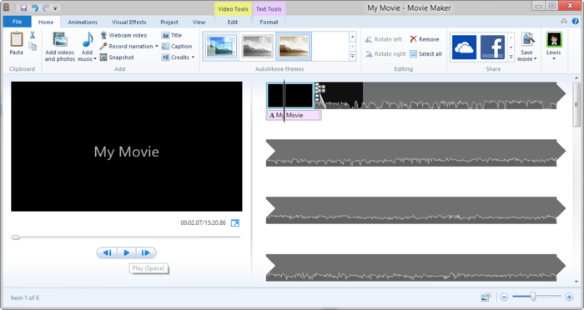
Software needed for Digital Storytelling
Movie Maker

Slide 11
Movie Maker

Slide 12
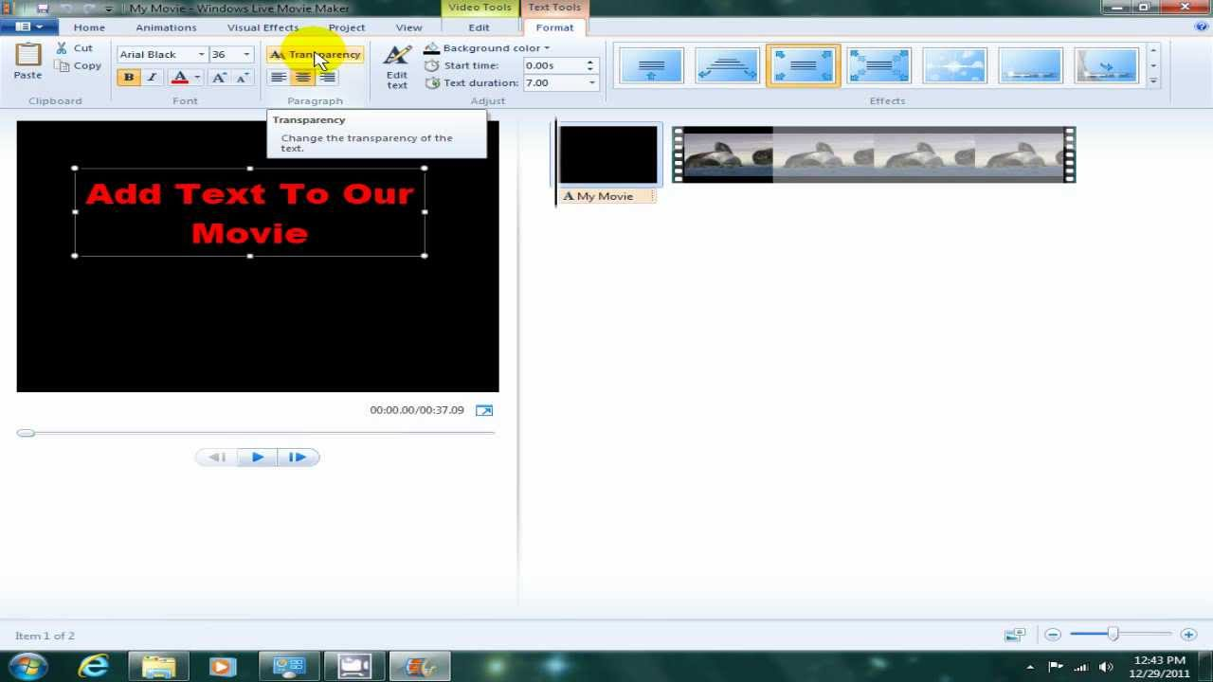
Movie Maker

Slide 13
Movie Maker

Slide 14
Movie Maker

Slide 15
Hypothesis Formulation
Working Hypothesis
“The use of digital storytelling influences positively in the development of the speaking skill in the students attending the third year of bachelor at Rumiñahui High School in Ambato.”
Null Hypothesis
“The use of digital storytelling does not influence positively in the development of the speaking skill in the students attending the third year of bachelor at Rumiñahui High School in Ambato.”

Slide 16
Hypothesis Formulation
Alternative Hypothesis
“The use of ELT podcasts influences positively in the development of the speaking skill in the students attending the third year of bachelor at Rumiñahui High School in Ambato.”

Slide 17
PART THREE
METHODOLOGICAL DESIGN

Slide 18
Research Type and Design
The present study is quasi-experimental, in the form of two groups pre-test and post-test design with quantitative data analyses.
Population
The population for this study included 55 students from the Rumiñahui High School. The treatment group was the 3rd of Bachelor section “H” with 25 students and the control group was the 3rd of Bachelor section “B” with 30 students.

Slide 19
Instruments for data collection
Field Work
This project was applied at The Rumiñahui High School which is located in Los Capulies Avenue, Atocha parish in the town of Ambato that belongs to the Tungurahua province.
The instruments for gathering data were a pre-test and a post-test.

Slide 20
PART FOUR
TESTING THE HYPOTHESIS

Slide 25
Conclusions
1. After the use of Digital Storytelling in the experimental group, it is seen by means of percentages, the improvement of the English speaking skill in this group. Therefore, the working hypothesis is confirmed.
2. In relation to the independent variable, Digital Storytelling, it gave positives results helping students practice their speaking skill.

Slide 26
Conclusions
3. With regard to the dependent variable, Speaking skill, it was found that the majority of the students from the experimental group, before digital storytelling treatment were mainly limited speakers but after treatment, the majority of them achieved satisfactory speaking levels and a small percentage even obtained good speaking levels.
4. The insufficient speaking practice, scant technology use and low student participation in the English classroom do not allow students to develop their speaking skill properly.
.

Slide 27
Recommendations
1. It is recommended that teachers use different methodologies, strategies and technology in order to motivate students and as a consequence, improve the learning process.
2. Meaningful activities should be given to students in order to enhance learning in them.
3. Teachers should use Digital Storytelling in the English classroom to improve students’ speaking skill.
4. Teachers should participate in a workshop about digital storytelling so they can implement this technological tool in class

Slide 28
PART FIVE
PROPOSAL

Slide 29
Stakeholder Analysis
Groups | Interests | Perceived Problems | Resources and Mandates
Students | -Acquire a good English speaking level so they can interact and communicate better in this language. | -Insufficient speaking practice in class. | -Be willing to participate in activities that help them improve their English speaking skill.
Teachers | -Help students develop their abilities and skills so they can use English effectively. | -A teacher centred approach used in class. -Teachers’ unawareness of the new technological tools used to teach English. | -Implement a new approach for English language teaching. -Use technological tools frequently in class.
High School | -Improve the level of English proficiency in the students. | - A low English speaking level in the students. -Scarce technology use in the English class. | -Provide constant pedagogical training to teachers. -Allow the access to the technological resources available in the High School to students and teachers.

Slide 30
PROBLEM TREE
Noncompetitive people
Frustrated people
Low achievement
Subject failure
Economic crisis
Low salary
Effects
Few study abroad opportunities
Low Performance
Few working opportunities
Low English speaking development
Insufficient class speaking practice
Low technology use
Low student participation
Causes
Spanish use
Insufficient speaking practice time
Low teachers’ technology awareness.
Labs misuse
Teacher centered approach

Slide 31
OBJECTIVE TREE
Competitive people
Encouraged people
High achievement
Subject success
Economic stability
Decent salary
Study abroad opportunities
High Performance
Working opportunities
Acceptable English speaking development
Adequate class speaking practice
Sufficient technology use.
Satisfactory student participation
English use
Sufficient speaking practice time
Teachers’ technology awareness.
Appropriate Labs use
Constructivist approach

Slide 32
ANALYTICAL STRUCTURE
Goal
Students’ confidence when speaking in English
Students’ English speaking skill improvement
Students’ higher performance on the post-test
Purpose
Students’ acceptable English speaking level
Components
Sufficient technology use.
Satisfactory student participation
Activities
Teachers’ technology awareness.
Constructivist approach

Slide 33
Analysis of the objectives
Narrative Summary | Indicators | Verifiers | Assumptions
Objective -To improve the speaking skill in students attending 3rd year of bachelor at Rumiñahui High School in Ambato. | -Students’ scores on the speaking post-test are higher than the speaking pre-test | -Scores of the speaking post-test | -Students feel comfortable speaking in English
Purpose -To enhance students speaking skill with the use of Digital Storytelling. | 80% of students from the experimental group perform satisfactorily on the speaking post-test. | -Scores of the speaking post-test | -Students can use the computer laboratory of the High School.
Components -Teachers’ technology awareness. -Constructivist Approach | -Teachers participate in a workshop on Digital Storytelling. -Students’ active participation in class. -Students’ interaction with the teacher, classmates and technology. | -Teachers’ attendance -Students’ participation in class. -Students’ work in class. -Students’ presentation of their digital stories in the class. | -Teachers’ positive attitudes toward the technology. - Students’ positive attitudes towards the constructivist approach.
Activities -Digital Storytelling Workshop for teachers held during 4 hours. | -Resources: computer, laboratory, internet, copies, folders, projector, markers, videos and stationary supplies. | Cost USD$ Total = $17.50

Slide 34
ANNEXES

Slide 35
Pre-test

Slide 36
Pre-test

Slide 37
Post-test

Slide 38
Post-test

Slide 39
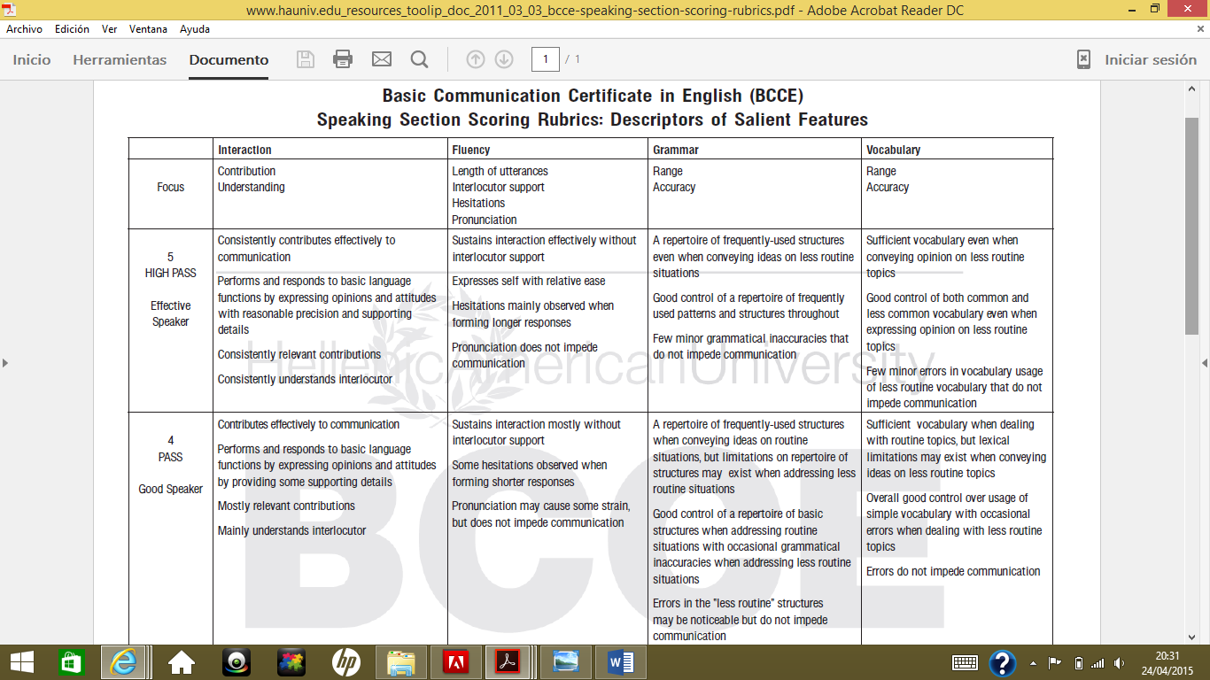
Speaking Rubric Part 1

Slide 40
Speaking Rubric Part 2

Slide 41
Speaking Rubric Part 3

Slide 42
LESSON PLAN
Group: 3 “H” of Bachelor | Date: February 2015 | Time: 40 minutes | No. of students: 25 students
Topic work: Digital Storytelling
Aims: Teach students what Digital Storytelling is and the steps to create a digital story.
Objectives: At the end of the lesson , students will be able to: Know what digital storytelling is and the steps to create a digital story.
Assessment: The teacher will assess students’ participation in class.
Materials: Projector, computer, copies, markers and eraser
Timing 40’ | Teacher activity -Deliver copies to students about Digital Storytelling. -Explain students what is Digital Storytelling and the steps for making a digital story. -Present an example of a digital story | Student activity. -Students will pay attention to the explanation about digital storytelling and make questions if they have any doubts. -The students will give opinions about the digital story they watched. | Success Indicators -Students understand what is a digital story -Students know the steps to create a digital story.
Homework/ Further work: Read the information about Digital Storytelling at home and look for the meaning of unknown words.

Slide 43
LESSON PLAN
Group: 3 “H” of Bachelor | Date: February 2015 | Time: 40 minutes | No. of students: 25 students
Topic work: Digital Storytelling through Windows Movie Maker.
Aims: Teach students to create a digital story through Windows Movie Maker.
Objectives: At the end of the lesson , students will be able to: Know how to create a digital story through Windows Movie Maker.
Assessment: The teacher will assess students’ participation in class.
Materials: Projector, computer, markers and eraser
Timing 40’ | Teacher activity -Present a video to students about how to create a digital story through the software Windows Movie Maker. -Explain the meaning of difficult words to students. | Student activity. -Students will pay attention to the video about how to create a digital story using Windows Movie Maker. -The students will ask questions about the video they watched -The students will write down the meaning of difficult words. | Success Indicators -Students know how to create a digital story through windows Movie Maker
Homework/ Further work: Study the new vocabulary.

Slide 44
LESSON PLAN
Group: 3”H” of Bachelor | Date: February 2015 | Time: 40 minutes | No. of students: 25 students
Topic work: Parts of an essay
Aims: Teach students how to write an essay
Objectives: At the end of the lesson , students will be able to : Know the structure of an essay.
Assessment: The teacher will assess students’ essays.
Materials: Dictionary, markers and eraser
Timing 40’ | Teacher activity -Write an example of an essay on the board and explain its structure. -Make students write their own essays with the title: All about myself. -Help students with their doubts. | Student activity. - Students will take notes about the structure of an essay. -Students will write their own essays with the title: All about myself | Success Indicators -Students know the structure of an essay -Students write their own essays

Slide 45
LESSON PLAN
Group: 3”H” of Bachelor | Date: February 2015 | Time: 40 minutes | No. of students: 25 students
Topic work: English Grammar and Pronunciation
Aims: Dispel doubts about English grammar and pronunciation
Objectives: At the end of the lesson , students will be able to: Understand English grammar better. Pronounce difficult words better.
Assessment: The teacher will assess students’ participation in class.
Materials: Dictionary, markers and eraser.
Timing 40’ | Teacher activity -Help students with grammatical problems in their essays. -Help students with pronunciation problems. | Student activity. -Students will ask about grammar points they don’t understand. -Students will ask about pronunciation doubts. | Success Indicators - Students have a better understanding of English grammar. -Students learn to pronounce difficult words.
Homework/ Further work: Practice the pronunciation of difficult words of their essays.

Slide 46
LESSON PLAN
Group: 3 “H” of Bachelor | Date: March 2015 | Time: 40 minutes | No. of students: 25 students
Topic work: Gathering Resources to make a digital story.
Aims: Help students to create a digital story.
Objectives: At the end of the lesson , students will be able to: Gather the elements to make a digital story.
Assessment: The teacher will assess students’ work in class.
Materials: Computer, cellphone, flash memory
Timing 40’ | Teacher activity -Make students search for pictures and music so they can create their digital stories. -Make students record their stories. | Student activity. -Students will search pictures and music so they can create their digital stories. -Students will record their stories by using the computer or their phones. | Success Indicators -Students search the necessary pictures and music to create the digital stories. -Students record the story using right pronunciation.
Homework/ Further work: Finish recording the story at home in case you did not finish it in class.

Slide 47
LESSON PLAN
Group: 3 “H” of Bachelor | Date: March 2015 | Time: 40 minutes | No. of students: 25 students
Topic work: Make a digital story using Windows Movie Maker.
Aims: Help students to create a digital story.
Objectives: At the end of the lesson , students will be able to: Make a digital story with Windows Movie Maker.
Assessment: The teacher will assess students’ work in class.
Materials: Computer , flash memory
Timing 40’ | Teacher activity -Make students do a digital story with the pictures, music and voiceover they previously gathered. -Help students with doubts about the use of the software. | Student activity. -Students will make a digital story with pictures, music and voiceover. -Students will ask questions if they have any doubts about the use of the software. | Success Indicators -Students use Windows Movie Maker correctly -Students’ stories done right.

Slide 48
LESSON PLAN
Group: 3 “H” of Bachelor | Date: March 2015 | Time: 40 minutes | No. of students: 25 students
Topic work: Presentation of digital stories made by students.
Aims: Help students practice speaking through digital stories.
Objectives: At the end of the lesson , students will be able to: Make a presentation of a digital story.
Assessment: The teacher will assess students’ presentation of their digital stories.
Materials: Computer, projector
Timing 40’ | Teacher activity -Make students present their digital stories to the class. -Provide feedback to the students about their digital stories. -Write new vocabulary taken from digital stories on the board. | Student activity. -Students will present their digital stories to the class | Success Indicators - Students’ digital stories are well developed.
Homework/ Further work: Write sentences using the new vocabulary.

Slide 49
Teaching students about Digital Storytelling.

Slide 50
Explaining about the Digital Storytelling process.

Slide 51
Showing an example of a digital story.

Slide 52
Students writing their essays.

Slide 53
Checking students’ essay

Slide 54
Students working on their digital stories.

Slide 55
Checking students’ digital stories

Slide 56
Student presenting his digital story.

Slide 57
Control group students.

Slide 58
Experimental group students.

Slide 59
Rumiñahui High School.

