Slide 1

DEPARTAMENTO DE CIENCIAS HUMANAS Y SOCIALES
CARRERA DE LINGÜÍSTICA APLICADA AL IDIOMA INGLÉS
PROJECT PRIOR TO OBTAINING APPLIED LINGUISTICS IN ENGLISH LANGUAGE BACHELOR´S DEGREE
TITLE: “INCIDENCE OF TASK – BASED LEARNING TO DEVELOP SPEAKING SKILL FOR STUDENTS OF TENTH YEAR AT FRANCISCO DE ORELLANA HIGH SCHOOL, DURING SCHOOL YEAR 2014-2015¨
AUTHOR: SALÁN TORRES SAUL ISMAEL
DIRECTOR: DR. VILLA OSWALDO
CO DIRECTOR: MSc. MADRID MARICELA
.

Slide 2
Part i research problem

Slide 3
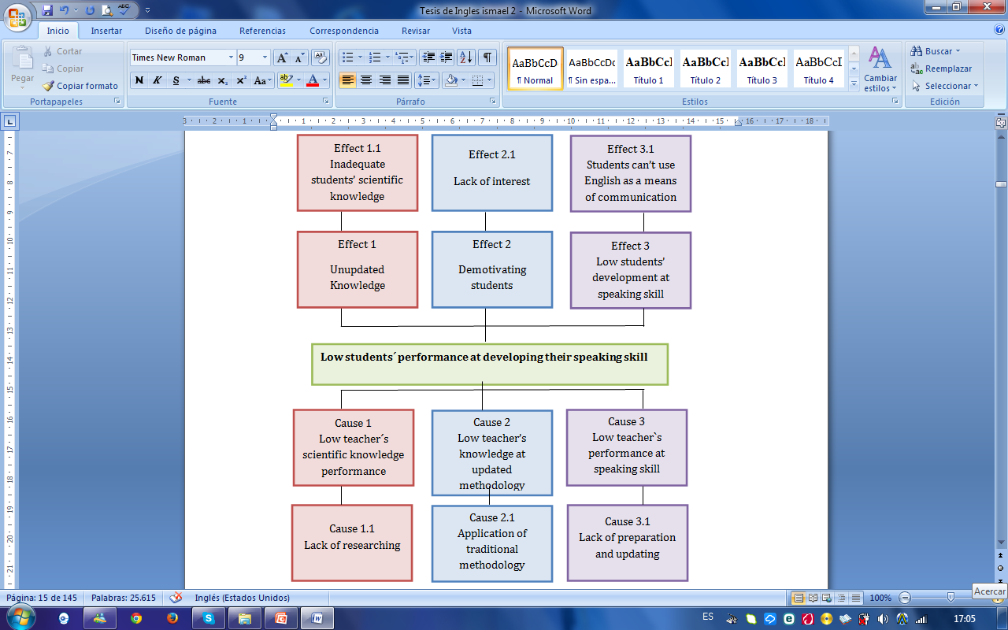
Problem Identification

Slide 4
GENERAL OBJECTIVE
Determine the influence of Task-Based Learning on the development of speaking skill in students of tenth grade at Francisco de Orellana High School, during school year 2014-2015.

Slide 5
SPECIFIC OBJECTIVES
Diagnose the level of English students of tenth grade have through a pre-test based on the Common European Framework of References scales.
Design Task-Based Learning strategies for students to develop the speaking skill
Analyze the use of Task-Based Learning to develop the speaking skill through the application of a post-test based on the Common European Framework of References scales.

Slide 6
PART TWO
THEORETICAL FRAMEWORK

Slide 7
TASK-BASED LEARNING
APPROACH
PROVIDE LEARNERS WITH NATURAL CONTEXT
LANGUAGE USE
TO COMPLETE A TASK
INTERACTION

Slide 8
TASK-BASED LEARNING STRATEGIES
Listing
Ordering and sorting
Comparing
Problem solving
Brainstorming
Memory games
Classifying
Sequencing
Collecting sets
Matching
Indentifying
Guessing games

Slide 9
SPEAKING SKILL
SPOKEN PRODUCTION
SPOKEN INTERACTION
ACCORDING TO COMMON EUROPEAN FRAMEWORK OF REFERENCES FOR LANGUAGES.

Slide 10
SPOKEN PRODUCTION
COMPREHENSION
PRONUNCIATION
FLUENCY
ACCURACY
SIMPLY PRODUCING WORDS

Slide 11
SPOKEN INTERACTION
SPEAKING/CONVERSING WITH OTHER PEOPLE
GRAMMAR AND VOCABULARY
PRONUNCIATION
INTERACTIVE COMMUNICATION
RESPONSE

Slide 12
Hypothesis formulation
Working hypothesis
The use of Task-Based Learning will improve in the development of speaking skill to tenth year students at Francisco de Orellana High School.
Null hypothesis
The use of Task-Based Learning to tenth year students at Francisco de Orellana High School will not improve in the development of speaking skill.

Slide 13
Part three methodological design

Slide 14
Research Type and Design
It is a quasi-experimental and of field research. The quality of data was presented by the administration of two tests: pre-test and post-test.
Size
Two groups of students were the objects of the study with a total of 63 students
Control Group = 35 students
Experimental Group = 28 students.

Slide 15
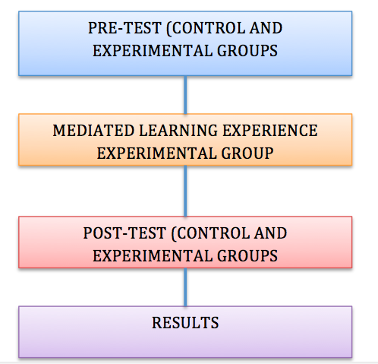
Field work
The research project took place at Francisco de Orellana High School during the school year 2014-2015
Instruments and data collection
Pre-test and post-test (adapted from KET, including rubrics)

Slide 16
Part four testing the hypothesis

Slide 17
Pre-test results

Slide 18
Post-test results

Slide 19
Descriptive statistic
Decision:
For the contrast of the hypothesis at a level of significance = 0.05, and 27 gl, due to the fact that the the t-students calculated (-8,0112) is higher than critical value (-2,0518) the null hypothesis is denied and working hypothesis is accepted concluding that there is a significant relationship between the application of Task-Based Learning and the speaking skill.

Slide 20
Conclusions
The use of Task-Based Learning influences in the developement of the speaking skill since the hypothesis null was denied based on the t-stundent = -8,0112 which is higher than -2,0518.
Task-Based Learning provides students with a tool to increase their confidence when developing spoken production and spoken interaction.
Tasks make teacher and students to tackle in the main aspects of speaking such as comprehension, grammar and vocabulary usage, pronunciation, fluency, and relatedness.

Slide 21
Recommendations
Teachers should use Task-Based Learning as a teaching tool to improve students’ speaking performance at all levels at Francisco de Orellana High School.
Teachers and students should have indicators for achieving speaking skill such as: comprehension, pronunciation, relatedness, fluency,
grammar and vocabulary usage.
Propose innovative Task-Based Learning activities for helping students to develop spoken production and spoken interaction.

Slide 22
Part five proposal

Slide 23
Objective
Develop speaking skills on students of Tenth Year at Francisco de Orellana High School through the application of Task-Based Learning Activities

Slide 24
Proposal description
UNIT | TOPICS | SUBTOPICS | TASK-BASED LEARNING STRATEGIES | TASK-BASED LEARNING ACTIVITIES | INTERACTION | FOCUS SKILL | TIME
ONE TWO | Everybody’s waiting for us Do you have any pizza dough? | Talk about what’s going on now Present continuous Talk about food by using count and noncount nouns | Listing Ordering and sorting Comparing Creative tasks Problem solving tasks | Brainstorming Memory games Classifying Sequencing Collecting sets Identifying Guessing games Question tasks | Solo work Pair work Group work | Spoken production Spoken Interaction | 40 hours

Slide 25
Proposal development
1. NAME OF THE UNIT:
Everybody’s waiting for us
2. A BRIEF DESCRIPTION OF THE UNIT:
In this unit students will be working in task-based learning activities that aimed to talk about what is going on now by using the present continuous.
3. OBJECTIVE:
Students will be able to talk about things that are happening now by using present continuous and by showing respect to individual characteristics.
4. TASK-BASED LEARNING STRATEGY:
*LISTING (Brainstorming and memory games)
*ORDERING AND SORTING (Classifying and Sequencing)
5. TIME: 20 hours

Slide 26
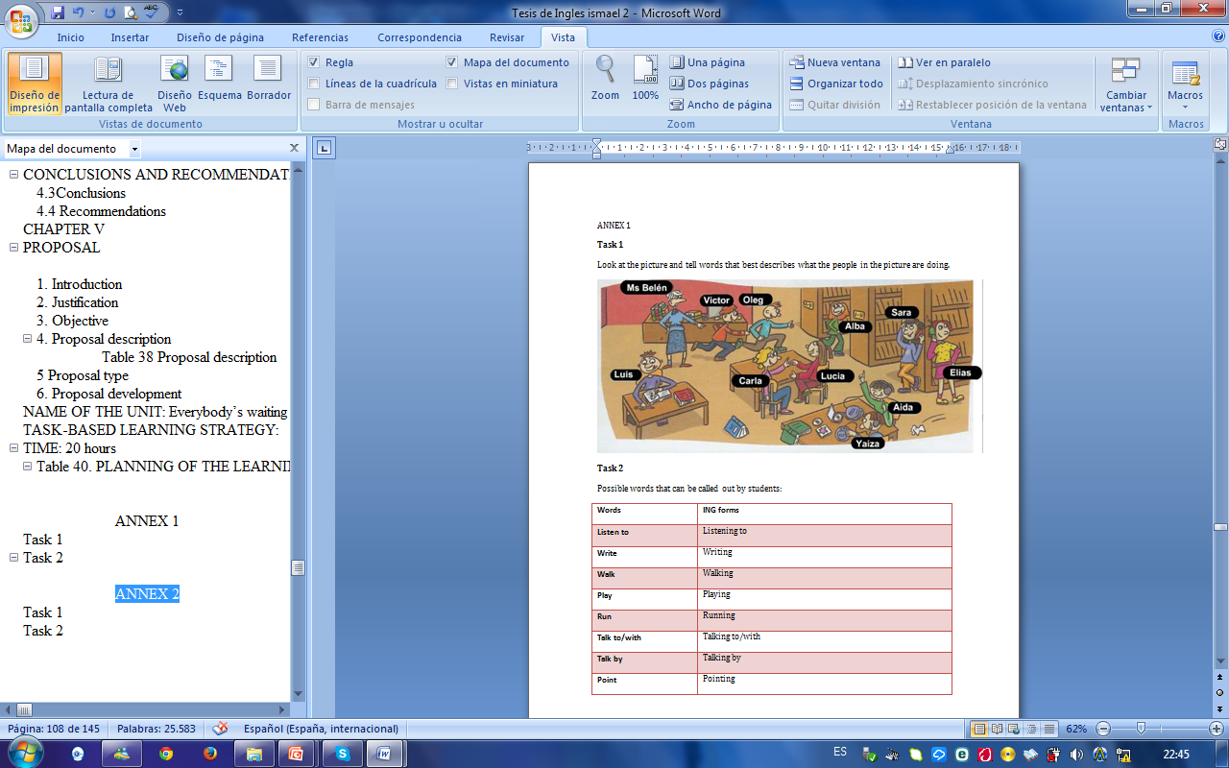
Annex 1

Slide 27
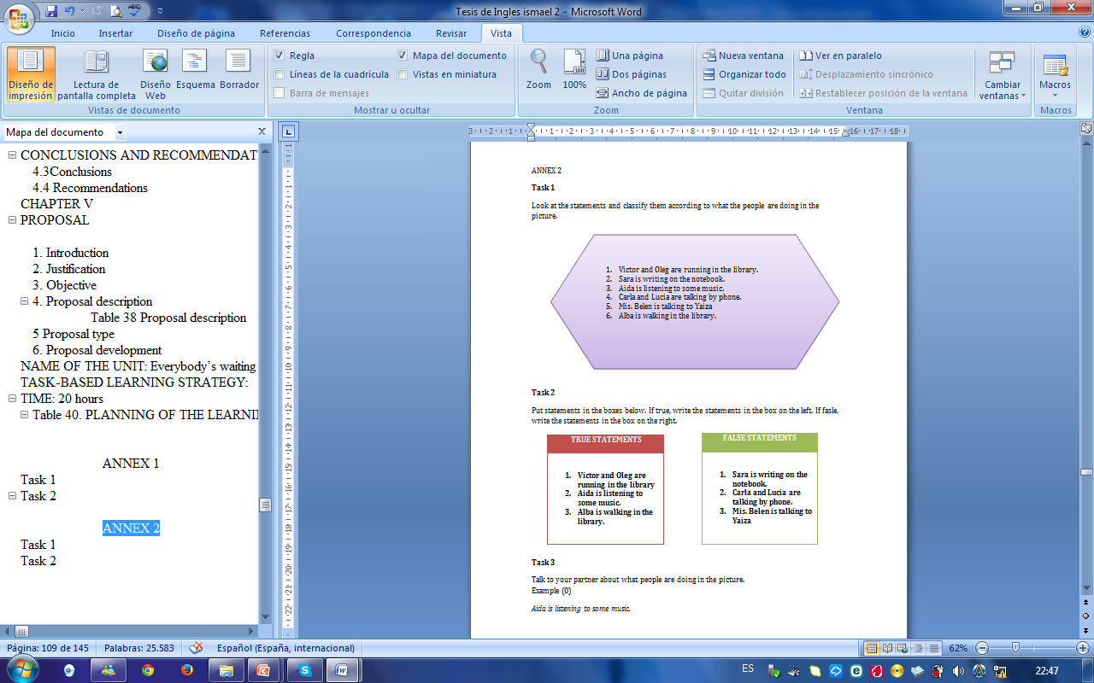
Annex 2

Slide 28
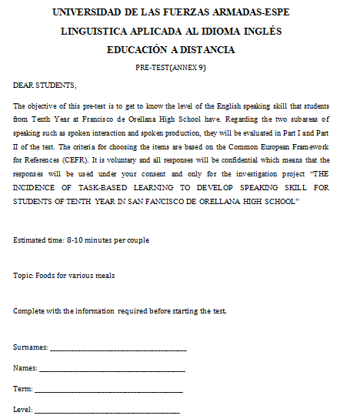
Pre-test

Slide 29
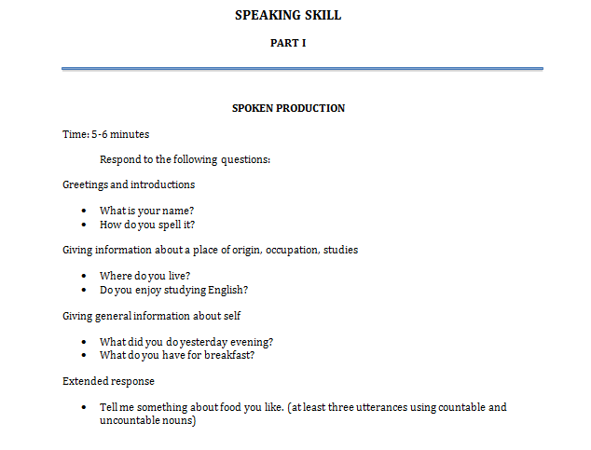
Pre-test

Slide 30
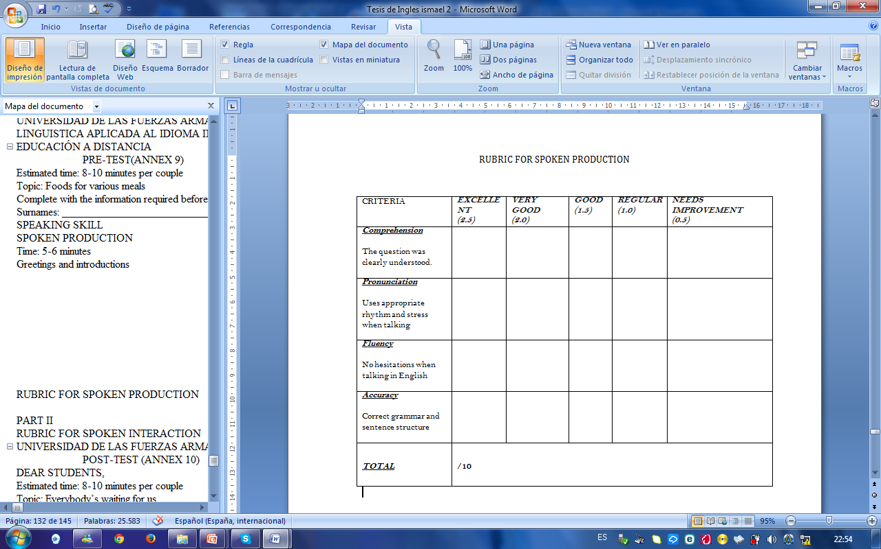
Rubric

Slide 31
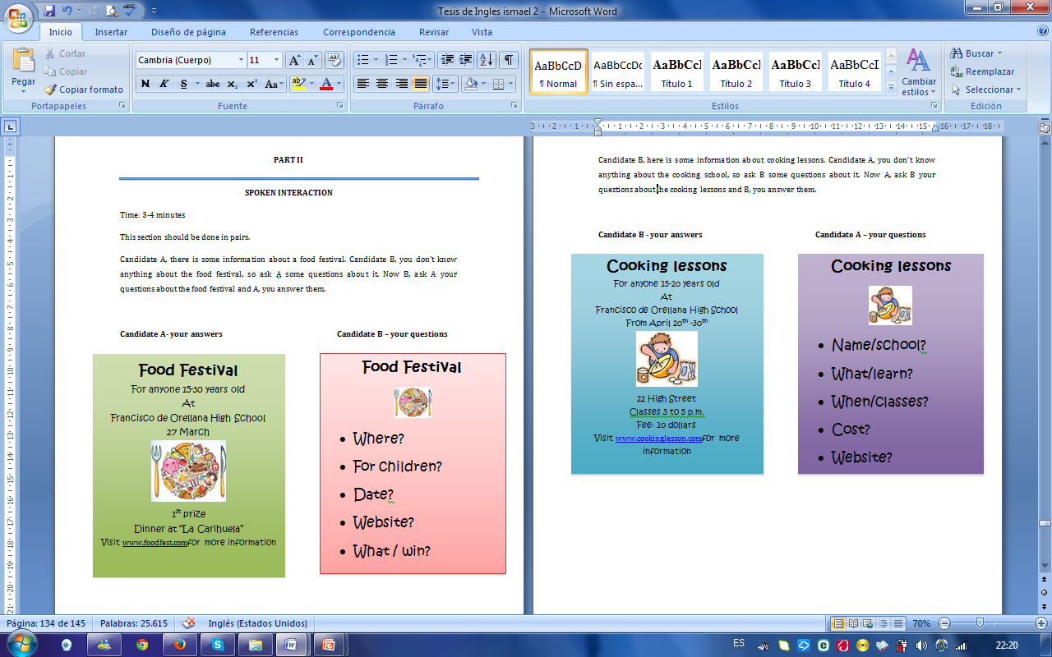
Pre-test

Slide 32
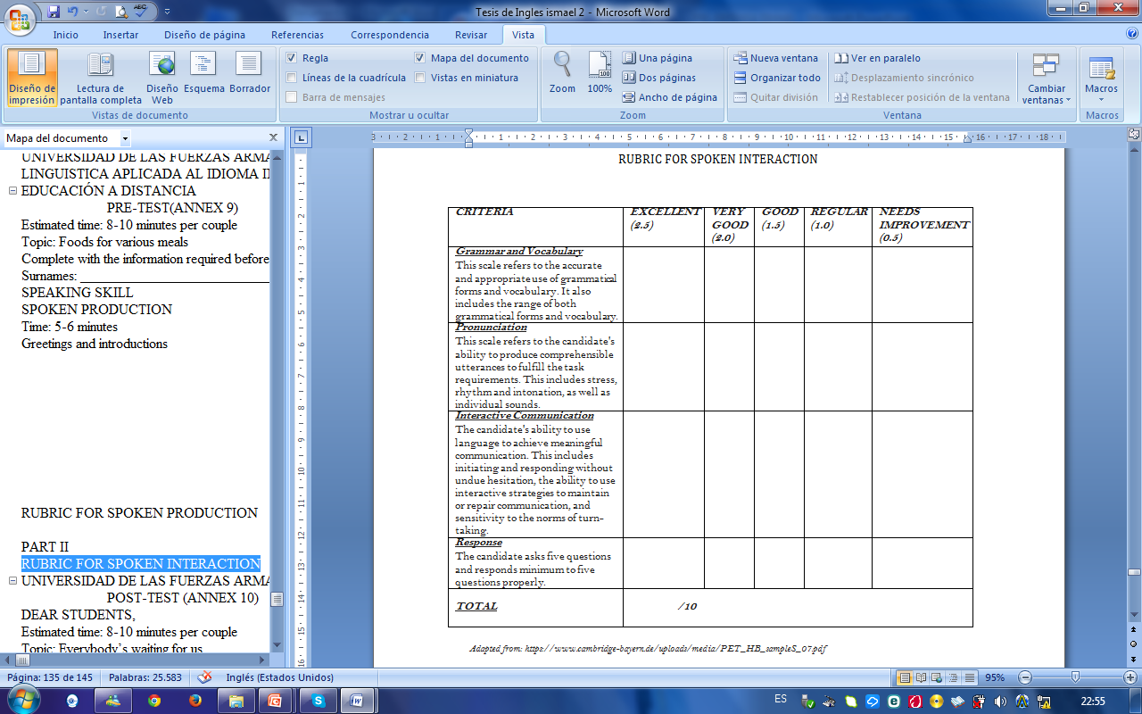
Rubric

Slide 33
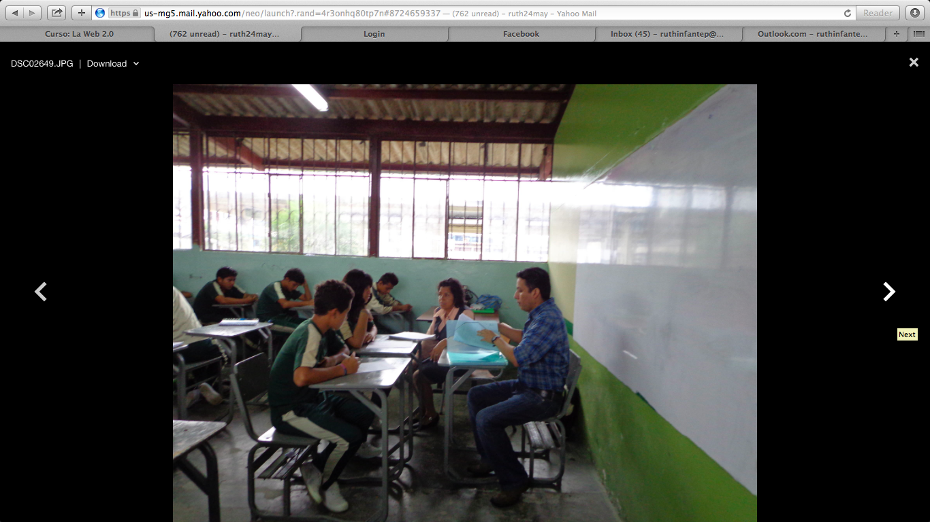
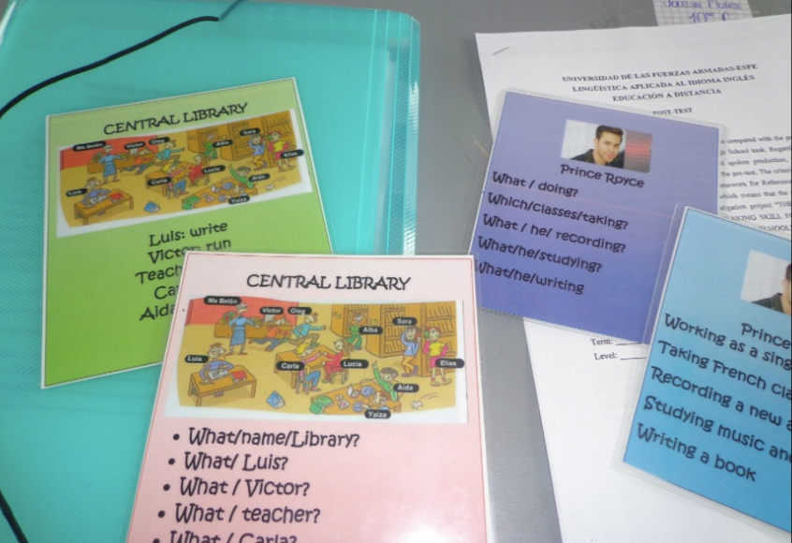
Photos
PRE-TEST is being applied to students at San Francisco de Orellana High School
Materials that were used for the POST-TEST

Slide 34
Thank you!

