Slide 1
DEPARTAMENTO DE CIENCIAS HUMANAS Y SOCIALES CARRERA DE LICENCIATURA EN LINGUÍSTICA APLICADA AL IDIOMA INGLÉS PROJECT PRIOR TO OBTAINING APPLIED LINGUISTICS IN ENGLISH LANGUAGE BACHELOR´S DEGREE “RECREATIONAL STRATEGIES FOR DEVELOPING LISTENING SKILL ON THE STUDENTS OF EIGHTH GRADE OF BASIC EDUCATION AT COLEGIO NOCTURNO TUNGURAHUA, BAÑOS, PROVINCE OF TUNGURAHUA, DURING THE FIRST TERM, 2012-2013 SCHOOL YEAR. AUTHOR: MARÍA VIVIANA LUZURIAGA OCHOA DIRECTOR: DR. GONZALO PUMA CH.

Slide 2
PART ONE
RESEARCH PROBLEM

Slide 3
TREE PROBLEMS

Slide 4
General Objective:
To determine the relationship between recreational Strategies and Listening skill development

Slide 5
Specific Objectives:
To diagnose deficiency problems in listening skills with students of the Eight grade of Education Basic.
To decide upon the most suitable recreational strategies for listening skills.
To come up with appropriate recreational strategies for listening skills.

Slide 6
PART TWO
THEORETICAL FRAMEWORK

Slide 7
CONCEPTS
Barkey
The student interact but doing different activities.
Adrian
He says that hear, understand, judging permit to listen and interpreted the messages.
Rustbelt
He says that make activities of summary, notes, using flash card solving problems.
Moir
He describes six strategies

Slide 8
Steps to listening skill
Hearing
Catch what the speaker saying
Understanding
What you heard and understand in your own way.
Judging
After that you understand, think if it has sense.

Slide 9
Activities and ideas enhance teaching listening skill
Listen to music
Key words
Pay attention to the story
Mime games
The images , videos or radio
Taking notes
Draw the Description
Physical Response

Slide 10
Hypothesis Formulation
Working Hypothesis
“Recreational strategies improve positively listening skills on the eighth grade students of Colegio Nocturno Tungurahua”
Null Hypothesis
“Recreational Strategies do not improve the listening skills on the eighth grades students of Colegio Nocturno Tungurahua”

Slide 11
PART THREE
METHODOLOGICAL DESIGN

Slide 12
Research Type and Design
The study was applied in the descriptive in the descriptive statistic and field statistic.
The technique used for collection data was a test..
The study was correlated because both statistic were important in the development of this work.
Size
The population test was 30 students they are from eight grade at Colegio Nocturno Tungurahua during the first semester of school year 2012-2013 in the province of Tungurahua, Baños city. 15 students are the control group and 15 students on the experimental group.

Slide 13
PART FOUR
GRAPHICAL EXPOSITION OF RESULTS
PRE-TEST

Slide 14
GRAPHICAL EXPOSITION OF RESULTS
POST-TEST

Slide 15
FINAL RESULTS OF PRE-TEST AND POST TEST IN EXPERIMENTAL GROUP

Slide 20
SCORES ACTIVITIES

Slide 21
ANALYSIS ESTADISTIC
95%
ACCEPTED
ZONE
H0
ACCEPTED
ZONE
Hi
Zt -0,96
Z=1,39
Zt 0,96

Slide 22
Conclusions
Teachers don´t use Recreational Strategies for Developing Listening Skill students only use the text for the development of the activities and sometimes the CD.
Analyzing the results students learn better when using Recreational Strategies as: Mimic games, Draw descriptions, Pass messages, Listening for key word, songs, music, summary, taking notes, TV. draw descriptions, predicting, taking notes, pay attention, understanding, hearing, judging, pass message, main idea, new vocabulary, speed, understand previous words.
Check the improvement of teaching of English Language using Recreational strategies with the others classes

Slide 23
Recommendations
Teacher should use new Methodologies to help to the student to have love for the English Language and get good scores.
Teacher should use different Recreational Strategies to motivate in the teaching Learning process, especially to improve the listening skill that is important in the English language.
Teacher should use new materials for teaching in order to awake the interest in the students and to increase their potential in managing the English Language.

Slide 24
PART FIVE
PROPOSAL

Slide 25
LOGICAL FRAMEWORK
Groups | Interest | Problems | Mandates and Resources
Students | To Develop listening skills in order to increase their potential in the English Language | They do not develop all their listening skills; there are difficulties to understand the English language in a percentage 80%. | Capacity to improve the teaching of the English language in sense of learning.
Teacher Advisor | To improve the quality of teaching and learning strategies for developing listening skills through of strategies Recreational for improvement the listening skills | Technology is not used for teaching of English language. Traditional methods are used instead. | To improve the quality educational and conditions in the teaching English language through of strategies Recreational for improvement the listening skills
Community | Everybody considered at English is an indispensable tool today. | Student does not understand the English language. | It is necessary that Recreational Strategies and listening Skills will be part of the teaching learning in the English language.

Slide 26
PROBLEM TREE
Effect 1
Academically unmotivated students
Effect 2
Poor performance in listening skills
Effect 3
Restless students
Effect 1.1 At risk of failing school year
Effect 2.1
Misunderstanding of English
Effect 3.1
Inadequate work environment
Students show difficulties in listening comprehension of English Language
Cause 1
Lack of use of recreational strategies
Cause 2 Deficient meaningful tools in the class
Cause 3 Absent of trust by the teacher to his students
Cause 1.1
Teacher is not updated knowledge.
Cause 2.1
Inappropriate resources in class development
Cause 3.1
Low teacher-student empathy

Slide 27
OBJECTIVES TREE
High percentage of students pass the school year
Academically motivated students
Good performance skills
Comprehension and balanced students
Students show ability in English listening comprehension in the eighth grade of Basic Education at Colegio Nocturno Tungurahua?
Appropriate strategies in the teaching of English.
Efficient meaningful tools in the English class
High teacher-student empathy
Teacher updated
for teaching the English Language
Appropriate resources in class development
Moderate confidence between teacher and students.

Slide 28
ALTERNATIVES TREE
Academically motivated students in the English class.
Good performance in the skills
Comprehension and balanced students
High percentage of students pass the school year
Understanding English class.
Adequate work environment the classroom
Students show difficulties in listening comprehension of English language
Appropriate Strategies in the teaching of English.
Efficient meaningful tools in the English class
Moderate confidence between teacher to students for working in group, questions and answer on the topic.
Teacher updated for teaching the English language using new Recreational Strategies to improve the listening skills.
Appropriate resources in class development, using CD. Stereo, computer, flash, poster, mime games, cards, reasoning exercises, projector, text.
High teacher -student empathy working group, listening histories, lectures, complete exercises, taking notes, mime games.
Description of pictures, listen histories and understand the message.

Slide 29
ANALYTICAL STRUCTURE
To develop Recreational strategies and listening skills in the students of English language
To good work environment for the learning process of the students.
The Recreational strategies are used in the development of listening skills in the students
Good tools for the teaching of English language.
Efficient communication between teacher and student
Knowledge of classroom education system in the English language
High use of materials and resources in the educational process
System oriented educational training in the classroom, using recreational strategies to improve listening skills.

Slide 30
ANNEXES

Slide 31
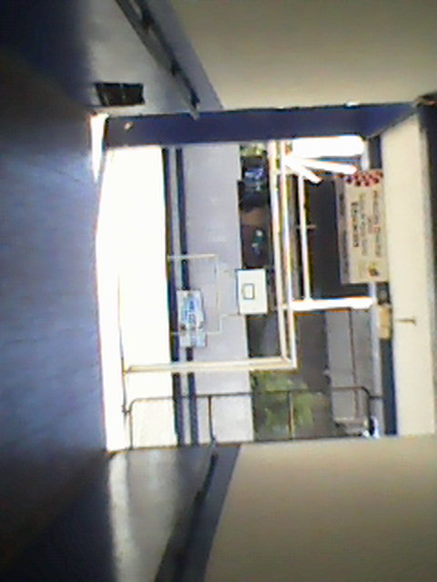
COLEGIO NOCTURNO TUNGURAHUA

Slide 32
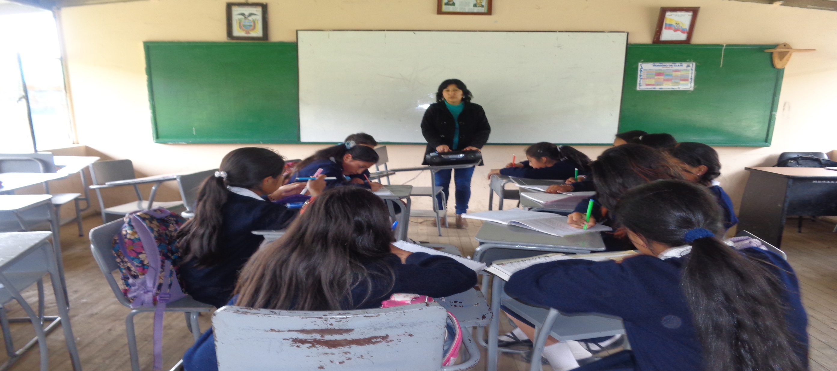
LISTENING

Slide 33
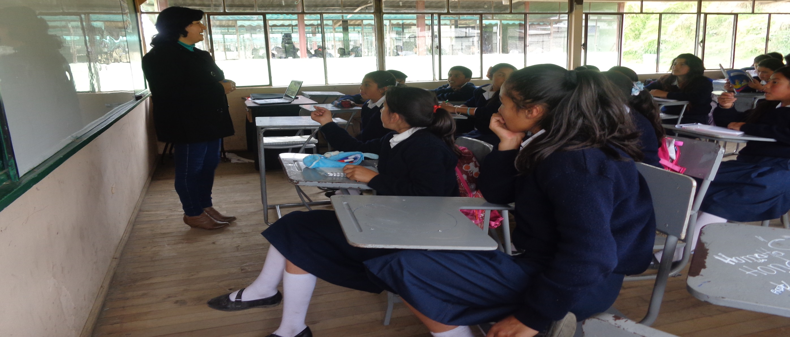
TELL A STORY

Slide 34
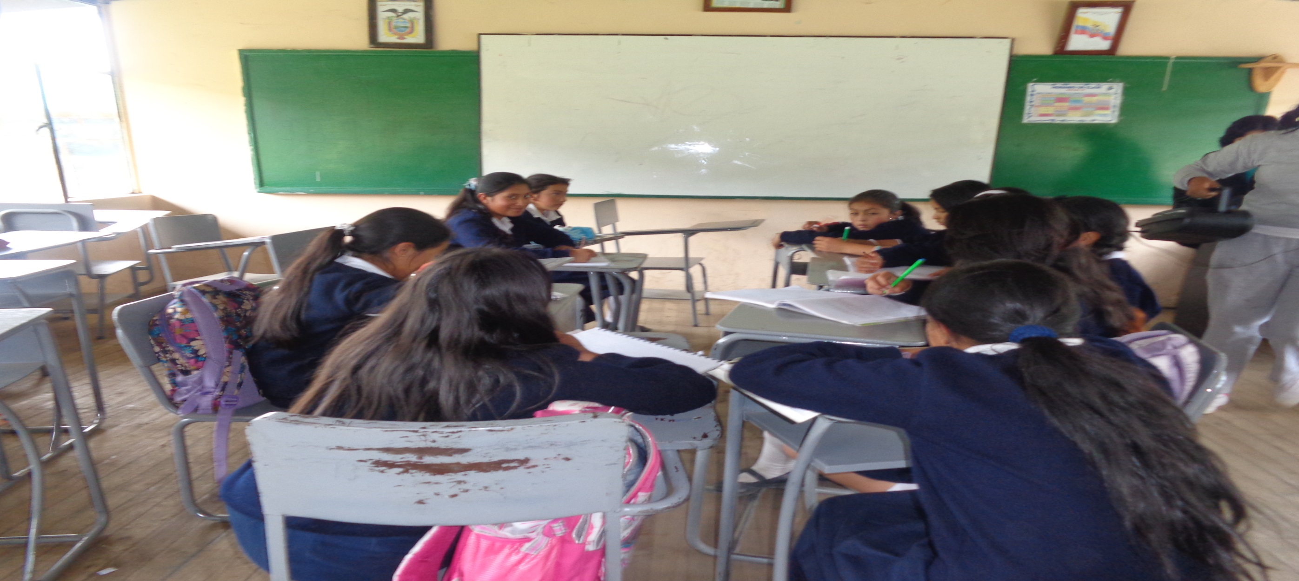
TAKING NOTES

Slide 35
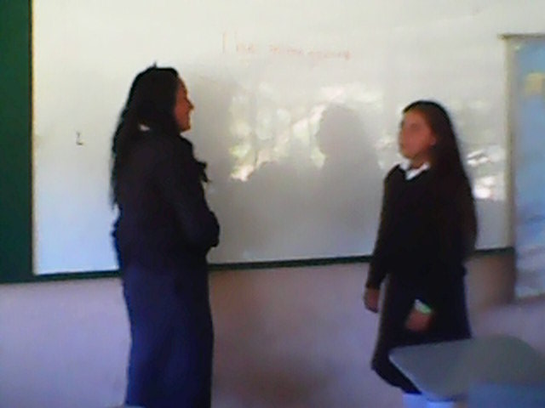
PHYSICAL RESPONSE

Slide 36
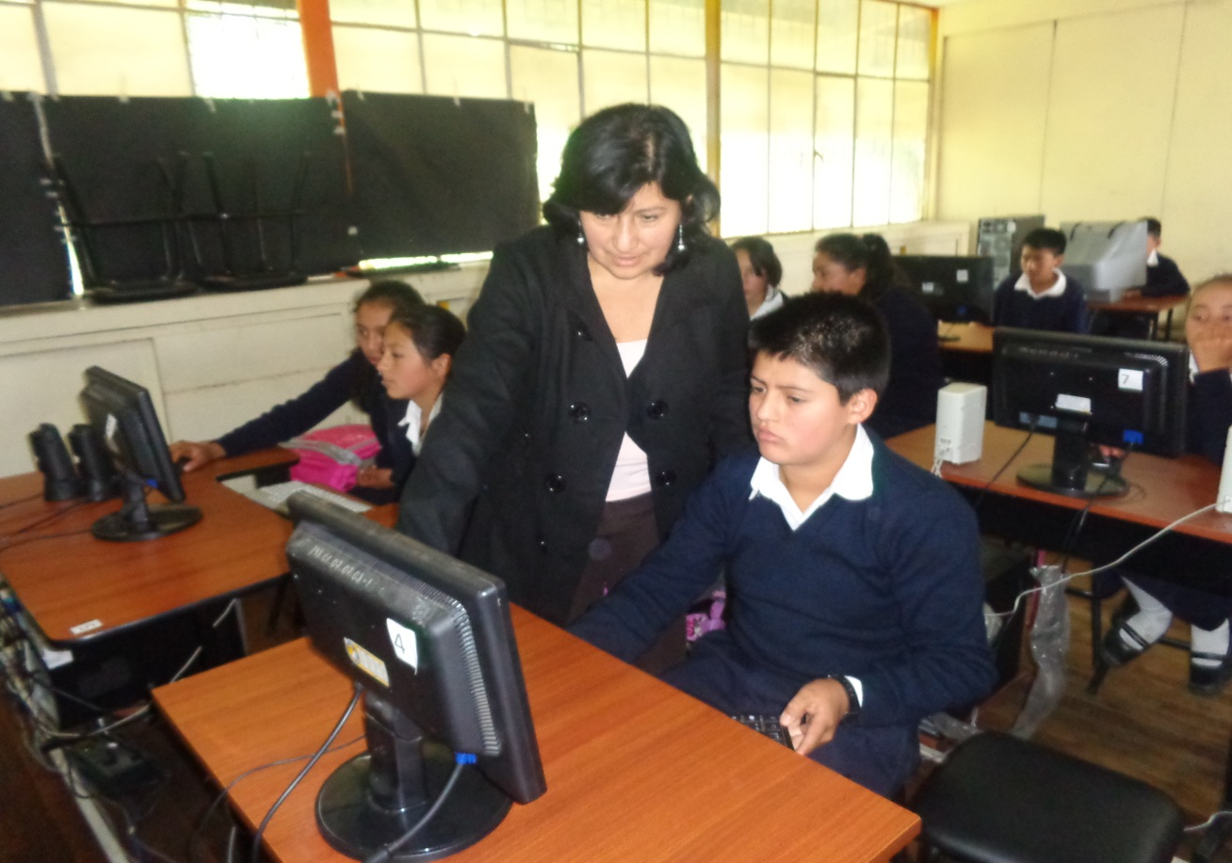
LISTENING STORIES FROM THE WEB

Slide 37
THANKS FOR YOUR
ATTENTION

