Slide 1

THE EFFECT OF BLENDING LEARNING USING VIDEO-BASED BLOGS AND THE SPEAKING SKILL DEVELOPMENT IN STUDENTS ATTENDING 1st YEAR OF BACHELLOR AT “MARCEL LANIADO DE WIND” HIGH SCHOOL, IN MACHALA, IN THE FIRST TERM, 2015-2016 SCHOOL YEAR
UNIVERSIDAD DE LAS FUERZAS ARMADAS ESPE
DEPARTAMENTO DE CIENCIAS HUMANAS Y SOCIALES
CARRERA DE LICENCIATURA EN LINGÜÍSTICA APLICADA AL IDIOMA INGLÉS
AUTHOR: PRISCILA JARAMILLO CANTOS
DIRECTOR: MASTER CARLOS ESPIN

Slide 2
PROBLEM IDENTIFICATION
Low development of the speaking skill
Lack of didactic material
Students cannot speak English well
Notes:
PART ONE – RESEARCH PROBLEM
Students at M.L.D.W High School have a problem in developing their Speaking Skill. (Low Development)
Lack of didactic material such as technological resources
Inadequate teaching methods
Traditional Methodologies
Teacher-centered approach – limits student participation and construction of knowledge
Learning is not meaningful and students do not feel confident to speak
Students cannot speak English well
Inadequate development of Ling. Skills
Memory-focused learning
Unmotivated Students
Low performance

Slide 3
OBJECTIVES
General Objective
Specific Objectives
To establish an effective blended instruction model for the speaking skill development of students.
To investigate the effects of the blended learning model in the speaking skill development of the English language.
To determine the effect of blended learning using video-based blogs and the speaking skill development in the English language.
To develop teacher training sessions to increase the variety of didactic material used in the classroom.

Slide 4
JUSTIFICATION
Students have difficulty developing their communicative skills
ICT tools can help students in the learning process
Blendend Learning using Video-Based Blogs
Promote collaborative and interactive learning
Notes:
ICT (Information and Communication Technology)
Blended Learned Methodology that combines face-to-face and virtual teaching.
Virtual teaching can include a wide variety of technological tools but for this study we are going to center in Video-Based Blogs
Vlogs as they are also known offer the opportunity to deliver personal opinions, share ideas with others, and interact with others with the incorporation of text, images and videos.
The development of this research is very significant in order to investigate the effect of the blended learning model using video-based blogs in the speaking skill development of students. Hence, this investigation will help teachers understand how to establish an effective blended instruction model for the speaking skill development of students.

Slide 5
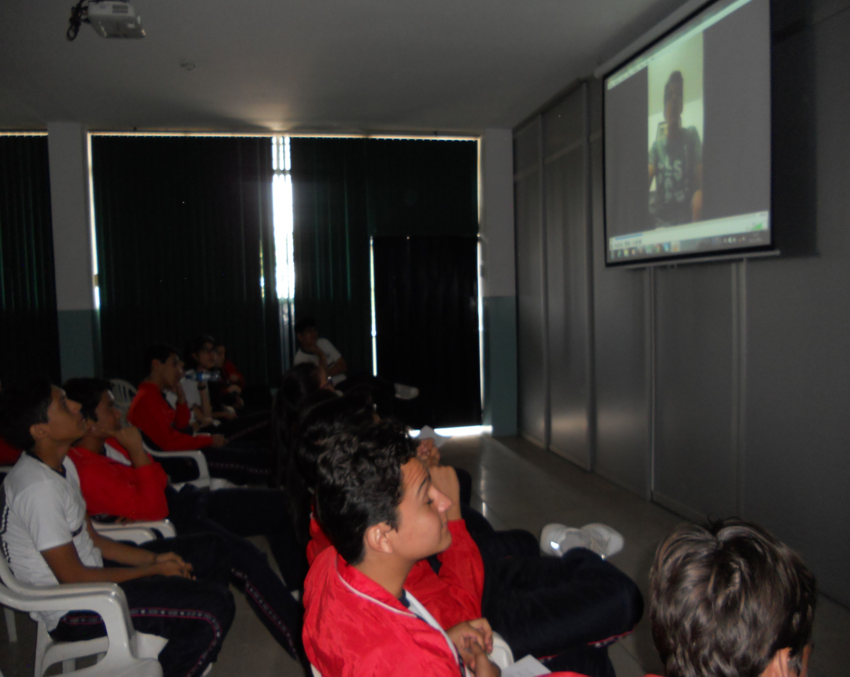
BLENDED LEARNING USING VIDEO-BASED BLOGS
Notes:
PART II – THEORETICAL FRAMEWORK

Slide 6
BLENDED LEARNING USING VIDEO-BASED BLOGS
An overview of Blended Learning
  Combines online and traditional face-to-face instruction
  Wide variety of online and technological resources
  Video-Based Blogs
The importante of Blended Learning
  Enhances the teaching and learning experience of students
  Provides efficient teaching and course management practice
  Helps achieve learning objectives in the class
Notes:
The term “blended learning” is generally applied to the practice of using both online and in-person learning experiences when teaching students.
“Internet Blogs”. In recent years, blogs have emerged as a “new communication and publication medium” and they are seen as a fresh way to share ideas, opinions and interact with others
Blogs itself include several tools that can be used to interact with others. One of these tools is videos. Videos can be very helpful in English classes because it allows students to practice speaking English in real-life situation
Record themselves and practice several times before publishing a video. These types of blogs allow students more time to organize their thoughts and prepare what they want to say in another language.
Reflect on and evaluate their work in the group, while providing suggestions for improvement.
Blogs create opportunities for cooperative learning which helps students improve their English skills.
In addition, the blending learning approach creates a personal space for students so they can feel safe to express themselves and to interact with others.

Slide 7
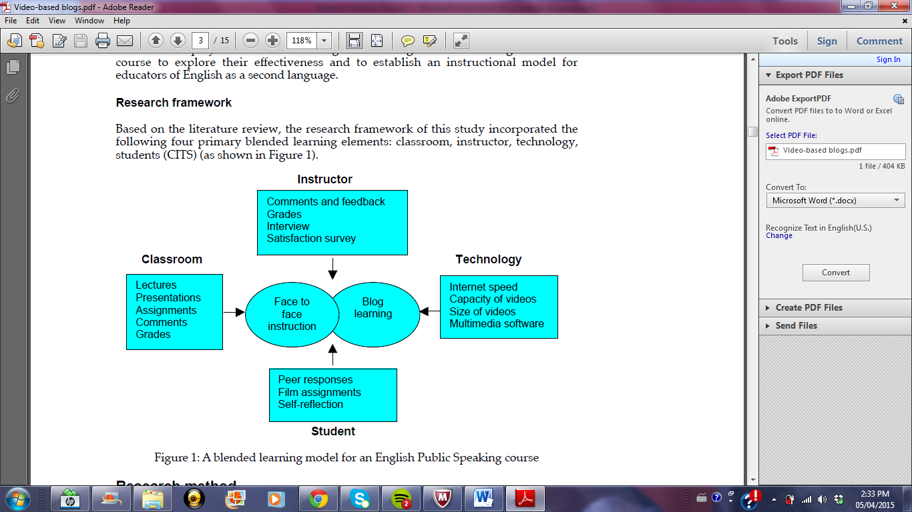
Blended Learning Elements
Source: (Shih, 2010)

Slide 8
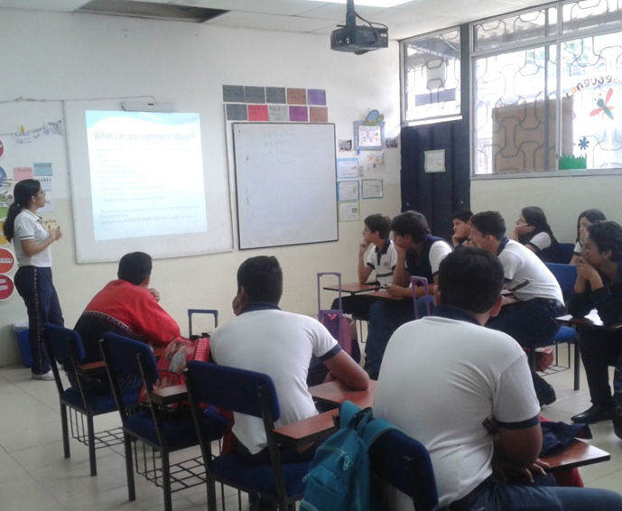
Face-to-Face Instruction
Lecture
-Oral Instruction given by a teacher
Presentations
- Teacher and students can exchange ideas and engage in live communication and discussion
Assignments
-Task or activities that are assessed by the instructor.
Comments
-Part of collaborative work to express ideas and opinions
Grades
-A standardized measurement of varying levels of achievement in a course.
Notes:
Many lectures include some sort of visual aid, such as a slideshow, a word document, an image, or a film.
In this project, the lecture will be developed by the teacher using a PowerPoint presentation where the instructor will explain what the project is about, the objectives and how the task will be developed each week
There are different types of assignments that help teachers assess students’ linguistic skills. There are essays, writing or research papers, oral presentations, projects, case studies, group assignments, etc.
Identify Purpose
Select Assignment Type
Construct Assignment
Develop Grading Criteria
Determine the Type of Feedback
Prepare Students
Monitor Student Progress
Grade and Evaluate Assignment

Slide 9
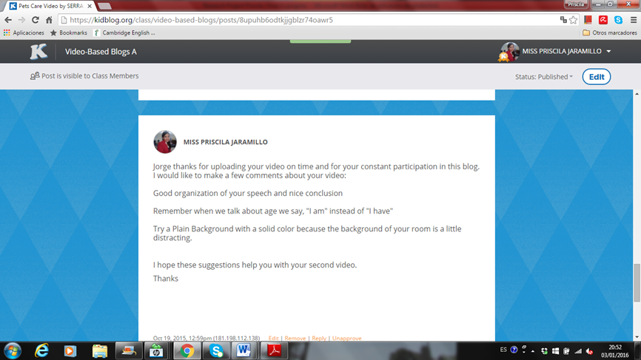
Online Instruction
Technology
Internet Speed
-It determines how quickly you can access or post information such as vlogs.
Capacity of Videos
-Blog websites may differ on the capacity of videos allowed
Size of Videos
-Video sizes can vary. Kidblog allows 100 MB - 500 MB
Multimedia Software
-It refers to the integration of multiple forms of media, which includes text, graphics, audio, video, etc.
Notes:
Therefore, internet is crucial to be successful when posting a video in a blog. Also, speed can also determine the quality of the video you are watching, or audio you are listening to. This will affect how fast others can watch a video posted in a blog. If the internet speed fails it may cause problems to run the video effectively.
There are different types of software that students can use when recording a video. Some examples of popular multimedia software used by students are: Adobe Premier Software, Windows Movie Maker, Flipagrams and iMovie.

Slide 10
THE SPEAKING SKILL IN THE ENGLISH LANGUAGE

Slide 11
SPEAKING SKILL
Grammar
-Use language in authentic ways
-Encourage collaboration
Pronunciation
- Sequential Development (Listening, Awareness, Control, Practice, Extension)
Vocabulary
- Definitions, Self-defining Context, Antonyms and Synonyms, Dramatization, Pictures and Drawings, Realia, Series, Scales and Systems
Background Knowledge
-Find relevant resources to teach content
-Use resources that go beyond the textbook and connect to students
Fluency
-Read different type of text and discuss it with others
-Record voice giving a speech and analyze strengths and weaknesses
Notes:
Speaking is defined as an interactive process of constructing meaning that involves producing and receiving and processing information. (Brown, 1994).
Speaking involves three areas of knowledge: mechanics, functions, social and cultural rules and norms
Grammar: System that puts words together into meaningful units
-Use language in authentic ways
-Encourage collaboration
Pronunciation: How we produce the sounds that we use to make meaning when we speak
Vocabulary: Conceptual Knowledge that goes beyond a dictionary definition
Background Knowledge: The knowledge students have, learned both formally in the classroom as well as informally through life experiences
Fluency: Correct the structures of language at normal speed, being able to speak naturally

Slide 12
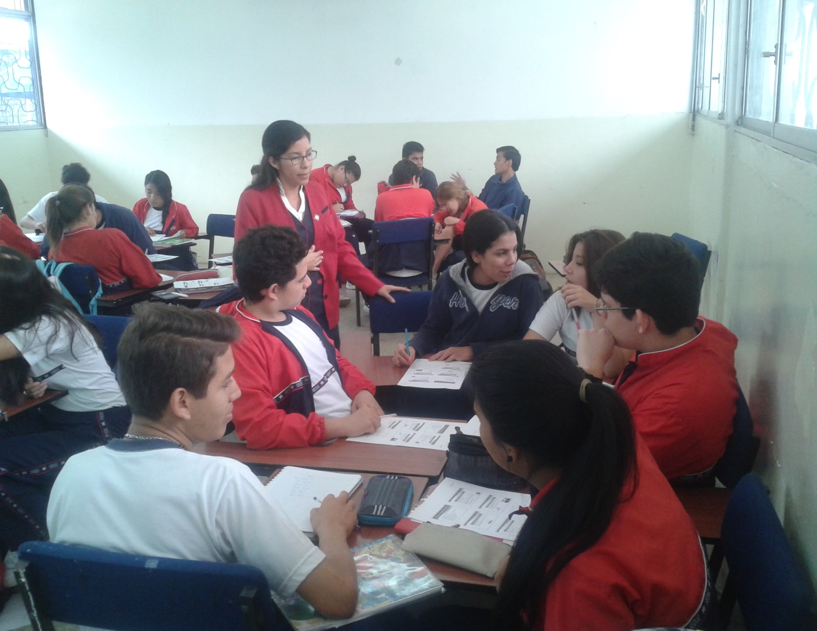
METHODOLOGICAL DESIGN

Slide 13
Population Sample
  43 students
  Experimental Group and Control Group
Setting
  “Marcel Laniado de Wind” High School
Instruments for Data Collection
  Pre-Test
  Post-Test
  Rubric
Notes:
PART III – METHODOLOGICAL DESIGN
Treatment Group 21 students Group A
Control Group 22 students Group B
Pre-test – Students had to record a regular video about a specific topic of their interest. The video length was 3-4 minutes.
Post-test – The experimental group was assessed with the a second videoblog recorded and posted on the Kidblog Website where they had already made the improvements advised by teacher and classmates.
- The control group made a regular video that did not involve the collaborative work involved in video-based blogs.

Slide 14
ANALYSIS OF RESULTS

Slide 15
ANALYSIS OF RESULTS

Slide 16
ANALYSIS OF RESULTS

Slide 17
ANALYSIS OF RESULTS

Slide 18
ANALYSIS OF RESULTS

Slide 19
CONCLUSIONS
Blended learning with the use of video-based blogs had a positive effect on the development of the speaking skill in the experimental group as shown in the results and percentages gathered in this investigation. Therefore, confirming the hypothesis that students can improve their oral skills with the use of video-based blogs.
The independent variable which is blended learning using video-based blogs proved to be an effective technological tool to help students develop and improve their speaking skills in the English language.
The dependent variable which is the speaking skill was developed effectively in the majority of students from the experimental group. Before the investigation, most students in this group had a satisfactory level but it was highly improved by achieving good and excellent communication skills. In the same way, a small percentage with a lower speaking skill also improved and reach a satisfactory or good level after using video-based blogs.
The lack of speaking related activities and usage of interactive and technological tools in the classroom limits students’ progress and improvement of their communicative skills.
Notes:
PART V – CONCLUSIONS AND RECOMMENDATIONS

Slide 20
RECOMMENDATIONS
It is recommended that teachers incorporate a blended learning approach with the use of interactive technological tools that give students the chance to practice and improve their communicative skills.
Collaborative task should be given to students so they can improve their skills with the help of their instructor and classmates.
Teachers should use video-based blog activities to develop and improve students’ speaking skill.
The English Department should organize workshops about blended learning and how to use different technological tools as video-based blogs to help students develop and improve their speaking skill.

Slide 21
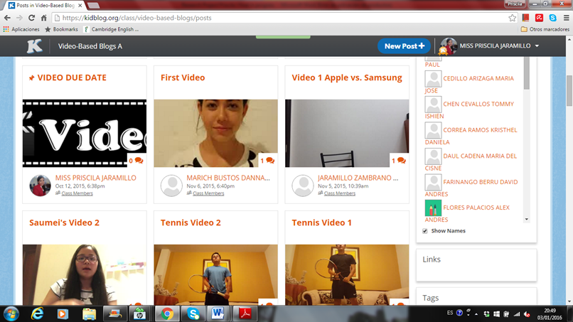
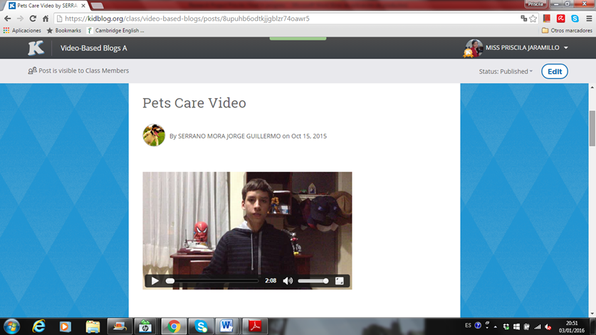
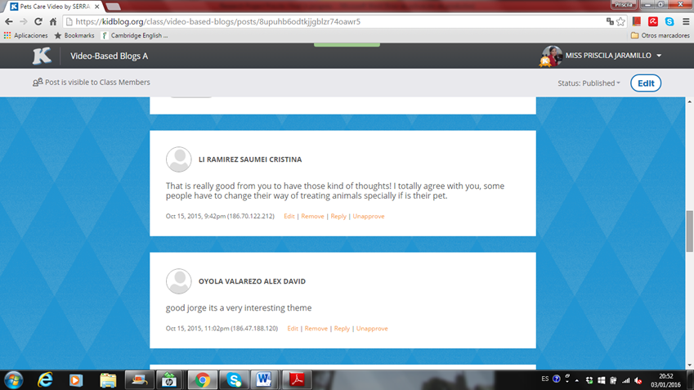
PROPOSAL

Slide 22
PROPOSAL
Groups | Interest | Perceived Problems | Resources and Instructions
Students | Develop an excellent English speaking level so they can communicate in an effective way. | Lack of speaking practice in the class. | Be motivated to practice and try new activities to improve their English speaking skill.
Teachers | Encourage students to develop and improve their English speaking skill with a new approach involving technology. | Traditional methodologies used in class Lack of teacher training development in the use of technological tools in the class | Incorporate a Blended learning approach in language teaching. Use technological resources to help students improve their English speaking skill.
High School | Achieve a proficiency English level in students. | A poor English speaking level in students. Limited use of technological tools in English classes. | Provide teacher training sessions in the use of new strategies and approaches with the use of technology. Give access to technological resources to both students and teachers.
Notes:
STAKEHOLDER ANALYSIS

Slide 23
OBJECTIVE TREE

Slide 25
ANALYSIS OF THE OBJECTIVES

Slide 26
Narrative Summary | Indicators | Verifiers | Assumptions
Objective -To determine the effect of blended learning using video-based blogs and the speaking skill development in the English language. | -Students’ results on the Post-Test | -Scores on the speaking post-test | Students feel motivated to speak English
Purpose -To improve students’ English speaking skill with the use of video-based blogs. | -80% of students from the experimental group achieve a good or excellent level on the speaking skill post-test | -Scores on the speaking post-test | Students have access to a blog account Students have access to a computer and internet at home
Components -Use of technological resources -Blended learning | -Teachers develop activities that include video-based blogs -Students participate in the development of a video-based blog -Students collaborate with teacher and other classmates to develop their video-based blog | -Teacher’ survey on use of technological resources -Student’s participation on activities -Students’ participation and video-based blog upload on the platform | Teachers know how to use technology related activities in class. Students are willing to participate on online collaborative task
Activities -Video-based blogs -Teacher training sessions on how to use a variety of didactic material. (Duration: 2 hours session every week for 1 month ) | Resources Free/Paid Blog Membership Video software Computer Lab Internet Projector Copies Markers | Cost USD$ $24,99 - - - - $5,00 $4,00 Total = $33,99 | Budget Area English Directors working along with computer teachers to train teachers on how to use a variety of didactic technological material.

Slide 27
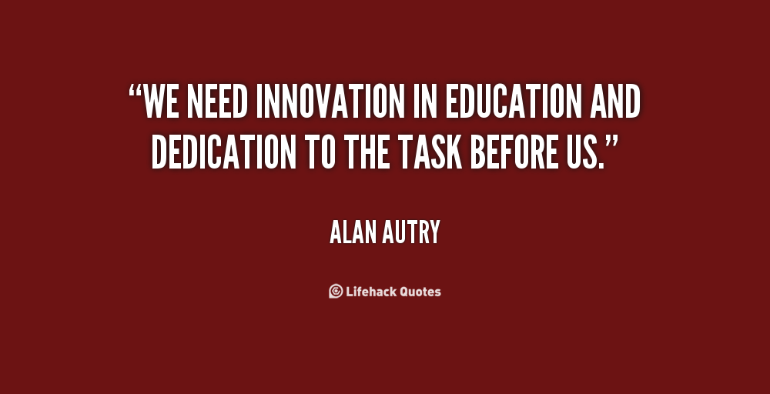
THANK YOU

