Slide 1

DEPARTAMENTO DE CIENCIAS HUMANAS Y SOCIALES
APPLIED LINGUISTICS IN ENGLISH program
RESEARCH PROJECT PRIOR TO OBTAINING THE APPLIED LINGUISTICS IN ENGLISH DEGREE
THEME:
“USE OF BLOGS TO IMPROVE THE ENGLISH WRITING SKILL, IN EIGHTH GRADE STUDENTS CLASSROOM “C”, AT MILITARY HIGH SCHOOL N° 13 “PATRIA” DURING THE FIRST QUIMESTRE, SCHOOL YEAR 2015-2016.”
AUTHOR: Néstor Benjamín Bonilla L.
TUTOR: MSc. Néstor Bonilla Bonilla
Sangolqui, 2016

Slide 2

PART ONE
RESEARCH PROBLEM

Slide 3
PROBLEM IDENTIFICATION
Poor writing in English performance

Slide 4

PROBLEM FORMULATION
What is the repercussion of the use of blogs on the English writing skill in eighth grade students classroom “C”, at Military High School N° 13“Patria” located in the city of Latacunga during the first quimestre of the school year 2015-2016?

Slide 5


VARIABLES MATRIX
INDEPENDENT VARIABLE
DEPENDENT VARIABLE

Slide 6
OBJECTIVES
General objective
To determine how the use of blogs affect the teaching learning process to improve English writing skill in eighth grade students classroom ‘C´ at, COMIL 13 “PATRIA”, during the first quimestre in school year 2015 – 2016.
To search strategies to update knowledge using blogs in order to achieve high teaching quality
To determine student’s problem to improve English writing skill.
To provide teachers and students vast quantity of writing activities through using blogs to improve writing skill.
Specific objectives

Slide 7
JUSTIFICATION
English language importance around the world, access to science and technology.
NET Students work better using electronic technological tools as BLOGS.
Use blogs helps to automate techniques and methodologies applied in English teaching -learning process, through using multimedia content, hypertext and hypermedia.
Low competence in English writing skill at COMIL 13 “PATRIA”.

Slide 8

PART TWO
THEORETICAL FRAMEWORK

Slide 9





Slide 10
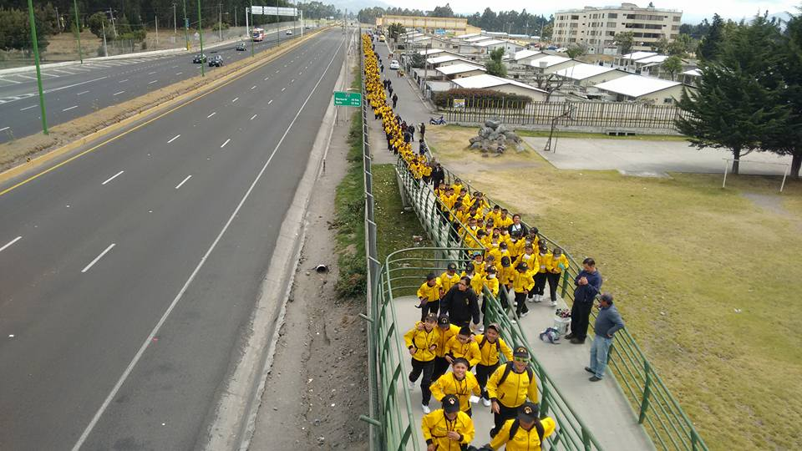
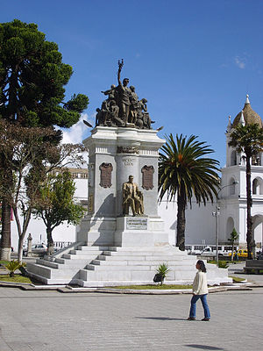

HISTORY
COMIL 13 was founded in 1988 by Mr. General Juan Donoso, it started educating Special Forces soldiers from Brigade N° 9 “PATRIA” , after some time school hosted a long number of students of Cotopaxi Province, it was a big reason to be considered one more in the 13 Military Schools of the Ecuadorian Army.
Parish Guaytacama
Latacunga
Cotopaxi
MISSION
Provide integral education to children and youth, at the initial, basic and high school levels, in order to form high school students in science, contributing to society develop through an alternative educational model within a framework of loyalty to the institution, conscious discipline and constant practice of values.

Slide 11


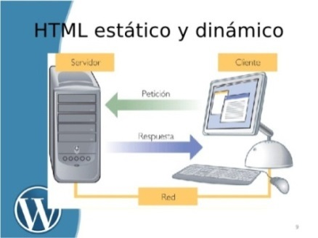



Independent variable
DEFINITION
ORIGINS
A free website, variety of content, rulers for users. CMS.
1999, acquired by google 2003
TYPES OF BLOGS
EDUCATION
BLOGS

Slide 12
Dependent variable
WRITING SKILL
DEFINITION
WRITING PROCESS
WRITING SUB-SKILLS
Pre-writing
Drafting
Revision
Edition
Publication
Content
Accuracy
Vocabulary range
Organization and cohesion
Appropriateness register and format
Writing is a communication form , that allows people to put their feelings, ideas, opinions and knowledge on paper, and express meaning through well constructed text, spelling, vocabulary, grammar work and grow together to improve writing

Slide 13
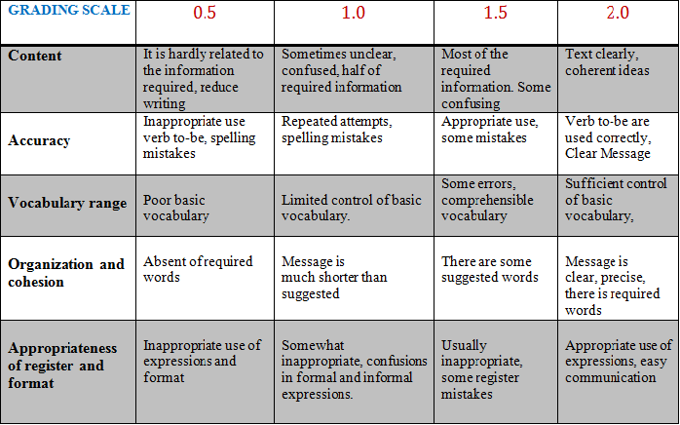
WRITING SUB-SKILLS RUBRICS

Slide 14

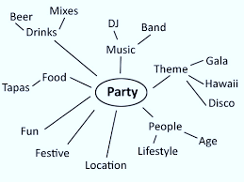
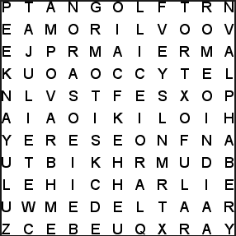

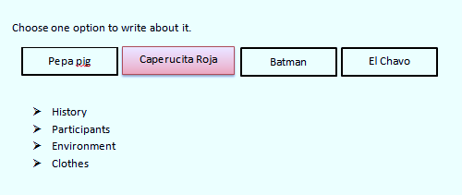
TECHNIQUES
Alphabetical soup
Brainstorm
Key word
Phiramide technique
Assumption technique
Magic word
1 Word
2 Words
3 Words
4 Words
Family
Father, mother
Brother, sister, uncle, aunt
Merry Christmas
Papa noel is coming
I am waiting for gifts
There are many candies

Slide 15
HYPOTHESIS FORMULATION
WORKING
HYPOTHESIS
NULL
HYPOTHESIS
ALTERNATIVE
HYPOTHESIS
Blogs have a positive effect improving the English writing skill in eighth grade students classroom “C”, at Military High School N° 13 “Patria”, during the first quimestre in the school year 2015-2016.
There is not any effect using blogs to improve English writing skill in eighth grade students classroom “C”, at Military High School N° 13 “Patria”, during the first quimestre in the school year 2015-2016.
Use ICTs, influence positively improving the English writing skill in eighth grade students classroom “C”, at Military High School N° 13 “Patria” during the first quimestre in the school year 2015-2016.

Slide 16

PART THREE
METHODOLOGICAL DESIGN

Slide 17
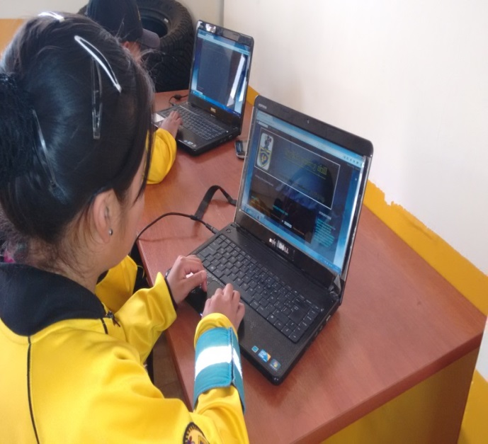
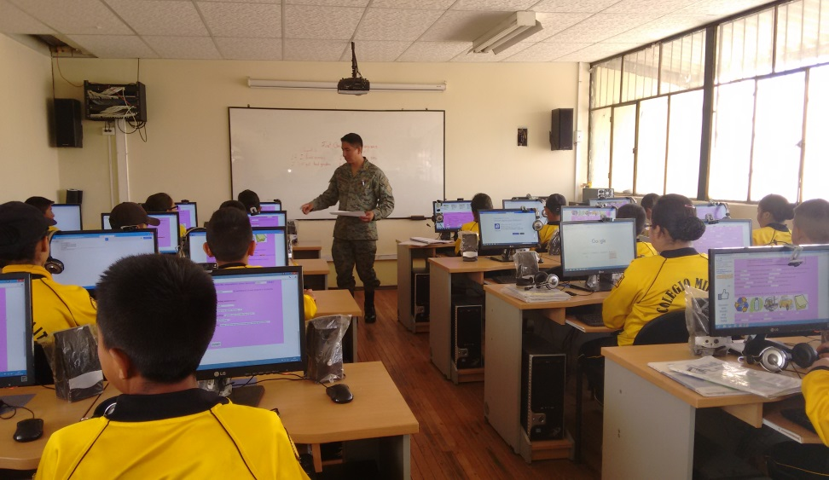
TYPE OF RESEARCH AND DESIGN
Descriptive research
Field work
POPULATION AND SAMPLE
25 students in grade eighth classroom “C”, at COMIL 13

Slide 18
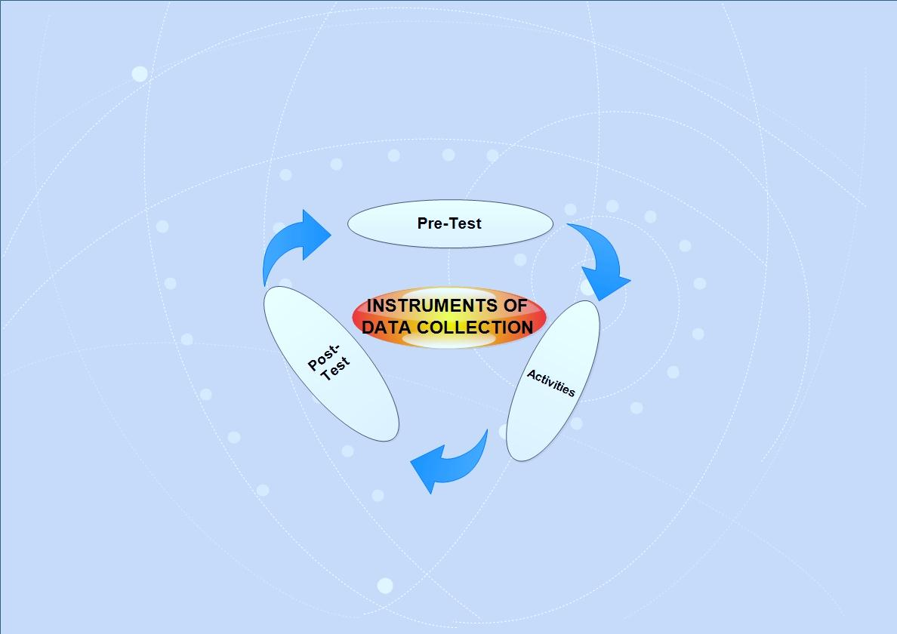
FIELD WORK
Survey
To identify actual market situation, frequency use internet, and how they feel about their English writing skills.

Slide 19
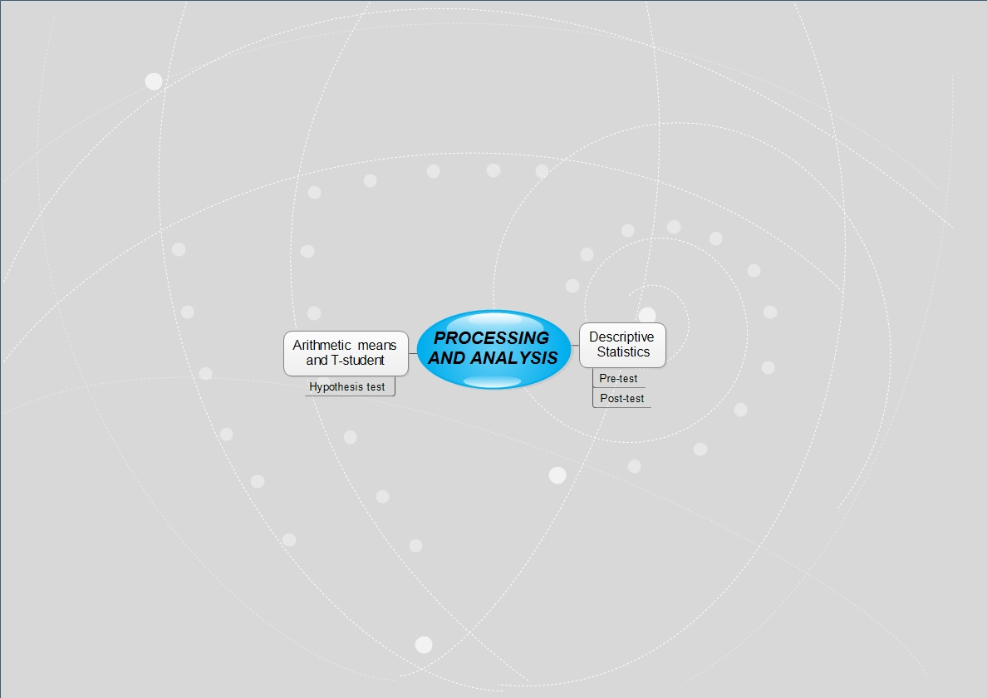
The arithmetic mean and T-student were implemented for the hypothesis test in order to establish if the pattern of frequency observed in students corresponded to expected pattern.

Slide 20
PART FOUR
TESTING HYPOTHESIS
Graphical result’s exposition

Slide 21
PRE – TEST RESULTS
Pre-test was used in both S – C group, in order to get diagnostic information at the beginning to study. Both groups reached low competences in English writing skill.

Slide 22

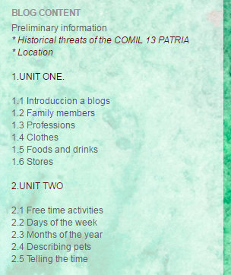
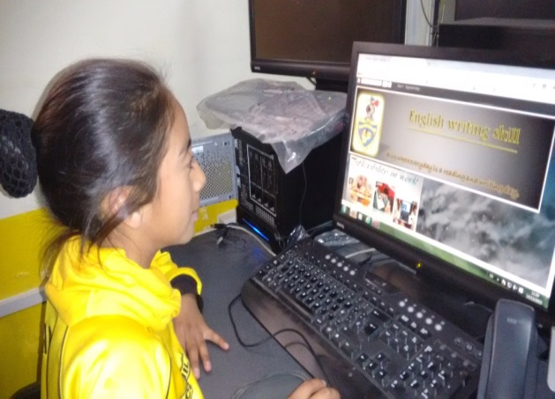
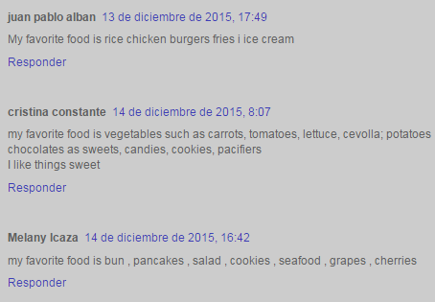
INTERACTIVE ACTIVITIES USING BLOGS
WITH THE STUDY GROUP
Eight grade students classroom “C” using blogs in writing activities.

Slide 23
POST – TEST RESULTS
CONTROL VS. STUDY GROUP
The post-test was used in both C – S group, is important remember that only S – G used BLOGS, and we can see in the graphic positive results of S – G in the writing sub-skills, there is a great difference in both groups, meanwhile the C - G did not have improvement in the development of writing skills. since they did not receive any technological didactical tools.

Slide 24
STUDY GROUP
PRE-TEST VS. POST-TEST
Progress of the S - G on improving writing skills through the application of blogs

Slide 25
Comparative results
Study average group
Control average group
We can see the progress in both S-G and C-G, is important remember that S-G used BLOGS, different techniques, additional writing activities and exercises , they have increasing up in 40 %.
Meanwhile C-G did not improve their writing skills from the pre-test to the post-test, they only have increasing up in 2,6 %

Slide 26
HYPOTHESIS TESTING
T-student formula
S= (Xi- X̄)2
N1= 25 Students in pre-test
N2= 25 Students in post-test
S1= 76,11 square pre-test desviation
S2= 76,23 square post-test deviation of T-student= √((S1+S2)/(N1+N2-2))
T-student = √((76,11+76,23)/(25+25-2))
T-student = 1.78
Determination technical and statistical test
gl = N1+N2-2 = freedom degrees
gl= 25+25-2
gl= 48 freedom degrees
100,5/25 =4,02
ORD | Xi | Xi-X̄ | S1 (Xi- X̄)2
1 | 7,5 | 3,48 | 12,11
 |  |  | Sum
25 |  |  | 76,11

Slide 27
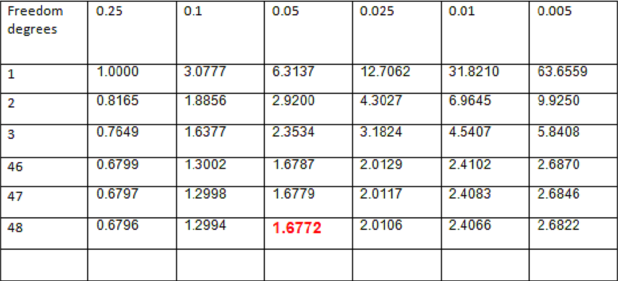
Distribution table t-student
That rounded is 1.6772
with a Confidence level of 95% (0.05)

Slide 28
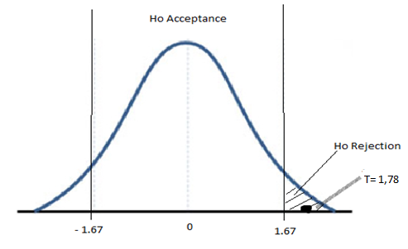
POST-TEST
T- STUDENT ANALYSIS
Gaussian curve
Tabulated T-student 1,78 is represented, we can identify the calculate T-student is outside the acceptance range, it means that Null Hypothesis rejected, meanwhile working Hypothesis accepted. Researching project viable and feasible.

Slide 29
CONCLUSIONS
Research project using blogs to improve English writing skill was applied in Latacunga city, Cotopaxi Province in eighth grade students classroom “C”, at Military High School Nª 13 “Patria”.
Using blogs had improved students writing skill, besides, they had positive progress in five writing sub-skills; content, accuracy, vocabulary range, organization and cohesion, and register and format appropriateness.
It was found through blogs application, greater results in their English writing skill performance.
Use blogs have generated a high impact on the results, It was increasing up from 4, 02 in pre-test to 8, 02 in post-test.

Slide 30
RECOMENDATIONS
It is recommended using more time to apply this technological teaching tool, in order to improve performance in the four main English language skills such as; Reading, writing, listening and speaking.
It is recommended Education Authorities manage or plan training for teachers about the importance using blogs in English language teaching-learning process.
It also recommended several interactive activities and writing exercises must be published in the blogs beside books activities, encouraging participation of the students in the use of languages.

Slide 31
PART FIVE
PROPOSAL
The proposal consists on:
Didactic guide about using blogs to English teachers at Military High School Nº 13 “Patria” in order to improve English writing skill students.
Training for English teachers at COMIL 13 “PATRIA”.

Slide 32
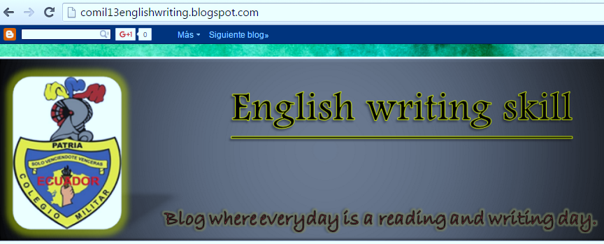
Main steps to create blogs
Create Google account.
Access blog
Name blog
Choose a template
Configuration and design blog

Slide 33
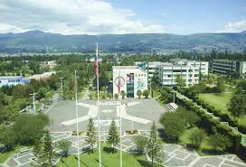
THANKS YOUR
ATTENTION

