Slide 1
TITLE:
“THE ACTION RESEARCH AS A STRATEGY TO IMPROVE TEACHING AND LEARNING PROCESS IN THE ENGLISH CLASS OF TENTH GRADES AT “ABDON CALDERON” MILITARY HIGH SCHOOL IN QUITO, DURING THE FIRST TERM, 2009 – 2010 SCHOOL YEAR”
AUTHORS: Almache Bermeo Mayra Elizabeth Badillo Pucha Rober Fernando ADVISORS: DIRECTOR: Dr. Oswaldo Villa CO DIRECTOR: Dr. Ma. Eugenia Arcos Jiménez M. Sc QUITO-ECUADOR OCTOBER-2011

Slide 2
INTRODUCTION
This thesis was elaborated considering the trends of teaching English language, focused on the use of action research and effective strategies which permit to teachers and students improve the teaching and learning process in English class, following specific strategies in the teaching work.

Slide 3
CAUSES
Old methodologies
Traditional teaching strategies
EFFECTS
Low communicative features during teaching practices
Memory focus of learning
TEACHERS DO NOT RESEARCH IN THE ENGLISH CLASS
Learning is limited
Teachers do not know how to implement strategies in the class
Low cognitive and mental process development
Low academic achievement

Slide 4
Main problem
How will the application of Action Research strategies contribute with the improvement in the teaching and learning process of the English Language for students of the tenth grades at “Abdón Calderón” Military high school, during the first term of school year 2009 - 2010?
Secundary problems
How do the lack of information and Teachers’ Training affects the teaching-learning process for secondary school students?
How does the loss of teachers’ initiative limit the learning of students for secondary school?
How does the lack of motivation minimize the students’ attention in the English class for secondary school students?

Slide 5
VARIABLES WORKING OUT
INDEPENDENT VARIABLE
The action research as a strategy.
DEPENDENT VARIABLE
Teaching and Learning process in the English class.

Slide 6
OBJECTIVES
To develop new action research strategies to achieve the way of relationships in the teaching and learning process in the class and the teacher practices training and applicability for secondary school of the tenth grades at “Abdón Calderón“ Military high school, during the first term of school year 2009 - 2010?
Solve and expand teachers knowledge with interactive activities and action research strategies to apply and improve the methodology in the teaching and learning process to students of the tenth grades at “Abdón Calderón“Military high school, during the first term of school year 2009 –2010. Determine how the loss of initiative of teachers limit the students learning for secondary school of the tenth grades at “Abdón Calderón“ Military high school, during the first term of school year 2009- 2010. Generate the research based on the proposal of applying action research to achieve the teaching and learning process to students at Abdón Calderón High School, term 2009-2010”
General
specific

Slide 7
Independent variable
The role envolves into a: -Decision maker -Consultant -Curriculum developer -Analyst -School leader
Look for a topic
Make a plan
Develop the project
Observe and listen students
Evaluate student’s work
STEPHEN KEMMINS

Slide 8
Communicates high expectations.
Independent variable
Uses active learning techniques
Methodology: Guideline for solving a problem, with specific components such as tasks, methods, techniques and tools
Gives feedback
The principle of triangulation
Observing interaction
Analysing the student´s work
Students participation
Interview students
GOOD PRACTICES IN ACTION LEARNING
Interaction and collaboration among students
Interaction among students and teachers

Slide 9
OBSERVATION
We obtain new insights
Provide detailed information
It reveals unexpected information
We obtain useful information
Independent variable
Reflective process
Helps educators to develop new strategies.
Where am I now?
Where do I want to be?
How will I get there?
Action and practice
How could I do?
PERSONAL DEVELOPMENT

Slide 10
LEARNING AS A PROCESS
EXPERIENCING
REFLECTING
THINKING
APPLYING
Dependent variable
Assessment
Collect Information
Reflection Interpretation
Planning
Choose Resources and approach
Instructtion
Bring Learners New Understanding
TEACHING AND LEARNING AS A PROCESS
Curriculum
Instruction
Assessment
Evaluation
TERACHING AS A PROCESS

Slide 11
Dependent variable
Computers
Projectors
Whiteboards
Games
Music
Movies
Graphic organizer
Improves the performance of the students.
Applied to modern times .
Interactive activities
METHODS OF PRACTICE AND PERFORMANCE
Collecting student feedback
Measuring
Monitoring
Dialogue
Identifying
Purposes
teaching and learning process
Reflect

Slide 12
Writing practice
Reading practices
Narrative Functional
TICS
Listening practices
TECHNIQUES
Are used by learners to complete speaking, reading, vocabulary, listening or writing activities presented in language lessons.

Slide 13
HYPOTHESIS SYSTEM
Working hypothesis
Action Research strategies will allow students and teachers to improve their skills and their interaction in the class during English lessons for secondary school students of the tenth grades at “Abdón Calderón” Military high school in Quito city during the first term of the school year 2009 - 2010”.
Null hypothesis
Action Research strategies do not allow students and teachers improve their skills and interaction in the class during English lessons for secondary school students of the tenth grades at “Abdón Calderón” Military high school in Quito city during the first term of the school year 2009 - 2010”.

Slide 14
METHODOLOGICAL DESIGN
RESEARCH TYPE AND DESIGN | POPULATION AND SAMPLE | FIELDING | INSTRUMENTS FOR DATA COLLECTION
Quasi experimental Qualitative and quantitative research approach, more specifically a qualitative descriptive informational case study. | The population is small and the hold group is considered as a sample. 20 students where the experimental group and 20 de control group. | ¨Abdon Calderon Military High School ¨. This is located in El Pintado Neighborhood, the students’ community is about a middle socio economical status. | Qualitative : Interviews, surveys, and the students’ projects. Quantitative: Pre test and post test, which evaluate the listening, speaking and reading skills.

Slide 15
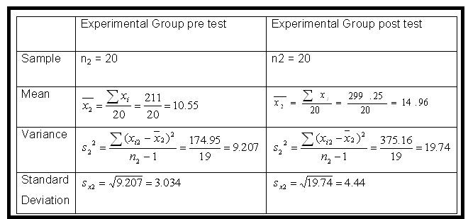
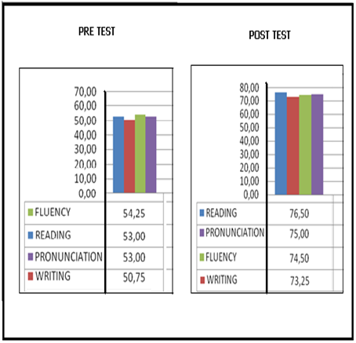
EXPERIMENTAL GROUP

Slide 16
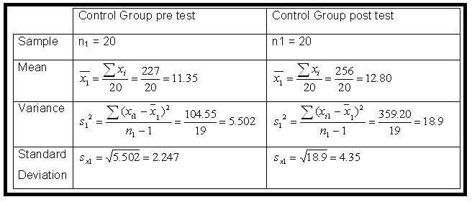
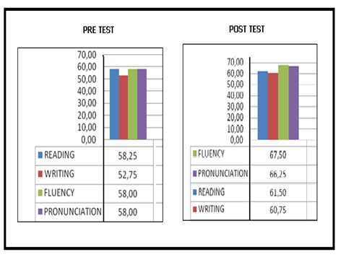
CONTROL GROUP

Slide 17
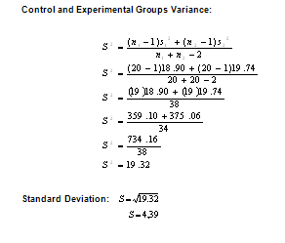
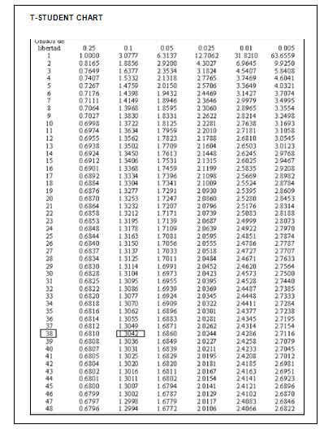
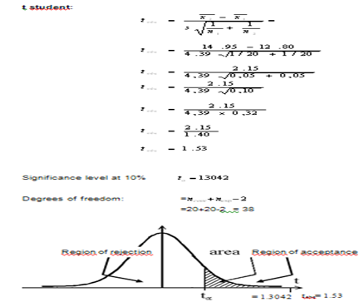

Slide 18
CONCLUSIONS | RECOMMENDATIONS
The action research strategies helps students and teachers to improve their learning and teaching process because once we have analyzed and checked the hypothesis we can see that the critical value is 1,3042 and the T calculated is 1,53 so it is evident that the Null hypothesis is rejected because it falls in the rejection zone | Apply action research strategies like Debates, Games, Group Work, Graphic Organizers, and Researching, all these based in projects to help students and teachers to improve their learning and teaching process.
On the other hand the working hypothesis is accepted because it falls in the acceptance region like you can see the critical value is 1, 3042 and T calculated is 1, 53 which clearly shows that the Working Hypothesis is greater than the Critical Value t obs = 1,53 > t a = 1,3042. | It is important to maintain an acceptance level in the class to be conscious that the teaching and learning process depends on the teacher's knowledge of action research strategies to be able to catch up students’ attention and interest while providing them with a high level of confidence and support.
It is important to point out that Action Research strategies help the students and teachers to improve their skills and interaction in the class to feedback as a part of the educational process | In other hand feedback students during the teaching and learning process implementing action research strategies is necessary because its help to monitory investigate and elaborate our own conclusions.

Slide 19
PROPOSAL
THE IMPLEMENTATION OF PROJECTS USING ACTION RESEARCH STRATEGIES TO IMPROVE TEACHING AND LEARNING PROCESS OF ENGLISH LANGUAGE IN THE “ABDON CALDERON” MILITARY HIGH SCHOOL IN QUITO CITY.

Slide 20
We have developed the Logical Framework Projects as a tool to help to conceptualize a project and analyze the assumptions behind it.
General objective
Specific objectives
Espected result
Activities
Evaluation

Slide 21
DEVELOPING THE PROJECT
General objective:
Give and compare information using correctly the past form of the verb.
Specific objectives:
Read articles about lost people.
Write correctly the past form of the verb to be, regular and irregular verbs.
Improve student’s pronunciation and fluency.
Develop individual and group work.

Slide 22
EXPECTED RESULTS
Understand articles about lost people.
Identify verbs in past form.
Use correctly the past form of the verbs.
Improve the pronunciation and fluency of the students.
Develop the student’s vocabulary

Slide 23
ACTIVITIES
First hour class:
Explain to the students the use of the verbs in past and give examples. (40 minutes)
Homework:
Reserarch in newspapers and internet articles about lost people and write in a paper.
Underline the verbs in past.
Second and thirth hour class:
Each student is going to read and explain their article in front of the class.
Enlist in the board some verbs in past used in their article.
Fourth hour class:
Share information in groups of work (4 students) and write in a paper a summary of the stories.

Slide 24
EVALUATION
Oral lesson: (pronunciation- fluency) 10 points
To talk in front of the class about the article.
Write lesson: (verbs in past and vocabulary)10 points.
Enlist in the board the past form of some verbs.
The students are going to share information and compare their projects in groups of work (4 students) and present a summary in a paper about each article, we are going to evaluate writing and reading skills.

Slide 25
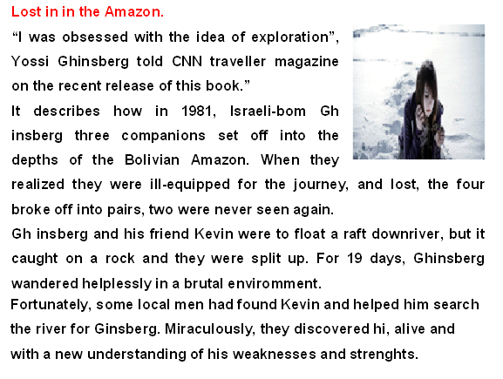
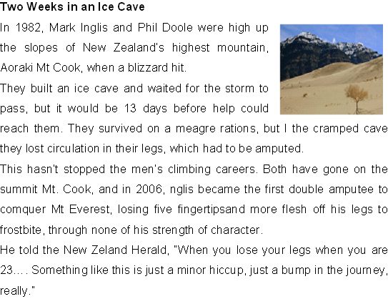
Some articles about lost people

Slide 26
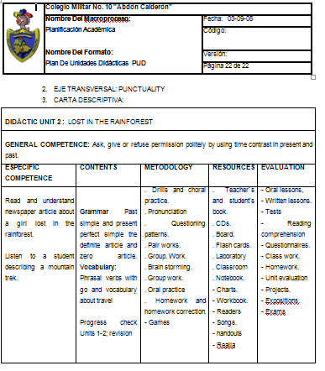

Slide 28
ANNEXES

Slide 29
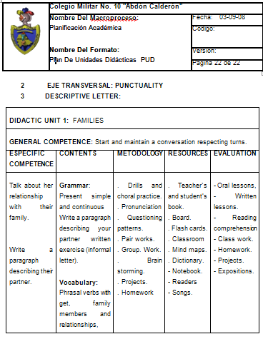

Slide 30
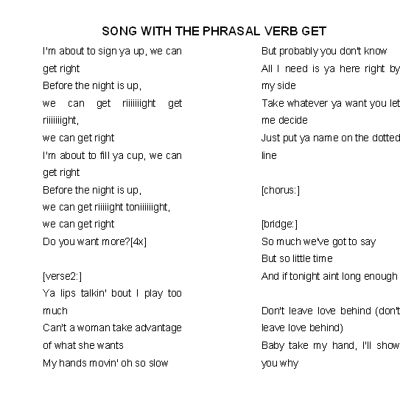
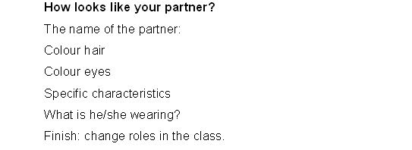
Some Projects in the class
Describing your best friend Working with the phrasel verb get.

Slide 31
PRE - TESTS AND POST
- TESTS EVALUATIO’S

Slide 32
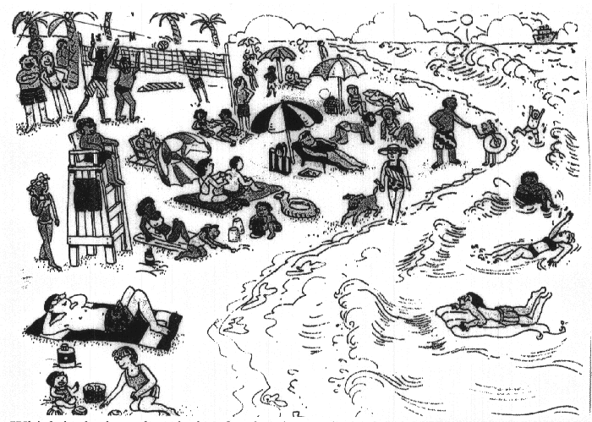
SPEAKING Fluency Which is the best description for the above picture? And explain a) Holiday beach b)beautiful beach c)Activity of people

Slide 33
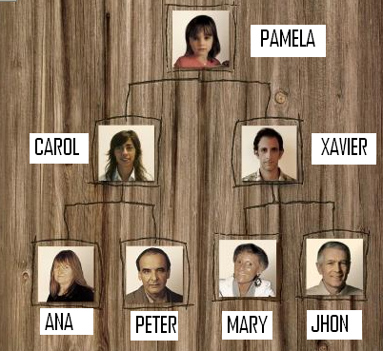
READING Look this family tree. Read four relationships. (CAROL/PAMELA) ---------------------------------­­­­­­­­­­­­­­­­­ (MARY/XAVIER) ---------------------------------­­­­­­­­­­­­­­­­­ (PAMELA/JHON) ---------------------------------­­­­­­­­­­­­­­­­­ (PETER/CAROL) --------------------------------------------------

Slide 34
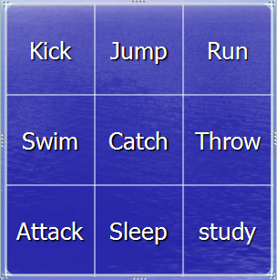
WRITING Making a sentence in simple present and a sentence in present continuous, writing a paragraph of any topic (four lines)? -------------------------------------------------------------------------------------------------- ---------------------------------------------------------------------------------------------------- ----------------------------------------------------------------------------------------------------- ------------------------------------------------------------------------------------------------------

Slide 35
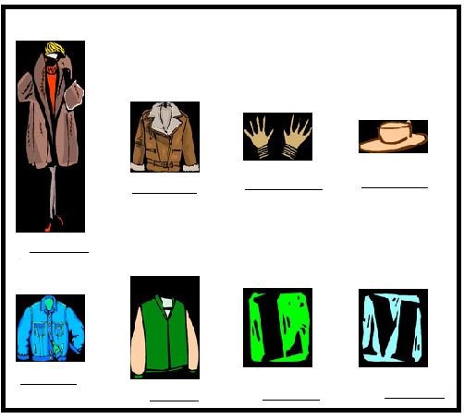
PRONUNCIATION Listen each picture and write under each image to hear the sound.

