Slide 1

DEPARTMENT OF LANGUAGES
APPLIED LINGUISTICS IN ENGLISH PROGRAM
ARMY POLYTECHNIC SCHOOL
AUTHOR: María Cecilia Missura
ADVISORS:
DIRECTOR: Lic. Mg. Miguel Ponce.
CO-DIRECTOR: Lic. Mg. Lilian Avalos
QUITO, JUNE 2012.

Slide 2

RESEARCH WORK:
“COACHING AS A STRATEGY TO IMPROVE THE TEACHING AND LEARNING PROCESS OF ENGLISH FOR STUDENTS ATTENDING THE EIGHTH LEVEL OF THE ONSITE PROGRAM AT ARMY POLYTECHNIC SCHOOL – DEPARTMENT OF LANGUAGE, DURING THE MARCH-AUGUST SEMESTER, 2010

Slide 3
INTRODUCTION:
Coaching has become one of the fastest growing industry within personal development.
Coaching comes from the word “COACH” something that takes you from one place to another, in this case with the help of a coach you can perform different and obtain higher achievements.
A coach will help students reach were they want to be.

Slide 4
PROBLEM FORMULATION:
“Does coaching influence the teaching and learning process of English for students attending the eighth level of English during the last semester of 2010?
Notes:
“

Slide 5
VARIABLES:
INDEPENDENT VARIABLE
DEPENDENT VARIABLE
Coaching
Teaching and learning process

Slide 6
OBJECTIVES
GENERAL
To help students maximize the benefits of feedback and identify what they might need to increase knowledge but do not have
To facilitate the exploration of needs, motivations, desires, skills and assist the student in making a real, lasting change
To determine the influence of coaching as a teaching strategy on the learning-teaching process of English

Slide 7
To raise self-esteem through learning - not to procrastinate.
To increase or enhance current competencies and link them to new situations.
SPECIFIC
OBJECTIVES
To provide structure, support and encouragement.
Help students increase self knowledge or learning styles.
Replace students unreasonably negative or self-defeating
thoughts with more accurate and self-enhancing alternatives.
Reduce their learning anxieties and therefore increase
their learning process.

Slide 8
JUSTIFICATION
English is the major language used around the world: in business, diplomacy, science, tourism,
athletics.
Students have serious problems in: learning, comprehending, assimilating English language;
Most teachers need to do their best to improve their teaching methodologies and level of English.
The need to find the best way to teach and reach the students so they improve their knowledge in the English language.

Slide 9
PART TWO
THEORETICAL FRAMEWORK

Slide 10
CHAPTER ONE
DEPARTMENT OF LANGUAGES AT ESPE
Technology and Science have change ESPE has not improve its level to meet or reach the standards required by the Common European Framework (B2) or the American Proficiency level (TOFEL-500)
Teachers use the traditional way to teach, they use Spanish in class and the four skills are not developed: reading, writing, speaking and listening.
Students do not have the opportunity to establish conversations with native speakers.
Most teachers do not have a high level of the language, if the purpose is to reach level B2 on the students, teachers should have level C1.

Slide 11
CHAPTER TWO
COACHING
A COACH:
Helps people increase internal and external structures.
Has to be real, patient, convincing, dedicated and hard working.
Has to identify the students skills and capabilities.
Has to define if it is for improvement or transformation or both.
Has to help them see how they best learn,how to operate in an academic environment and how to be sucessful in school.
Focus on: time management, organization, study strategies, test taking, critical thinking.

Slide 12
THERE ARE THREE APPROACHES:
Evolutionary coaching:
works in all levels, from
improving through engagement to
transformation,
it’s defined as “the professional
facilitaror of learning at different
levels”
The ability of the coach is supporting
the client through the double loop
learning for transformation
Functionalist coaching:
aims to improve performance,
suppress challenge and questioning
Engagement coaching:
recognizes the subjective world of
the client and uses a non-directive
match to keep the status quo (this
applies more for organizations)
The single and double loop learning were first used by Argyris and Schon in l996 to differenciate between learning for improving and learning for transformation.

Slide 13
The FLOW model: (James Flaherty in l999)
The SOS model: (Parsloe and Wray in 2000)
MODELS:
The GROW model: (John Whitmore)
G - establishing the goal
R - examining the reality
O - considering all options
W - confirming the will to act
The Jenny Roger´s : created in 2004 to be used in the evolutionary coaching.
The Egan´s skilled helper: the goal is to help people become better at helping themselves within their everyday live.

Slide 14
COACHING
GOAL SETTING
MOTIVATION
RAISE SELF-ESTEEM
TIME MANAGEMENT
PROCRASTINATION

Slide 15
Goals will help students focus their effort in a specific direction.
They can be short or long term.
Goals act as energizers
GOAL SETTING
The aim is to accomplish or achieve their learning
The client generates their own goals
Goals should be specific, measurable, achievable, realistic, time-bounded
Higher goals encourage higher efforts
Make students persistent and stimulate cognitive knowledge and strategies
Goals are established knowing the strength and weaknesses.

Slide 16
GOALS
SMART
S specific and concrete
M measurable
A achievable
R realistic
T time-bounded
MMM
M measurable
M manageable
M motivational
RAW
R realistic
A attainable
W worthwhile

Slide 17
MOTIVATION
A coach will hold the student responsible for the commitments made.
The coach will help students stand by their goals and plans.
A coach will inspire and support the student
Small achievements act as motivators and help students go on to try more.
Recognition is another strong motivator
Gives confidence and helps obtain authentic sense of self-esteem supported on positive experiences
makes them feel useful
makes them gain confidence
SELF-ESTEEM

Slide 18
TIME MANAGEMENT
PROCRASTINATION
Teach them how to manage their time
Recognize the tasks that are not urgent
Have to learn planning process
Search for shortcuts
Avoiding or putting off something
that you have to do
Its a bad habit
Reasons: perfectionism, fear of failure, confusion, poor motivation or lack of priorities.
Makes your life full of dissappointments and regrets
Wears you down your immune system

Slide 19
CHAPTER THREE
TEACHING AND LEARNING PROCESS
There is no science or theory that would involved all the activities that imply learning in humans.
Behavioral psychologist identify learning in changed behavior.
Cognitive psychologist look for a change inside the person.
Traditional academic learning emphasized learning as exclusively a mental process
Humanist approach recognize the power in every human being to learn in a self-directed way.
Progressive approaches are said that learning must also be active.
The three domains in learning should be considered.
Doing
Thinking, and
Feeling.

Slide 20
TEACHING AND LEARNING PROCESS
PURPOSE:
the context were learning happens is crucial,
learning is a social process,
the context and conditions where learning takes place are influenced
METHODOLOGY:
a method is the link between thoughts and actions that are common
to them
can connect particular principles with particular techniques - making a meaningful package
CONTENT:
students have to obtain basic abilities,
strategies and methods
RESOURCES
technology: audio conferencing, videoconference internet

Slide 21
CHAPTER FOUR
COACHING AND THE TEACHING LEARNING PROCESS
The best way to improve learning is improving teaching
Teachers that have been coached apply their learning in a more deeply, frequently and consistently way
Teachers that have been coached
have significant changes in their behaviour,
A different professoinal development is peer coaching - teachers share their experience and give one another feedback, support and assistance: refine their present skills, learn new skills and-or solve classroom-related problems

Slide 22
understand the abilities, preferences and goals of the student.
decide the appropriate training path for the student
A COACH HAS TO:
give the support and structure to make changes last
encourage students to become self-aware by understanding his or her strengths, values, interests, purpose and decisions.
develop the necessary skills to make them responsible for their actions and decisions.
create affection, confidence and positive attitude toward learning.
monitor the student´s progress
help them develop challenges
create strategies

Slide 23
COACHES WILL HAVE TO:
DEFINE – identify the students goals
ASSESS – obtain valid, pertinent information that will help to base the coaching plans and activities
PLAN – created a detailed plan with specific action steps and target dates for completion
EXECUTE THE PLAN – work out activities and tasks
REVIEW - evaluate the results

Slide 24
CHAPTER FIVE
OTHER CAUSES OF THE CORE PROBLEM
Education has been uneffective and inefficent
Students´cultural and generational backgrounds have not been taken into account
Learning objectives and policies have not been presented accurately
Good strategies have not been developed
Some teachers are not skilled enough to understand the student
Students do not receive appropriate feedback

Slide 25
HYPOTHESIS
WORKING HYPOTHESIS (Hi)
Coaching affects positively the teaching and learning process of English students in eighth level
NULL HYPOTHESIS (Ho)
Coaching does not affect the teaching and learning process of English

Slide 26
PART THREE
METHODOLOGICAL DESIGN

Slide 27
Field work
The 8th level of English Education at Army Polytechnic School – School of Languages, in Sangolqui
METHODOLOGICAL DESIGN
The type of research and design
Applied and descriptive and of field
Population and sample
5 classes of the eighth level
102 students
4 teachers
Data Collection
Surveys and interviews
Data analysis procedures
Descriptive statistics

Slide 28
PART FOUR
TESTING THE HYPOTESIS

Slide 29
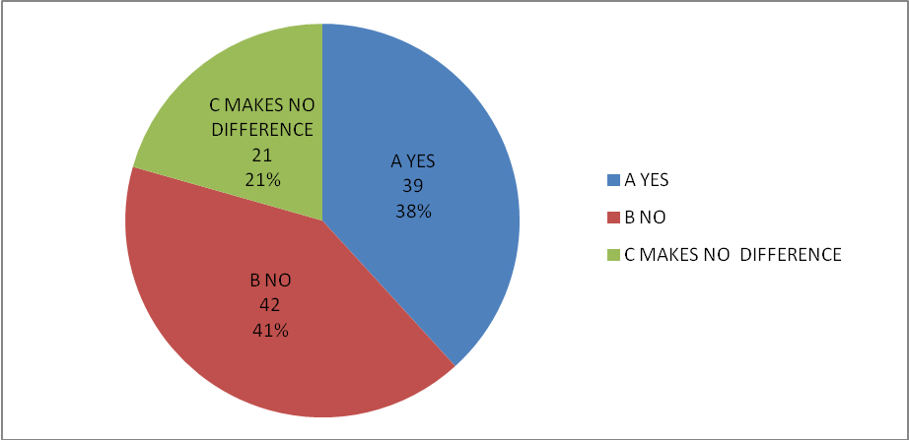
GRAPHICAL EXPOSITION OF RESULTS
Do you study English because you like it?
INDICATOR | A YES | B NO | C MAKES NO DIFFERENCE
FRECUENCY | 39 | 42 | 21
PERCENTAGE | 38% | 41% | 21%
SOURCE: Survey
PREPARED BY: Cecilia Missura
ANALYSIS:
38% of the students studied English because they like it, 41% of the students did not like to study English and 21% of the students made no difference, they just have to study it.

Slide 30
VERIFICATION OF THE HYPOTHESIS
GROUP 1
VARIABLES | A YES | B NO | C MAKES NO DIFFERENCE | TOTAL
1. Do you study English because you like it? | 39 | 42 | 21 | 102
11. Now that you are in your last semester, do you think that a coach may have helped you increase your knowledge and appreciation of the English Language | 82 | 9 | 11 | 102
TOTAL | 121 | 51 | 32 | 204

Slide 31
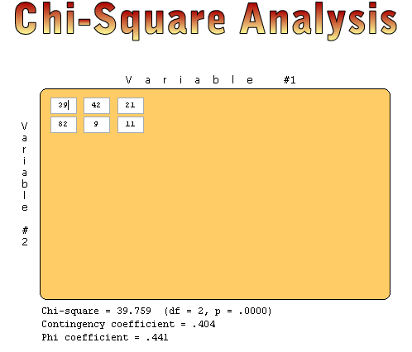
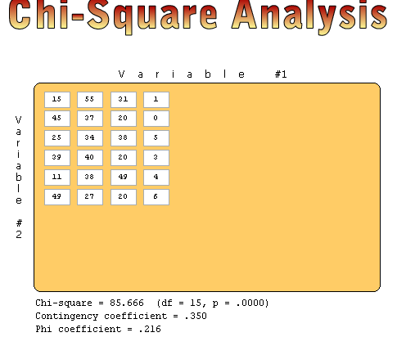
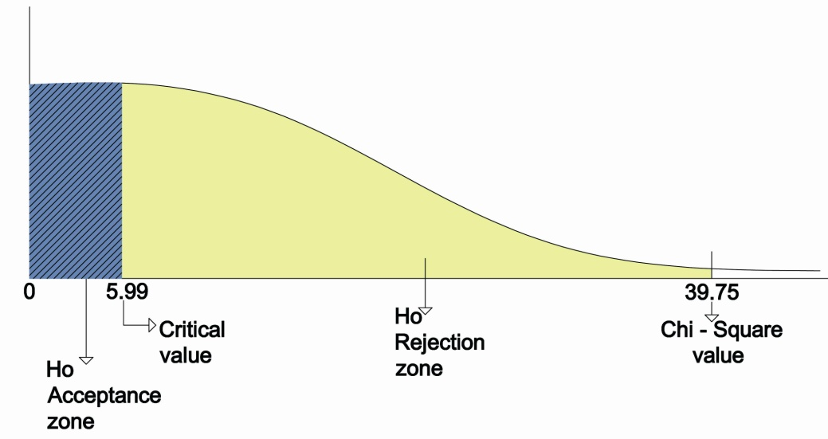
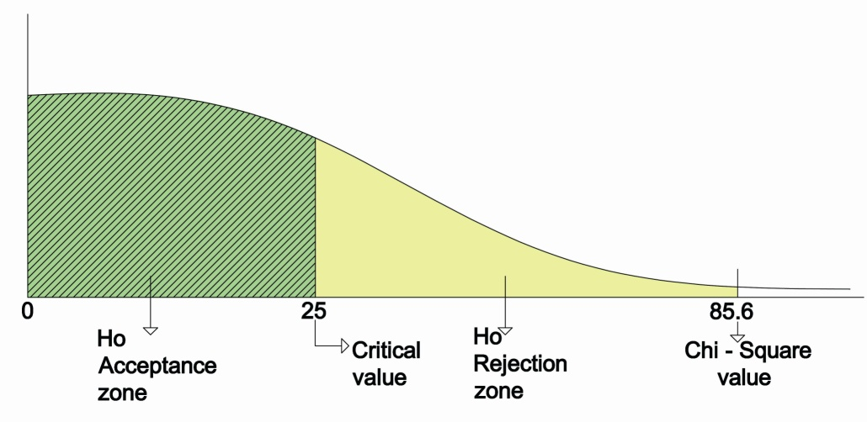
CHI-SQUARE ANALYSIS
GROUP 1
GROUP 2

Slide 32
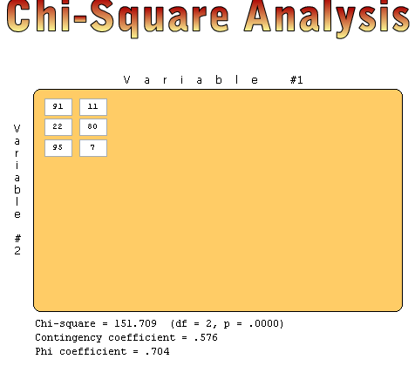
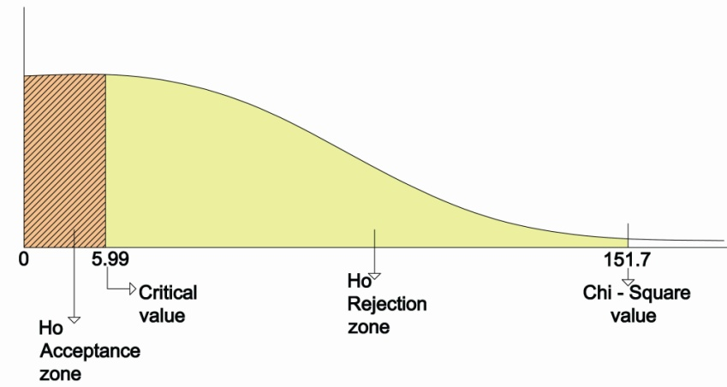
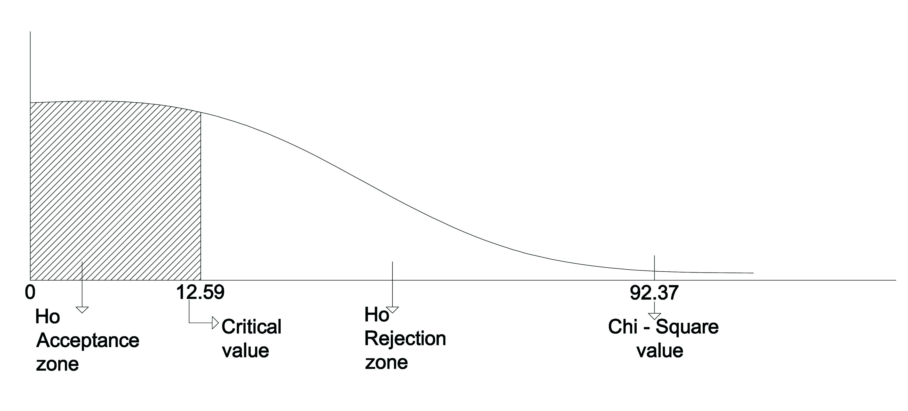
GROUP 3
ANALYSIS GROUP 1,2 AND 3

Slide 33
Students believe that teachers should use different styles of teaching to meet the needs of the students
A high percentage of the students procrastinate
CONCLUSIONS
A high percentage of the students think that a coach would have helped them increase their knowledge and appreciation of the English language
A teacher should be like a coach
Most students study English because it is a requirement at ESPE
Students need someone to help them increase their self-esteem
Students believe that they would have done better if there had been someone like a coah to help them go through their study of the language

Slide 34
PART FIVE
PROPOSAL

Slide 35
PROPOSAL
Considering that coaching promotes learning and builds capacity for change in Education, ESPE should search for coaches that will help teachers become peer-coaches this means that teachers will help each other, or they should find coaches that will help students directly because:
Coaching will explore the students needs, their desires and skills
Coaching will help students make a real and lasting change
The aim of coaching is to improve teamwork and leadership for a rapid and sustainable improvement in standards.

Slide 36
LOGIC VERTICAL OF THE OBJECTIVES
Narrative Resume of the objectives | Indicators | Verification Media | Supposing
Goals 1. To help students acquire and develop meaningful linguistics skills with less time 2. To acquire conversational skills through everyday life activities through experiential learning | Student (80%) will have less problems to reach a high performance Every student will have to use English to talk about their everyday activities | Results of the tests A pre and post test will be taken by the students (beginning and end of each semester) Teachers will learn how to work with students in the different areas where a coach will work | Students are aware of the need of the help of a Coach
Purpose The process of TEACHING-LEARNING is satisfactory in the learning of ENGLISH | The number of students (70%) will improve their performance in English Language | At the end of the semester the students should be able to demonstrate the difference between having or not having a coach | Giving the necessary conditions to improve the needs and knowledge of the students and teachers

Slide 37
Narrative Resume of the objectives | Indicators | Verification Media | Supposing
Components Confidence and self-assurance in English class Students have a high level of English Teachers speak English well Teachers share their time and knowledge | Coaching will be implemented in their classes through their teachers or a different person (a coach) Teachers need to have contact with English-speaking natives and-or improve their English with classes
Activities Workshops on peer coaching, team work and leadership Continuous coaching meetings and training with students Lecturers Programs to improve teaching and learning | Resources Coach Books Trainers Utilities (copies, use of internet) | Expenses US$2.000,00 US$ 600,00 US$ 500,00 US$ 740,00 TOTAL 3,340,00

