Slide 1

DEPARTMENT OF LANGUAGES
APPLIED LINGUISTICS CAREER
THESIS DEFENSE
WELCOME EVERYBODY

Slide 2

THESIS THEME
THE CONVERGENT AND DIVERGENT THINKING IN THE MEANINGFUL LEARNING OF THE ENGLISH LANGUAGE FOR STUDENTS OF THE THIRD YEAR OF BACHELOR AT “DR. FRANCISCO CAMPOS COELLO” PUBLIC HIGH SCHOOL IN GUAYAQUIL DURING THE FIRST QUIMESTRE OF THIS SCHOOL YEAR

Slide 3

PROBLEMATIZATION
Dr. Francisco Campos Coello, high school
English teaching and learning process
Methodology
Teaching class activities
Students’ performance and motivation
Teaching resources

Slide 4
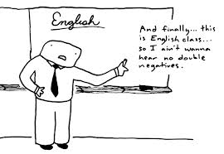
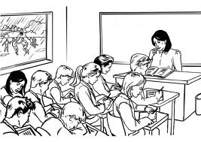
PROBLEM IDENTIFICATION
FEW OPPORTUNITIES FOR TEACHERS TO INNOVATE THEIR KNOWLEDGE ABOUT TEACHING METHODOLOGY
LACK OF CLASSROOM RESEARCH IN THE FIELD OF ENGLISH TEACHING METHODOLOGY

Slide 5

PROBLEM SETTING
Lack of Convergent and Divergent thinking activities in the English classroom
Convergent and Divergent thinking knowledge
Convergent and Divergent Methods and Techniques
Meaningful Learning Techniques
Lesson Planning with Convergent and Divergent Thinking

Slide 6
OPERATIONALIZATION OF VARIABLES

Slide 7
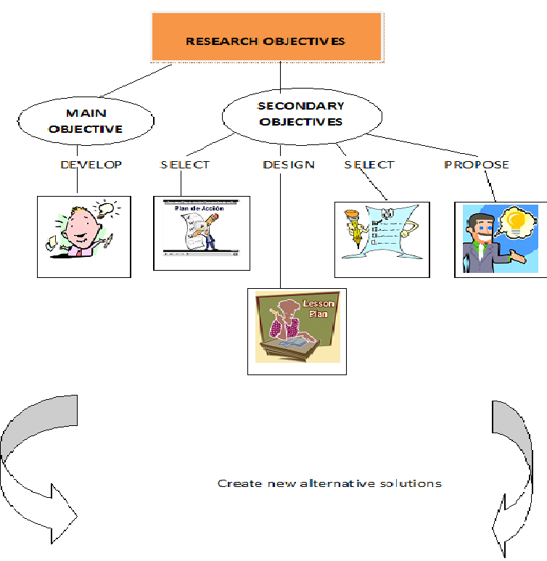

Slide 9
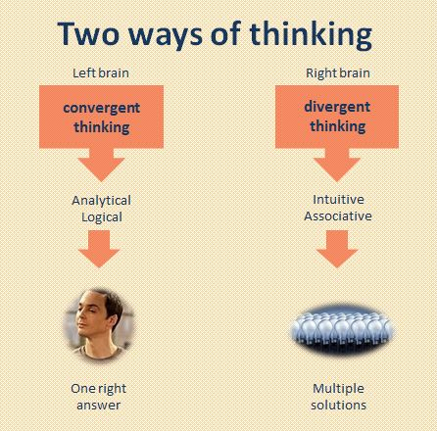
Convergent and Divergent Thinking

Slide 10
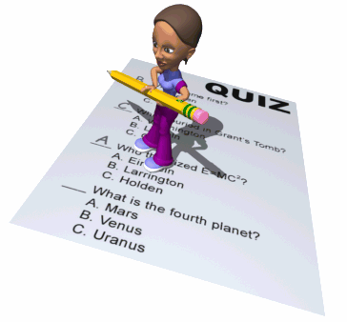
CONVERGENT TECHNIQUES
- Multiple Choice
- True or False
- Filling in the blanks
- Matching
- Listing
- Identifying
- Comparing and contrasting
- Ranking

Slide 11
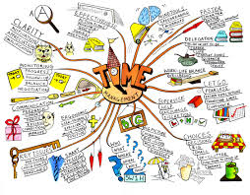
DIVERGENT TECHNIQUES
- Open ended
questions
- Brainstorming
- Mind maps
- Creating questions
- Creating dialogs
- Free writing

Slide 12
MEANINGFUL LEARNING AND LEARNING STYLES
LEARNING STYLES
Visual
Auditory
Kinesthetic

Slide 13
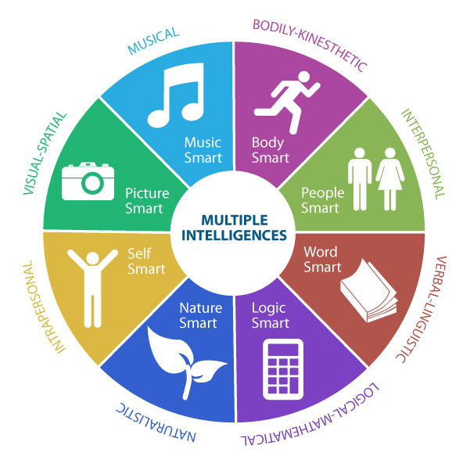
MULTIPLE INTELLIGENCES

Slide 14
METHODOLOGICAL DESIGN
Research type
Research methods
Population and sample
Instruments of data collection
Steps for processing and analysis

Slide 15
METHODOLOGICAL DESIGN
Research Type
Applied
a fact gathering project to solve a specific problem
Quasi-experimental
- 2 variables
- control and experimental groups
observation of all the population,
or a representative subset,
at one specific point in time.
Transversal
makes comparisons, the relationship between two or more variables.
Descriptive
Correllational
analyzes, describes events
In a natural setting, researcher went to the school to make observations
Of Field
-numerical data
-formulas, statistical data
Quantitative

Slide 16
METHODOLOGICAL DESIGN

Slide 17
METHODOLOGICAL DESIGN

Slide 18
TESTING THE HYPOTHESIS
TEACHERS’ QUESTIONNAIRE

Slide 19
TESTING THE HYPOTHESIS
TEACHERS’ QUESTIONNAIRE

Slide 20
TESTING HYPOTHESIS
CLASSROOM OBSERVATIONS

Slide 21
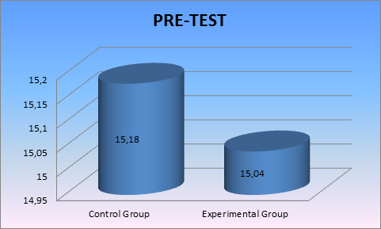
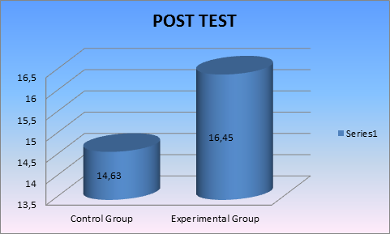
ANALYSIS OF STUDENTS’RESULTS
MEAN

Slide 22
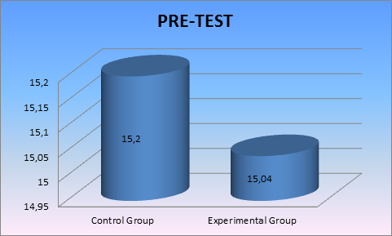
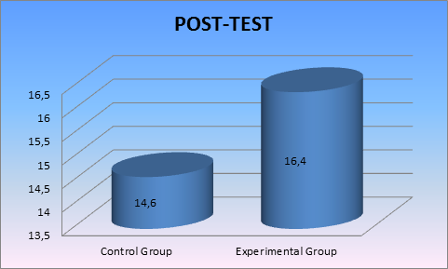
ANALYSIS OF STUDENTS’ RESULTS
VARIANCE

Slide 23
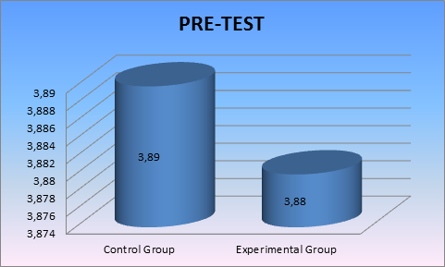
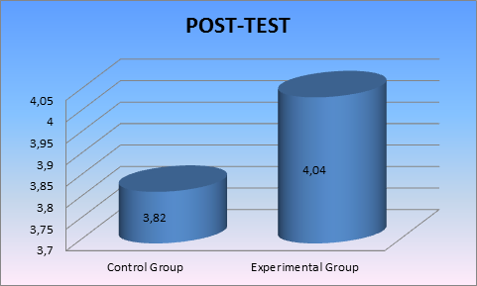
ANALYSIS OF STUDENTS’ RESULTS
STANDARD DEVIATION

Slide 24
TESTING HYPOTHESIS
WORKING ( ACCEPTED)
The convergent and divergent thinking promote the meaningful learning in the classroom on the students of the third year of Bachelor at the “Dr. Francisco Campos Coello” public high school in Guayaquil during the first quimestre of this school year.
Null (REJECTED)
Alternative (REJECTED)

Slide 25
CONCLUSIONS
The working hypothesis is accepted because:
The results can be compared and contrasted when analyzing the statistical factors in the pre- and post-tests in the experimental group
The convergent and divergent thinking activities promoted the meaningful learning and they helped students become more self-directed learners
These activities really developed the creativity and analysis
Creative thinking contributes with the communicational skills
Teachers should apply methods and techniques to create a good environment in the classroom

Slide 26


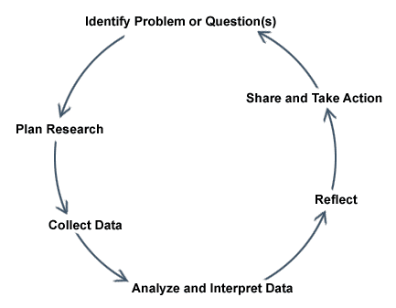

RECOMMENDATIONS
To continue implementing activities of convergent and divergent thinking
Adopt the classroom research as an institutional policy
Provide teachers with training on the new methods and techniques
Incorporate classroom activities that awaken the students’ interest and desire to learn.

Slide 27


PROPOSAL
HOW TO PROMOTE THE EFFECTIVE LEARNING AT THE “DR. FRANCISCO CAMPOS COELLO” PUBLIC HIGH SCHOOL ON THE STUDENTS OF THE THIRD YEAR OF BACHELOR IN GUAYAQUIL DURING THE FIRST QUIMESTRE OF THIS SCHOOL YEAR

Slide 28
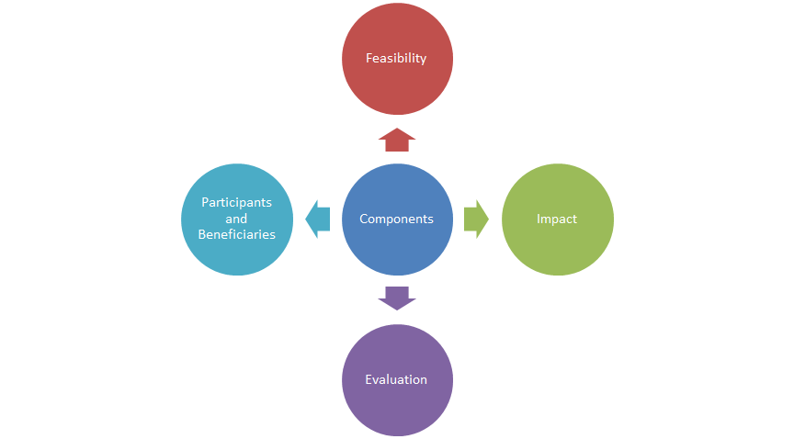


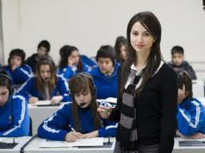


PROPOSAL’S COMPONENTS

Slide 29

There is no substitute for persistence

