Slide 1
DEPARTMENT OF HUMANITIES AND SOCIAL SCIENCES APPLIED LINGUISTICS CAREER IN THE ENGLISH LANGUAGE TITLE: “INFLUENCE OF THE WEB 2.0 TOOLS (VOKI, VOCAROO AND VOICE THREAD) AS TECHNIQUES TO IMPROVE THE SPEAKING SKILL IN STUDENTS OF SECOND YEAR OF ACCOUNTING AT THE ALANGASÍ HIGH SCHOOL, DURING THE FIRST PARTIAL OF THE SECOND TERM OF 2014-2015 SCHOOL YEAR” AUTHORS: MARÍA DEL CONSUELO ROSALES CEVALLOS EMILIO RODRIGO BASANTES MORALES DIRECTOR: MST. MÓNICA PINTO CODIRECTOR: MST. LOURDES ATIAJA 2015

Slide 2
SEQUENCE
Research problem
Objectives
Methodological design
Results and discussion
Conclusions and recommendations

Slide 3
INTRODUCTION
Web 2.0 tools | Voki, vocaroo and voicethread
 | Improve the speaking skill
 | Progress and development of people
Students | High rates of desertion
 | Pages on the internet have been helpful in the learning
 | Technologies have contributed positively to improve skills
Source: (Madsen 1983:159).

Slide 4
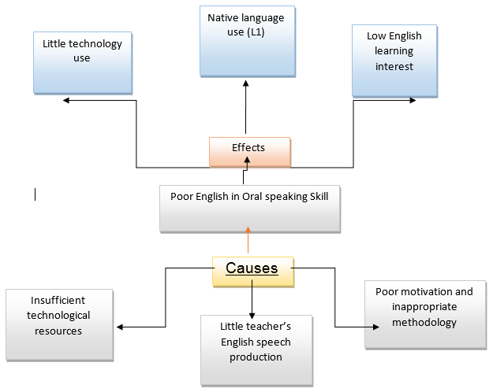
Tree problem

Slide 5
PROBLEM SETTING
MAIN PROBLEM
Why is there a low performance in the oral skill in the English language?
SECONDARY PROBLEMS
Alangasí High School has a small laboratory, but it is used just for computer classes.
The computer laboratory needs a full revision to put update in different programs which allows students to use in an effectively way.
The internet coverage is deficient; therefore the computer lab serves just to learn the basic technology.

Slide 6
VARIABLES
INDEPENDENT VARIABLE
(x) = Web 2.0 tools (Voki, Vocaroo and Voicethread)
DEPENDENT VARIABLE
(y) = Speaking skills.

Slide 7
OBJETIVES
General
To establish the efficacy of the use of the Web 2.0 (Voki, Vocaroo and Voicethread) as techniques to improve the speaking skills in students of second year of Accounting at Alangasí High School, during the second school year term 2014-2015.

Slide 8
METHODOLOGICAL DESIGN
Research type and design
This research will be descriptive, of field and Quasi-experimental; we use these types of researches because with the descriptive research we can observe the qualitative behavior in front of these applications
Population and sample
The population will be thirty on students of second year of bachelorette, specialization Accounting “B” at Alangasí School. The students are 17 years old around
Field work
The research is going to be applied to thirty one students of second year of bachelorette, specialization accounting at Alangasí School during the first partial of second term 2014-2015 scholar year

Slide 9
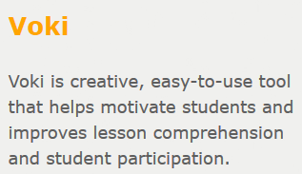
Voki has become a household name among teachers and students the world over. Almost a million teachers and students worldwide use Voki to create and share sp...
What is Voki?
Voki is a FREE service that lets you create customized speaking characters

Slide 10
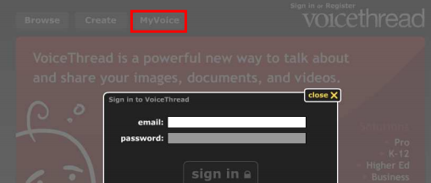

Slide 11
RESULTS
The results of the pretest demonstrated what was stated at the beginning of this research as a problem with the students of second year accountancy at Alangasí High School: a low level of competence in speaking skills. The pretest reached a mean of about 3.58 out of ten, which is very low. In addition the pretest allowed us to know that the students had a similar level of speaking competence. In this way this research was strengthened in its internal validity. On the other hand, the instrument (a speaking test where the students were asked some questions about themselves and a specific topic) to test the speaking proficiency was really effective, since it allowed to measure the speaking production in pronunciation, content, questions and fluency areas. The test was not as stressing for the students as the usual ones.

Slide 12
TABLA 1. Results of the pretest conducted in the students of the second year of the school Alangasí.
PARAMETERS | GRADES /10 | PERCENTAGE (%)
FLUENCY | 2,65 | 26,5
PRONUNCIATION | 2,75 | 27,5
CONTENT | 2,71 | 27,1
QQ. AA. | 2,64 | 26,4
AVERAGE | 2,69 | 26,9
Elaborated by Consuelo Rosales and Emilio Basantes, 2015

Slide 13
RESULTS
The results of the posttest were very interesting for the objective of this study, since the same group of students were evaluated with the same speaking test but after applying many practices in the laboratory using technological tools from web 2.0 such as Voki, Vocaroo, and Voice thread. These web 2.0 tools were ver useful for the students and they helped them in developing a better speaking production. We can see that the use of technology, such as web 2.0 Voki, Vocaroo and Voice Thread, has been of a great importance because the improvement in the four parameters fluency, pronunciation, content and questions and answers, is very high about 2.66 points in fluency, 3.02 in pronunciation, 2.69 in content and finally 2.71 in questions and answers. Regarding the pronunciation parameter, this could be due to the fact that the students in Alangasi High School were exposed to an important number of English teaching hours per week.

Slide 14
RESULTS
The web 2.0 tools were innovative for the students and invited them to talk. The students were really motivated with the innovation. We could overcome some limitations that we had regarding the developing oral production. The factor of not having enough opportunities for oral practice in class was overcome through the constant practices in the laboratory using Voki, Vocaroo, and Voice thread software.
During the practices in the laboratory the students had the chance to record their voices as many times they wanted until they agreed their pronunciation, therefore, the technology web 2.0 Voki, Vocaroo, and Voice thread were very useful for them to increase their oral production and at the same time they enjoyed working with these new innovative software forgetting about the pressure of a normal classroom.

Slide 15
TABLA 2. Results obtained from the application of web 2.0 tools Voki, Vocaroo and Voice thread, to the experimental group from the second year accounting students.
PARAMETERS | 1st. | 2nd. | 3rd. | 4th. | 5th. | AVERAGE | PERCENT (%)
 | WEEKS
FLUENCY | 2,8 | 3,3 | 4,5 | 5,6 | 7,5 | 4,74 | 23,4
PRONUNCIATION | 2,6 | 4,6 | 5,6 | 6,4 | 8,4 | 5,52 | 27,3
CONTENT | 2,9 | 3,4 | 4,6 | 5,5 | 7,3 | 4,74 | 23,4
QQ. AA. | 2,7 | 3,3 | 5,2 | 6,1 | 8,9 | 5,24 | 25,9
AVERAGE | 2,75 | 3,65 | 4,97 | 5,9 | 8,02 | 5,06
Elaborated by Consuelo Rosales and Emilio Basantes, 2015.

Slide 16
RESULTS
It was mentioned previously that teaching oral production is not an easy task and it is usually neglected by teachers due to the lack of technology exposure and also time for speaking in the target language. The instrument used in this research proved to be helpful and effective. I would recommend teachers to use this kind of evaluation instruments: give your opinion on a certain topic of general interest. Of course I suggest teachers to emphasize more on assessing their students oral production by using an instrument similar to the one we used on this research project.
In order to see the progress of the students some statistical analysis had to be made. However it is not commonly carried out by teachers to take statistical registers of the development of the English teaching process. I don´t mean the scores register to assign grades to students, but to inferential statistics that allow to measure the level of progress of students. Statistics is not a thing that most people like, but knowing and applying statistical procedures will give more light to our teaching procedures. That’s not easy and is very demanding, but it is worth the effort.
.

Slide 17
RECOMMENDATIONS
It is important to mention the methodologies teachers can apply to get the best results. In this case, the methodology of using web 2.0 tools Voki, Vocaroo, and Voice thread proved to be effective. One difficulty that teachers face sometimes is the limitations in knowing different and more effective techniques for applying to our teaching practice. Fortunately, on the internet there are many sources available. This makes possible for all teachers to be aware of the last techniques in English teaching.
Besides, the ability of research in our schools is not a widespread custom. Therefore, there is a need for educational research. This causes that in education we copy models that are out of our reality (it is not implied that these models are bad). That is why it is desirable to promote educational research so that our educational system can be improved. On the other hand, the authorities of educational institutions should provide all the equipment to teachers to access the technology and electronic means such as laboratories, CDs, videos, virtual libraries, internet. Certain time could be scheduled for teachers’ research within the institutions, as part of their job. This will be highly profitable for teachers, students and the institutions will get the results soon.
Finally, I would suggest teachers to try these innovative tools because your students not only will practice the target language but also they will motivate themselves with these new technologies, specially to develop their oral production which is the most difficult when learning English

Slide 18
Thanks

