Slide 1
DEPARTAMENTO DE CIENCIAS HUMANAS Y SOCIALES
APPLIED LINGUISTICS IN ENGLISH CAREER
INCIDENCE OF THE APPLICATION OF THE GOOGLE DRIVE AS AN E-LEARNING TOOL TO DEVELOP THE WRITING SKILL ON STUDENTS ATTENDING THE EIGHTH GRADES AT UNIDAD EDUCATIVA MARTIM CERERÊ DURING THE FIRST QUIMESTRE OF THE 2013-2014 SCHOOL YEAR
AUTHORS:
LEÓN PAZMIÑO JORGE IGNACIO
ALMEIDA LARA DAYSI MARIBEL
DIRECTOR: DR. VILLA OSWALDO
CO-DIRECTOR: DR. PUMA GONZALO

Slide 2
PART ONE RESEARCH PROBLEM

Slide 3
Introduction
English is without doubt the actual universal language
Government and Ministry of Education focusing and value English
Traditional methods
Nowdays Technology in education
Purpose of this study

Slide 4
How did we know
about this problem?
Problem Identification
English teachers complain:
low production in writing
Teachers
Actors were pressed by the time
Limited access to authentic resources: workbook and dictionary
Questions, answers, corrections, and feedback are verbally
Class Observation
Frustration - Low motivation - Distractions
Students are academically affected
Results

Slide 5
PROBLEM TREE
Students are unmotivated and affected academically
Low contact with the language
Students are limited to teacher´s production
Plagiarism
Lack of authentic resources
Low output production
Copy and paste
EFFECTS
LOW WRITING PRODUCTION
CAUSES
Students are not allowed to use computers lab during English classes
Teacher does not have proper E-learning training
Students do not know how to skim information
Students only use workbooks
Traditional method applied
They do not digest information

Slide 6
OBJECTIVES
GENERAL
To analyze the incidence of the application of the Google Drive as an e-learning tool to develop the writing skill on students attending the eighth grades at Unidad Educativa Martim Cererê during the first quimestre of the 2013-2014 school year.
SPECIFICS
To identify what is the relationship between Google Drive and the writing skill on the students attending the 8th year of Basic Education at Martim Cererê.
To provide plenty of information about the use of multimedia lab that let teachers establish a good environment where students attending the 8th year of Basic Education at Martim Cererê can interact among them and with the technology to develop writing skill.
To use an appropriate performance of Google Drive and their tools in order to facilitate the good production of writing competence on students attending the 8th year of Basic Education at Martim Cererê.

Slide 7
PART TWO THEORETICAL FRAMEWORK

Slide 8
CONSTRUCTIVISM
Piaget
Vigotsky
Ausubel
Kolb
Individual – Cognitive constructivism – Children cognitive development - Experience
Social Constructivism – Social interaction
Meaningful Learning
Concrete Experience – Reflection – Abstract Conceptualisation - Experimentation

Slide 9
Independent Variable
Google Drive as an e-Learning Tool
Users can work simultaneously with partners or colleagues on a same document, everyone can view and edit the document at the same time
All changes appear in real time and they are saved for later reviews
Students become active and autonomous lernears

Slide 10
Dependent Variable
The Writing Development
It is an essential for effective communication, that it is represented by signs and symbols
Writing relies on many of the same structures as speech such as vocabulary, grammar, semantics and other important structures
Teachers teach writing using traditional methods, students rarely interact with others except teachers and classmates

Slide 11
NULL HYPOTHESIS (H_{o})
The application of Google Drive as an e-learning tool does not improve the writing skill in the eighth graders at Unidad Educativa Martim Cererê during the first quimestre of the 2013-2014 school year.
ALTERNATIVE HYPOTHESIS (H₁)
The application of Google Drive as an e-learning tool improves the writing skill in the eighth graders at Unidad Educativa Martim Cererê during the first quimestre of the 2013-2014 school year.

Slide 12
PART THREE
METHODOLOGICAL DESIGN

Slide 13
Methodology
Type:
Design:
Applied
Descriptive Qualitative (describe)
Descriptive Quantitative (measure)
Of Field
Longitudinal
Quasi-experimental

Slide 14
Population:
44 students
Sample:
44 students
Fielding:
Unidad Educativa Martim Cererê, which is located in the city of Quito, in San Isidro del Inca´s neighborhood

Slide 15
Instruments of Data Collection
Pre-test: students had to write a paragraph about daily routines
Post-test: students had to write a paragraph describing a picture
Learners show their abilities in mechanics, content, grammar, vocabulary, coherence, and organization.
Scoring: Both tests were scored by a rating ability rubric.

Slide 16
Statistical Procedures
Excel 2013
Calculations
Means
Frequencies
Charts
Bars
Variance
Pies
Data Analysis
f-test
t-student

Slide 17
PART FOUR
ANALYSIS OF RESULTS

Slide 18
REQUIRED LEARNING PRE-TEST
 |  |  | CONTROL GROUP |  |  | EXPERIMENTAL GROUP
 | Scores |  | Frequency | % |  | Frequency | %
Overcomes | 10 |  | 0 | 0% |  | 0 | 0%
Masters | 9 |  | 0 | 0% |  | 0 | 0%
Achieves | 7 - 8 |  | 6 | 27% |  | 3 | 14%
Close to achieving | 5 - 6 |  | 16 | 73% |  | 19 | 86%
Does not reach | <5 |  | 0 | 0% |  | 0 | 0%
 |  |  | 22 | 100% |  | 22 | 100%
CONTROL
GROUP
EXPERIMENTAL
GROUP

Slide 19
REQUIRED LEARNING POST-TEST
 |  |  | CONTROL GROUP |  |  | EXPERIMENTAL GROUP
 | Scores |  | Frequency | % |  | Frequency | %
Overcomes | 10 |  | 0 | 0% |  | 3 | 14%
Masters | 9 |  | 2 | 9% |  | 15 | 68%
Achieves | 7 - 8 |  | 9 | 41% |  | 4 | 18%
Close to achieving | 5 - 6 |  | 11 | 50% |  | 0 | 0%
Does not reach | <5 |  | 0 | 0% |  | 0 | 0%
 |  |  | 22 | 100% |  | 22 | 100%
CONTROL
GROUP
EXPERIMENTAL
GROUP

Slide 20
Both Groups
Means Comparison

Slide 21
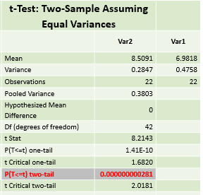
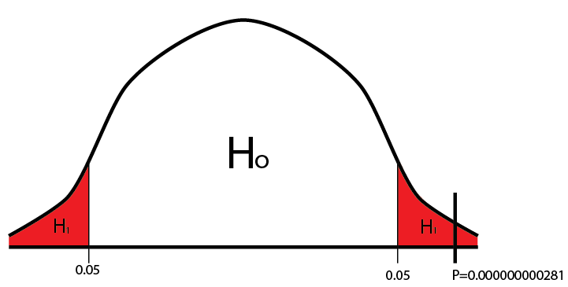
T-STUDENT
Post-test |  |  |  | t-Test: Two-Sample Assuming Equal Variances
n | control (var1) | experimental (var2) |  |  | Var2 | Var1
1 | 7.40 | 8.20 |  | Mean | 8.5091 | 6.9818
2 | 7.00 | 8.40 |  | Variance | 0.2847 | 0.4758
3 | 7.20 | 9.00 |  | Observations | 22 | 22
4 | 6.80 | 8.40 |  | Pooled Variance | 0.3803
5 | 7.20 | 9.40 |  | Hypothesized Mean Difference | 0
6 | 7.60 | 8.60 |  | Df (degrees of freedom) | 42
7 | 6.60 | 8.80 |  | t Stat | 8.2143
8 | 7.60 | 8.40 |  | P(T<=t) one-tail | 1.41E-10
9 | 6.80 | 9.00 |  | t Critical one-tail | 1.6820
10 | 6.80 | 8.60 |  | P(T<=t) two-tail | 0.000000000281
11 | 6.40 | 8.60 |  | t Critical two-tail | 2.0181
12 | 8.80 | 9.40
13 | 7.00 | 8.60
14 | 6.40 | 8.40
15 | 6.40 | 7.60
16 | 6.80 | 8.20
17 | 7.00 | 9.20
18 | 6.40 | 8.20
19 | 6.20 | 7.60
20 | 5.80 | 7.60
21 | 8.40 | 8.00
22 | 7.00 | 9.00

Slide 22
Conclusions
The statistical result of pre-test let us know that both groups, control and experimental, had a similar level of writing competence which is very low. On the other hand, the instrument, Google Drive, as an e-learning tool to develop the writing skill was really effective, since it allowed measuring the writing production.
Since the experimental group showed a considerable increase in their results. This leads to affirm that students had a good way to develop their writing skill implementing Google Drive in class. Therefore, we reject the null hypothesis.
The Application of Google drive in the Meaningful Learning of the English Language allows not only teachers develop an excellent curriculum based on the students´ needs, but also students enhance their writing skill as it was shown by the post-test results. The students felt really motivated and comfortable with this tool, and students had plenty of opportunities to share their works.

Slide 23
Recommendations
We proved that Google Drive is helpful and effective tool. Therefore we firmly suggest use this tool not only by English teachers, but also teachers from other subjects.
Unidad Educativa Martim Cererê doesn’t have an English Lab. The existing computer lab is used only for Computer Science classes. We recommend that English classes be held in this lab at least once a week.
We recommend that Google Drive should be part of the English curriculum.

Slide 24
PART FIVE
PROPOSAL

Slide 25
UNIDAD EDUCATIVA “MARTIM CERERE” LESSON PLAN
Group: English Teachers | Date: | Time: 40 min | Teachers: 3
Recent topic work: Parts of the speech | Recent Language work: nouns, verbs, adjectives
Aims: Sharing – Commenting – Chatting Teachers will use a students activity (Grammar on the Go) to understand this process
Objectives: Teachers will be able to share documents with others Teachers will learn how to evaluate and how to give feedback without talking. Using comments and chatroom
Assessment: Teachers identify nouns, verbs, and adjectives correctly Teachers use the comment tool and the chatroom to stablish written communication with trainer and co-workers
Materials: Google accounts, computers, Internet, Projector
Workshop for Teachers

Slide 26
A C T I V I T I E S
Open Google Drive -> www.drive.google.com Sign in using your Gmail account. If you don´t have one, refers to the user manual. Create a New Activity Click on New Select Docs, Sheets, Slides, Maps, GeoGebra, etc. Type the title of the document Document is saved automatically Sharing the Activity – you are the owner Click on Share option Type the email addresses of the persons you want to share this document with. Give them access to Edit, Comment, or View Using a shared Activity – you are the guest Click on Shared With Me option Open the Shared Document you want to work with Just the owner can give you rights. You cannot delete de document. You only can Edit, Comment, or View | Doing The Activity Open the activity GRAMMAR ON THE GO Read the instructions You have 10 minutes to complete the activity If you have questions for the trainer or co-workers, use the Chat room If you want to correct, give feedback, ask the meaning of a word; highlight the text and click on Comment. Evaluation and Feedback Click on Comment and/or Chat option You can chat in private – just select the user you want to chat with. ENHANCE STUDENTS´ WRITING SKILL AVOIDING SPOKEN LANGUAGE DURING THE WRITING PROCESS. ENCOURAGE THEM TO USE THE COMMENT AND CHATROOM TOOLS.

Slide 27
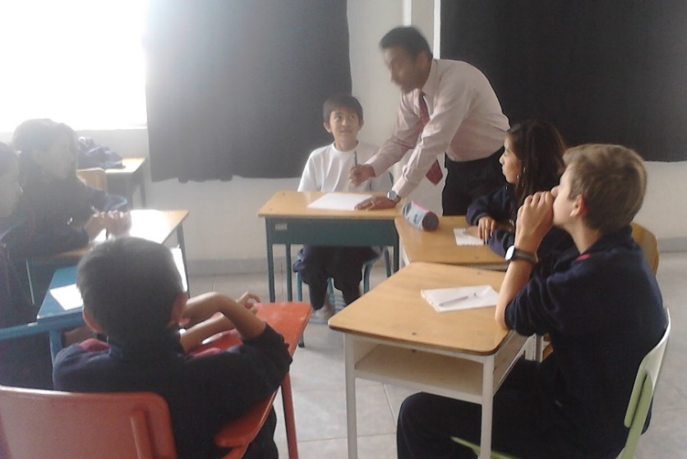
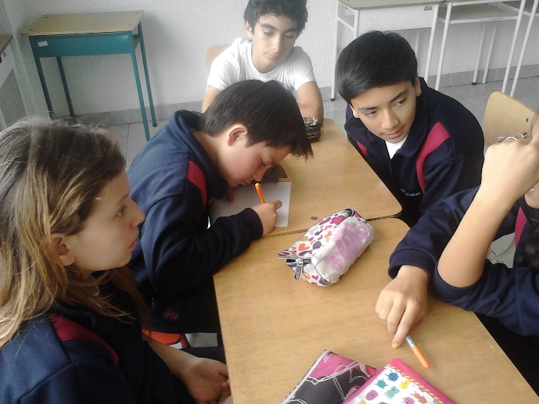
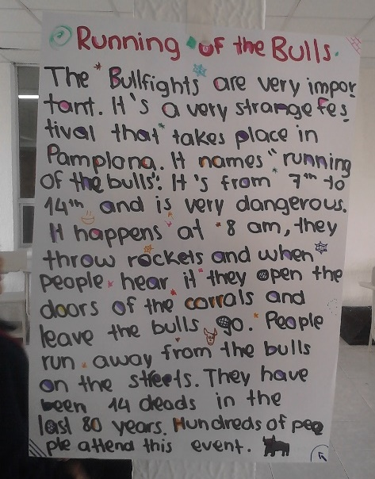
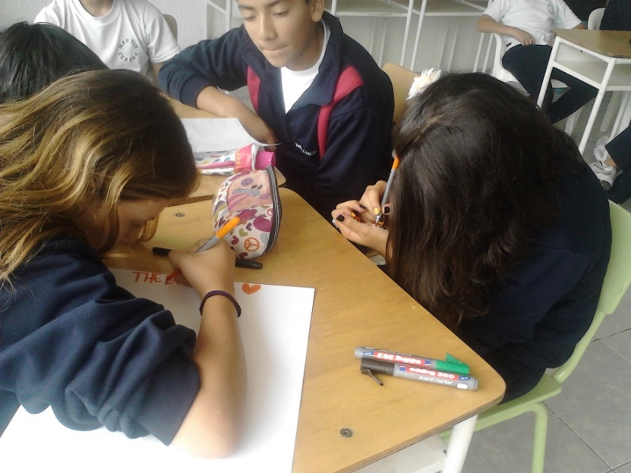
A TRADITIONAL WRITING ACTIVITY IN CLASS

Slide 28
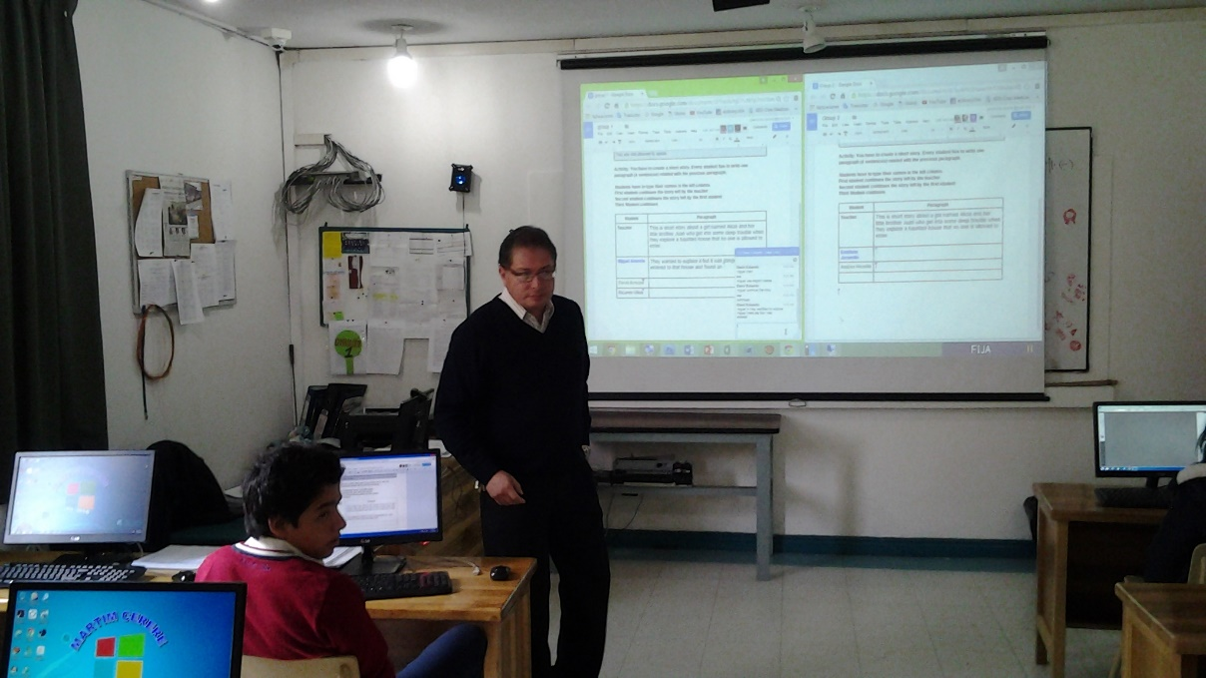
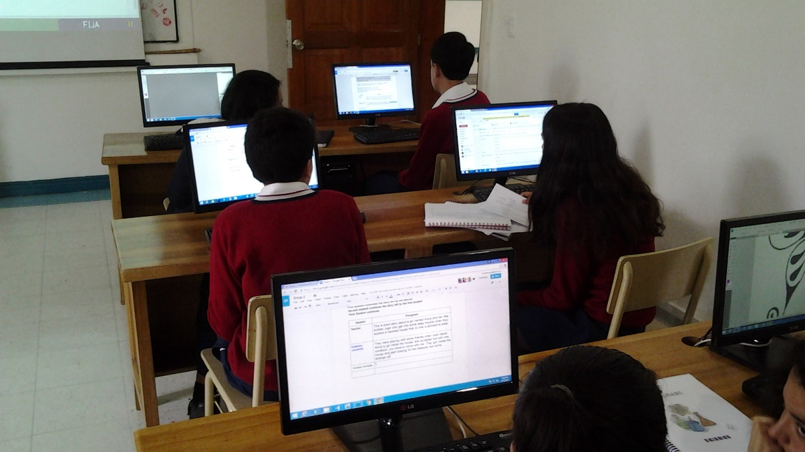
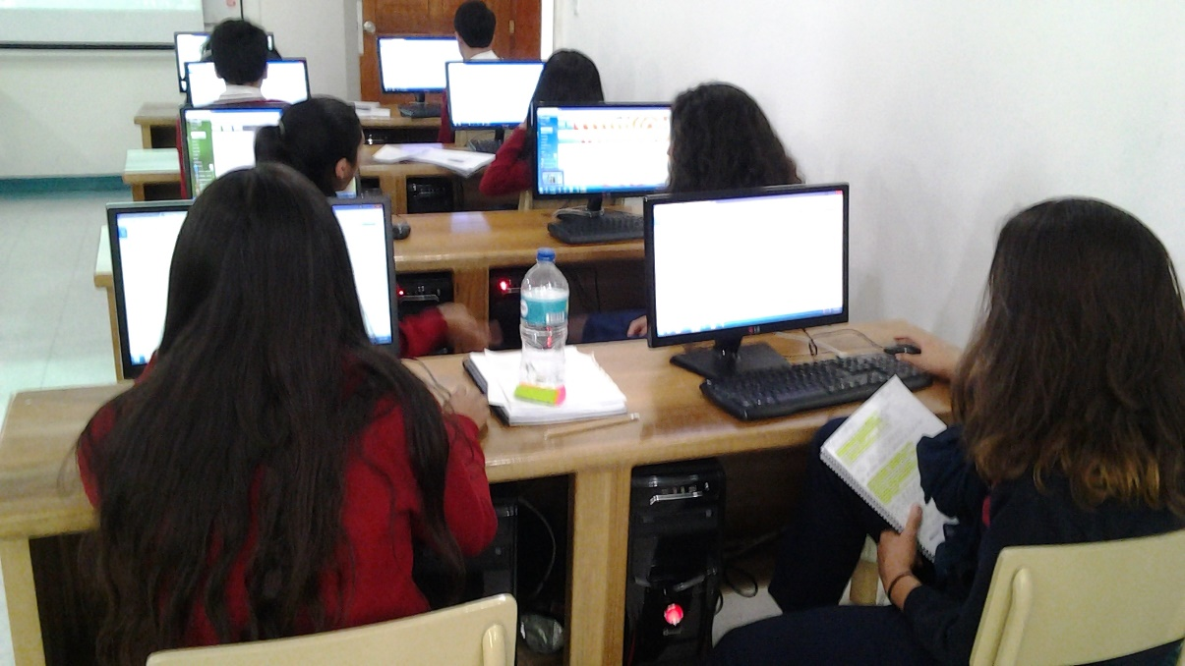
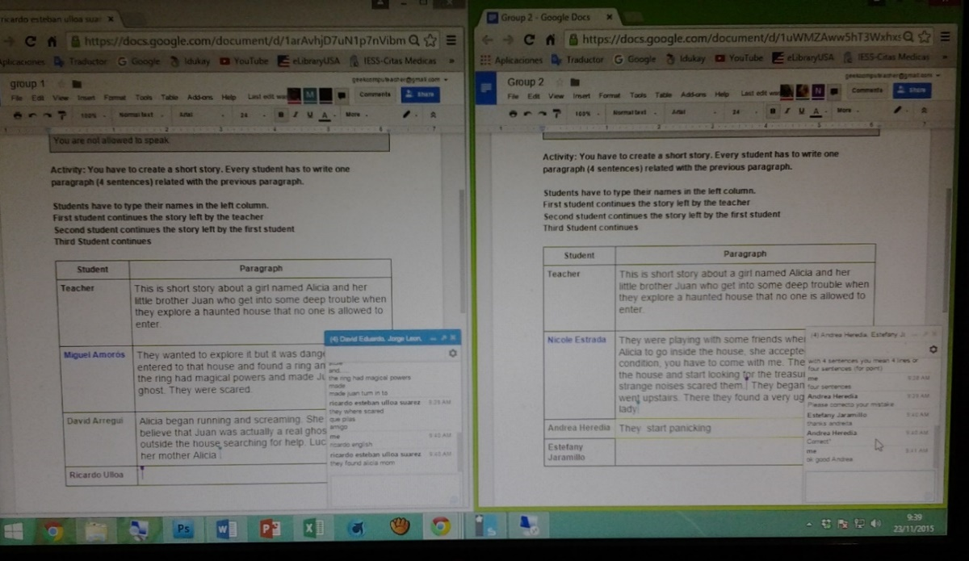
GOOGLE DRIVE:A CANVAS OF OPPORTUNITY

Slide 29
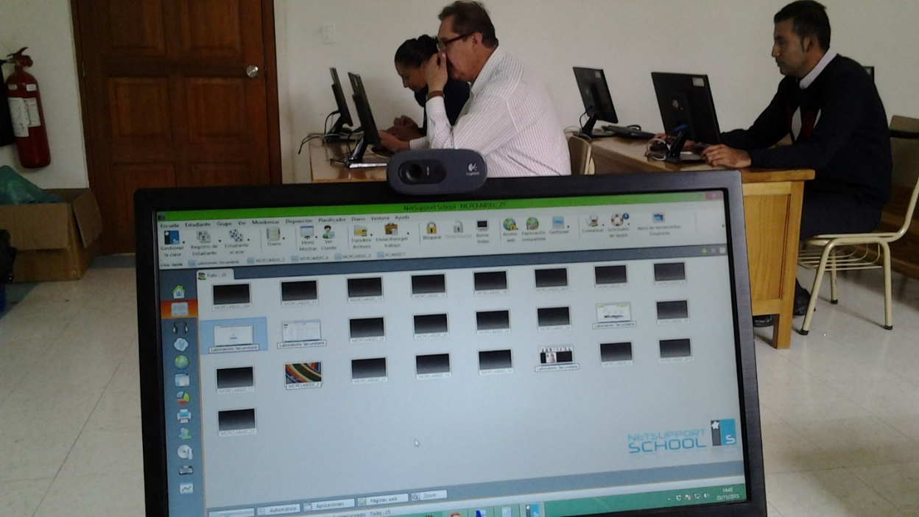
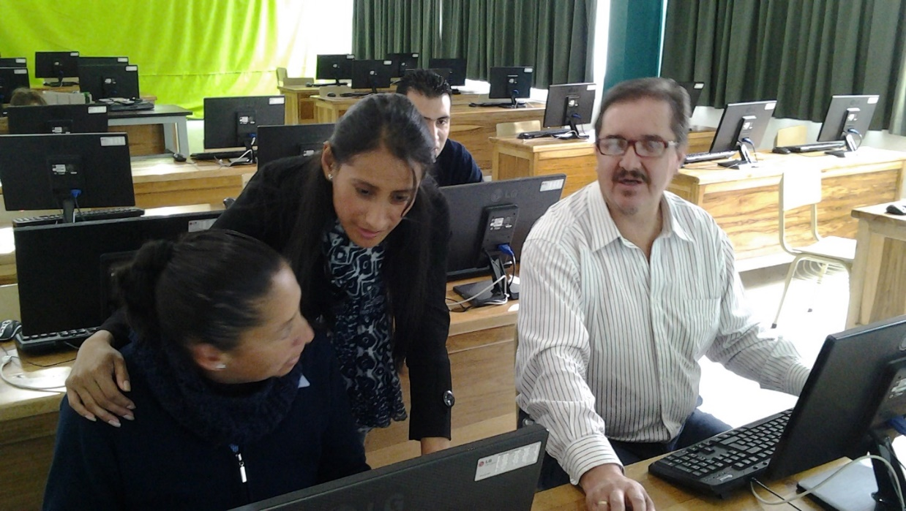
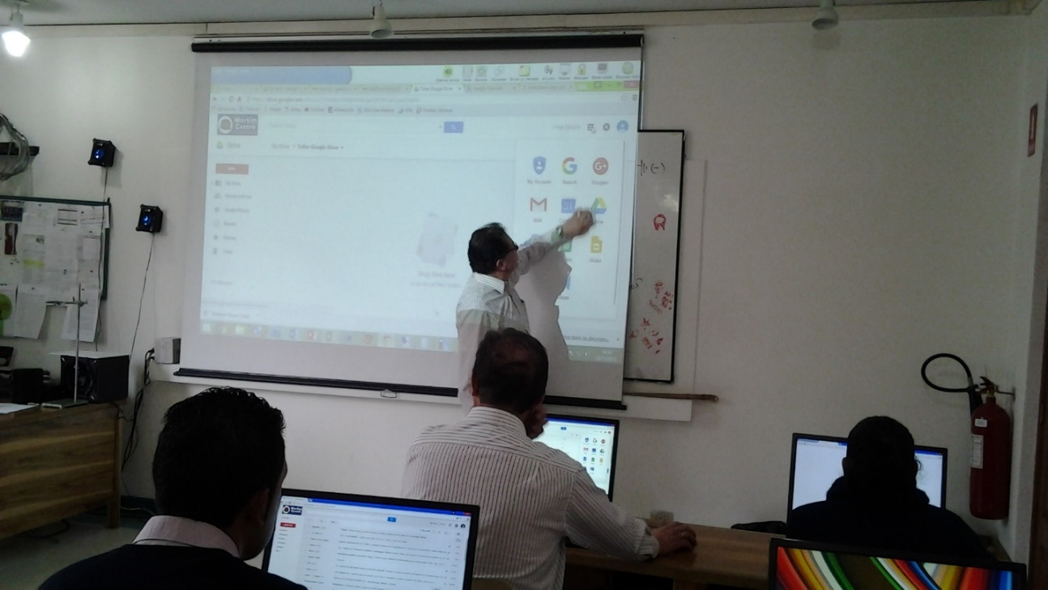
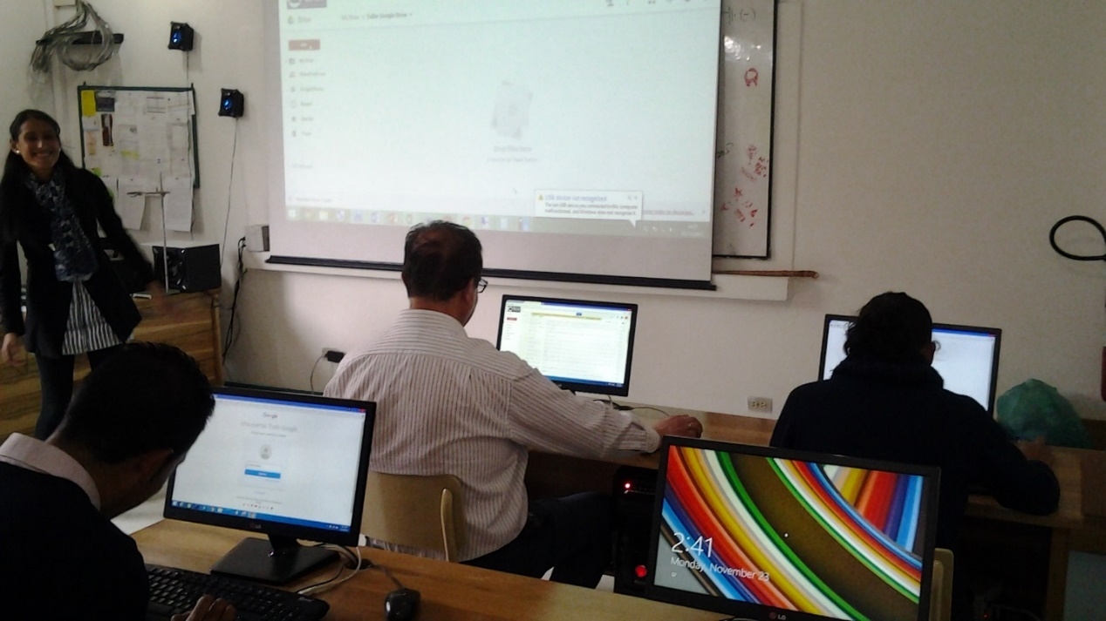
A BROAD PATH IN THE GALLERY OF UNDERSTANDING

Slide 30
THANKS FOR YOUR ATTENTION
HAVE A WONDERFUL DAY

