Slide 1
THE INFLUENCE OF DESUGGESTOPEDIA IN THE IMPROVEMENT OF SYNTAX-ENGLISH SENTENCE STRUCTURE IN THE STUDENTS OF FIRST YEAR OF BACCALAUREATE, ELECTROMECHANICAL AUTOMOTIVE A1 AND A2 EFL CLASSROOMS AT INSTITUTO TECNOLÓGICO SUPERIOR CENTRAL TÉCNICO DURING THE SCHOOL YEAR 2014 – 2015
Authors:
Karen Ivette Resabala Encalada
Johanna Patricia Rivadeneira Rivadeneira
December 2015

Slide 2
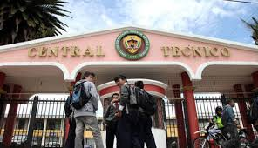
Instituto Tecnológico Superior “Central Técnico”

Slide 3
PROBLEM TREE

Slide 4
PROBLEM TREE
Low English performance
Unmotivated students
Underdeveloped grammar structure
POOR ENGLISH GRAMMAR STRUCTURE
Traditional teaching methods
Lack of methodological tools
Ineffective English
curriculum

Slide 5
MATRIX

Slide 6
MATRIX
1.3. Variables Matrix
Dependent Variable: Syntax.
Independent Variable: Desuggestopedia.
VARIABLE | DEFINITION | DIMENSIONS | SUBDIMENSIONS
INDEPENDENT VARIABLE: Desuggestopedia | Method that uses the suggestion to develop the capacities of two hemispheres of the brain. | Main types of methods: | Total Physical Response, Communicative Language Teaching, Desuggestopedia.
 |  | Desuggestopedia Techniques: | Peripheral learning, Positive suggestion, Choose a new identity, Role play, Active concert, Passive concert.

Slide 7
MATRIX
VARIABLE | DEFINITION | DIMENSIONS | SUBDIMENSIONS
DEPENDENTVARIABLE: Syntax | It is the form of sentence structure for the organization of the words, considering specific rules of the language. | Syntax | Definition Relation of syntax with the other components of language: -Morphology and syntax -Phonology and syntax -Semantics and syntax -Pragmatics and syntax
 |  | Syntactic categories | Word level categories: - Noun, Verb, Adjective, Preposition, Adverb, Determiner, Conjunction. Phrasal categories: - Noun phrase, Verb phrase, Adjective phrase, Prepositional phrase, Adverbial phrase.
 |  | Sentence Patterns | First pattern, Second pattern, Third pattern, Fourth pattern, and Fifth pattern.

Slide 8
MATRIX
VARIABLE | DEFINITION | DIMENSIONS | SUBDIMENSIONS
IV + DV: Desuggestopedia in the improvement of syntax | Method based on suggestion for the development of the cerebral capacities, in the use of rules and structures of English in the students. | -Curriculum development | Lesson Plans, Tests, Rubrics.
 |  | -Techniques | Choose a new identity, Peripheral learning, Positive suggestion.

Slide 9
OBJECTIVES

Slide 10
General Objective
To analyze the influence of desuggestopedia in the improvement of syntax – English sentence structure in the students of the first year of baccalaureate, specialization Electromechanical Automotive, A1 and A2 EFL classrooms at “Instituto Tecnológico Superior Central Técnico” during the school year 2014 - 2015.

Slide 11
Specific Objectives
To gather theoretical information about the active methodology and the management of techniques as tools that will serve for the development of the analysis and the approach of a proposal.
To define the teaching methodology used by the teachers and the development of the grammar structure during the learning process in the students of first year of specialization Electromechanical Automotive, A1 and A2 EFL classrooms, in the process teaching-learning.

Slide 12
Specific Objectives
To consider the results of the diagnosis that allows us to determine the efficiency of the methodology applied and their effects in learning English in the students.
To elaborate a proposal that first encourage teachers to the use of Desuggestopedia and second help Students understand and make progress in their English classrooms as an alternative methodology to improve the English sentence structure.

Slide 13
JUSTIFICATION

Slide 14
English language
requires
(Elements)
Word
Phrase
Clause
Different use in a sentence
Area of knowledge and teaching
Practice and methodology
is changed into
Communication Skills
Listening
Writing
Reading
speaking
Develop an important role
Teaching – learning process
Desuggestopedia
Interest and importance
Learning English
develops
Students
learn
Interactive games (playful methods)
Students do not have the fear to learn

Slide 15
THEORETICAL FRAMEWORK

Slide 16
THEORETICAL FRAMEWORK: syntax
LEVEL CATEGORIES
WORD Level Categories:
Content & Function
Noun
Verb
Adj
Prep
Adv
Determiner
Conjunction
PHRASE Level Categories
Noun Phrase
Verb Phrase
Adjective Phrase
Prepositional Phrase
Adverbial Phrase

Slide 17
THEORETICAL FRAMEWORK: syntax
SENTENCE PATTERNS
First Pattern
S + Vi
Second Pattern
S + Vt + DO
Third Pattern
S+Vl + PA
Fourth Pattern
S+ Vl + PN
Fifth Pattern
S+ Vt + IO+ DO

Slide 18
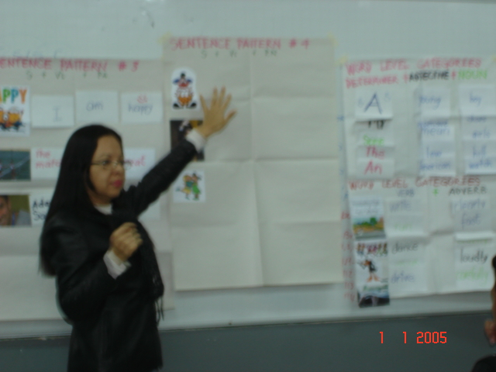
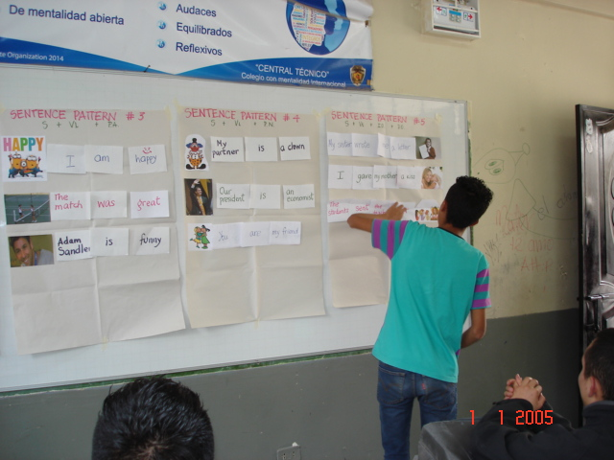
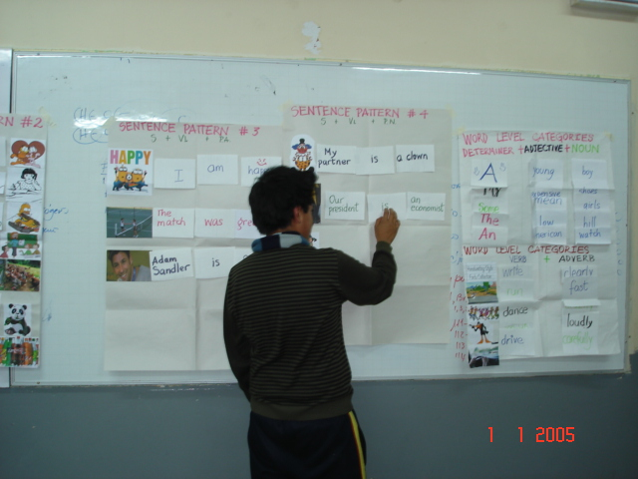
THEORETICAL FRAMEWORK: SENTENCE PATTERNS

Slide 19
THEORETICAL FRAMEWORK: DESUGGESTOPEDIA
The Bulgarian psychotherapist Georgi Lozanov created the desuggestopedia method.
It reduces the time the brain assimilates the information.
UNESCO (United Nations Educational, Scientific and Cultural Organization) indicates that this method is effective because it is based on studies of suggestion.
It is used through music, art and dance in the educational system, and students learn in a fast, safe and entertainment way.
Different fields of studies have used this method, but foreign language learning has mostly used it.
Lozanov mentions that we use only 5 to 10 percent of our mental capacity.

Slide 20
DESUGGESTOPEDIA TECHNIQUES

Slide 21
DESUGGESTOPEDIA TECHNIQUES PERIPHERAL LEARNING
This technique uses posters containing grammatical information about the target language on the classrooms walls, students will absorb the lesson easily.
The posters are changed from time to time to indicate actual grammatical information according to what the students are studying.
Teacher should use pictures, graphics, flashcards, large wall papers, photographs or illustrations for an easy learning.

Slide 22
DESUGGESTOPEDIA TECHNIQUES
Positive Suggestion
The teacher begins the class telling the students that they are going to be successful and gives positive suggestion.
The teacher could use a famous phrase and begins speaking about it, so students can give an opinion.

Slide 23
DESUGGESTOPEDIA TECHNIQUES CHOOSE A NEW IDENTITY
The students can choose a new name and occupation.
While the course continues, they have the opportunity to write a whole biography about their fictional selves.
Then the teacher asks them to talk or write about their fictional hometown, childhood and family.

Slide 24
DESUGGESTOPEDIA TECHNIQUES PRIMARY ACTIVATION
This activity has a dialog which is made with the target language (English).
This dialog can be playfully reread out loud as individuals or in groups.
The dialog has three parts, and the group of students read parts of the dialog in a particular manner: the first group reads sadly; the next group angrily and the last group cheerfully.

Slide 25
HYPOTHESIS FORMULATION

Slide 26
HYPOTHESIS FORMULATION
WORKING HYPOTHESIS
The application of desuggestopedia will improve the syntax – English sentence structure in the students of the first year of baccalaureate, specialization Electromechanical Automotive, A1 and A2 EFL classrooms.
NULL HYPOTHESIS
The application of desuggestopedia will not improve the syntax – English sentence structure in the students of the first year of baccalaureate, specialization Electromechanical Automotive, A1 and A2 EFL classrooms.

Slide 27
METHODOLOGICAL DESIGN

Slide 28
METHODOLOGICAL DESIGN
Exploratory investigation
Secondary research.
Quasi-Experimental Investigation
Control and experimental group.
Compare scores between two groups: the control group 1st A1 and the exploratory group 1st A2 EFL classrooms.
The goal: to demonstrate cause-effect.
Uses pre-tests and post-tests to compare the outcomes obtained.
SIZE OF POPULATION AND SAMPLE
RESEARCH TYPE AND DESIGN
Some specializations.
INSTRUMENTS FOR DATA COLLECTION
Pre-Test and post-test.
Electromechanical Automotive had 4 classrooms in the morning of the first year of baccalaureate, and just two (A1 and A2) EFL classrooms at night section with 25 students each one: SAMPLE
The results are measured or evaluated before to draw a conclusion.

Slide 29
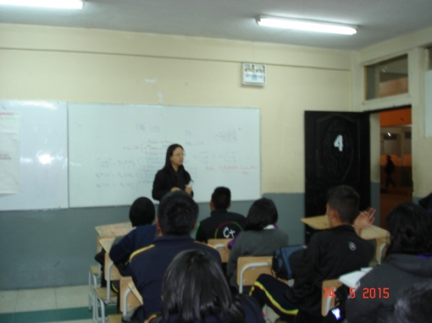
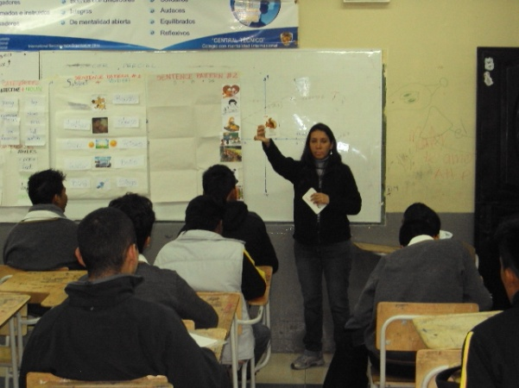
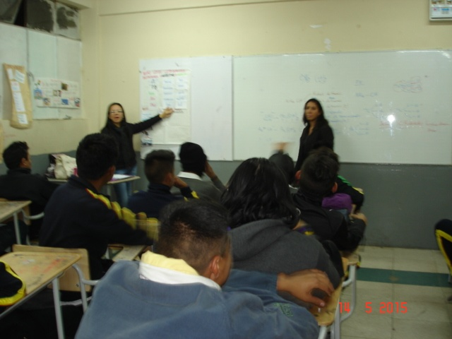
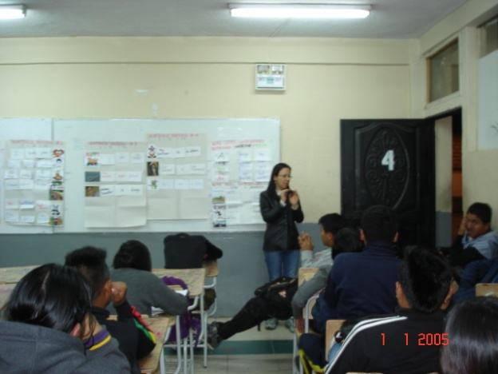
STUDENTS
CONTROL GROUP
1º A1
EXPERIMENTAL GROUP 1º A2

Slide 30
TESTING HYPOTHESIS

Slide 31
TESTING HYPOTHESIS: bar graph of pre-test and post-test control VS EXPERIMENTAL GROUP
Source: 1º A1 and 1º A2 at Instituto Tecnológico Superior Central Técnico. May 2015
Authors: Karen Resabala and Johanna Rivadeneira

Slide 32
TESTING HYPOTHESIS: CALCULATING z SCORE

Slide 33
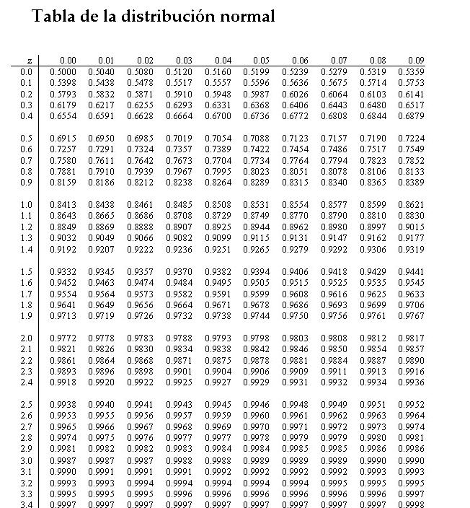

Slide 34
TESTING HYPOTHESIS: CALCULATING z SCORE

Slide 35
TESTING HYPOTHESIS: NORMAL DISTRIBUTION BELL

Slide 36
CONCLUSIONS

Slide 37
CONCLUSIONS
CONCLUSIONS
As z = -4.33, the null hypothesis is rejected.
According to the working hypothesis, the experimental group showed improvement in the English sentence structures after applying desuggestopedia.
The students of experimental group were interested and able to understand due to different techniques applied.
Students were able to remember the grammatical structure (syntax) thanks to Peripheral Learning and it led to good progress.
Students were encouraged and eager to participate and learn.
Therefore, students improved learning, understanding and development of syntax.

Slide 38
RECOMMENDATIONS

Slide 39
RECOMMENDATIONS
Desuggestopedia should be considered as an alternative method which could help with excellent results when it is combined with other methods.
This method of desuggestopedia enthusiastically promotes to extend this teaching courses to other specialties, public and private schools and universities.
There are some institutions, organizations and individuals which are dedicated to the research and could give further support to this method. Then, this idea could transcends in a local, provincial, institutional and international level.

Slide 40
PROPOSAL FOR TEACHERS

Slide 41
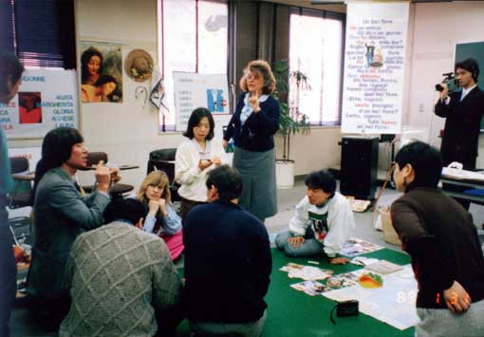
PROPOSAL FOR TEACHERS
Training program to teach the desuggestopedia method to the English teachers of “Instituto Tecnológico Superior Central Técnico” during the second term
January 2016 – August 2016
Tutors present different activities during the training program.
Teachers attend the training during three Saturdays
from 9 am to 11:15 am.

Slide 42
PROPOSAL FOR STUDENTS

Slide 43
PROPOSAL FOR STUDENTS
To implement tutorials using the desuggestopedia method for students with low performance in Syntax - English sentence structure.

Slide 44
PROPOSAL FOR STUDENTS
To implement tutorials using the desuggestopedia method for students with low performance in Syntax - English sentence structure.

Slide 45
PROPOSAL FOR STUDENTS

Slide 46
PROPOSAL FOR STUDENTS

Slide 47
PROPOSAL FOR STUDENTS

Slide 48
PROPOSAL FOR STUDENTS

Slide 49
THANKS FOR YOUR ATTENTION
Karen Resabala
& Johanna Rivadeneira

