Slide 1
ARMY POLYTECHNIC SCHOOL
DEPARTMENT OF LANGUAGES
APPLIED LINGUISTICS IN ENGLISH CAREER
“OUR PARENTS HAVE GIVEN LIFE, BUT OUR TEACHERS HAVE TAUGHT HOW TO LIVE IT”
AUTHORS:
DORIS NIEVES AND JAIRO DOTA

Slide 2
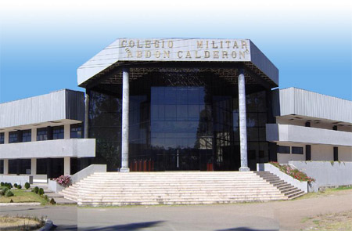
SUMMARY
CHAPTER I RESEARCH PROBLEM
CHAPTER II THEORETICAL FRAMEWORK
CHAPTER III METHODICAL DESIGN
CHAPTER IV ANALYSIS AND INTERPRETATION OF RESULTS
CHAPTER V CONCLUSIONS AND RECOMMENDATIONS
CHAPTER VI PROPOSAL

Slide 3

RESEARCH THEME:
“THE APPLICATION OF A GRAMMAR MANUAL IN ORDER TO SOLVE COMMON VERB- CONJUGATION PROBLEMS FOUND IN THE STUDENTS OF THE FIRST COURSES OF BASIC LEVEL AT ‘ABDON CALDERON MILITARY HIGH SCHOOL’ OF CUENCA DURING THE SCHOOL YEAR 2008-2009”

Slide 4

CHAPTER I
RESEARCH PROBLEM
PROBLEM
IDENTIFICATION
PROBLEM
FORMULATION
VARIABLES
MATRIX
OBJECTIVES
JUSTIFICATION

Slide 5
PROBLEM IDENTIFICATION
“The command of a foreign language has become quite important in our contemporary society. Indeed it has become a real need which is justified by different reasons.”
It is so powerful, the globalization process that we are living in, and our Country is not apart of this reality.
Throughout classroom observation and conversation with students at High School we have realized they have a low performance, shown mainly in the difficulty in communicating in real situations, dealing with grammar structures, specially with the conjugation of verbs with the third person in singular.
The methodology is traditional, teacher centred and content based.
Most of students had not developed the ability to write clear and comprehensible sentences, it is probably the most important and useful skill in today’s world.

Slide 7
PROBLEM FORMULATION
How to teach verb-conjugation to get a significant learning in the students of the first courses of Basic level at Abdon Calderon Military High School during the School year 2008-2009.

Slide 8
    Secondary Problems
How does the COMIL-4 plan the English Program to teach the verb-conjugations to the students of the first courses of Basic level during the School year 2008-2009?
How to use correctly the materials that the COMIL-4 has to teach verb-conjugations to the students of the first courses of Basic level during the School year 2008-2009?
How does the lack of materials in the high school difficult students of first courses of Basic level at the Abdon Calderon to put into the practice what they learn during the School year 2008-2009?

Slide 9
VARIABLES MATRIX
Independent Variable | Dependent Variable
Grammar manual to teach verb-conjugations using actives techniques to get significant learning | Learning process.

Slide 10
OBJECTIVES:
GENERAL OBJECTIVE
To determine the incidence of applying the Grammar Manual in order to solve the verb- conjugation problems on students of first courses of Basic level at the Abdon Calderon Military High School during the School year 2008-2009.

Slide 11

OBJECTIVES:
SPECIFIC OBJECTIVES
To correct interactive learning situations where teachers and students build collectively new conceptualizations, integrating previous knowledge and specific theoretical contributions to students.
To provide appropriate materials in order to attain as many opportunities as possible for doing grammar in the students.
To generate a teaching instrument, by means of which, the students make learning a lot easier, and to contribute to teachers with a manual which facilitates to the teaching-process to students.

Slide 12

JUSTIFICATION
Demands of the Global World which we live in
Command of a Language
Organization of the teaching process

Slide 13
CHAPTER II
THEORETICAL FRAMEWORK
Theoretical and Conceptual Focus
Structure
Hypothesis Formulation

Slide 14

STRUCTURE
INDEPENDENT VARIABLE
DEPENDANT VARIABLE
TEACHING TECHNIQUES
WRITING PRODUCTION
Approaches for EFL teaching
Grammar in use
Communicative Language Teaching
Curriculum based on Competences
Cooperative Learning
Common Reference Levels
Interactive Classroom Activities
RELATION BETWEEN INDEPENDENT
AND DEPENDENT VARIABLES

Slide 15
INDEPENDENT VARIABLE
Teaching Techniques

Slide 16






APPROACHES FOR EFL TEACHING
Grammar Translation | Direct Method | Audio Lingual | Community Language Learning | Suggest-opedia | Silent Way | Total Physical Response | Communi-cative Language Teaching
Translation of a literary passage Reading comprehension questions Cognates Deductive application of rule Fill-in-the blanks -Memorization Use words in sentences - Composition | Reading aloud Question and answer Getting students to self correct Conversation practice Fill-in-the blanks Dictation Map drawing -Paragraph writing | Dialog memorization -Repetition drill Chain drill Single-slot substitution drill Multiple-slot substitution drill Transformation drill Question and answer drill - Use of minimal pairs | Tape recording student conversation Transcription -Reflection on experience Reflective listening Human computer - Small group task | Classroom set-up Peripheral learning Positive suggestion Choose a new identity Role play First concert -Second concert Primary activation - Creative adaptation | Sound-color chart Teacher´s silence Peer correction Rods Self correction gestures Word chart Fidel charts - Structured feedback | Using commands to direct behavior Role reversal - Action sequence | Authentic materials Scrambled sentences Language games Picture strip story - Role play

Slide 17
COMMUNICATIVE
LANGUAGE TEACHING
The goal of the language teaching
is communicative competence
Communicative Language Competence
Features of the Communicative
Language teaching
Linguistic competences
- Use of authentic materials
- Language functions and meanings.
- Language games, scramble sentences,
picture strip story, jig saw, role plays.
Errors are tolerated.
Fluency more important than accuracy
Cooperative working.
Teachers act as facilitators and
advisors
Sociolinguistic competences
Pragmatic competences

Slide 18
Cooperative Learning
Groups of two or three may be best.
A signal can be used which means the groups should pay attention to teacher
One student per group can be the noise monitor or “quiet captain,”
Students who don’t want to study in groups can be allowed to work on their own
Have groups that finish early compare what they have done with other groups
Keep groups together for fairly long periods —four to eight weeks—
Combine a group component with ones in which students work alone

Slide 19
Interactive Classroom Activities
Information Gap.
Jigsaws
Writing Activity
The conversation game

Slide 20
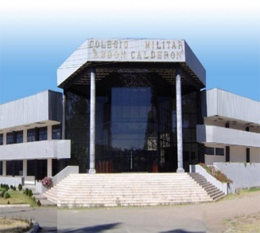
DEPENDENT VARIABLE
Grammar in Use

Slide 21
Grammar in Use
The Interpersonal Function
Social Relations
Use of English
The Ideational Function
Express content and
communicate information
Proficient User
C2
C1
Common Reference Levels:
global scale
B2
Independent User
B1
Basic User
A2
A1

Slide 22
Curriculum based on competences
“to know, to do and be able how to do”
According the CEF an A2 level can:
• Can write short, simple notes and
• messages relating to matters in areas
of immediate need.
• Can write a very simple personal letter
for example thanking sb for something
• informal letters
• formal letters
• interview
• Compositions
• co-planning
• practical goal-oriented co-operation
Writing Production Activities
Examples of writing activities include:
• Essays, job applications, resumes,
research papers, information, instructions,
• reports and any other written
communication will be better received and
respected if they are free of grammatical
errors, misspelled words and ineffective
sentence structure.
They may involve, for example:
• Free writing,
• taking notes from a speech text or visual
aids (diagrams, pictures, charts, etc.);
• acting out a rehearsed role;
• Doing spontaneously exercises;
• Making summaries.

Slide 23
RELATION BETWEEN INDEPENDANT AND DEPENDANT VARIABLES
No perfect Method
Teacher, a kind of Chef
Overcoming obstacles
Doesn't matter what you teach; but how to teach it is important

Slide 24
HYPOTHESIS SYSTEM
Working Hypothesis
Incidence of a new methodical Manual of verb-conjugation focused on competence, new techniques and creativity, in academic performance of the students of the first courses of basic level at ‘Abdon Calderon Military High School’ of Cuenca during the School year 2008- 2009.”
Null Hypothesis
There is no incidence of a new Manual of verb-conjugation focused on competence, new techniques and creativity, in academic performance of the students of the first courses of basic level at ‘Abdon Calderon Military High School’ of Cuenca during the School year 2008- 2009.”
Alternative Hypothesis
The application of a new methodical Manual of verb-conjugation focused on competence, new techniques and creativity, will improve the academic performance of the students of the first courses of basic level at ‘Abdon Calderon Military High School’ of Cuenca during the School year 2008- 2009.”

Slide 25
CHAPTER VI
PROPOSAL
A GRAMMAR MANUAL ABOUT VERB-CONJUGATION BASED ON COMPETENCE, NEW TECHNIQUES AND CREATIVITY FOR BASIC LEVEL STUDENTS AT THE ABDON CALDERON MILITARY HIGH SCHOOL OF CUENCA DURING THE SCHOOL YEAR 2008-2009.
PROPOSAL
DESCRIPTION
JUSTIFICATION
OBJECTIVES
THEORITICAL
FOUNDATION

Slide 26
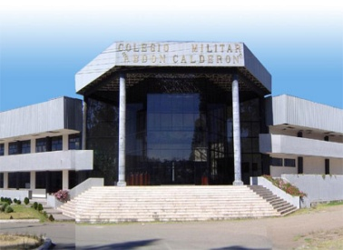
Doesn't matter what you teach; but how to teach it is important

Slide 27


