Slide 1

“The incidence of using WebQuests on the teaching-learning process of English Foreign Language (EFL) for students attending the seventh year of basic education at República de Panamá School, 2010-2011 school year”.
Dissertation Theme

Slide 2
Introduction
Why was this theme chosen?
Importance of English Foreign Language.
Traditional strategies used in EFL teaching-learning process.
Low level of competence in the target language.
Lack of motivation in students.
Need to reverse this situation.
What to do?
Implementation of innovative teaching strategies as WebQuests in the EFL teaching-learning process.
Subjects of study
Students attending 7th. year of Basic Education at Republica de Panama School.

Slide 3
Problem Identification
LOW LEVEL OF ENGLISH KNOWLEDGE AND PERFORMANCE IN STUDENTS
Lack of students' motivation
Teachers use traditional methods
Deficient EFL teaching-learning process , especially in Public Schools
Not applying innovative strategies in classrooms
Traditional instructions limit the learning process
Does the use of the WebQuest Strategy have any
incidence in the teaching-learning
process of EFL?

Slide 4


Variables Working Out
Dependent Variable:
The Teaching-Learning Process
Independent Variable: WebQuests

Slide 5
Objectives
OBJECTIVES
General
To determine the incidence of using WebQuests on the Teaching-Learning Process of EFL.
To propose the implementation of WebQuests on the Teaching-Learning Process of EFL.
Specific
To carry out an analysis about the use of WebQuests on the Teaching-Learning Process of EFL.
To design a sample guide for implementing WebQuests in the EFL curriculum.
To promote the students’ motivation to learn English through the use of WebQuests.

Slide 6
Justification
English Foreign Language
Facilitates communication
Most spoken language
around the world
Mandatory instruction
due to its importance
Current English knowledge?
Low level of English knowledge,
and performance in students
Traditional strategies
used in
teaching-learning
process
Why?
Lack of motivation
in
students
What to do?
Technology offers innovative tools
for using in teaching-learning process
of EFL
Options
Results
Web tool= WebQuest Strategy
* Construct knowledge
* Higher thinking skills
* Motivation
Improvement of EFL teaching-learning
Language Skills Development
Competence/performance

Slide 7
Theoretical Framework
THEORETICAL AND CONCEPTUAL FOCUS
THE TEACHING-LEARNING
PROCESS
Definition: Act performed by means of the effective
interaction of teachers, learners, contents, and the
appropriate teaching resources and strategies.
Objective: Achieve predetermined academic goals.
Students' acquisition of knowledge (effective learning)
Learning Theories: Behaviorism
Cognitivism
Constructivism

Slide 8
Theoretical Framework
ELEMENTS OF TEACHING-LEARNING PROCESS
TEACHER
LEARNER
TEACHING RESOURCES AND STRATEGIES
LEARNING ENVIRONMENT
CONTENT
Role (impart knowledge, create learning-environment).
Characteristics and Behavior in classroom.
Effective interaction
of all the elements
facilitates the teaching-learning
process.
It stimulates the flow of communication of all the participants.
Role (active participants)
Characteristics and Behavior in classroom.
Physical tools such as: computers, books, etc.
Teaching strategies or methods used by teachers to instruct in classrooms such as lecture, role play, etc.
The content is what is taught and determined by learning objectives.
E.g. an INNOVATIVE strategy
as WebQuests is a good option
that can have a positive effect
on students' attitudes to learn.
The STUDENT-ACHIEVEMENT or OUTCOME
is the primary focus on
the teaching-learning process.

Slide 9
Theoretical Framework
WEBQUESTS
Definition: According to Bernie Dodge (1995),
“a WebQuest is an inquiry-oriented activity in which
some or all of the information that learners interact with
comes from resources on the internet”.
General benefits:
Easy implementation in the curriculum.
Engage students in active learning.
Promote understanding and construction of knowledge.
Useful way of using internet for teaching and learning
Avoid the burdensome of using internet
(preselected resources).
Use of technology arouses students' interest to learn.

Slide 10
Theoretical Framework
WEBQUESTS
Types
Short-Term
Long-Term
General Attributes
Critical
Components
Introduction
Task
Process
Resources
Evaluation
Conclusion
Non-critical
Theoretical Foundations
Constructivism
Motivation
Cooperative Learning
Criteria for designing the strategy
* Attractive Start
* Challenging Task or Topic
* Definition of Roles /Distribution of Groups
* Transformative Thinking- useful information
* Correct use of Web resources

Slide 11
Theoretical Framework
THE WEBQUEST STRATEGY IN THE TEACHING-LEARNING PROCESS OF EFL
Promote motivation in students
Development of language skills
Cooperative work-interaction and practice with the target language
Construction of significant knowledge
Real communication in the target language
Engage students in learning the target language
Effective way for teachers when instructing EFL
Student achievement is possible

Slide 12
Theoretical Framework
HYPOTHESIS SYSTEM
WORKING HYPOTHESIS
The WebQuests have a positive incidence on the teaching-learning process of EFL for students attending the seventh year of basic education at Republica de Panama School.
NULL HYPOTHESIS
The WebQuests do not have any incidence on the teaching-learning process of EFL for students attending the seventh year of basic education at Republica de Panama School.

Slide 13
Methodological Design

Slide 14

Testing the Hypothesis
GRAPHICAL EXPOSITION OF RESULTS
PRE-TEST RESULTS

Slide 15
COMPARISON OF PRE-TEST RESULTS
According to the analysis of the mean of the pres-tests applied to the students, it was concluded that both the experimental (mean 13,14) and the control group (mean 13,41) had a low level of English knowledge.

Slide 16
POST-TEST RESULTS

Slide 17
COMPARISON OF POST-TEST RESULTS
According to the analysis of the mean of the post-tests applied, it was concluded that the mean of the experimental group (15,77) increased after the application of the WebQuest strategy in the teaching-learning process of EFL during the month of the experiment, while the mean of the control group (13,61) which worked with the regular curriculum program, did not have important changes.

Slide 18


GENERAL ANALYSIS
The calculation of the mean of scores obtained by experimental and control group in the first test, determined their low level of English knowledge and in the second one, the significant difference of performance between the students who worked with WebQuests and those who did not.
Conclusion: Control group got low scores in both tests, but the experimental group showed a higher performance in the second test, which means the integration of WebQuests in the EFL curriculum had the expected result: Motivate students to learn the target language, improve competence, and increase performance considerably.
TESTING THE HYPOTHESIS
T-test was used to compare the difference between the two means obtained and determine a significant difference to reject the hypothesis.
FORMULA:

Slide 19
STATISTICAL RESULTS
                Degree of freedom 42
Significance level 0.10
Critical value 1.682 (t-student table)
T result 4.965
The T result must be higher than the critical value
in order to reject the hypothesis.
STATISTICAL DECISION
It was obtained t=4.965 which is higher than the critical value, for this the null hypothesis is rejected. Therefore, the work hypothesis is accepted as valid, because using WebQuests had a positive incidence on the teaching-learning process of EFL for students attending the 7th grade at Republica de Panama School.

Slide 20
CONCLUSIONS AND RECOMMENDATIONS
CONCLUSIONS | RECOMMENDATIONS
WebQuests had a positive incidence on the teaching-learning process of EFL. All the students showed a low level of English knowledge after applying the pre-test. | WebQuests should be included into the curriculum program to improve the teaching-learning process of EFL.
Traditional strategies did not arouse students´ interest in learning EFL. Lack of motivation to learn. | Appropriate teaching strategies should be used for students to feel motivated to learn EFL.
Experimental group showed more interest in learning EFL when using the WebQuest strategy and also increased their performance. After using WebQuests, the experimental group showed a better development of language skills, especially in writing, reading, and speaking. | Teachers should work with appropriate teaching resources that help students to acquire a better EFL competence and develop their language skills. Schools and teachers should analyze the importance of using new teaching strategies in order to achieve the student outcome.

Slide 21

The Proposal
“Sample guide for the development and implementation of the WebQuest strategy in the EFL curriculum”
DESCRIPTION:
It is a guide for teachers to learn how to develop and implement the WebQuest strategy in the EFL curriculum of Republica de Panama School, which will be a new tool to teach the target language to the students and motivate them to learn and achieve its competence.

Slide 22
OBJECTIVES:
        To learn how to design and apply the WebQuest strategy in the EFL classrooms.
        To implement the WebQuest strategy in the EFL curriculum as a practical tool to improve the teaching-learning process.
        To include interactive activities in the EFL curriculum by means of
        WebQuests for students to feel motivated to learn English and increase their performance .
FEASIBILITY
Easy to create and implement.
IMPACT
EFL teachers can improve their teaching in classrooms.
The need of new teaching strategies in the EFL curriculum program to improve the teaching-learning process.
Resources available for the implementation (internet access, computers).
Active participation of students and teachers.
Instructions will be moved from teacher-centered to learner-centered.
Increase students' motivation and performance.
Promote cooperative learning and construction of knowledge.
Achievement of educational goals (teachers and students).
Integration of new strategies improves the EFL teaching-learning process.
Useful and practical tool for teachers and students.
Students can acquire better competence in the target language.

Slide 23
STRUCTURE AND DEVELOPMENT:

Slide 24

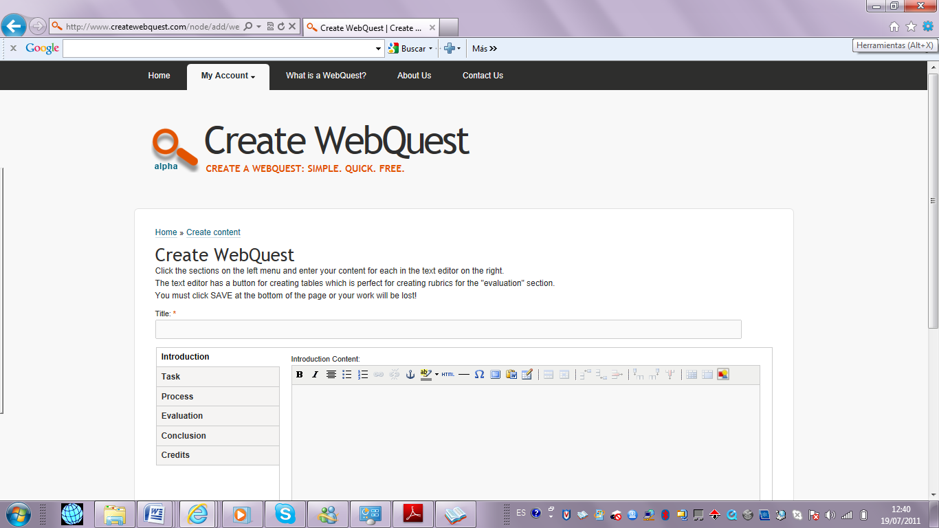
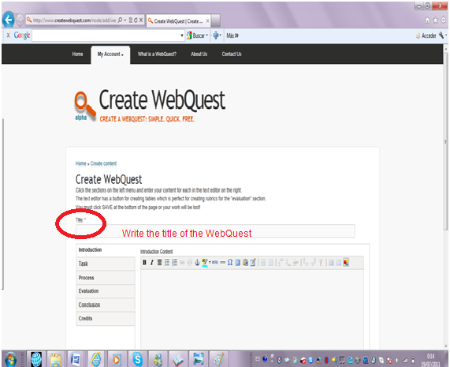
WEBQUEST STRATEGY DEVELOPMENT:
STEP 1. Go to the platform page to create the WebQuests and click button
STEP 2. Write the title of the topic. The first page shows links to the other parts of the WebQuest.
Create WebQuest
1
2

Slide 25
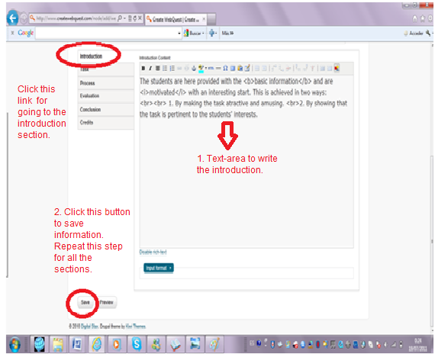
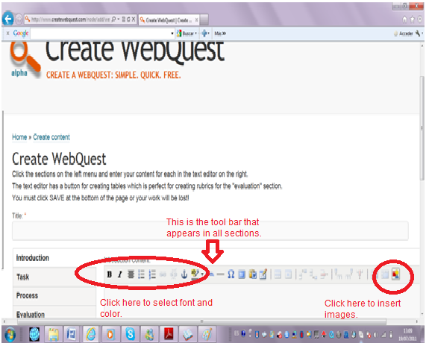
STEP 3. The background of the topic will be placed by clicking the INTRODUCTION link. Save the information in each section by clicking button .
STEP 4. Click the option on the tool bar that appears in all sections to select font, color, and insert images.
Save
3
4

Slide 26
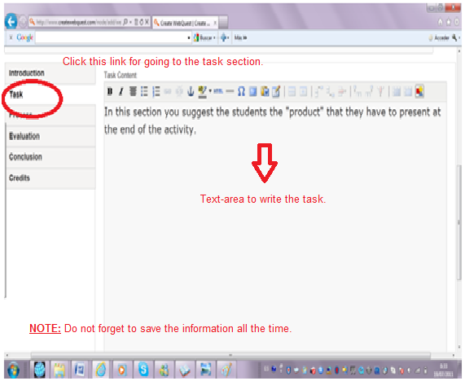
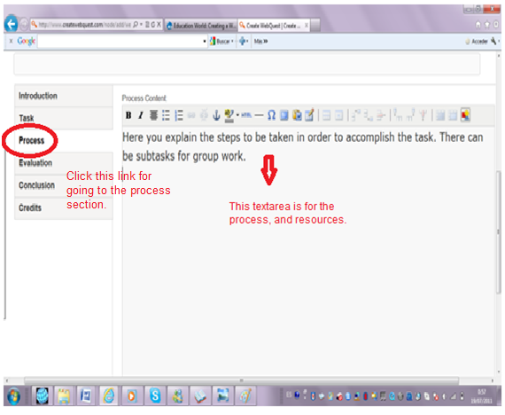
STEP 5. The TASK and the PROCESS sections follow the same steps as in the introduction part.
5

Slide 27
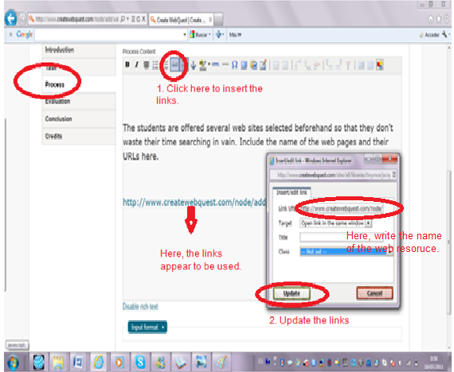
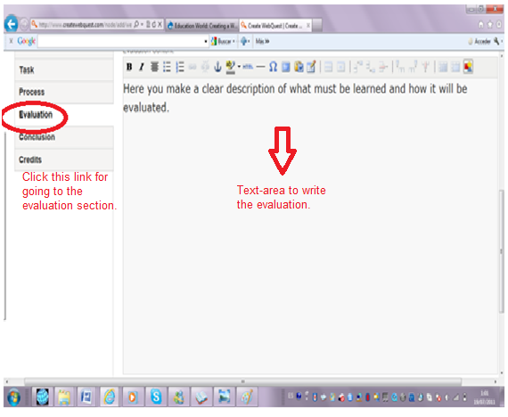
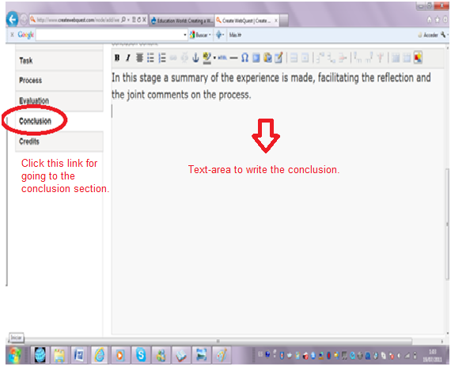
STEP 6. The RESOURCES are linked in the process section, by clicking the link button on the tool bar. Write the name of the website and update it.
STEP 7. The EVALUATION and the CONCLUSION sections follow the same steps as in the introduction part.
6
7

Slide 28
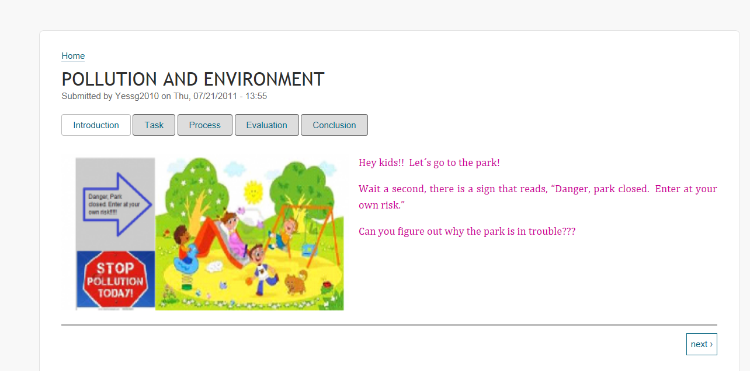
At this point, the WebQuest is completely done and ready to be used in the classroom. This is a sample of the final work that can be seen by clicking the button at the
bottom of the page:
Preview
Preview

Slide 29
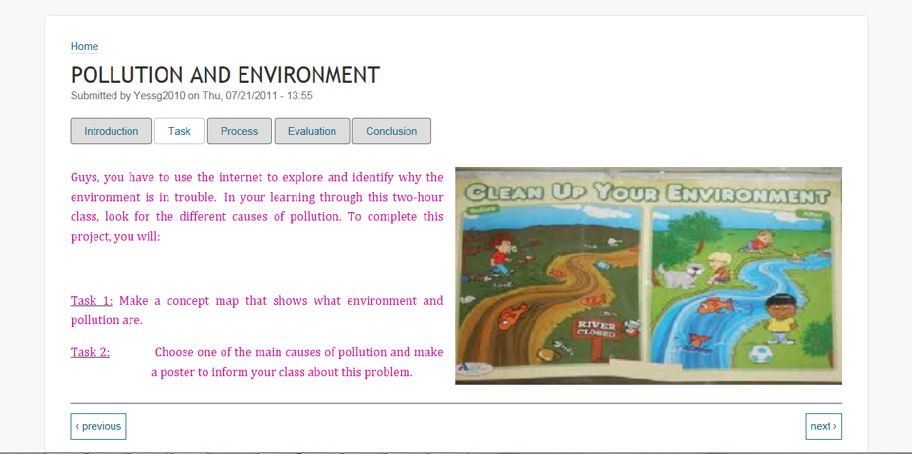
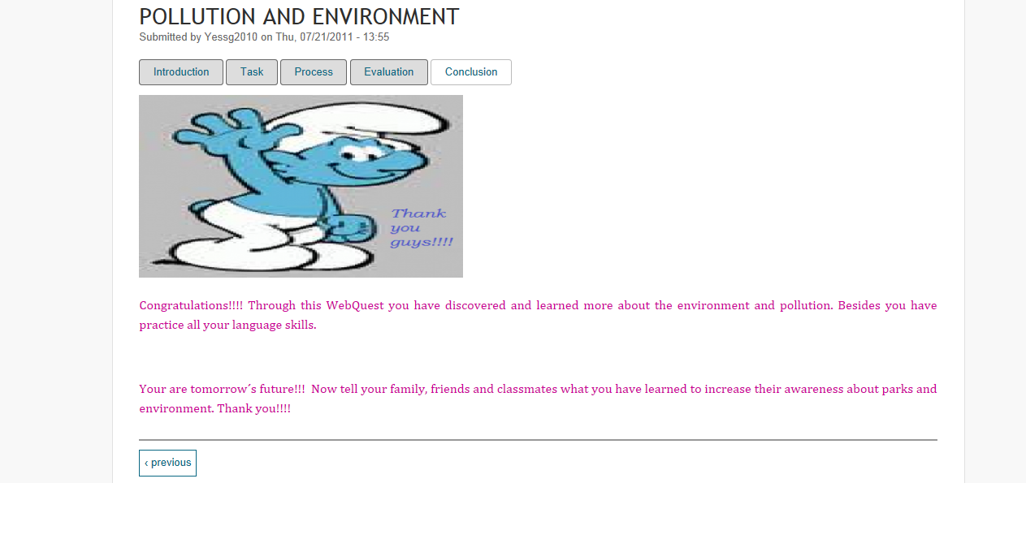
In sum, the WebQuest strategy is a useful tool for teachers to impart the target language. The appropriate creation and application of this activity is mandatory if teachers want their students to be motivated to learn and acquire a better competence. This work is presented as a guide for teachers to learn how to create a new strategy that facilitates and improves the teaching-learning process of EFL.

Slide 30
THE END
AUTHOR:
María Belén Sánchez
ADVISORS:
Msc. Lilián Ávalos
Dra. Dolores Paredes

