Slide 1
DEPARTAMENTO DE LENGUAS
CARRERA DE LINGÜÍSTICA APLICADA AL IDIOMA INGLÉS
PROJECT PRIOR TO OBTAINING APPLIED LINGUISTICS IN ENGLISH LANGUAGE BACHELOR´S DEGREE
DIRECTOR: LIC. MG. MARICELA MADRID
CO DIRECTOR: ING. LIC. EVELYN ALMEIDA
AUTHOR: MARÍA JULIA PÉREZ VILLARREAL

Slide 2
TOPIC: Incidence of cooperative learning to improve listening comprehension skills in the English language in students attending second and third year of Bachillerato at Salamanca Evening High School during the last three months academic year 2013 -2014

Slide 3
Research Problem
Variables Working out
Independent Variable: Cooperative Learning
Dependent Variable: Listening Comprehension skill
General Objective
To determine the incidence of Cooperative Learning
in the use of listening comprehension skill on
students of second and third year at Salamanca
Evening High School.

Slide 4
Research Problem
Specific Objectives
To diagnose the conditions of English listening
comprehension skills in students of second and third
year.
To determine the English listening comprehension
skills that students of second and third year have
problems with, to propose the adequate methodology.
To diagram a methodological guide to teach English
listening comprehension skills with cooperative
learning techniques.

Slide 5
Justification
Students of Salamanca Evening High School who are the main actors of learning process need a tool which help them to be competitive in their future education and professional life.
It is necessary to give a teaching method to introduce listening comprehension in Salamanca Evening School that can raise the English language level in students.
Evening Schools in our country need to become an effective option for those people who cannot go to school because of their job or any activities that do not let them finish their studies.
Notes:
Justification
The productive skills like speaking and writing have become the standard of the knowledge of second language; listening and reading have been turned to be the secondary ones. Besides, in our schools, colleges and even in the higher levels, instructors direct how to read and write, not how to speak or listen.
We can expect to listen twice as much as we speak, four times more than we read, and five times more than we write." So, listening, as a skill, is assuming more and more weight in second language classrooms than ever before.
Listening is vital in the language classroom because it provides input for the learner. Without understanding input at the right level, any learning simply cannot begin.

Slide 6
SECOND PART
THEORETICAL FRAMEWORK

Slide 7
Theoretical Framework
History of cooperative learning
B.C. : Talmud
Century I: Séneca
1989: Spencer Kagan and Johnson. Theory and Research
1990: Cooperative Learning becomes popular among teachers
1996: First Annual Congress about leadership in Cooperative Learning. Minneapolis
Notes:
History of Cooperative Learning
From 1960 to 1969, appeared several investigations about cooperation and intergrupal competence. The most important authors that can be named are: Johnson, Stuart Cook, Kagan, Bruner, and others. Johnson began training educators in the use of cooperative, competitive, and individualistic learning. Johnson developed such procedures for teachers, specifying three types of cooperative learning: formal, informal and base group learning. In the years 1974-1975 Johnson and Johnson published the book “Working together and alone” the authors analyze three ways of reaching objectives: competitive, individualistic y cooperative. That means, teachers need to decide when the students have to compete, when to work alone and when to work cooperatively.
In 1976 Shlomo and Yael Sharan say that using Small Group Teaching students can pick their partners for making a determinate group. After that they will be given a task and when they are done they will show it to the other groups in the classroom.
In 1985 Spencer Kagan proposed the Structures for cooperative learning; these structures are designed to increase the participation levels and cooperation of the students. These structures are important because the teacher can have each student to answer to a question several times instead of asking to two or three students to answer each one single question. This will take the same period of time.

Slide 8
Theoretical Framework
Definition of Cooperative Learning
“Cooperative learning is an arrangement in which students work in mixed ability groups and are rewarded on the basis of the success of the group" (A.Woolfolk, 2001)
Notes:
Definition of Cooperative Learning
There are two points that are important to mention, one is that all members in the group make efforts to obtain the same goals. Another point is that each member learns as an individual and in the mean time the group learns a global knowledge. This means that all members are benefited.

Slide 9
Theoretical Framework
Essential components of cooperative learning
Source: Cooperative Learning in the classroom, David and Roger Johnson and Holubec
Notes:
Essential components of cooperative learning
Positive Interdependence
Positive interdependence refers to a group can only succeed if they work together. That means a member´s success depends on the other member. Positive interdependence talks about a mutual responsibility; it means students have the responsibility of learning the assigned material and make sure that all students of the group learn it too.
Individual accountability
The group should be able to evaluate: the progress made to reach the objectives and the individual effort of each member. The results of this evaluation is told to the members so they can determine who needs more help, support and strength to execute the task given. With individual accountability students learn together and after have a better performance individually.
Face to Face Promotive Interaction
said that team members promote each other's productivity by helping, sharing, and encouraging efforts to produce. Members explain, discuss, and teach what they know to teammates. The relationships among members must be considered and dedicated.
Interpersonal and Small Group Skills
Instructors emphasize these skills as purposefully and precisely as job performance skills. Collaborative skills include instructorship, decision-making, trust building, communication, and conflict-management skills.
Group Processing
The teacher must assess how the group is working together. Then, teachers should list at least three member actions that helped the group be successful and, list one action that could be added to make the group even more successful tomorrow.

Slide 10
Theoretical Framework
Types of Cooperative Learning
Formal or conventional
Students work in a period of time, the period can last for a school year or for several weeks.
Informal
Students work in provisional groups, which last only a few minutes or even a period of class.
Notes:
Types of Cooperative Learning
Three authors divided the cooperative learning in three kinds. Each one characterized by the duration of them and the activities done into the groups. Johnson, Johnson and Holubec
Formal or conventional
students work in period of time, The teacher, explains the objectives of the lesson take decisions before the lesson starts
The jigsaw technique
Assignments that involve group problem solving and decision making
Laboratory or experiment assignments
Peer review work
Informal
which last only a few minutes or even a period of class.
Breaking up lectures with short cooperative processing times.
Temporary, ad-hoc groups that last for only one discussion or class period
Base Group Learning
Academic support tasks
Personal support tasks

Slide 11
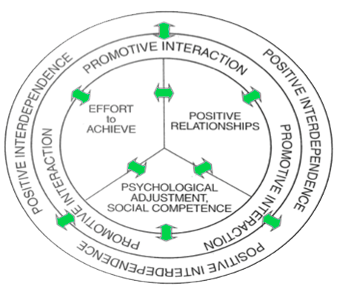
Theoretical Framework
Benefits of Cooperative Learning
Achievement
Critical Thinking
competencies
Psychological health
Liking for classmates
Source: Cooperative learning in the classroom, David and Roger Johnson and Holubec
Notes:
Benefits of Cooperative Learning
Achievement
finding the effects of using cooperative, competitive or individualistic learning, there have been results showing that cooperative learning is the best. These results point that cooperative learning develops these skills: task attainment, verbal problem solving, categorization, spatial problem solving, retention and memory, guessing- judging- predicting.
Critical Thinking competencies
Science education for example requires people who can examine, evaluate and find some sense in nonsense.
Psychological health
well-adjusted relations, strong personal identity and basic optimism about people. The conjunction of these indices attempts to help students in the future in their careers, family and improve participation in the society
Liking for classmates
This is that students no matter what the initial impressions they had about the members, they can work together and increase the level of commitment for obtaining common goals.

Slide 12
Theoretical Framework
Definition of listening comprehension
“Listening comprehension is the receptive skill in the oral mode. When we speak of listening what we really mean is listening and understanding what we hear” (Richards, 1983).

Slide 13
Theoretical Framework
Types of listening
Discriminative listening
Comprehensive listening
Informational listening
Critical listening
Therapeutic or Emphatic
listening
Notes:
Types of listening
Discriminative listening
This is the most basic form of listening and does not involve the understanding of the meaning of words or phrases but merely the different sounds that are produced
Comprehensive listening
In order to be able use comprehensive listening and therefore gain understanding the listener first needs appropriate vocabulary and language skills
Informational listening
Informational listening differs from the other kinds of listening in that the purpose of it is to get specific information and the speaker might not need a feedback from us.
Critical listening
Critical listening is akin to critical reading; both involve analysis of the information being received and alignment with what we already know or believe.
Therapeutic or Emphatic listening
Empathic listening involves attempting to understand the feelings and emotions of the speaker.

Slide 14
Theoretical Framework
Listening Comprehension in second language acquisition
“Listening is an important language skill to develop in terms of second language acquisition, in fact is the heart of language learning” (Dunkel, 1991; Rost, 2001; Vandergrift, 2007).

Slide 15
Theoretical Framework
Process of listening comprehension to English as a second language
The second language listener has two basic disadvantages:
Lack the knowledge of the language
Lack of background knowledge

Slide 16
Theoretical Framework
Top-down skills
Top-down skills are processes that involve the use of prior knowledge to understand the meaning of a message.
Listening for the main idea
Predicting
Drawing Inferences
Summarizing

Slide 17
Theoretical Framework
Bottom-Up skills
This refers to the use of linguistic knowledge to understand the meaning of a message. This means the understanding of sounds and words in English.
Listening for specific details
Recognizing cognates
Recognizing word-order
patterns

Slide 18
Theoretical Framework
Lesson structure when teaching listening for comprehension
Pre listening stage

Slide 19
Theoretical Framework
Lesson structure when teaching listening for comprehension
While listening stage
These activities are what students are asked to do during the time that they are listening to the text.
Post-listening stage
At this stage students check their answers and discuss the difficulties they had.

Slide 20
Theoretical Framework
Theoretical Framework
Lesson structure when teaching listening for comprehension
Hypothesis System
Working Hypothesis
While listening stage
Cooperative learning improves the listening comprehension skills of students attending second and third year of Bachillerato at Salamanca Evening High School
The inputs are made by the teacher and after students answer the questions about what they heard.
Post-listening stage
Null Hypothesis
Cooperative learning does not improve the listening comprehension skills of students attending second and third year of Bachillerato at Salamanca Evening high school
En esta etapa los alumnos a comprobar sus respuestas y hablar de las dificultades que tenían.
Alternative Hypothesis
Total physical response improves the listening comprehension skills of students attending second and third year of Bachillerato at Salamanca Evening high school.

Slide 21
THIRD PART
METHODOLOGICAL DESIGN

Slide 22
Methodological Design
Type and Design of Research
According to the approach: Quantitative Research
centralization measures
mean, median and mode
Statistics
dispersion measures
variance and standard deviation

Slide 23
Methodological Design
Type and Design of Research
According to the design: Quasi-Experimental Research
Sample divided in:
Experimental group
Control group

Slide 24
Methodological Design
Type and Design of Research
According to the source and place: Field and place research
Natural environment (classrooms)
Thesis has been done in the school directly.
According to the time: Cross sectional research
The researcher evaluated the exposure to listening comprehension lessons in a period of time of three months

Slide 25
Methodological Design
Population: 192 students
Second year
A, C1, C2
Third year
A, B, C1, C2, C3
Sample: 192 students
Notes:
Population and Sample
Population
The population of this research is 192 students of the 2nd and 3rd year of Salamanca evening high school (all students). The second grade has three classes: A, C1 and C2. The third grade has five classes: A, B, C1, C2 and C3.
Sample
According to Herrera (2012) the sample criterion says that: when a population is less or equal to 200 elements, then the size of the sample can be the same population.
Basing on this criterion the size of the sample is 192 elements (students of the 2nd and 3rd year), the same as the population.

Slide 26
Methodological Design
Sampling Type: Experimental and control groups
“ It is very important to note that all case studies are
valuable sources of causal and qualitative information
embodied differently conceived the theory of scientific
research” Yacuzzi (2005)

Slide 27
Methodological Design
Experimental Group
2nd A, 2nd C1, 3rd B and 3rd C3.
Control Group
2nd C2, 3rd A, 3rd C1 and 3rd C2.
Notes:
Population and Sample
Population
The population of this research is 192 students of the 2nd and 3rd year of Salamanca evening high school (all students). The second grade has three classes: A, C1 and C2. The third grade has five classes: A, B, C1, C2 and C3.
Sample
According to Herrera (2012) the sample criterion says that: when a population is less or equal to 200 elements, then the size of the sample can be the same population.
Basing on this criterion the size of the sample is 192 elements (students of the 2nd and 3rd year), the same as the population.

Slide 28
Methodological Design
Field Work
This research was done at Salamanca Evening High School. The school is located in Iñaquito, north of Quito. Students evaluated are those from the second and third years of Bachillerato. The academic year was 2013-2014.

Slide 29
Methodological Design
Data Collection Instrument

Slide 30
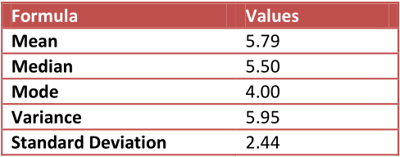
Methodological Design
Processing and Analysis
Analysis of diagnostic test in the complete group
*** Standard deviation: when the standard deviation has a high value means that the values ​​are further from the mean

Slide 31
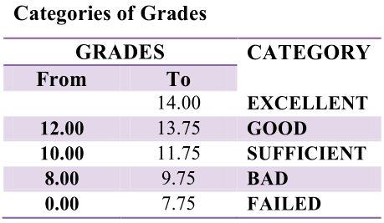
Methodological Design

Slide 32
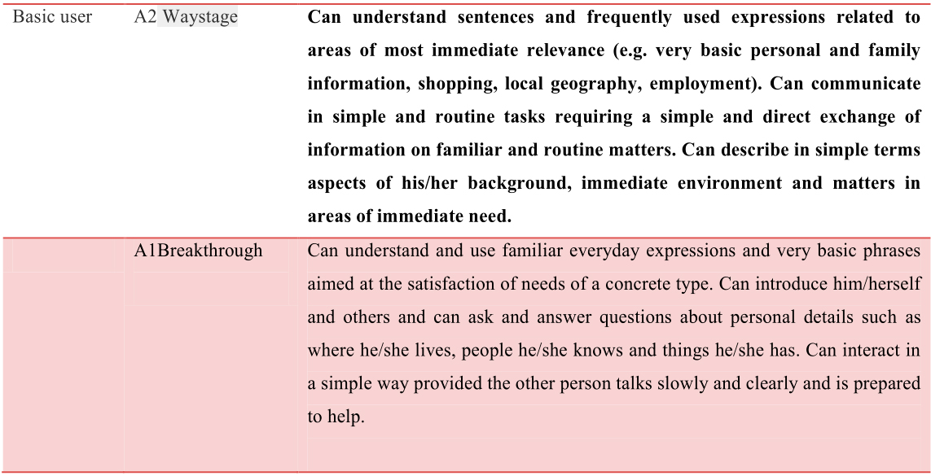
Methodological Design
Common Reference Levels: global (Common European Framework)

Slide 33
Methodological Design
Common European Framework Main Suite Guided Learning Hours

Slide 34
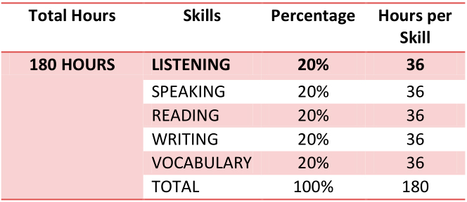
Methodological Design
Hours needed to apply the listening comprehension methodology
English Mind Students Book 1, Second Edition by Cambrigde

Slide 35
FOURTH PART
HYPOTHESIS TEST

Slide 36
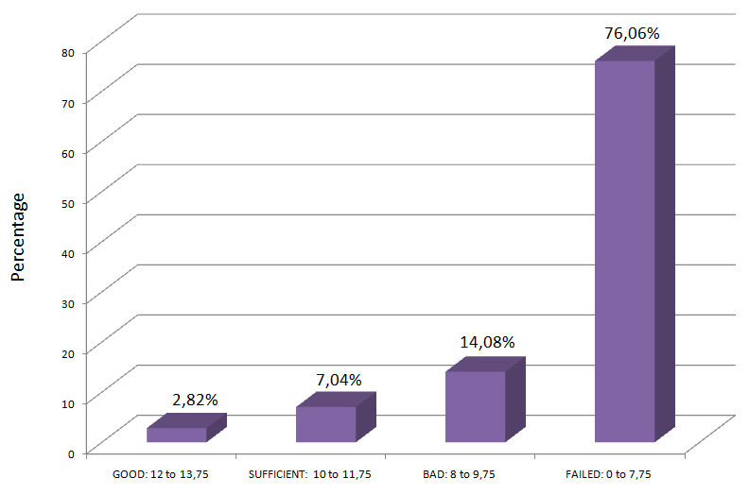
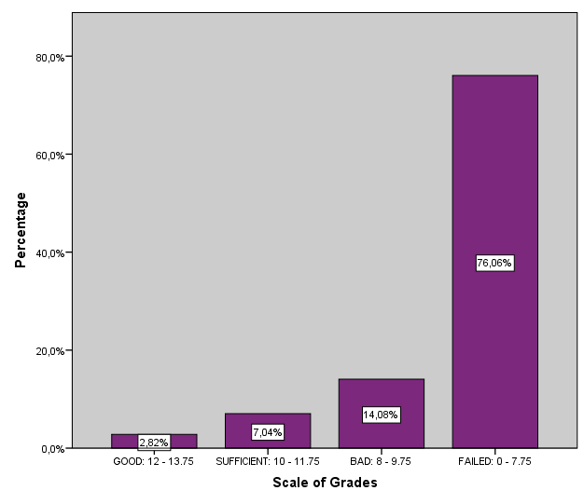
Hypothesis Test
Percentage of scores of experimental group in diagnostic test

Slide 37
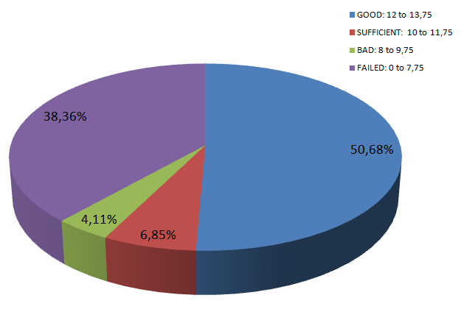
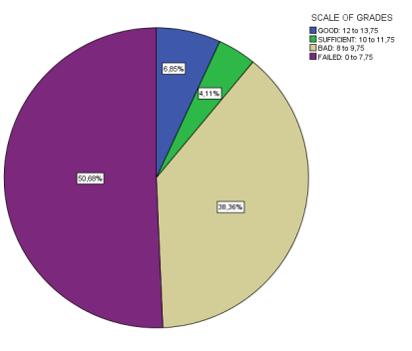
Hypothesis Test
Percentage of grades of experimental group in the second test

Slide 38
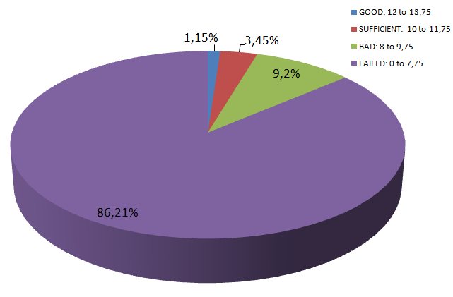
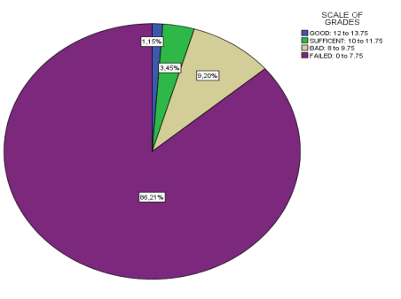
Hypothesis Test
Percentage of scores of the control group in diagnostic test

Slide 39
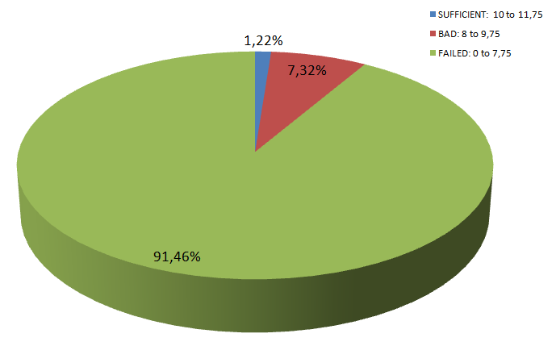
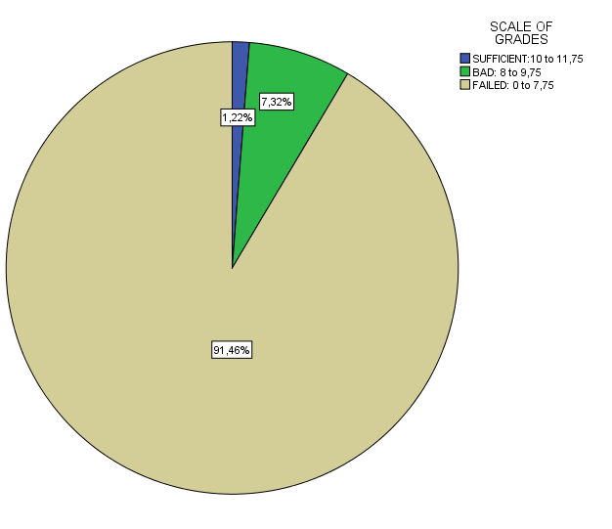
Hypothesis Test
Percentage of scores of the control group in the second test

Slide 40
Comparison of results
Hypothesis Test
Experimental group
Category | Before | After | Increasing or Decreasing
Failed | 76.06 % | 50.58 % | D 25.48 %
Bad | 14,08% | 30.36% | I 16,28%
Sufficient | 7.04% | 4.11% | D 2.93 %
Good | 2.82% | 6.85 % | I 4,03%
Excellent | 0 | 0 | 0
Control group
Category | Before | After | Increasing or Decreasing
Failed | 86.21 % | 91.46 % | I 5,25%
Bad | 9.20 % | 7.32 % | D 1.88 %
Sufficient | 3.45 % | 1.22 % | D 2.23 %
Good | 1.15 % | 0 | 1.15 %
Excellent | 0 | 0 | 0

Slide 41
CONCLUSIONS
The results of the diagnostic test applied to the students showed that 81% of students obtained grades set in lowest category. Only 1.27 % of them obtained grades set in the good category and no one reached the excellent category.
It is noticeable that students of the experimental group reached the category good after the methodology was applied; this is the higher category they were able to reach; but in the mean time the number of students in the sufficient which is a lower category in the scale, decreased.
In students of the control group, it is noticeable that most students moved from the failed category to the rest of categories: bad, sufficient and good categories after the methodology was applied

Slide 42
RECOMMENDATIONS
Listening comprehension should be used as the basis to continue teaching with the rest of English learning skills specially speaking.
It is advisable to expose to students as much as possible to listening comprehension by including it in the school curricula.
It is advisable to include the listening comprehension methodology proposed in this work in the school class hours that involves not only working with cooperative learning in the classroom but outside of it.

Slide 43
FIFTH PART
PROPOSAL

Slide 44
Proposal
Justification
Listening comprehension

Slide 45
Proposal
Justification
Listening is not the same as hearing

Slide 46
Proposal
General Objective
To apply a listening comprehension methodology using cooperative learning at Salamanca Evening School.
Specific
To include listening comprehension classes in the
school curricula from the first year until the last year.
To expose students to listening comprehension skill by
using audio laboratories or other technological
devices.

Slide 47
Proposal
Beneficiaries
Teachers
Students
Institution

Slide 48
Proposal
Scope
Lesson plans should be used in the Institution, from the first years to the last years of the school

Slide 49
Proposal
Pre-listening and while-listening activities
While- listening activities
Lesson plan

Slide 50
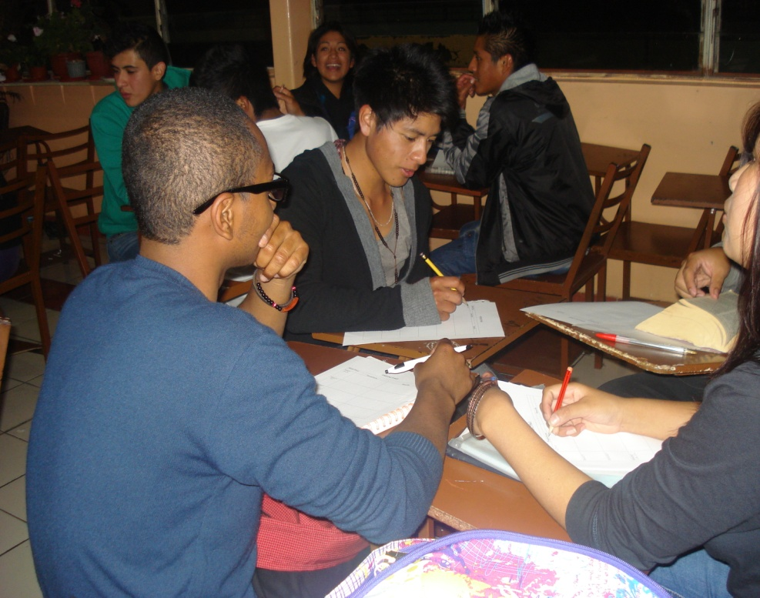
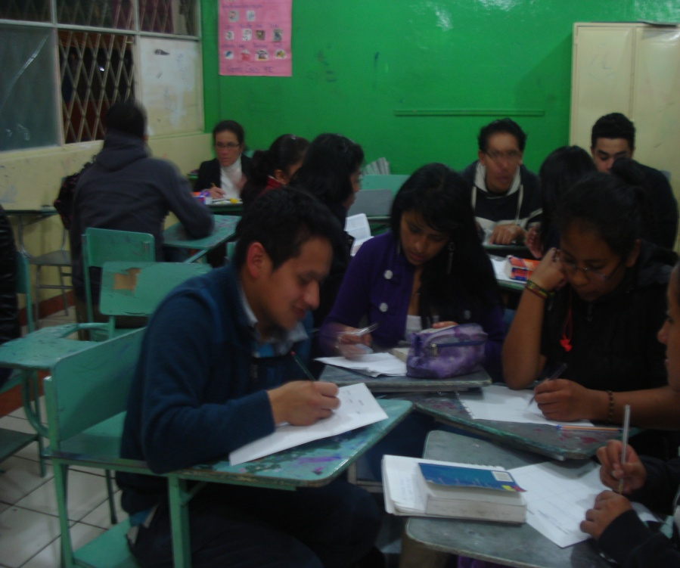
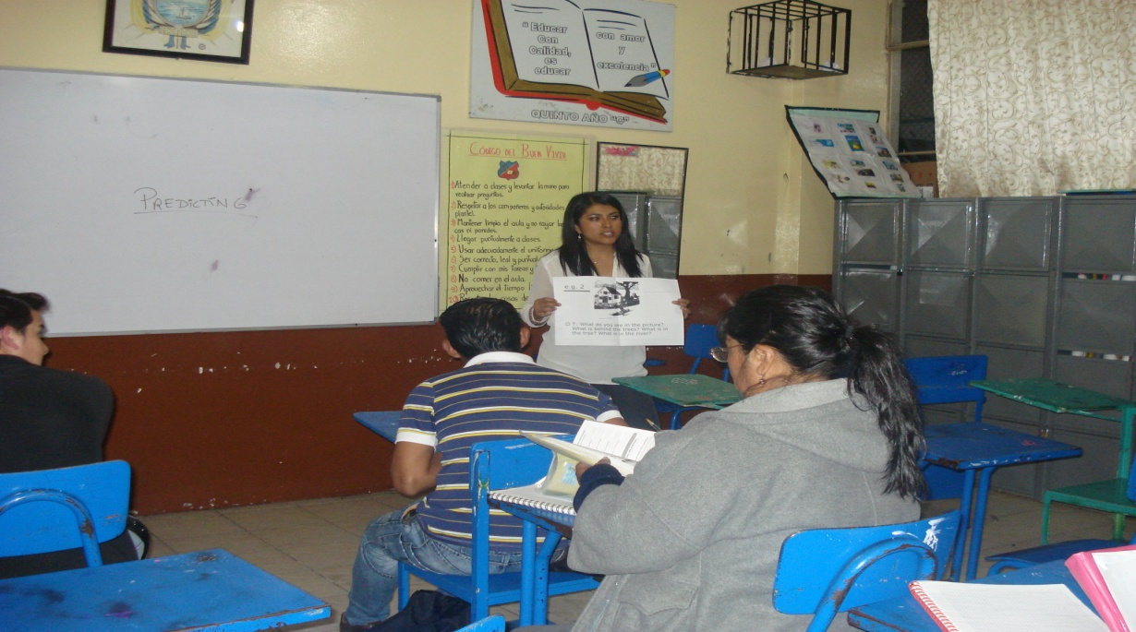
Post- listening activities

Slide 51
THANKS FOR YOUR ATTENTION

